Slide 1
Instructions for using the PowerPoint slides:
To view the animated steps - click anywhere on the slide.
To skip the animated steps to go to previous or next page - click the arrowheads at the bottom right.
Chp 4 Combinational Logic

Slide 2
1. Introductory Concepts
2. Numbering Systems
3. Boolean Algebra
4. Combinational Logic
Flip-Flops
Arithmetic Circuit
Counters & Shift Registers
MSI Devices
IC Logic Families
Chp 4 Combinational Logic

Slide 3
4 Combinational Logic
Boolean expressions in SOP, POS forms
K-map – for Simplifying Boolean Expression
Process of Combinational Logic Circuit Design
XOR, XNOR gates
Concept of Enabling / Disabling gates
Chp 4 Combinational Logic

Slide 4
Steps to
Designing Combinational Logic Circuits
4.4
1 A task is given: Find out input signals and how the output behaves
Draw up a truth table to relate the output to the inputs
Write the output expression in SOP forms
4 Simplify the output expression by either
(i) Boolean Algebra (chapter 3) or
(ii) K-map (Chapter 4)
5 Implement the circuit
Chp 4 Combinational Logic

Slide 5
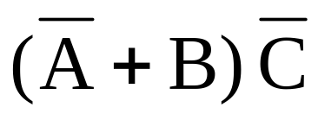
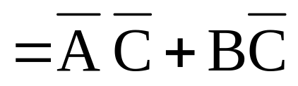
Logic Expressions (2 general forms)
4.1
Products-of-Sums (POS)
Sum-of-Products (SOP)
Chp 4 Combinational Logic

Slide 6


SOP / POS ?
4.1
(?)
(a) AB + CD + E
(b) AB(C + D)
(c) (A + B)(C + D + F)
(d)
(e)
(?)
(?)
(?)
(?)
Chp 4 Combinational Logic

Slide 7
4.1
SOP / POS ?
(SOP)
(a) AB + CD + E
(b) AB(C + D)
(c) (A + B)(C + D + F)
(d)
(e)
(POS)
(POS)
(neither)
(neither)
Chp 4 Combinational Logic

Slide 8



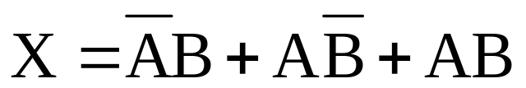
Obtaining SOP from Truth Table 2-input
4.5
e.g.
A B X
0 0 0
0 1 1
1 0 1
1 1 1
X will be 1 when
A=0 AND B=1
OR
A=1 AND B=0
OR
A=1 AND B=1
SOP:
Chp 4 Combinational Logic

Slide 9
4.5
Obtaining SOP from Truth Table 2-input
Summarise the steps
e.g.
Step 1
Write product terms for each row where output = 1
A B X
0 0 0
0 1 1
1 0 1
1 1 1
Step 2
Sum the product terms to obtain SOP
SOP:
Chp 4 Combinational Logic

Slide 10
Obtaining SOP from Truth Table 3-input
4.5
e.g.
A B C X
0 0 0 1
0 0 1 1
0 1 0 1
0 1 1 0
1 0 0 0
1 0 1 0
1 0 1
1 1 1 0
Chp 4 Combinational Logic

Slide 11




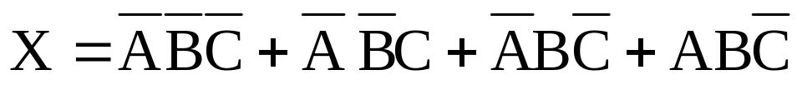
4.5
Obtaining SOP from Truth Table 3-input
e.g.
A B C X
0 0 0 1
0 0 1 1
0 1 0 1
0 1 1 0
1 0 0 0
1 0 1 0
1 0 1
1 1 1 0
SOP:
Chp 4 Combinational Logic

Slide 12
Obtaining SOP from Truth Table 4-input
4.5
e.g.
A B C D X
0 0 0 0 0
0 0 0 1 1
0 0 1 0 0
0 0 1 1 0
0 1 0 0 0
0 1 0 1 1
0 1 1 0 0
0 1 1 1 0
1 0 0 0 0
1 0 0 1 0
1 0 1 0 0
1 0 1 1 0
1 1 0 0 0
1 1 0 1 1
1 1 1 0 0
1 1 1 1 1
Chp 4 Combinational Logic

Slide 13
4.5
Obtaining SOP from Truth Table 4-input
e.g.
A B C D X
0 0 0 0 0
0 0 0 1 1
0 0 1 0 0
0 0 1 1 0
0 1 0 0 0
0 1 0 1 1
0 1 1 0 0
0 1 1 1 0
1 0 0 0 0
1 0 0 1 0
1 0 1 0 0
1 0 1 1 0
1 1 0 0 0
1 1 0 1 1
1 1 1 0 0
1 1 1 1 1
Chp 4 Combinational Logic

Slide 14
Karnaugh Map (K map)
4.5
K map, like truth table, is a graphical way of showing the relationship between logic inputs and the desired output
BUT
It provides a systematic method for simplifying Boolean expressions
http://www.puz.com/sw/karnaugh/karnaugh_12.htm
Chp 4 Combinational Logic

Slide 15




K Map – 2-input
4.5
If there are 2 inputs, the K Map will have 2² squares.
Take note how the rows and columns are labelled
Chp 4 Combinational Logic

Slide 16






K Map – 3-input
4.5
If there are 3 inputs, the K Map will have 2³ squares.
Take note:
The K-map squares are labeled so that neighbours differ only in one variable.
Chp 4 Combinational Logic

Slide 17








K Map – 4-input
4.5
If there are 4 inputs, the K Map will have 2⁴ squares.
Chp 4 Combinational Logic

Slide 18




4.5
From Truth Table to K-Map
e.g.
A B X
0 0 0
0 1 1
1 0 1
1 1 1
1
1
1
Chp 4 Combinational Logic

Slide 19










4.5
From Truth Table to K-Map
e.g.
A B C X
0 0 0 1
0 0 1 1
0 1 0 1
0 1 1 0
1 0 0 0
1 0 1 0
1 0 1
1 1 1 0
Chp 4 Combinational Logic

Slide 20
4.5
From Truth Table to K-Map
e.g.
A B C X
0 0 0 1
0 0 1 1
0 1 0 1
0 1 1 0
1 0 0 0
1 0 1 0
1 0 1
1 1 1 0
1
1
1
1
Chp 4 Combinational Logic

Slide 21












4.5
From Truth Table to K-Map
e.g.
A B C D X
0 0 0 0 0
0 0 0 1 1
0 0 1 0 0
0 0 1 1 0
0 1 0 0 0
0 1 0 1 1
0 1 1 0 0
0 1 1 1 0
1 0 0 0 0
1 0 0 1 0
1 0 1 0 0
1 0 1 1 0
1 1 0 0 0
1 1 0 1 1
1 1 1 0 0
1 1 1 1 1
Chp 4 Combinational Logic

Slide 22
4.5
From Truth Table to K-Map
e.g.
A B C D X
0 0 0 0 0
0 0 0 1 1
0 0 1 0 0
0 0 1 1 0
0 1 0 0 0
0 1 0 1 1
0 1 1 0 0
0 1 1 1 0
1 0 0 0 0
1 0 0 1 0
1 0 1 0 0
1 0 1 1 0
1 1 0 0 0
1 1 0 1 1
1 1 1 0 0
1 1 1 1 1
1
1
1
1
Chp 4 Combinational Logic

Slide 23
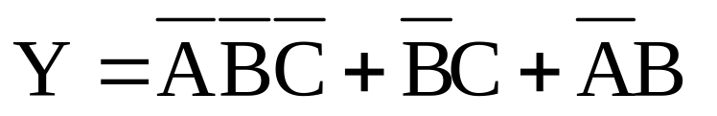


From Expression to K-Map 3-input
1
1
1
1
1
Chp 4 Combinational Logic

Slide 24

From Expression to K-Map 4-input
1
1
1
1
1
1
1
1
Chp 4 Combinational Logic

Slide 25
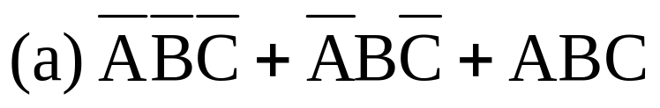
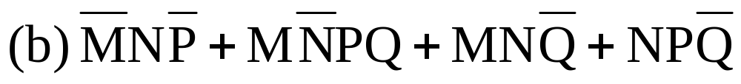
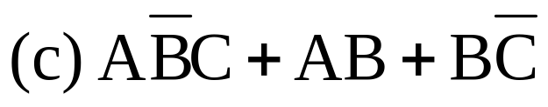
4.5
Construct the K maps for the following SOP expressions:
Chp 4 Combinational Logic

Slide 26








4.5
Construct the K maps for the following SOP expressions:
1
1
 | 1
1
1 | 1
 | 1
1 | 1 |  | 1
1 |  | 1 | 1
 |  | 1
Chp 4 Combinational Logic

Slide 27
After moving the ‘1’ into K-map
We would then loop the
horizontally or vertically adjacent ‘1’ in
pair (2),
quad (4),
octet (8)
…
This is done for the purpose of obtaining simplified Boolean Expression
Chp 4 Combinational Logic

Slide 28
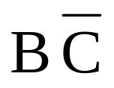
Looping pair
4.5
e.g.
Look for common variables to obtain the product term for the loop
1
1
Chp 4 Combinational Logic

Slide 29

4.5
Looping pair
e.g.
1
1
Chp 4 Combinational Logic

Slide 30
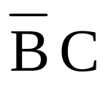
4.5
Looping pair
Top and bottom rows are neighbours,
Left most and right most columns are also neighbours
e.g.
1
1
Chp 4 Combinational Logic

Slide 31
4.5
Looping pair
Where else can a pair appear?
e.g.
Chp 4 Combinational Logic

Slide 32

4.5
Looping pair
e.g.
1
1
Chp 4 Combinational Logic

Slide 33
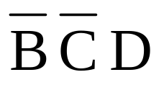
4.5
Looping pair
e.g.
1
1
Chp 4 Combinational Logic

Slide 34
4.5
Looping pair
Where else can a pair appear?
e.g.
Chp 4 Combinational Logic

Slide 35

Looping quad
4.5
e.g.
1
1
1
1
Chp 4 Combinational Logic

Slide 36

4.5
Looping quad
e.g.
1
1
1
1
Chp 4 Combinational Logic

Slide 37
4.5
Looping quad
Where else can a quad appear?
e.g.
Chp 4 Combinational Logic

Slide 38

4.5
Looping quad
e.g.
1
1
1
1
Chp 4 Combinational Logic

Slide 39

4.5
Looping quad
e.g.
1
1
1
1
Chp 4 Combinational Logic

Slide 40
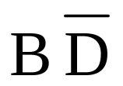
4.5
Looping quad
e.g.
1
1
1
1
Chp 4 Combinational Logic

Slide 41
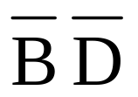
4.5
Looping quad
e.g.
1
1
1
1
Chp 4 Combinational Logic

Slide 42
4.5
Looping quad
Where else can a quad appear?
e.g.
Chp 4 Combinational Logic

Slide 43

Looping octet
4.1
e.g.
1
1
1
1
1
1
1
1
Chp 4 Combinational Logic

Slide 44
4.5
Looping octet
e.g.
1
1
1
1
1
1
1
1
Chp 4 Combinational Logic

Slide 45

4.5
Looping octet
e.g.
1
1
1
1
1
1
1
1
Chp 4 Combinational Logic

Slide 46
4.5
Looping octet
Where else can a octet appear?
e.g.
Chp 4 Combinational Logic

Slide 47
Rules / Steps in K-map
Rule 1 Use the minimum number of loops
Rule 2 Stop once all ‘1’ are looped
Rule 3 Follow this order:
Step 1: Loop isolated ‘1’, if any. (‘1’ with NO neighbour at all)
Step 2: Loop lonely pairs, if any. (‘1’ with ONLY one neighbour)
Step 3: Loop octets, if any, if rule 2 not fulfilled. (start with the biggest …)
Step 4: Loop quad, s if any, if rule 2 not fulfilled.
Step 5: Loop pairs, if any, if rule 2 not fulfilled.
Form SOP: sum of all the product terms generated by each loop.
Note: The same ‘1’ can be looped more than once to fulfill the above.
Chp 4 Combinational Logic

Slide 48
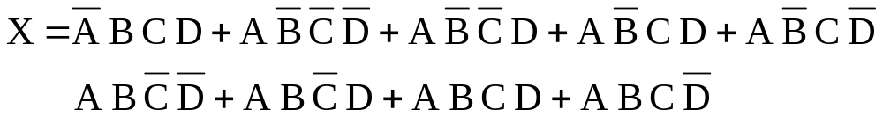
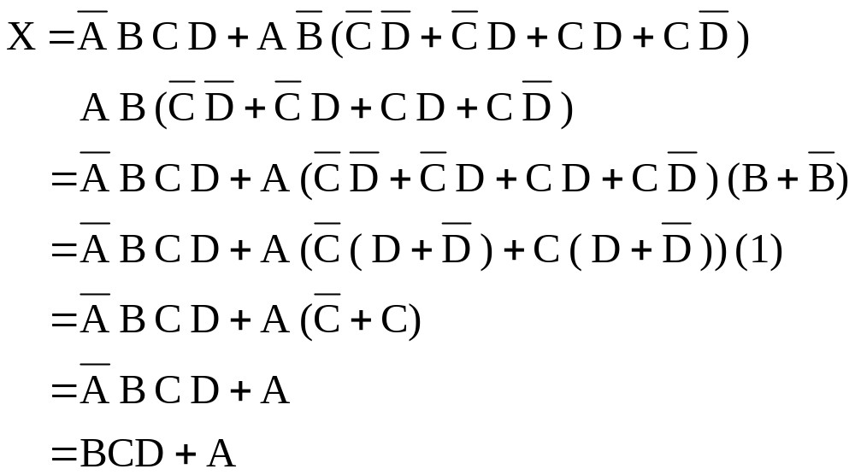
4.5
Simplify the expression
Method 1: Using Boolean Algebra
Chp 4 Combinational Logic

Slide 49
4.5
Simplify the expression
Method 2: Using K Map, con’t
Draw the K map and fill it with ‘1’
 |  | 1
1 | 1 | 1 | 1
1 | 1 | 1 | 1
Chp 4 Combinational Logic

Slide 50
4.5
Start looping
Method 2: Using K Map, con’t
1 Any isolated ‘1’ ?
2 Any lonely pair ?
 |  | 1
1 | 1 | 1 | 1
1 | 1 | 1 | 1
All ‘1’ looped?
Chp 4 Combinational Logic

Slide 51

4.5
Method 2: Using K Map, con’t
3 Any octet?
 |  | 1
1 | 1 | 1 | 1
1 | 1 | 1 | 1
All ‘1’ looped?
Obtain the SOP
Chp 4 Combinational Logic

Slide 52
Obtain the simplified expression from the K-map
4.1
 | 1
 | 1 | 1 | 1
1 | 1 | 1
 |  | 1
Chp 4 Combinational Logic

Slide 53
Obtain the simplified expression from the K-map
Start looping
 | 1
 | 1 | 1 | 1
1 | 1 | 1
 |  | 1
1 Any isolated ‘1’ ?
2 Any lonely pair ?
All ‘1’ looped?
Chp 4 Combinational Logic

Slide 54
Obtain the simplified expression from the K-map
 |  |  | 1
 | 1 | 1
 | 1 | 1 | 1
Chp 4 Combinational Logic

Slide 55
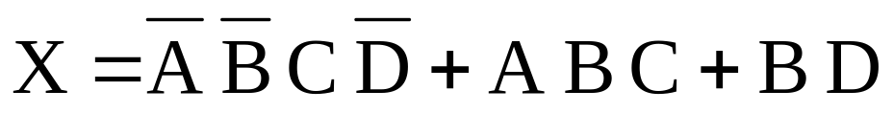
Obtain the simplified expression from the K-map
Start looping
 |  |  | 1
 | 1 | 1
 | 1 | 1 | 1
1 Any isolated ‘1’ ?
2 Any lonely pair ?
3 Any octet?
4 Any quartet ?
All ‘1’ looped?
Chp 4 Combinational Logic

Slide 56
Obtain the simplified expression from the K-map
 |  | 1
1 | 1 | 1 | 1
1 |  |  | 1
Chp 4 Combinational Logic

Slide 57
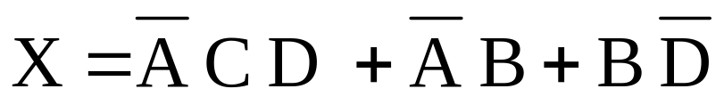
Obtain the simplified expression from the K-map
looping:
1: isolated ‘1’ ?
2: lonely pairs ?
3: octet ?
4: quad ?
 |  | 1
1 | 1 | 1 | 1
1 |  |  | 1
All ‘1’ looped?
Chp 4 Combinational Logic

Slide 58
Obtain the simplified expression from the K-map
 | 1
 | 1 | 1 | 1
 |  |  | 1
1 | 1 |  | 1
Chp 4 Combinational Logic

Slide 59
Obtain the simplified expression from the K-map
 | 1
 | 1 | 1 | 1
 |  |  | 1
1 | 1 |  | 1
 | 1
 | 1 | 1 | 1
 |  |  | 1
1 | 1 |  | 1
There can be more than one solution for the same K map
Chp 4 Combinational Logic

Slide 60
Complete Design Examples
Chp 4 Combinational Logic

Slide 61




4.4
Design a logic circuit that has three inputs, A, B, and C and whose output will be HIGH only when a majority of the inputs are HIGH.
Step 1: Set up the truth-table
Step 2: SOP Expression
A B C X
0 0 0
0 0 1
0 1 0
0 1 1
1 0 0
1 0 1
1 1 0
1 1 1
0
Step 3: Simplified Expression from K-map
0
0
 | 1
1 | 1
 | 1
1
0
1
1
1
Chp 4 Combinational Logic

Slide 62

4.4
Step 4: Circuit Implementation
Con’t
A B C
X
Chp 4 Combinational Logic

Slide 63
Greater-than-6 detector
Chp 4 Combinational Logic

Slide 64
4.4
Design a logic circuit that will produce a HIGH whenever a four bit binary number ABCD is greater than 6. A is the MSB and D is the LSB. Implement the circuit using NAND gates only.
Chp 4 Combinational Logic

Slide 65
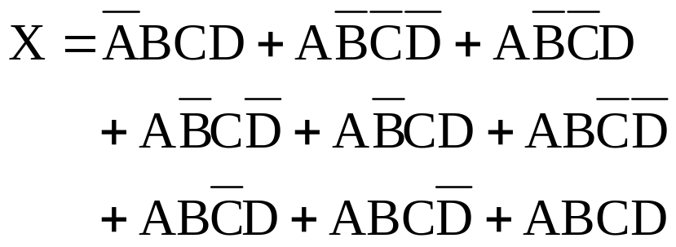
4.4
Step1: Set up the truth table
Step 2: SOP Expression
A B C D X
0 0 0 0
0 0 0 1
0 0 1 0
0 0 1 1
0 1 0 0
0 1 0 1
0 1 1 0
0 1 1 1
1 0 0 0
1 0 0 1
1 0 1 0
1 0 1 1
1 1 0 0
1 1 0 1
1 1 1 0
1 1 1 1
0
0
0
0
0
0
0
Step 3: Simplification
1
1
1
1
1
1
1
1
1
 |  | 1
1 | 1 | 1 | 1
1 | 1 | 1 | 1
Chp 4 Combinational Logic

Slide 66
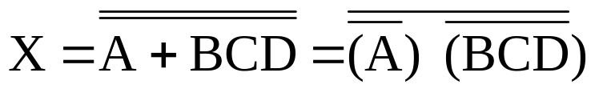
4.4
Con’t Step 4: Circuit Implementation
X = A + BCD
A
X
B
C
D
Step 5: Using Nand Gates only
A
A
B
C
D
BCD
X = A + BCD
Chp 4 Combinational Logic

Slide 67
Copy Machine
Chp 4 Combinational Logic

Slide 68
4.4
A simple copy machine will generate a stop signal when EITHER one of the followings conditions occurred:
1. There is no paper in the feeder tray, P=0
2. The two micro-switches in paper path are
activated whenever paper are jammed
i.e Q=R=1
Design the logic circuit to produce a HIGH for output signal S for the stated condition using NAND gates only.
Chp 4 Combinational Logic

Slide 69





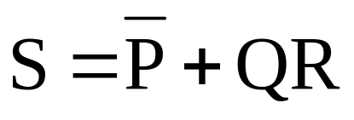


4.4
Step 1: Set up the truth-table
Step 2: SOP Expression
P Q R S
0 0 0
0 0 1
0 1 0
0 1 1
1 0 0
1 0 1
1 1 0
1 1 1
1
Step 3: Simplification (using K-map)
1
1
1
1 | 1
1 | 1
 | 1
0
0
0
1
Chp 4 Combinational Logic

Slide 70
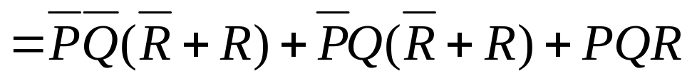
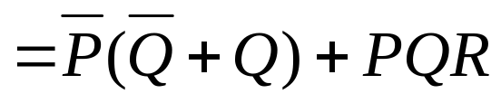
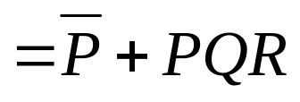
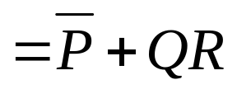
4.4
Con’t Step 3: Simplification (using Boolean Algebra)
Chp 4 Combinational Logic

Slide 71
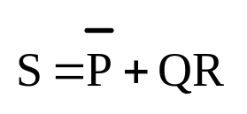
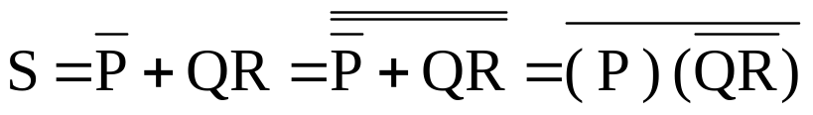
4.4
Con’t Step 4: Circuit Implementation
P
Q
R
Step 5: Using Nand Gates only
P
S
Q
R
Chp 4 Combinational Logic

Slide 72
“Don’t-Care” Conditions
4.5
In some applications, some input conditions will never occur. We called these “don’t-care” conditions.
Don’t care conditions can be used to our advantage in simplifying logic circuit design.
In truth table and K map, don’t care conditions are entered as “X”. They may be used like “1” if it helps to simplify the expression.
Chp 4 Combinational Logic

Slide 73
4.5
“Don’t-Care” Conditions - illustration
e.g.
It does not help in simplification. Hence, it is treated as a 0.
A B C X
0 0 0 0
0 0 1 0
0 1 0 0
0 1 1 x
1 0 0 x
1 0 1 1
1 1 0 1
1 1 1 1
Don’t Care Conditions
C
C
C
C
AB
AB
AB
x
AB
0
AB
1
1
AB
1
1
AB
x
1
AB
1
1
It helps in simplification. Hence, it is treated as a 1.
X = A
Chp 4 Combinational Logic

Slide 74
Lift
Chp 4 Combinational Logic

Slide 75






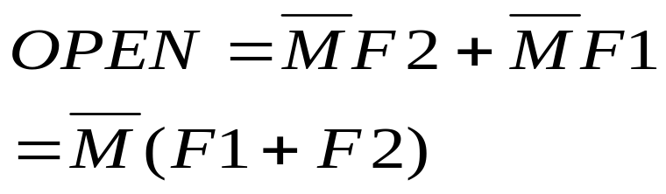
Design a logic circuit that controls a lift door in a 2 storey-building.
M is HIGH when lift is moving.
F1 and F2 are floor indicator signal. They go HIGH when the lift is positioned at the level of that particular floor.
The output is the OPEN signal, it goes HIGH when the lift door is to be opened.
Step 1: Set up the truth-table
Step 2: Simplified Expression
M F1 F2 OPEN
0 0 0
0 0 1
0 1 0
0 1 1
1 0 0
1 0 1
1 0
1 1 1
0
 | 1 | x | 1
1
1
X
0
0
0
0
Chp 4 Combinational Logic

Slide 76
Con’t Step 4: Circuit Implementation
In this case, expressing in POS
may make the meaning clearer
OPEN
M
F1
F2
Chp 4 Combinational Logic

Slide 77
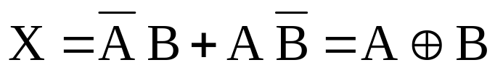
Exclusive-OR (XOR) Gate
4.6
Symbol
Truth Table
X
A | B | X
0 | 0 | 0
0 | 1 | 1
1 | 0 | 1
1 | 1 | 0
A
B
Boolean Expression
Note
Output = 1 when the inputs are different
There are 2 inputs and 1 output
Chp 4 Combinational Logic

Slide 78
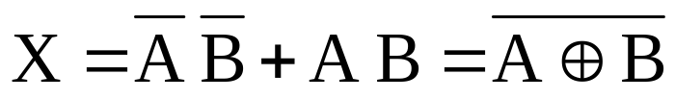
Exclusive-NOR (XNOR) Gate
4.6
Symbol
Truth Table
X
A | B | X
0 | 0 | 1
0 | 1 | 0
1 | 0 | 0
1 | 1 | 1
A
B
Boolean Expression
Note
Output = 1 when the inputs are the same
There are 2 inputs and 1 output
Opposite to XOR
Chp 4 Combinational Logic

Slide 79
Enable / Disable Circuits
Chp 4 Combinational Logic

Slide 80


Enable / Disable Circuits
All the basic gates (AND ,OR , NAND, and NOR) can be used to control the passage of input logic signal through to the output.
ENABLE
DISABLE
A
A
X = 0
B = 1
B = 0
A
A
X = 1
B = 1
B = 0
A
A
X = 1
B = 0
B = 1
A
A
X = 0
B = 0
B = 1
Chp 4 Combinational Logic

Slide 81
Design a logic circuit with input signal A, control input B, and outputs X and Y to operate as follows:
1. When B = 1, output X will follow input A, and output Y will be 0.
2. When B = 0, output X will be 0, and the output Y will follow input A
Chp 4 Combinational Logic

Slide 82
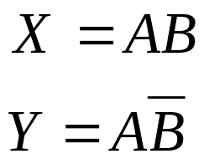
Design a logic circuit with input signal A, control input B, and outputs X and Y to operate as follows:
1. When B = 1, output X will follow input A, and output Y will be 0.
2. When B = 0, output X will be 0, and the output Y will follow input A
A B X Y
B
0 0
0 1
1 0
1 1
0
0
Control
X
0
0
A
0
1
Signal
Y
1
0
Chp 4 Combinational Logic

Slide 83
Design a circuit that will disable the passage of an input signal A only when control inputs B, C, and D are all HIGH; the output is to be HIGH in the disable condition.
Chp 4 Combinational Logic

Slide 84
Design a circuit that will disable the passage of an input signal A only when control inputs B, C, and D are all HIGH; the output is to be HIGH in the disable condition.
A B C D Y
0 0 0 0
. . .
0 1 1 1
0 0 0
. . .
1 1 1 1
 |  | 1
1 | 1 | 1 | 1
1 | 1 | 1 | 1
0
1
1
1
Draw the circuit yourself
Chp 4 Combinational Logic

Slide 85
Design a logic circuit that controls the passage of a signal A according to the following requirements:
(1) Output X will equal A when control inputs B and C are the same.
(2) X will remain HIGH when B and C are different.
Chp 4 Combinational Logic

Slide 86
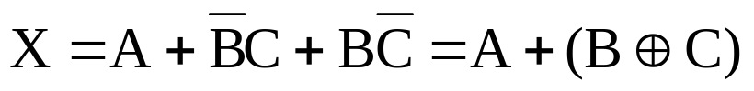
Design a logic circuit that controls the passage of a signal A according to the following requirements:
(1) Output X will equal A when control inputs B and C are the same.
(2) X will remain HIGH when B and C are different.
A B C X
0 0 0
0 0 1
0 1 0
0 1 1
0 0
1 0 1
1 0
1 1 1
0
 | 1
1
1 | 1
1 | 1
A
1
X
1
B
0
C
1
1
1
1
Chp 4 Combinational Logic

Slide 87
Design a logic circuit that has two signal inputs A₁ and A₀ and a control input S so that it functions according to the requirements given in the figure below. This type of circuit is called a multiplexer.
A₀
Multiplexer
S Z
0 = A₀
1 = A₁
Z
A₁
S
Chp 4 Combinational Logic

Slide 88






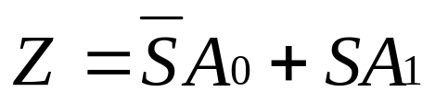
S Z
0 = A₀
1 = A₁
 |  | 1 | 1
 | 1 | 1
S A₀ A₁ Z
0 0 0
0 0 1
0 1 0
0 1 1
0 0
1 0 1
1 0
1 1 1
0
0
Follow A₀
1
1
S
0
A₁
Z
1
Follow A₁
A₀
0
1
Chp 4 Combinational Logic

Slide 89
THE END OF THE LESSON!!!
Chp 4 Combinational Logic

