Slide 1

DIGITAL SIGNAL PROCESSING Chapter 2
EEE DSP Teaching Team
Notes:
Chapter 2 of Digital Signal Processing. Please pay attention as it will be a short but important chapter

Slide 2
Understand the concept of frequency domain analysis.
At the end of this chapter, students should:
Explain how the spectral components of periodic signals can be obtained.
Infer how Fourier transform can be used to obtain the frequency spectrum of aperiodic signals.
Describe how simple signals can be perceived in the frequency domain.
Notes:
In this Chapter 2, it covers the following :
how the spectral components of periodic signals can be obtained.
how Fourier transform can be used to obtain the frequency spectrum of aperiodic signals.
Describe how simple signals can be perceived in the frequency domain.

Slide 3
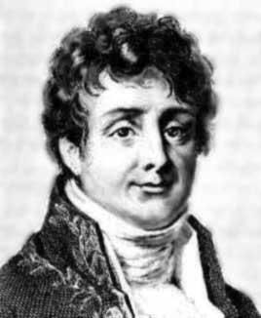
Frequency domain analysis
In early 1800s, Jean Baptiste Fourier showed that any signal can be made up by adding together a series of pure sinusoids with appropriate amplitude and phase.
To honour him, his discovery is named the Fourier series (and later Fourier transform).
Notes:
In early 1800s, Jean Baptiste Fourier or rather Jean-Baptiste Joseph Fourier showed that any signal can be made up by adding together a series of pure sinusoids with appropriate amplitude and phase. He is best known for initiating the investigation of Fourier series, which eventually developed into Fourier analysis and their applications to problems of heat transfer and analysis.

Slide 4
Frequency domain analysis
It is a useful tool for analysis
It gives a new perspective to look into signals and systems
Sine waves are basic building blocks
Notes:
It is easy for us to visualize a signal as a time function in which its magnitude changes over time. For example, we can observe the voltage variation at a point in a circuit by using an oscilloscope. However, more information about the signal can be extracted when it is observed from other domains. One such domain is the frequency domain. For example, in a speech signal, by studying how its amplitude varies with time may not reveal much information about the signal. But the frequency content of the signal could tell us about the pitch or fundamental frequency of the signal with which we can deduce the gender of the speaker.
Frequency domain refers to the analysis of mathematical functions or signals with respect to frequency rather than time. A time-domain graph shows how a signal changes over time which we use an oscilloscope to display the waveforms for example a sine wave , whereas a frequency-domain graph shows how much of the signal lies within each given frequency band over a range of frequencies which we use another kind of instrument, spectrum analyser. A frequency-domain representation can also include information on the phase shift that must be applied to each sinusoid in order to be able to recombine the frequency components to recover the original time signal.

Slide 5
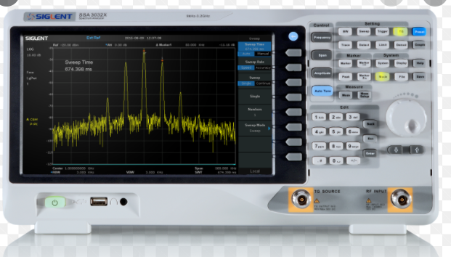
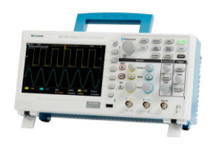
Frequency domain analysis
y(t) = 1*sin(2π *1* t)
= A sin(2 πft)
Amplitude =1, frequency=1 Hz
+/-1V
magnitude
Spectrum analyser
display frequency
Components below
Oscilloscope measures time domain
Signal such as sine wave
1Hz
Frequency
Notes:
Here we can see that a sine wave in the time-domain graph measured using an oscilloscope can be also be represented by an impulse centred at one hertz frequency on the spectrum analyser.
If we have a time domain sinewave as shown here, storing this signal requires a lot of memory. You would need to sample the signal frequency at different time points. Sampling will be cover in later chapter.
However, the plot of magnitude versus frequency, it appears as an impulse function at a certain frequency value , in this case one hertz – one single amplitude! In this case, you will find that the frequency-domain simple clearer and also “cheaper” to store as information to represent a sine wave of one hertz.

Slide 6
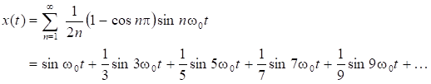
Fourier Series
For a square wave, the Fourier series can be expressed as:
Fundamental
frequency, f₀
3rd harmonics
3f₀
5th harmonics
5f₀
9th harmonics
9f₀
Notes:
Jean Baptiste Fourier had shown that any signal can be made up, or synthesized, just by adding together a series of pure sinusoids (sine waves) with appropriate amplitude and phase. If the signal is periodic, this is known as the Fourier series analysis.
Hence a periodic square wave can be represented by a series of pure sinusoids of odd harmonics. Note that the decreasing amplitude of harmonics.

Slide 7

Example of Fourier analysis
Fundamental frequency show in blue colour as sine wave
Original signal, Pulse Train
Notes:
The red waveform shows the pulse train and the blue sinewave shows the fundamental frequency, f0

Slide 8
Example of Fourier analysis
Fundamental, f₀ + 3rd harmonic, 3 f₀
Individual waves
Summation of both waves
Does it look like a square wave?
Notes:
By adding the third harmonic, the summation of the fundamental and third harmonics will be quite like the square wave.

Slide 9
Example of Fourier analysis
Fundamental + 3rd + 5th harmonic
Notes:
Continuing to add the fifth harmonics, it is even more resemblance of the square wave

Slide 10
Example of Fourier analysis
Fundamental + 3rd + 5th + 7th harmonic
Notes:
Add the seventh harmonics. You will notice the refinement of the right waveform

Slide 11
Example of Fourier analysis
Fundamental + 3rd + 5th + 7th + 9th harmonic
Notes:
And the ninth harmonics, it is getting better and you can continue to add the eleven harmonics and so on.
Hence a square wave may be synthesized by adding together pure sine waves at the multiples (or harmonics) of the fundamental frequency.

Slide 12
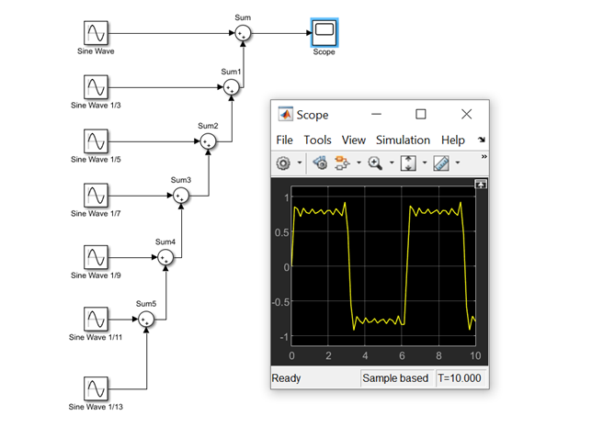
Simulink – Square Train
Notes:
Simulink can also be used to generate the square waveform by adding the odd sinusoidal harmonics.

Slide 13
Fourier analysis
This plot is called the frequency (magnitude) spectrum of the square wave.
It represents the square wave in different domain by a series of sinusoidal signals comprises of odd harmonics.
Notes:
By combining it with the Fourier series analysis, we can now represent any periodic signals in the frequency domain. Now, instead of plotting the square wave as a function of time, we can visualize the square wave as a collection of sine waves and obtain its frequency spectrum by plotting the amplitude of each sine wave against their frequencies.
The amplitude of the even harmonics are all ZEROs.

Slide 14
Fourier analysis
Example shows that a square wave synthesized by adding pure sine waves at multiples (or harmonics) of the fundamental frequency.
With this knowledge, we can visualise the square wave in another way.
We plot the amplitudes of sine waves against their frequencies.
Notes:
The previous example shows that a square wave synthesized by adding pure sine waves at multiples (or harmonics) of the fundamental frequency.
we can visualise the square wave in another way that is in the frequency domain.
We also see the characteristic of the harmonics for the square wave where only the harmonics exist.

Slide 15
Fourier transform
The mathematical formula which transform a signal from the time domain to the frequency domain is called Fourier transform:
where f(t) is the signal in time domain (function of t) and F(Ω) is the signal in frequency domain (function of Ω).
Notes:
Fourier series analysis may be extended to non-periodic signals by assuming that the periodic signals have infinitely long period. This formulation is known as the Fourier transform.
Fourier Transform, which is one of the most important aspects of signal processing.
The mathematical formula which transform a signal from the time domain to the frequency domain is called Fourier transform by the formula.
This is a mathematical formula, which transforms a signal in time domain (as a function of t) to a signal in frequency domain (as a function of omega ).
It is important to note that the Fourier Transform as defined in this equation here is applicable only to aperiodic signals.

Slide 16
Example of Fourier transform
Consider a non-periodic signal x(t):
Notes:
Given a non-periodic signal x(t). Notice it is a single pulse and not a periodic signal, pulse train.
Firstly is the rectangular function, which we often call this a “window” because when we multiple it with a signal, it lets some signals through, and blocks others, just like a window letting in a specific view.

Slide 17

Taking the Fourier transform of x(t):
Notes:
By using the Fourier transform we can transform the signal in the time domain, t to frequency domain, omega as shown.

Slide 18
Example of Fourier transform
Using Fourier transform, hence the frequency spectrum of the signal is given by:
Notes:
The absolute magnitude of the frequency domain of X is shown.
Fourier transform essentially decomposes a non-periodic signal into infinitely numerous sinusoids with microscopic differences in their frequencies. The continuous double-sided spectrum plot that is seen in Figure is actually the envelope of the infinitely numerous pairs of impulses representing magnitudes of these sinusoids.
Note also that the result of the Fourier transform, , may be a complex expression.
This called the sinc-function and is important in signals. It can be view as an oscillatory signal sin(x) with its amplitude monotonically decreasing as time goes to ±infinity. The magnitude is zero for at even pi values.
The period of oscillation is governed by the sine term.

Slide 19
Features of Fourier transform
Note that:
The plot shows a double-sided spectrum (i.e. the plot extends to negative frequency region).
The result of Fourier transform is a complex expression.
In general, to represent a signal in the frequency domain, two plots are needed:
1. Magnitude spectrum, |F(Ω)|.
2. Phase spectrum, ∠F(Ω).
Notes:
The plot shows a double-sided spectrum (i.e. the plot extends to negative frequency region).
The result of Fourier transform is a complex expression.
There are two plots but only the magnitude spectrum is shown. Most often the magnitude spectrum is used in practice.

Slide 20
Common Fourier transform pairs
Sinusoid:
Notes:
The following examples show some common signals and their corresponding Fourier transforms. Since Fourier transform is linear, it may be noted that Fourier transform of a linear combination of these common signals can easily be obtained.
Here the frequency domain shows the double sided band, that is both the positive and negative spectrum. The sinewave of one kilo hertz is show in both domains.
In order to get a “real-world” signal such as an everlasting cosine or sine wave, we need to have both the positive and negative frequency components by using Euler formula

Slide 21

Common Fourier transform pairs
2. Combination of sinusoids:
Figure: Signal is a combination of two sinusoids
Notes:
This signal consists of two frequencies one kilo and two kilo hertz.

Slide 22
Common Fourier transform pairs
3. Square wave:
Notes:
This is our square wave with 50 percent duty cycle and the harmonics in the frequency domains of fundamental frequency, 1 kilo hertz and the rest of the odd harmonics.
Square wave signal, we only need to use three values at f, 3f, 7f, 9f and so forth.

Slide 23
Conclusion
Frequency domain analysis gives useful information about the signal.
Fourier transform enables time⬄ frequency domain transfers.
Notes:
We learnt that Frequency domain is another dimension to understand the signal.
The time domain signal can be transformed using Fourier Transform into the frequency spectrum.
For periodic time signals, we use Fourier Series to convert the time domain signals into a series of impulses of different harmonies. Any time domain signal can be represented as a linear combination of sinewaves at different frequencies, suitably weighted by some coefficients.
For non periodic signals, we use Fourier Transform to convert into a continuous Frequency domain.

