Slide 1
C++ Operators
Chapter 3

Slide 2
C++ Operators
Arithmetic Operators
Relational Operators
Logical Operators
Bitwise Operators

Slide 3
C++ Operators
The basic syntax of Operators is as follows :
Operand Operator Operand
Eg. 3 + 5
The sum of 3 and 5.

Slide 4
Symbols for arithmetic operations
SYMBOL | MEANING
* | Multiplication
/ | Division
% | Modulus
+ | Addition
- | Subtraction

Slide 5
Some sample results of these operations are shown below:
FORMULA | RESULT
4 * 2 | 8
64 / 4 | 16
11 % 3 | 2
12 + 9 | 21
80 - 15 | 65

Slide 6
Some sample results of these operations are shown below:
11 % 3 is the remainder of 11/3 which is 2
  Example : 25 % 5 is 0
When an integer is divided by an integer, the outcome is an integer.
  Example : 7/3 is 2 (not 2.33)

Slide 7
The Division Operator
int main()
{
int num1, num2;
double result;
num1 = 3;
num2 = 2;
result = num1/num2;
cout << "The result of 3/2 is " << result;
return 0;
}

Slide 8
The Division Operator
The result of 3/2 is 1
why?
num1 / num2
int / int
int

Slide 9
The Division Operator
int main()
{
int num2;
double num1, result;
num1 = 3.0;
num2 = 2;
result = num1/num2;
cout << "The result of 3.0/2 is " << result;
return 0;
}

Slide 10
The Division Operator
The result of 3/2 is 1.5
why?
num1 / num2
double / int
double

Slide 11
Output:
However, if at least ONE of the numbers is a double, it will give you a floating point result .
double / int
double
int / double
double
double / double
double

Slide 12
Activity
Write the instructions to convert from time in mins to hours:mins.
eg. 150 mins is 2:30

Slide 13
Activity
#include <iostream>
using namespace std;
int main()
{
int total_mins, hours, mins;
cout << "Enter time in minutes: ";
cin >> total_mins;
hours = ____________________
mins = ____________________
cout << ____________________
return 0;
}

Slide 14
Order of Precedence
The order of precedence determines exactly how C++ computes arithmetic expressions.
  2 + 3 * 2
  =
  10 or 8?

Slide 15
This is summarized in the table below:
ORDER | OPERATION
First | Multiplication, Division, Modulus (* , / , %)
Second | Addition, Subtraction ( + , - )

Slide 16
Examples
6 + 2 * 3 – 4 / 2
6 + 6 – 4 / 2
6 + 6 – 2
12 – 2
10
6 + (2 * 3) – (4 / 2)

Slide 17
Examples
3 * 4 / 2 + 3 - 1
12 / 2 + 3 - 1
6 + 3 – 1
9 – 1
8
(3 * 4) / 2 + 3 - 1

Slide 18
Examples
20 / 3 + 5 % 2
6 + 5 % 2
6 + 1
7
(20 / 3) + (5 % 2)

Slide 19
Using Parenthesis ( )
Parenthesis ( ) have higher precedence than all other operations in the precedence table.
In other words, any calculation within parenthesis is always done first before anything else.

Slide 20
Using Parenthesis ( )
e.g.
2 + 3 * 2 gives a result 8
(2 + 3) * 2 gives a result of 10

Slide 21
Using Parenthesis ( )
6 + 2 * (3 – 4) / 2
6 + 2 * –1 / 2
6 + -2 / 2
6 + -1
5

Slide 22
Using Parenthesis ( )
3 * 4 / 2 + (3 – 1)
3 * 4 / 2 + 2
12 / 2 + 2
6 + 2
8

Slide 23
Using Parenthesis ( )
20 / (3 + 5) % 2
20 / 8 % 2
2 % 2
0
Brackets/parenthesis have the highest priority.

Slide 24
Order of Precedence and Associativity of C++ Operators
Operators | Type | Associativity
() [] | Groups | Left to Right
! ~ ++ -- | Unary | Right to Left
* / % | Multiplicative | Left to Right
+ - | Additive | Left to Right
<< >> | Shift | Left to Right
< > <= >= | Relational | Left to Right
== != | Equality | Left to Right
& | Bitwise | Left to Right
^
|
&& | Logical | Left to Right
||
= += -= *= /= | Assignment | Right to Left
Relational Operators
Logical Operators

Slide 25
Exercise
Data variables x, y, z are declared as follows:
int x = 5, y = 6, z = 4;
double w = 3.5;
Evaluate each of the following statements, if possible. If it is not possible, state the reason.
a. (x + z) % y
b. (x + y) % w

Slide 26
Exercise
Do a walk-through to find the value assigned to e. Assume that all variables are integers and they are properly declared.
a = 3;
b = 4;
c = (a % b) * 6;
d = c / b;
e = (a + b + c + d) / 4;

Slide 27
C++ Operators
Unary operators require only one operand.
y = 5; i = 5;
y++; // or y = y + 1
i--; // or i = i - 1
will cause y to be 6 and i to be 4.

Slide 28
Is this possible?
int count;
count = 10;
count = count + 5;
Unlike maths,
this is possible because ‘+’
is done first before ‘=‘

Slide 29
Examples
int count;
?
count = 10;
10
count += 5; // count = count + 5
15
count -= 2; // count = count - 2
13

Slide 30
Activity
Evaluate the following expressions:
  34 / 7
  3 + 8 % 3
  2 * 7 / (8 – 5) + 8
Determine the result:
  double varA=4.8; varA++;
  int varB = 2; varB -= 5;
  int varA = 4; varA += 5 + 3;

Slide 31
Exercise
Which of the following are valid C++ assignment statements? Assume that i, x and percent are double variables.
a. i = i + 5;
b. x + 2 = x;
c. x = 2.5 * x;
d. percent = 10%;

Slide 32
Predefined Math Functions
A set of instructions that are executed only when activated.
Part of C++ system.
Cmath library contains many functions for common mathematical operations.
Following pre-processor directive must be included.
#include <cmath>

Slide 33
Predefined Math Functions
Some common mathematical functions:
  pow – to raise a number to a power
  sqrt – to compute the square root of a number
  sin – to compute the sine of an angle
  log – to compute the logarithm of a number
  … many more.

Slide 34
#include <iostream>
#include <cmath>
using namespace std;
int main()
{
double side, vol, area;
// Using pow() to calculate volume
cout << "Enter length of a cube: ";
cin >> side;
vol = pow(side,3);
cout << "Volume of cube is " << vol << endl;
// Using sqrt() to find side of a square
cout << "Enter area of a square: ";
cin >> area;
side = sqrt(area);
cout << "Length of the square is " << side << endl;
return 0;
}
vol = side³

Slide 35
Displaying Several Variables
int main()
{
int num1, num2, sum;
/* Read Numbers */
cout <<"\nWhat is the first number : ";
cin >> num1;
cout << "\nWhat is the second number : ";
cin >> num2;
sum = num1 + num2;
num1
num2
sum
?
?
?
5
?
?
5
10
?
5
10
15

Slide 36
Displaying Several Variables
/* Display Result */
cout << "Sum of " << num1 <<"+" <<num2 << " is " << sum ;
return 0;
}
Output: Sum of 5+10 is 15

Slide 37
Activity
Write a program to ask user to enter the value of x from the keyboard and calculate the value of y using the following equation:
y=3(x+2)³ + 4
print the result on the screen.

Slide 38
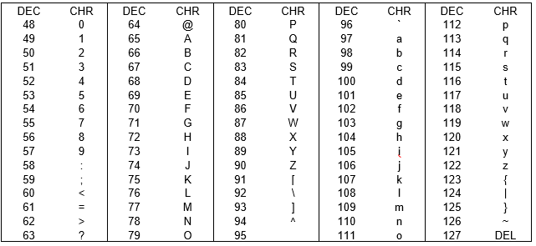
A closer look at character
Characters are stored as integer values based on their ASCII codes

Slide 39
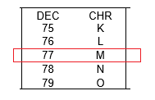
A closer look at character
Character is 1 byte.
If a value greater than 255 (decimal) is being assigned to a character variable, only a single byte of data will be retained.
char a = 333;
cout << " a = " << a ;
a = M
(As 333 – 256 = 77)

Slide 40
A closer look at character
It is valid to assign integer value to a character
Simple arithmetic is also allowed
a = M
char a = 77;
cout << " a = " << a ;
char a = 'M'+2;
cout << " a = " << a ;
a = O

Slide 41
Formatting Float Outputs
int main()
{
//-- Variable Declarations ------------
double annual, monthly;
//-- Read Input ----------------
cout << "Please enter Annual Pay :$";
cin >> annual;
//-- Calculate Monthly Pay ------------
monthly = annual/12;
//-- Output Monthly Pay ---------------
cout << "Your Monthly Pay is " << monthly;
return 0;
}

Slide 42
Output:
Please enter Annual Pay :$185210
Your monthly pay is $15434.2
By default, the display is in 6 significant digits. In order to have a better control of the display, we need to use the I/O manipulators.

Slide 43
iomanip
resetiosflags | Clears the specified flags.
setbase | Set base for integers.
setfill | Sets the character that will be used to fill spaces in a right-justified display.
setiosflags | Sets the specified flags.
setprecision | Sets the precision for floating-point values.
setw | Specifies the width of the display field.

Slide 44
iostream
endl | Terminates a line and flushes the buffer.
flush | Flushes the buffer.
dec | Specifies that integer variables appear in base 10 notation.
fixed | Specifies that a floating-point number is displayed in fixed-decimal notation.
hex | Specifies that integer variables appear in base 16 notation.
left | Causes text that is not as wide as the output width to appear in the stream flush with the left margin.
oct | Specifies that integer variables appear in base 8 notation.
right | Causes text that is not as wide as the output width to appear in the stream flush with the right margin.
scientific | Causes floating point numbers to be displayed using scientific notation.

Slide 45
2 decimal places
cout << "Your Monthly pay is $ "
<< fixed << setprecision(2)
<< monthly << "\n";
This will produce the following output:
Your Monthly pay is $15434.17

Slide 46
To reserve 10 places for the entire number
cout << "Your Monthly pay is $ "
<< fixed << setprecision(2)
<<right<<setw(10)<<monthly<<"\n";
This will produce the following output:
Your Monthly pay is $ 15434.17
^^^^^^^^^^
1234567890
2 decimals
2 spaces
10 columns

Slide 47
Relational Operators
Relational Operators are used to compare data.
They are used to determine whether the result of a comparison is TRUE or FALSE.
It is important to note that C++ uses a double equal sign (==) to test if two values are equal.

Slide 48
Relational Operators
OPERATOR | MEANING
> | Greater than
>= | Greater than or Equal to
< | Less than
<= | Less than or Equal to
== | Equal to
!= | Not Equal to

Slide 49
Relational Operators
Operator | Description | Example | Evaluation
> | greater than | 5 > 4 | TRUE
 |  | 5 > 5 | FALSE

Slide 50
Relational Operators
Operator | Description | Example | Evaluation
>= | greater than or equal | 5 >= 4 | TRUE
 |  | 5 >= 5 | TRUE

Slide 51
Relational Operators
Operator | Description | Example | Evaluation
< | less than | 5 < 4 | FALSE
 |  | 5 < 5 | FALSE

Slide 52
Relational Operators
Operator | Description | Example | Evaluation
<= | less than or equal | 5 <= 4 | FALSE
 |  | 5 <= 5 | TRUE

Slide 53
Relational Operators
Operator | Description | Example | Evaluation
== | equal | 5 == 4 | FALSE
 |  | 5 == 5 | TRUE

Slide 54
Relational Operators
Operator | Description | Example | Evaluation
!= | not equal | 5 != 4 | TRUE
 |  | 5 != 5 | FALSE

Slide 55
Relational Operators
The single equal sign (=) is used to assign a value to a variable.
  e.g. num1 = 5;
but == is for comparing
  e.g. num1 == 5 will result in either
  TRUE if num1 is 5 or
  FALSE otherwise.
  num1 will be unchanged.

Slide 56
Relational Operators
Relational Operators have lower precedence than Arithmetic Operators.
  For example, the expression
  i < limit - 1
  is interpreted as
  i < (limit - 1)

Slide 57
Shown below are some Logical Operators used in C++.
OPERATOR | MEANING
&& | AND
|| | OR

Slide 58
P && Q
P | Q | Result
FALSE | FALSE | FALSE
FALSE | TRUE | FALSE
TRUE | FALSE | FALSE
TRUE | TRUE | TRUE

Slide 59
P || Q
P | Q | Result
FALSE | FALSE | FALSE
FALSE | TRUE | TRUE
TRUE | FALSE | TRUE
TRUE | TRUE | TRUE

Slide 60
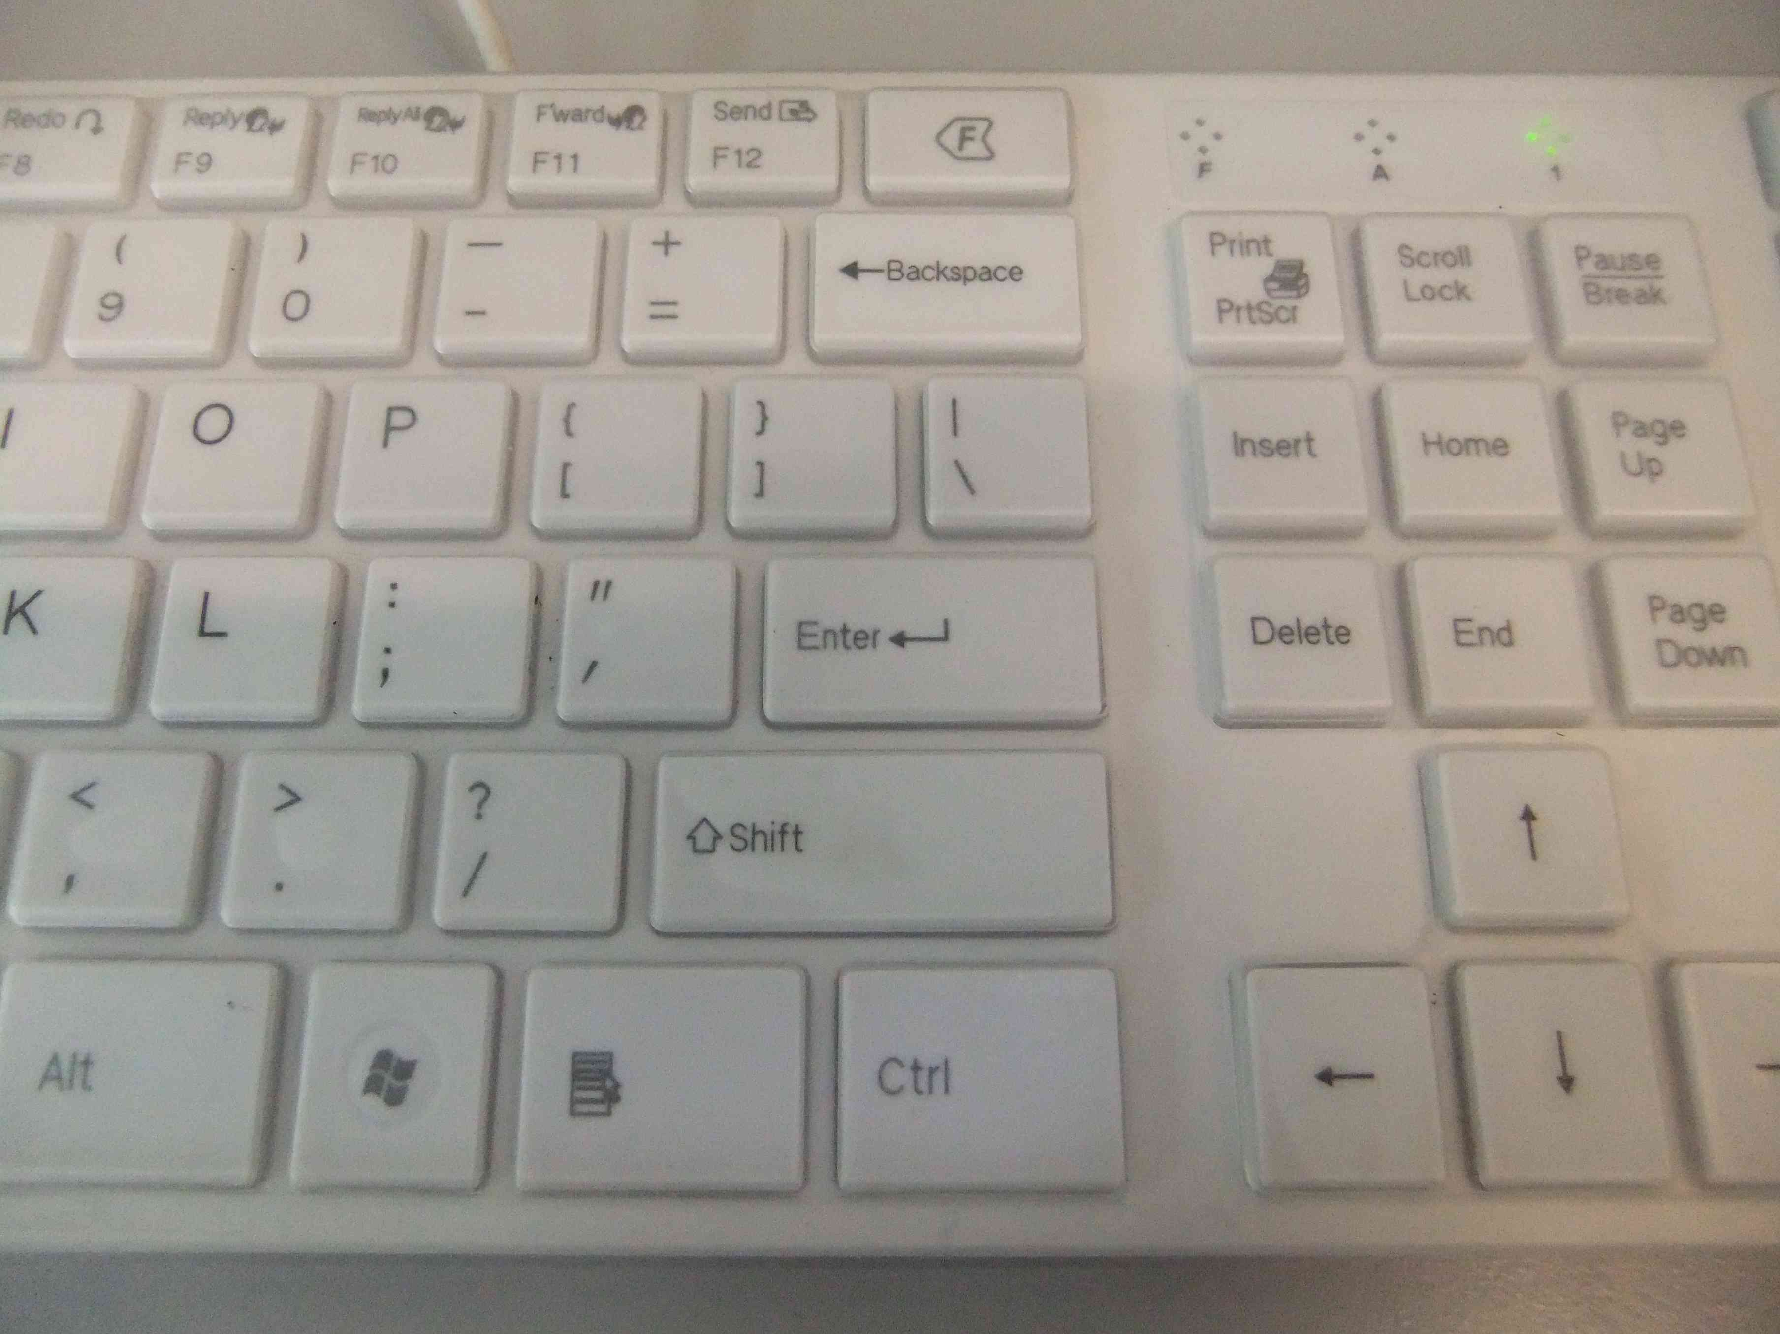
Where is the key ‘|’ ?

Slide 61
Shown below are some Logical Operators used in C++.
Logical Operators have a lower precedence than Relational Operators.
For example the expression
count<10 && step>0.1
is equivalent to
(count<10) && (step>0.1)

Slide 62
the precedence of && is greater than that of ||
This means that the expression
a<0 || b>10 && c>20
is interpreted as
a<0 || (b>10 && c>20)

Slide 63
1 if TRUE and 0 if FALSE.
cout << 5==5;
will display 1 because the expression (5==5) is true and hence has a value 1
cout << 5==4;
will display 0 because the expression (5==4) is FALSE and hence has a value 0.

Slide 64
Activity
Evaluate the following expressions:
  (17<4*3+5) || (8*2==4*4) && (3+3==6)
  char ch = 'A'; cout << (ch >= 65);
Rewrite the following conditions in a single C++ expression:
  A is greater than B but less than C
  A is greater than or equal to B and A is equal to C

Slide 65
Exercise
Determine the output of the following code segment.
int main()
{
int x, y, z=4;
y = (7+6) % 5 / 2; cout << y << "\n" ;
z *= 3 + 2; cout << z << "\n" ;
x=y==z; cout << x << "\n" ;
return 0;
}

Slide 66
Exercise
Determine the output of the following code segment.
int main()
{
char x, y;
int z = 61;
x = 'a' + 10; cout << x << "\n" ;
y = z +10; cout << y << "\n" ;
cout << (z+10) << "\n" ;
return 0;
}

Slide 67
Exercise
Spot and correct the errors in the following code:
#include <iostream>
using namespace std;
int main()
{
int weight;
int result;
cout << "Enter your weight in lbs: ";
cin >> "weight";
result == weight x 2.2;
cout << "\nYour weight is : " << setprecision
<< result << endl;
return 0;
}

Slide 68
Exercise
The equivalent resistance of two resistors connected in parallel is given by the equation:
R = R1*R2/(R1+R2)
Write a program that prompts the user to enter the value of the two resistors. The program then calculates and displays the equivalent resistance.

Slide 69
Exercise
Write a program that calculates the equivalent resistances of two resistors connected in series and parallel. The user will be prompted to enter the values of the two resistors. A sample run of the code is shown below:
Program to calculate equivalent resistances in series and parallel.
Enter the value of the first resistor : 5
Enter the value of the second resistor: 20
The equivalent resistance in series is 25 Ohms.
The equivalent resistance in parallel is 4 Ohms.

