Slide 1
iNTUition v9.0
Khiu Kim Hong

Slide 2
01.
Track chosen
02.
Project built
03.
Video demonstration

Slide 3

Open track
01. Track chosen

Slide 4
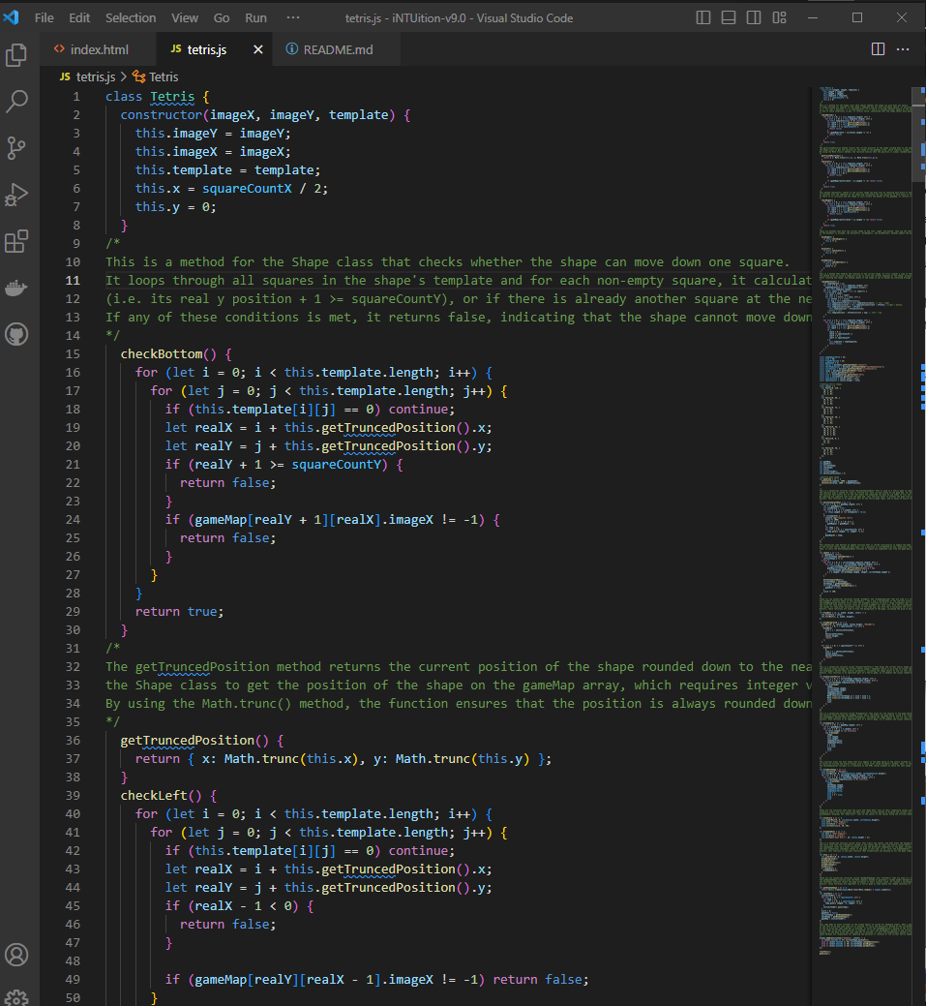
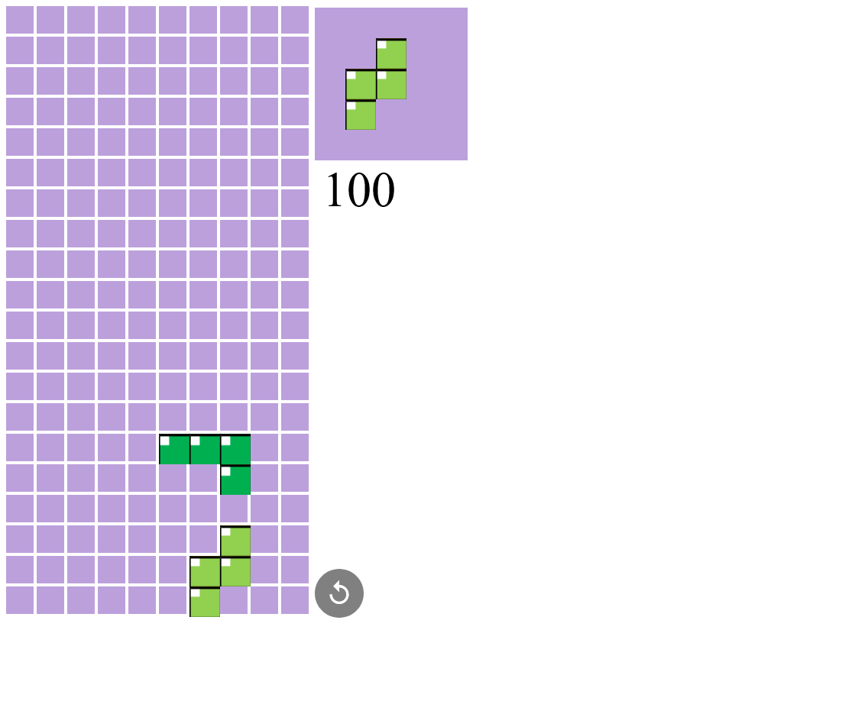
02. Project built
Notes:
A simple tetris game playable in a browser, built using HTML and javascript

Slide 5
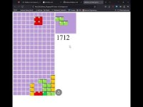
03. Video demonstration

