Slide 1
Policy search with a Mixture of Experts

Slide 2
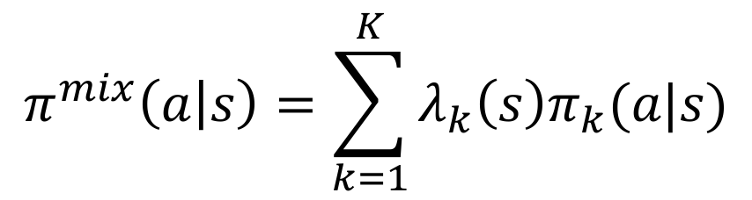

Mixture of Experts Policy
For two experts
$$π^{mix}\left(a | s\right)=λ_{1}\left(s\right)π_{1}\left(a\right|s)+λ_{2}\left(s\right)π_{2}(a|s)$$
Where,
$$λ\left(s\right)=[λ_{1}\left(s\right), λ_{2}\left(s\right)]$$
Weighting function that outputs a discrete distribution.
For K many experts,
$$π^{mix}\left(a | s\right)=\sum_{k=1}^{K}{λ_{k}\left(s\right)π_{k}(a|s)}$$

Slide 3
Why define a mixture of experts policy?
Mixture policy serves as a medium for information sharing between agents that are exploring a space in parallel.
Update parameters of each expert policy to maximize performance of mixture policy. (using importance sampling)
Importance sampling drives both policies to stay close to the state distribution of the mixture policy. (And hence to each other)

Slide 4
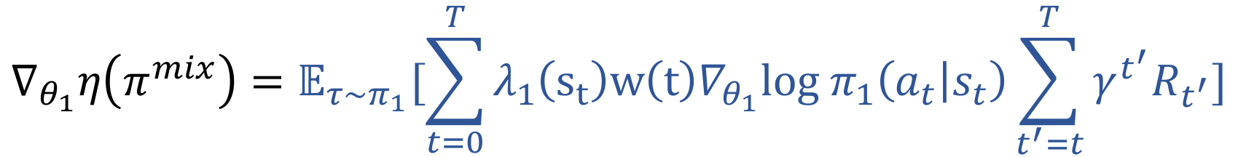
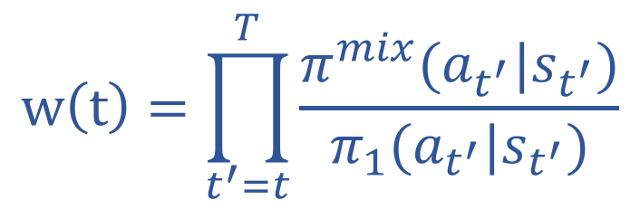
Gradient of Mixture Policy Performance
Information Sharing & Cooperation between agents
$$∇_{θ_{1}}η\left(π^{mix}\right)=𝔼_{τ\sim π_{1}}[\sum_{t=0}^{T}{{λ_{1}\left(s_{t}\right)w\left(t\right)∇}_{θ_{1}}log π_{1}\left(a_{t} | s_{t}\right)\sum_{t^{′}=t}^{T}{{γ^{t^{′}}R}_{t^{′}}}]}$$
$$w\left(t\right)=\prod_{t^{′}=t}^{T}{\frac{π^{mix}(a_{t^{′}}|s_{t^{′}})}{π_{1}(a_{t^{′}}|s_{t^{′}})}}$$

Slide 5
How can we discover multiple strategies with this model?
We will say that multiple strategies exist if there exists more than one single modal state distribution which attains the maximum returns from the initial state.
If multiple strategies exist, then we want each policy to discover a different strategy. (i.e. become an expert in a different part of the state space)
We will use KL divergence between the expert policies to accomplish this task.

Slide 6
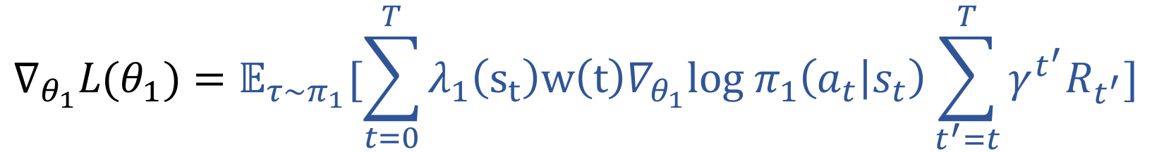
Modified Policy Gradient
Information Sharing & Cooperation between agents
$$∇_{θ_{1}}L(θ_{1})=𝔼_{τ\sim π_{1}}[\sum_{t=0}^{T}{{λ_{1}\left(s_{t}\right)w\left(t\right)∇}_{θ_{1}}log π_{1}\left(a_{t} | s_{t}\right)\sum_{t^{′}=t}^{T}{{γ^{t^{′}}R}_{t^{′}}}]}$$
$$+β ∇_{θ_{1}}𝔼_{s \sim π_{1}}\left[KL\left(π_{2}(∙\right|s\right)|| π_{1}(∙|s)]$$
Deviation between agents
Weighting

Slide 7
What can we expect the model to learn?
If multiple strategies exist, KL divergence constraint will encourage each expert policy to explore different parts of the state space. On the other hand, converging to the same policy is discouraged.
If only one good strategy exists, then eventually both experts will settle on the same strategy. (Granted that the KL constraint is ”properly” annealed)

Slide 8
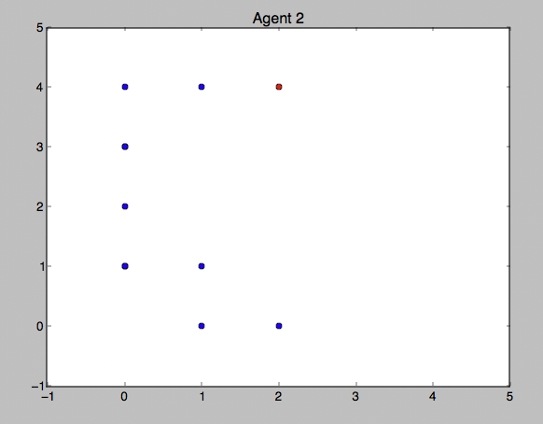
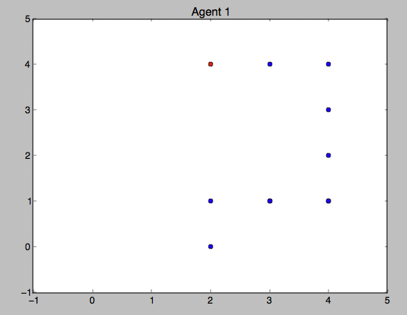
Initial Results – Multiple Strategies Discovered
Goal
Goal
Start
Start

Slide 9
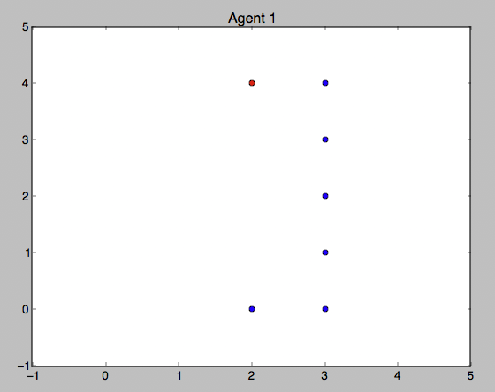
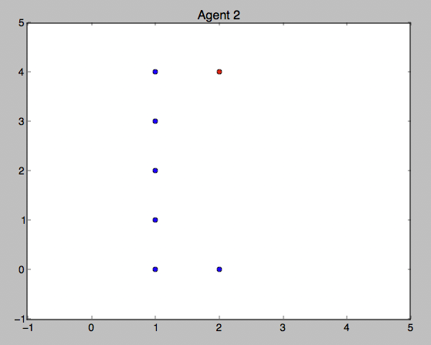
Initial Results – Multiple Strategies Discovered
Goal
Goal
Start
Start

Slide 10
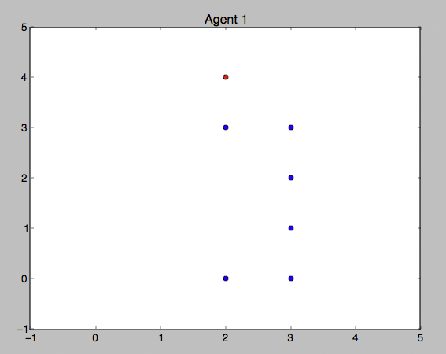
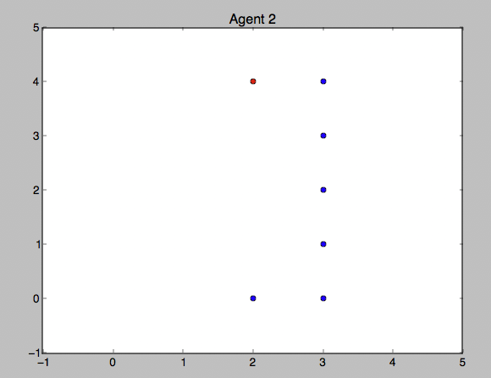
Initial Results – One optimal strategy
Goal
Goal
Start
Start

Slide 11
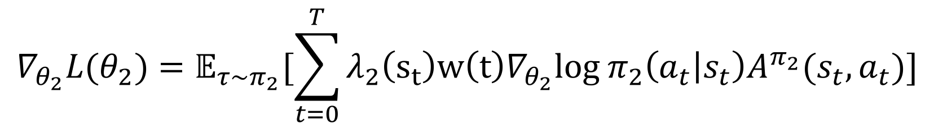
Future Directions
How can we better encourage competition?
$$∇_{θ_{2}}L(θ_{2})=𝔼_{τ\sim π_{2}}[\sum_{t=0}^{T}{{λ_{2}\left(s_{t}\right)w\left(t\right)∇}_{θ_{2}}log π_{2}\left(a_{t} | s_{t}\right)A^{π_{2}}(s_{t}, a_{t})]}$$
$$A^{π_{2}}\left(s_{t}, a_{t}\right)= Q^{π_{2}}\left(s_{t}, a_{t}\right)−V^{π_{2}}\left(s_{t}\right)= \sum_{t^{′}=t}^{T}{γ^{t^{′}}R_{t^{′}}}−V^{π_{2}}\left(s_{t}\right)$$
Instead of scaling grad-log probability by advantage with respect to its own policy, can we try to scale it with the cross advantage?
DEF:
$$A^{π_{2}π_{1}}\left(s_{t}, a_{t}\right)= Q^{π_{2}}\left(s_{t}, a_{t}\right)−V^{π_{1}}(s_{t})$$

Slide 12
Cross Advantage
$$A^{π_{2}π_{1}}\left(s_{t}, a_{t}\right)= Q^{π_{2}}\left(s_{t}, a_{t}\right)−V^{π_{1}}(s_{t})$$
Qualitatively, if a policy visits states where there already exists an expert policy for, it must discover a path that has higher returns than the current expert estimated value of that state.
If a policy visits a state for which there exists no expert, it is encouraged to explore that state since the value estimates will be low.

Slide 13
Can we find a good balance?
$$A\left(s_{t}, a_{t}\right)=λ_{2}\left(s_{t}\right)A^{π_{2}}\left(s_{t}, a_{t}\right)+λ_{1}\left(s_{t}\right)A^{{π_{2}π}_{1}}(s_{t}, a_{t})$$
If the policy is an expert in the region, then weight by the normal advantage. If policy in region where another policy is the expert, weight more on the cross advantage.
In the beginning of learning, both policies will consider cross advantage which encourages each other to either find different parts of the state space to explore or to outperform the other agent
As both policies converge to an expert region, they will each follow their own advantage.

Slide 14
Results – Cross Advantage
Goal
Goal
Start
Start

Slide 15
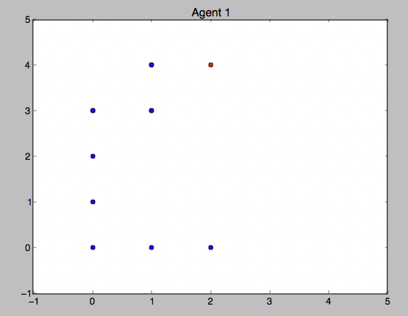
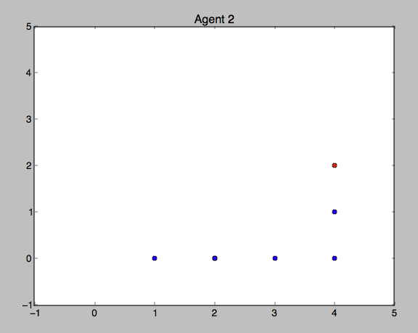
Results – Cross Advantage
Can we use two agents to prevent
Falling into sub-optimal goals?
Global optimal goal with
Reward +100
Sub-optimal Goal with reward +10

Slide 16
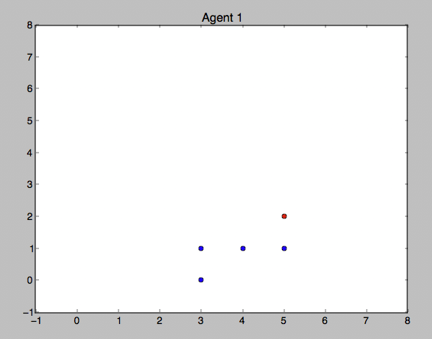
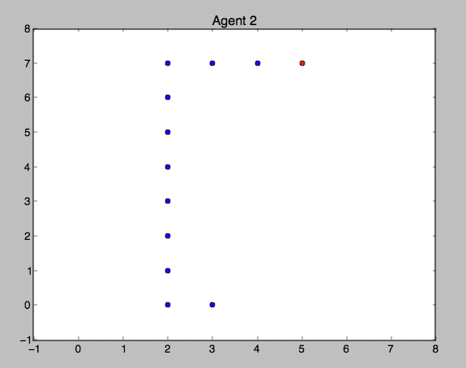
Results – Cross Advantage (8x8 maze)
Global optimal goal
with Reward +100
Sub-optimal Goal with reward +10
Entropy regularized single agent
Converges to this goal 95% of the time
Using two agents, a second agent will always
Discover the global optimal goal

Slide 17
Comparison with KL constraints
In the maze-environments above, both KL divergence constraints and cross advantage achieve similar performance. (99% both agents will converge to different strategies)
For larger state/action space, cross advantage method will have the edge in computation time since gradient of KL doesn’t have to be calculated.

Slide 18
Questions
Mathematically, the cross advantage still uses an action-independent baseline, meaning that the sampled gradients are still an unbiased estimate of the original objective. (Maximizing returns)
So how does this method actually improve exploration / discovery of multiple strategies? Is there any mathematical intuition for this?

Slide 19
Going back to mixture of experts
Advantages:
As opposed to prior RL methods trying to learn multimodal policies (e.g. deep energy based policies; T Haarnoja et al. 2017), we can parallelize the learning process with a divide & conquer approach.
After the learning process, we can also execute each expert policy separately which gives the user more control over which strategies he wants to use later in application time.
Hopefully, each expert policy will also be more interpretable.

Slide 20
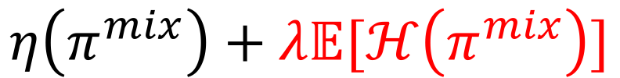
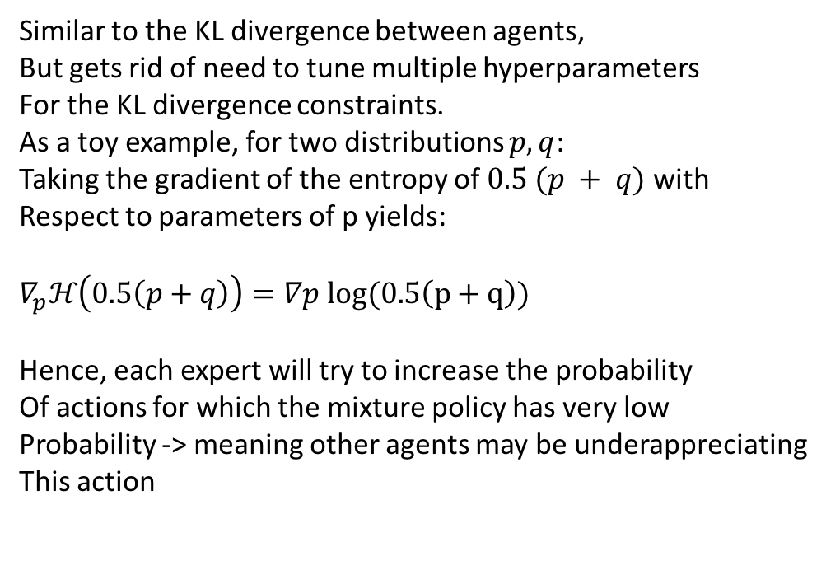
Refined formulation
Joint goal of all experts:
$$η\left(π^{mix}\right)+λ𝔼[ℋ\left(π^{mix}\right)]$$
Similar to the KL divergence between agents,
But gets rid of need to tune multiple hyperparameters
For the KL divergence constraints.
As a toy example, for two distributions $p, q$:
Taking the gradient of the entropy of $0.5 (p + q)$with
Respect to parameters of p yields:
$∇_{p}ℋ\left(0.5\left(p+q\right)\right)=$ $∇p log(0.5\left(p+q\right))$
Hence, each expert will try to increase the probability
Of actions for which the mixture policy has very low
Probability -> meaning other agents may be underappreciating
This action

Slide 21
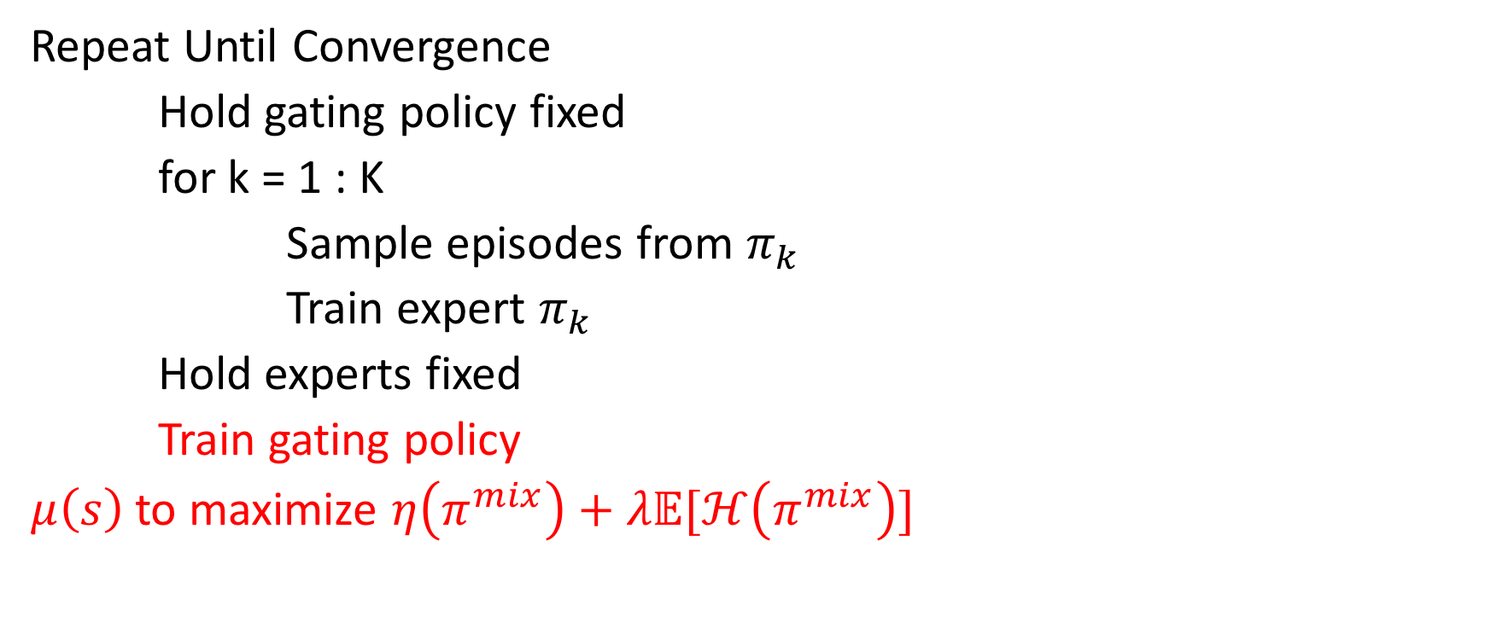
Full Algorithm in a nutshell
Repeat Until Convergence
Hold gating policy fixed
for k = 1 : K
Sample episodes from $π_{k}$
Train expert $π_{k}$
Hold experts fixed
Train gating policy
$μ\left(s\right)$ to maximize $η\left(π^{mix}\right)+λ𝔼[ℋ\left(π^{mix}\right)]$
Instead of using a count-based gating function which can be
Difficult to implement in high-dimensional space -> learn the
Weightings adaptively

