Slide 1
Object Oriented DQN
Meeting 1: High-level Goals, Milestones, and Initial Results

Slide 2
High-level Goals
Demonstrate improved sample-efficiency & consequently faster learning time.
Perhaps even improved performance?
Target conference:

Slide 3
Milestones
 | Proof of Concept – Handcraft object segmentation
 | Get general segmentation algorithm
 | Fine-tune state reprsentation

Slide 4
Fully Convolutional Networks (FCN)
Trained on Pascal Visual Object Classes Challenge 2011 dataset
20 Object classes (Person, Animal[bird, cat, …], Vehicle[aeroplane, bicylcle…], Indoor[bottle, chair, …])
Around 15000 training images, 15000 test images
Implementation available @: https://github.com/Yuliang-Zou/tf_fcn

Slide 5
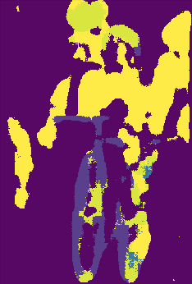
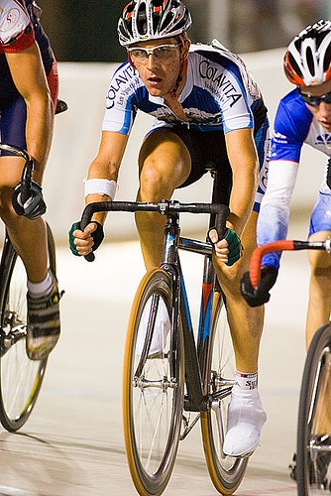
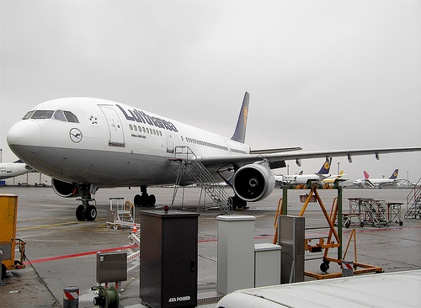
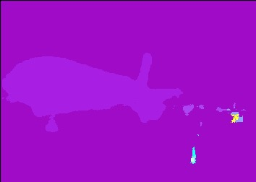
FCN on test images

Slide 6
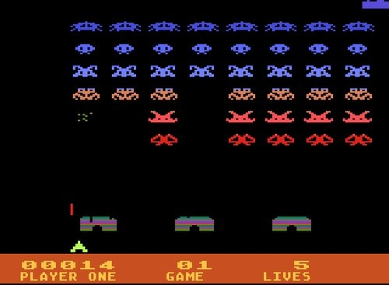
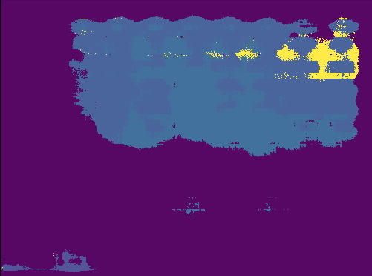
FCN applied to Atari Input
Original Image
Segmentation Mask

Slide 7
Overlapped View

Slide 8
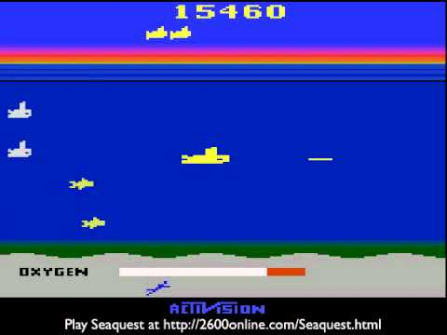
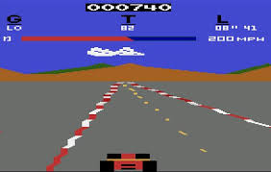
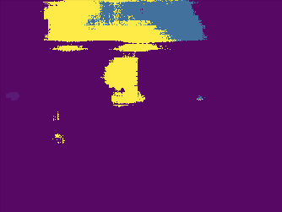

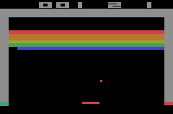
More Atari segmentation results
No segmentation mask discovered

Slide 9
Faster-RCNN
Trained on
Implementation available: @

