Slide 1

Instructions for
Programming Assignment
[CSED233-01] 2022 Spring, Data Structure
Seunguk Do Suhyeon Jeong Minjae Jeong Sangjun Lee Jaesik Park

Slide 2
Overview
How to configure C++ environment
Online environment repl.it
Offline environment CLion editor
Programming Assignment Guidance
How to submit your code

Slide 3
How to configure C++ environment

Slide 4
Option 1) Online compiler Repl.it

Slide 5
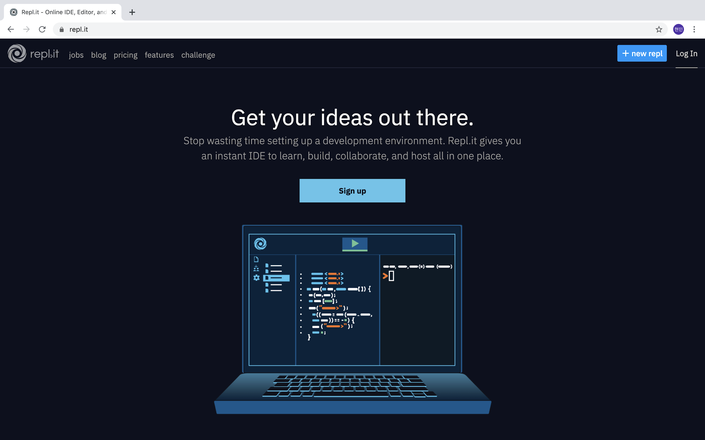
Repl.it (Strongly Recommended)
repl.it
create an account

Slide 6
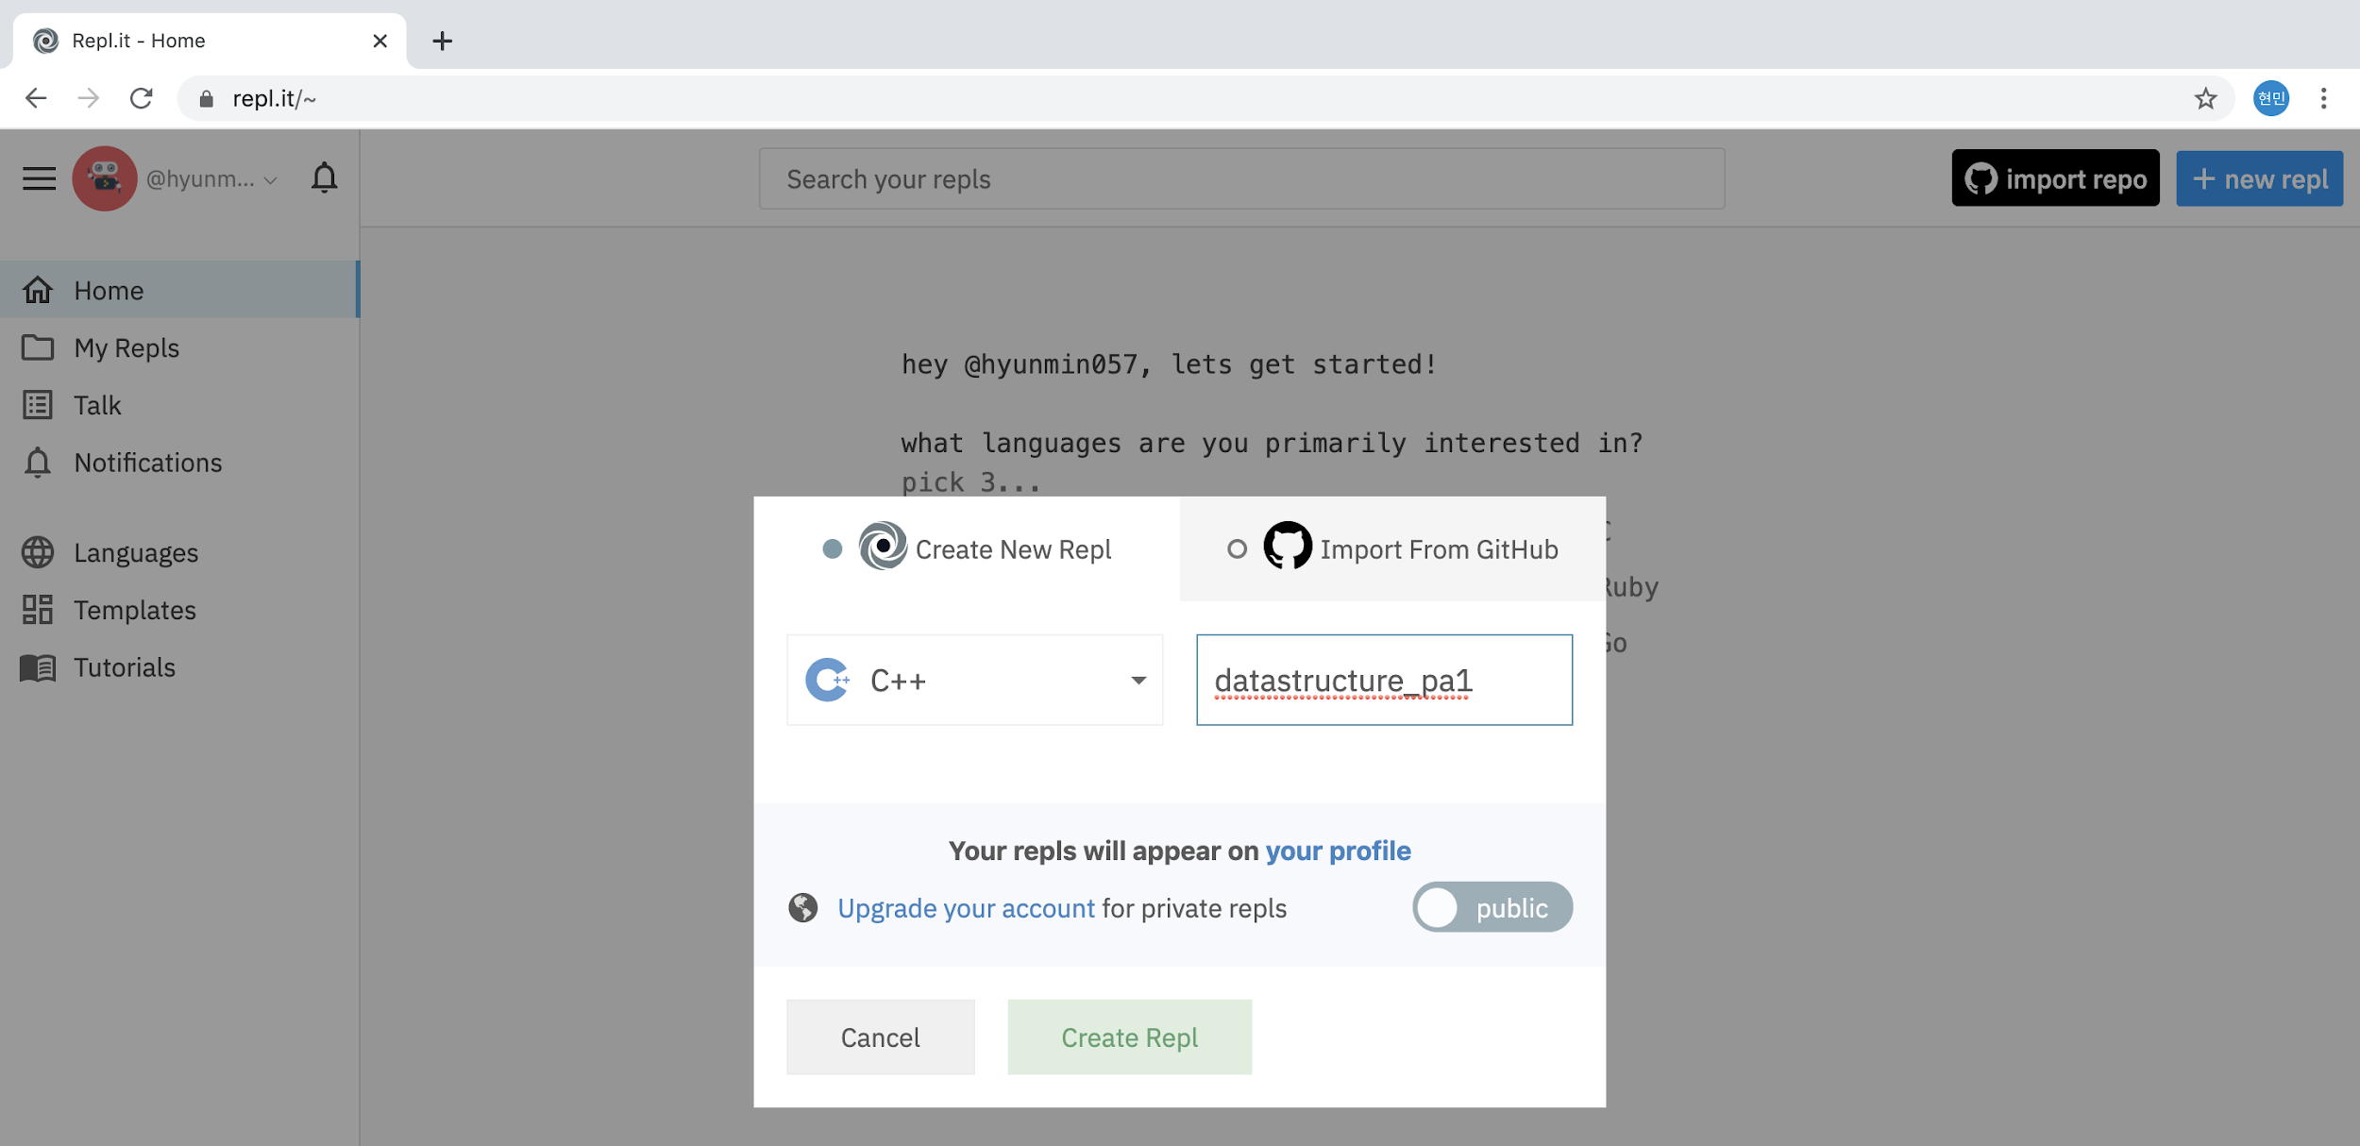
Repl.it (Strongly Recommended)
create a new project
1. create new project
2. choose C++
3. click

Slide 7
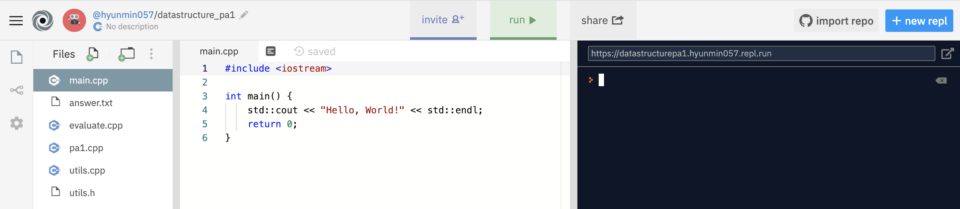
Repl.it (Strongly Recommended)
2. add pa1.cpp, evaluate.cpp, answer.txt files to the project
drag & drop

Slide 8
Option 2) CLion editor

Slide 9
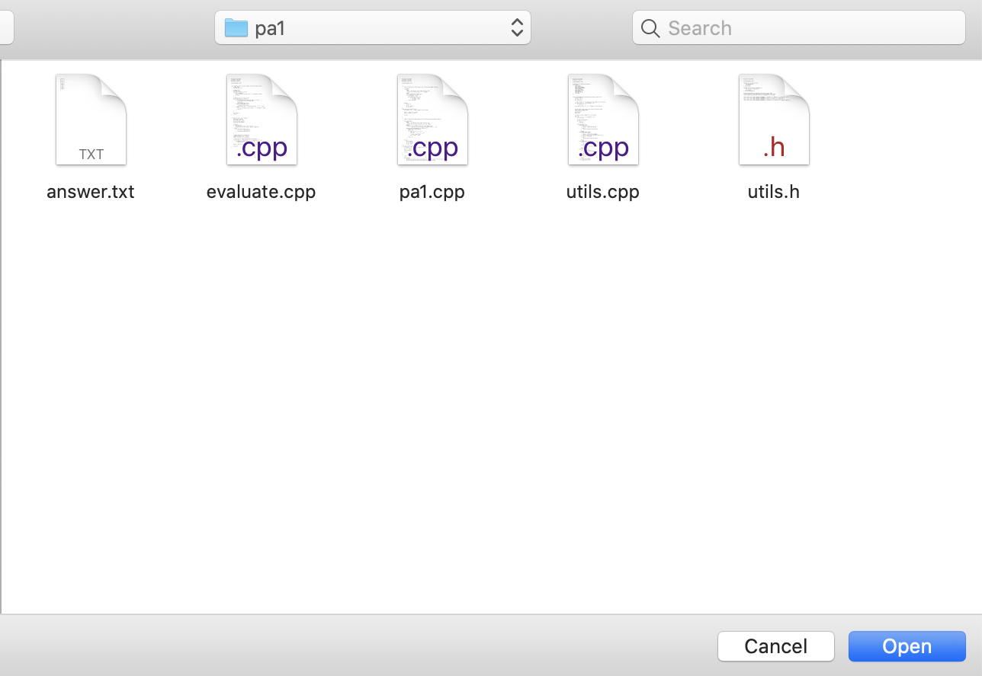
CLion
unzip pa1.zip then open the folder in CLion

Slide 10
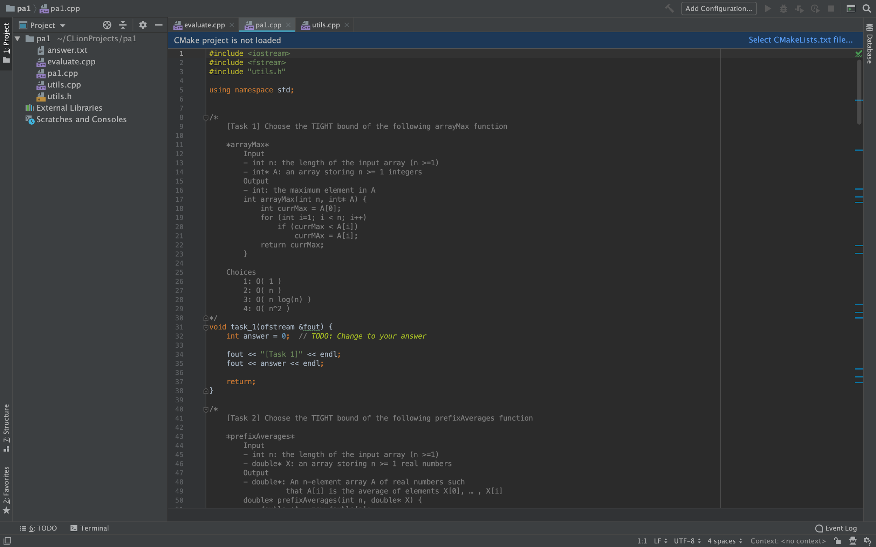
CLion
2. you can see the CLion as below

Slide 11
Programming Assignment Guidance

Slide 12
Overall process
Provided for the students
pa1.cpp
evaluate.cpp
NOT provided for the students
void task1() {
//do something
}
void task2() {
// implement code
}
don’t change anything here
/*
read answer.txt
read submit.txt
then compare
*/
real_test cases
real answer.txt
compile & execution
compile & execution
this will be your actual score :)
answer.txt
submit.txt
compare &
tell your score
[Task1]
…
[Task2]
…
[Task1]
…
[Task2]
…
you can self-check if your implementations are correct with the provided files

Slide 13
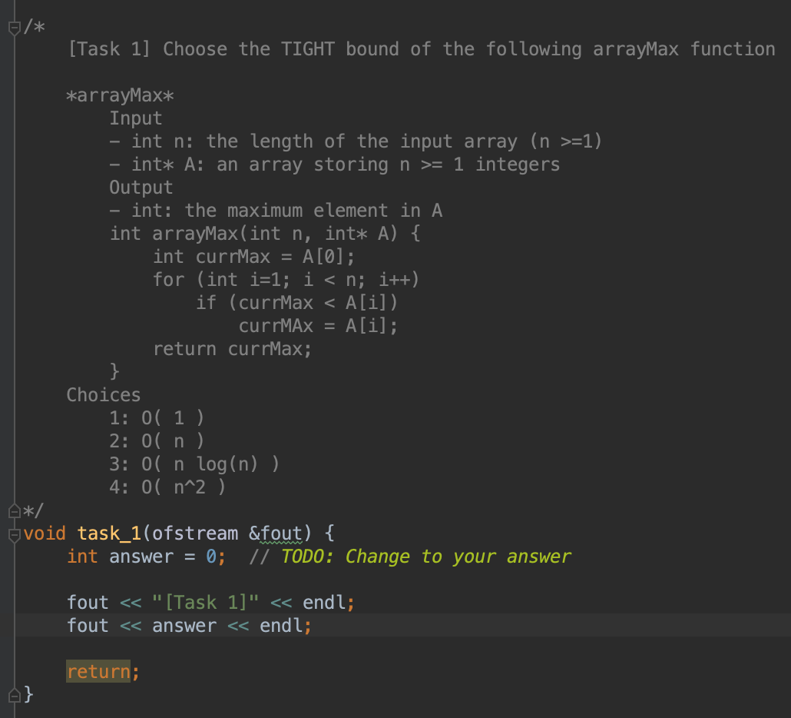
Programming Assignment guidance
open pa1.cpp file and fill the functions. *Some functions may not need to implement the code.
explanation of the task
you need to complete the TODO

Slide 14
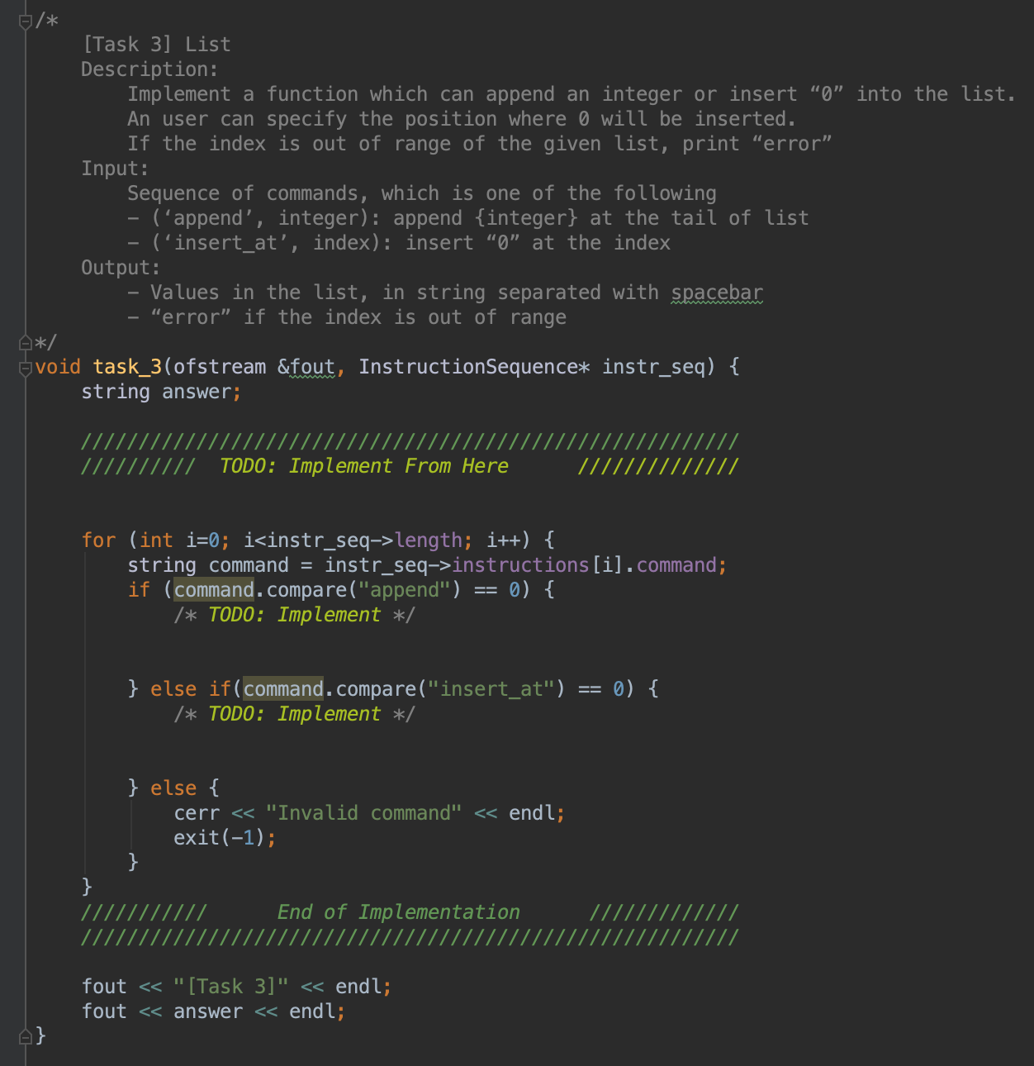
Programming Assignment guidance
open pa1.cpp file and fill the functions. *Some functions may need to implement the code.
explanation of the task
you need to complete the TODO

Slide 15
Programming Assignment guidance
3. When you are done, run pa1.cpp
Repl.it user: type as below in terminal
CLion user: type as below in terminal, refer to the link for opening the terminal
** note that you need to specify the compiler version to 11 by -std=c++11

Slide 16
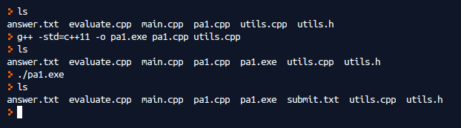
Programming Assignment guidance
4. Step3 will generate submit.txt file which contains your answer
Repl.it
CLion: submit.txt file will be generated in [cmake-build-debug] folder
← running this line will create pa1.exe
← running this line will create submit.txt

Slide 17
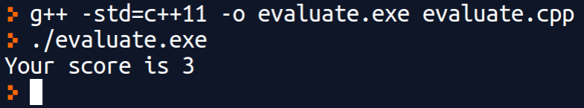
Programming Assignment guidance
5. check your score by running evaluate.cpp file. This will compare your answer submit.txt with the provided answer answer.txt.
Repl.it & CLion
note that this is not your actual score since we might use other test cases from what we’ve provided

Slide 18

Try TODAY!
Even if the process looks not familiar to you, that is normal.
If you are not sure, please use Q&A or discuss it with your friends.
Animal Crossing, © Nintendo

Slide 19
How to submit your work

Slide 20
Via POSTECH-LMS
Go to LMS(https://lms.postech.ac.kr/) → CSED233-01 → Learning activity → assignments
Submit your pa1.cpp file and pa1.exe (not answer.txt, submit.txt file)
Please be aware... we won’t accept email submissions

Slide 21
Q&A

