Slide 1
Node Vector Structure
Vector NodeV
Vector of all nodes in circuit
Vector Index | 0 | 1 | 2 | 3 | 4
Node | Ref = 5 Gate = PI Logic = 1 Lev = 0 …. | Ref = 6 Gate = AND Logic = 0 Lev = 1 …. | Ref = 1 Gate = PI Logic = 0 Lev = 0 …. | Ref =2 Gate = PO Logic = 1 Lev = 2 …. | Ref = 7 Gate = NOT Logic = 1 Lev = 2 ….
Vector ref2index
Quick way to find the location of a node given the reference
Generated after the circuit is read from the file, does not change
Vector Index (Node Ref) | 0 | 1 | 2 | 3 | 4 | 5 | 6 | 7
Index in NodeV | - | 2 | 3 | - | - | 0 | 1 | 4
To get node N:
Node = NodeV[ref2index[N]]

Slide 2
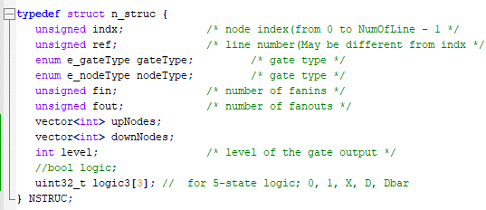
Logic Table
Bit 0 | 0 | 1 | 0 | 1 | 0
Bit 1 | 0 | 1 | 1 | 0 | 1
Bit 2 | 0 | 0 | 0 | 1 | 1
 | 0 | 1 | X | D | Dbar
Each column is an iteration to be processed
Either a test pattern or a fault scenario
 | Iteration 0 | Iteration 1 | Iteration 2 | Iteration 3 | Iteration 4 | …. Iter 31
Bit | 0 | 1 | 2 | 3 | 4 | … 31
Word 0 | 0 | 1 | 0 | 1 | ` | …
Word 1 | 1 | 1 | 0 | 0 | 1 | …
Word 2 | 0 | 0 | 0 | 1 | 0 | …
 | X | 1 | 0 | D | 1

Slide 3
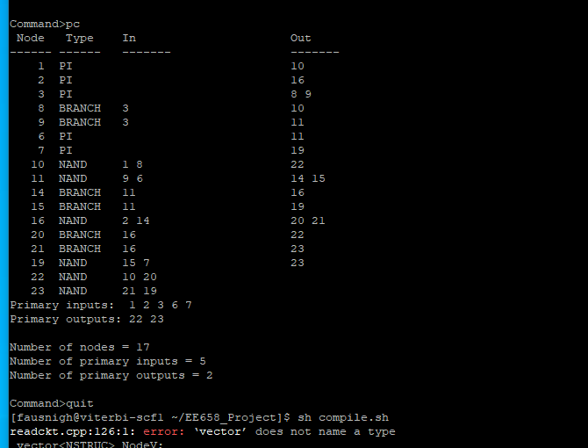
Example C17.ckt

