Slide 1
302CEM
Choi Hei Man ,Serena 56237944
Lau Chi Man,Choco 56237747
Kwok Ka Hei,Kelly 56237981
Lin Ka Ching,Wendy 56235662
Notes:
Our project is about to building a system to submit building material order between the interior design and decoration platform and the material supply company called 3S.

Slide 2
Company overview
ABC company(Interior design and decoration platform)
Role: Admin(us), custumer, provider
3S Co.,Ltd (3rd material supply company)
Role: Admin(3S), custumer(ABC Co. provider)
Notes:
For the background:
-ABC company is a company provide an interior design and decoration platform to help customers find the most suitable provider to provide reliable services. Customers register and create the request of design or decoration for their requirement. Meanwhile, the provider also needs to register their account so that they can see the customers' cases and apply for the job.
-3S Company is a third party material company. It will supply material to ABC company provider.

Slide 3
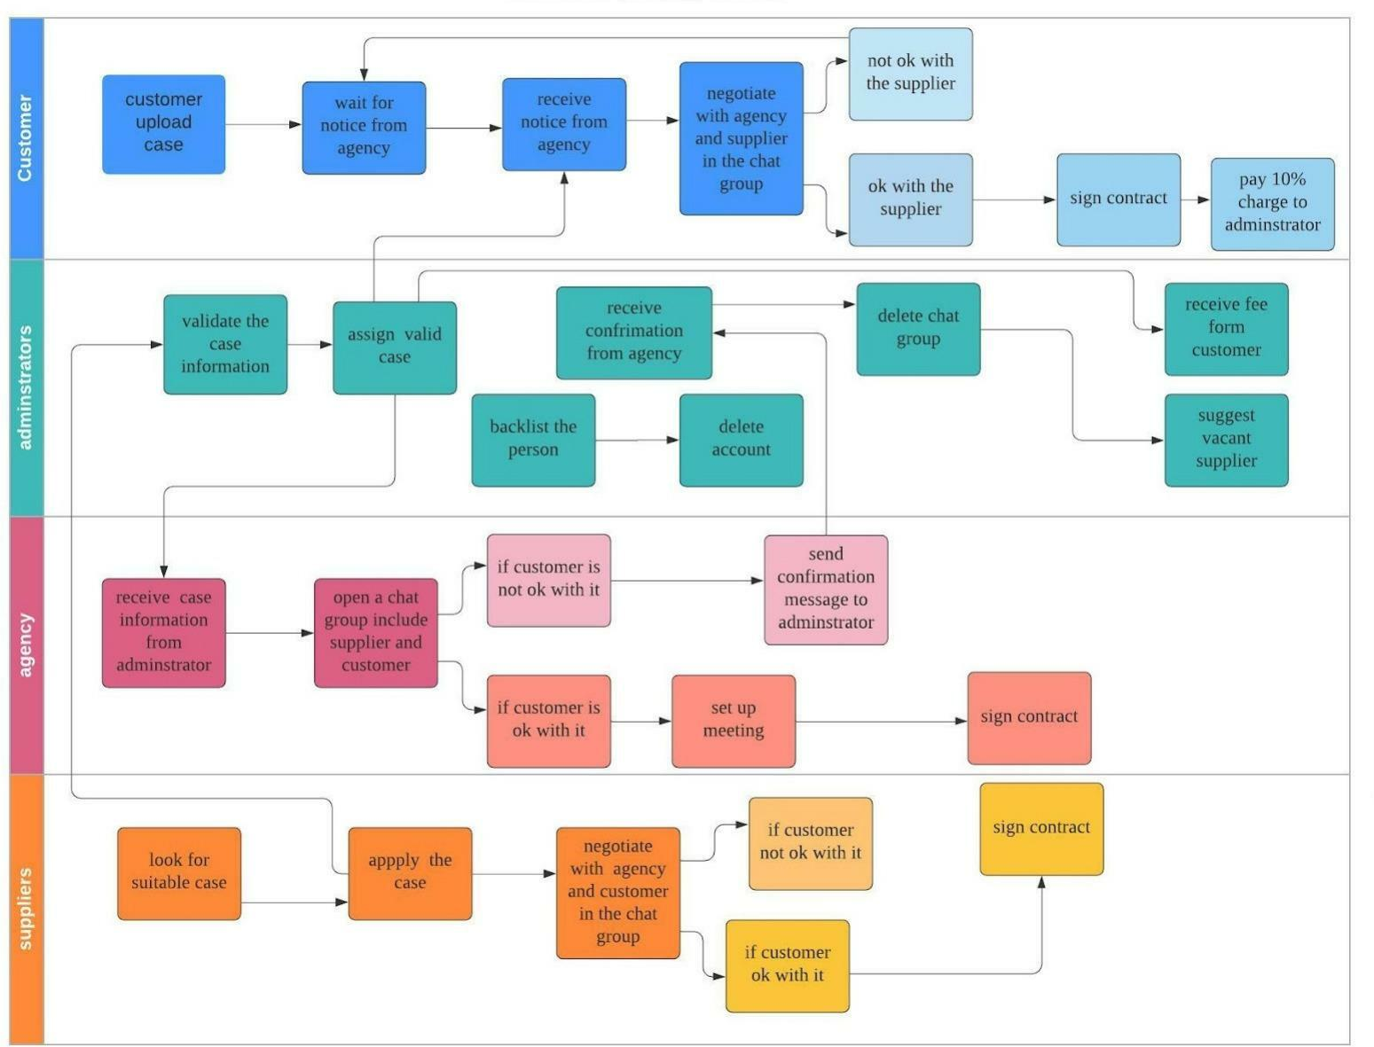
Design & decoration intermediary company service blueprint
Notes:
This is the service blueprint of the Design & decoration intermediary company service blueprint.
To show the process flow in the system, customers can filter based on conditions, and compare multiple interior design companies in the application immediately.
It helps customers find the most suitable provider to provide reliable services. Customers register and create the request of design or decoration for their requirement. Meanwhile, the provider also needs to register their account so that they can see the customers' cases and apply for the job. Both customers and providers are more reliable and safer through using the platform because all registration of each customer and provider are verified by the administrator. In addition, our application has the rating and review function for reference. At the same time, providers can also apply for different types of jobs because our platform will concentrate the customers who need interior design and decoration service.

Slide 4
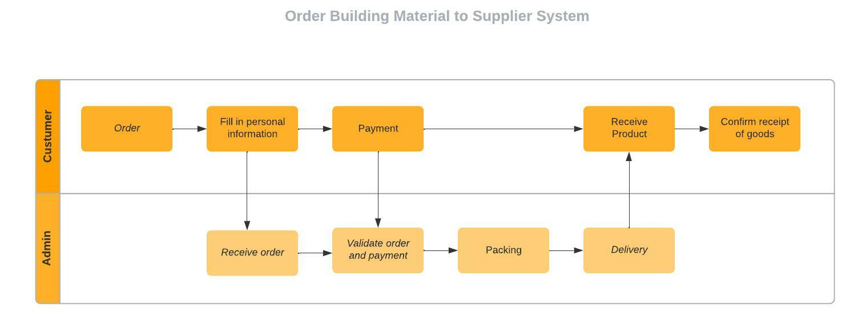
The Service Blueprint of Material Supply Company
(3S custumer = ABC provider)
Notes:
Our project are going to add the function to interchange the order data for the ACB provider, to buy building material though the system.
This is the service blueprint of material supply company named 3S.
The 3S company customer is as known as ABC provider ; and the Admin is 3S Company Admin.

Slide 5
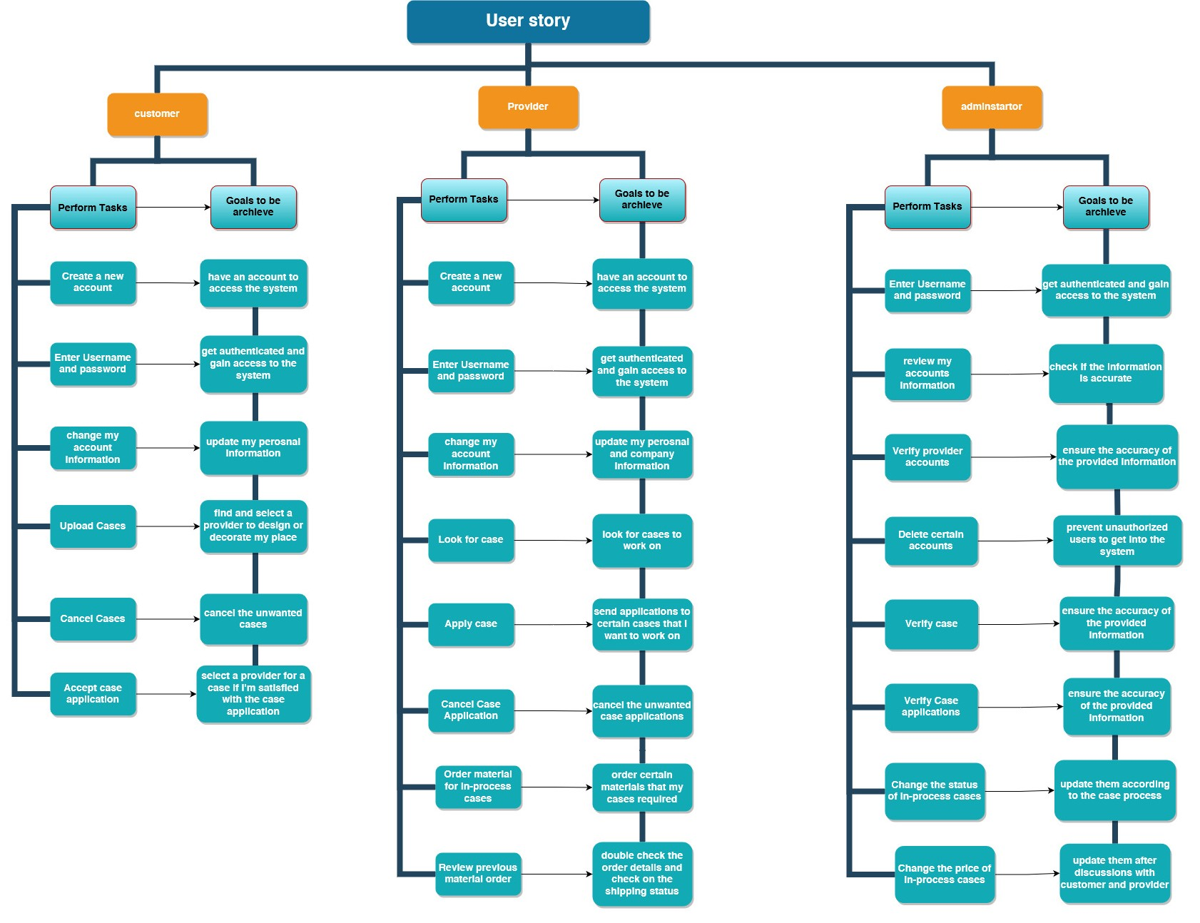
User stories
Notes:
those are our user stories which are divided according to different roles: customer, provider, admin.
for example, both customers and Provider can create an account to login to our system while admin can access to the system by inputing username and password.

Slide 6
Agile project template
Notes:
show excel

Slide 7
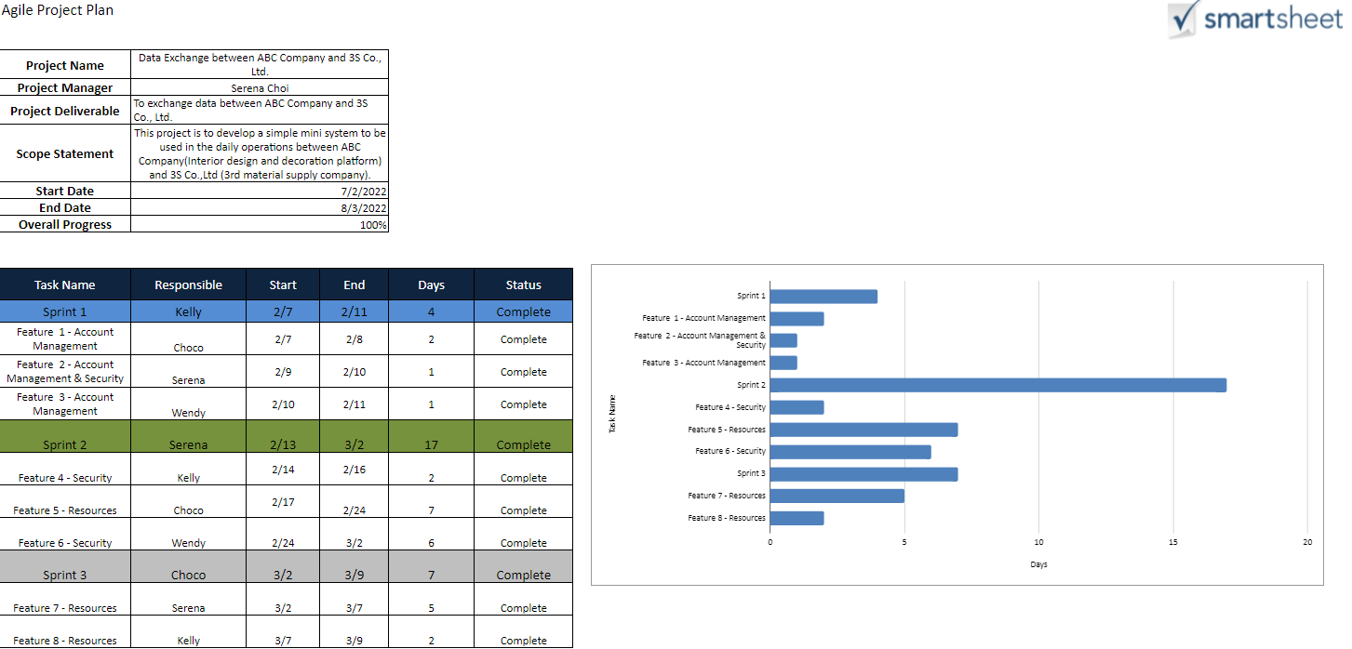
Notes:
This is our agile project plan. And here are total eight features and we will spend about one month to complete our project.

Slide 8
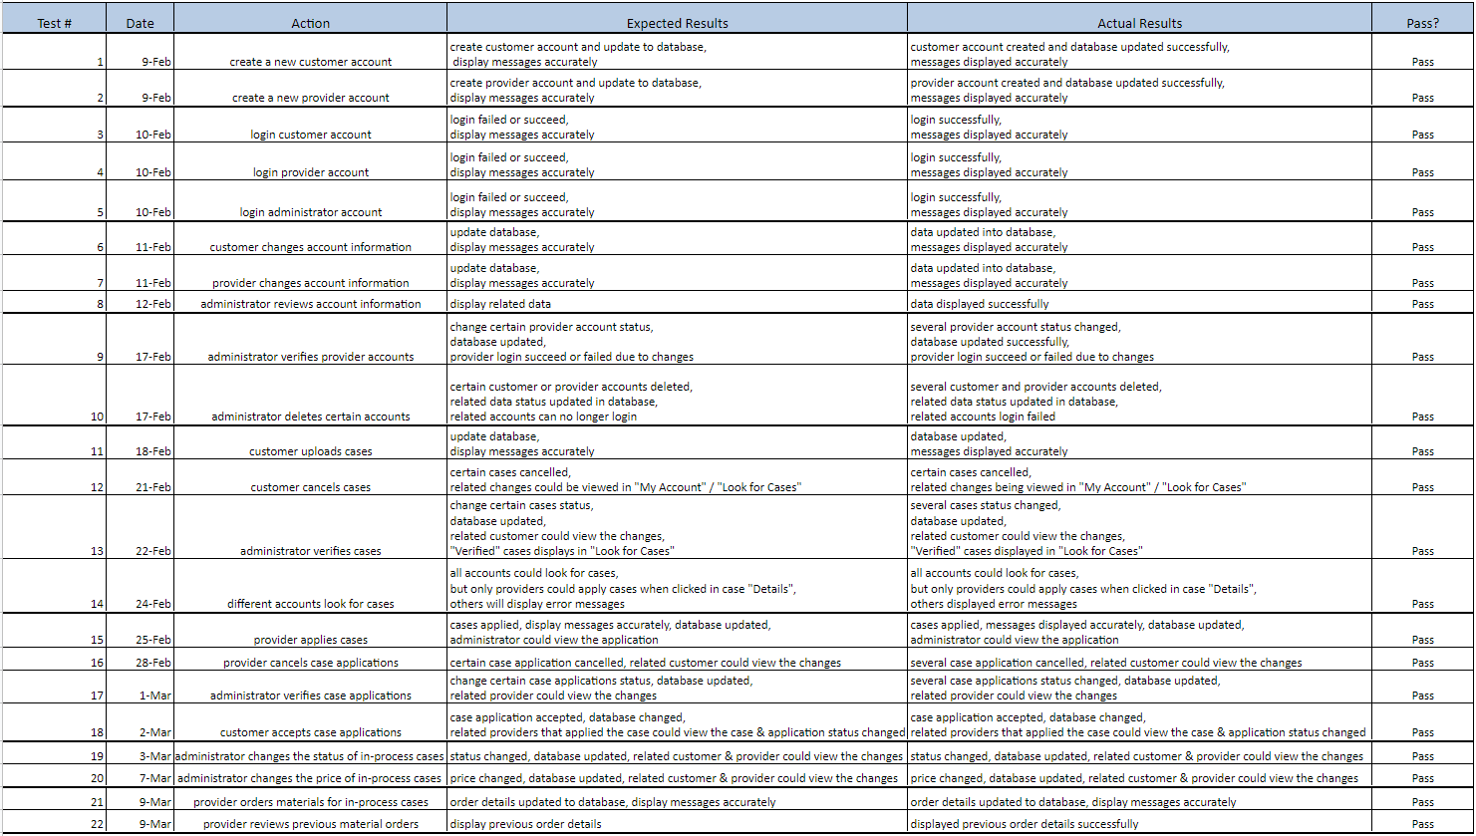
Notes:
This is our test plan. There are 22 test plan and all cases passed the test.

Slide 9
Data Interface

Slide 10
Data Interface
ABC company: 1. customers upload cases
2. providers apply cases
3. customers accept one application
4. providers order materials
3S Co.,Ltd: receive & complete orders
Notes:
For the data interface, the data upload to the database will include(1-4)
And the 3S company will recevice these four data from the database.

Slide 11
Data Interface layout
ABC APP
3S APP
Provider
Order generate
Order data import
Display data
ABC phpmyadmin DB
3S DB
import to 3S DB
JSON file export
send JSON file via email
ABC Co.
3S Co.
Notes:
This is the data interface layout that show the data interaction between ABC appication and 3S application.

Slide 12
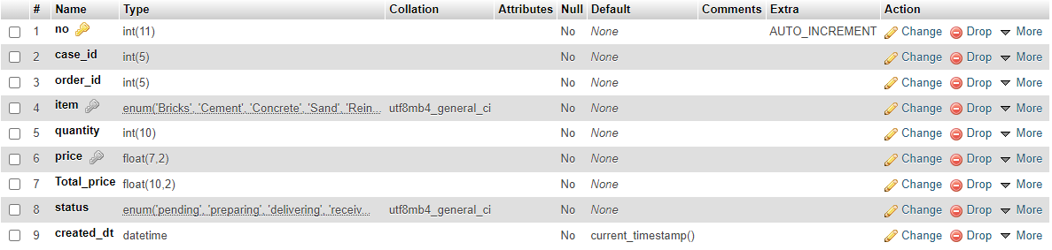
Data Interface layout_Data structure
Notes:
As shown above, this is the data structure of the database that we store the order information

Slide 13
Data Exchange

Slide 14
Data Exchange - Orders generate and ABC CO. export the file
-Provider places orders in the ABC Company application
-Auto upload order details to PHPmyadmin(ABC) in SQL
-PHPmyadmin(ABC) exports new order details in JSON text format
-Auto send email to 3S Co., Ltd in real-time
-3S Co., Ltd. receives email
Notes:
Let’s talk about how the data exchange work in actual situation
First, the provider of ABC company will place the order in the application which belongs to ABC company.
Then, there will be upload order details to the database of ABC company in SQL automatically.
At the same time, the PHPmyadmin also will export order details in JSON text file and send it to 3S Comapany through email.
So that, 3S company receives the email.

Slide 15
Data Exchange - 3S Co. receive the data and import to DB
-When 3S Co., Ltd. turns on their application
-Auto read email & update PHPmyadmin(3S)
Notes:
Then, to talk about how 3S receive the data.
After 3S company receive the email that contain the new order of JSON file,the appication of 3S will auto read the email and update to the PHPmyadmin when 3S turns on their application.

Slide 16
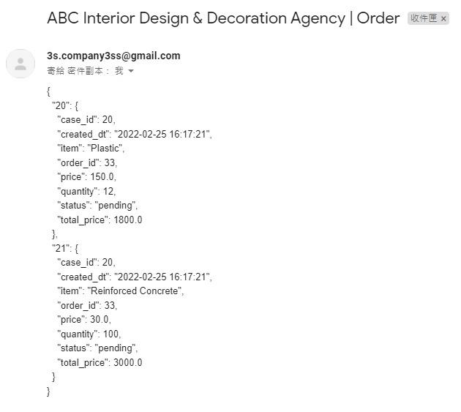
Data Exchange
-This is the email example received by 3S Co., Ltd. automatically
Notes:
The above Python code is for dumping the JSON file.
The content of the email is the new order data that export from ABC company database by JSON text format.

Slide 17
Demostration

Slide 18
End

