Slide 1
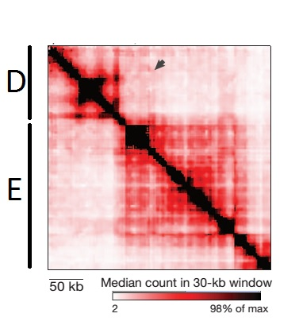
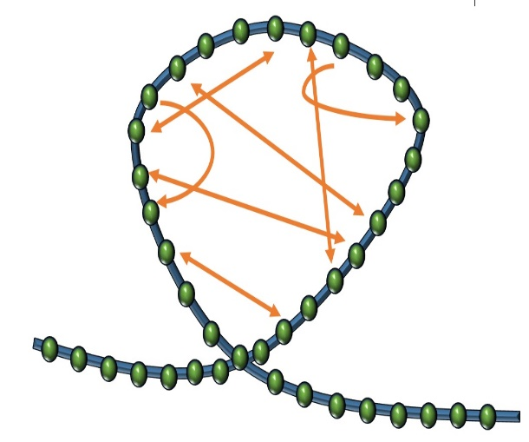
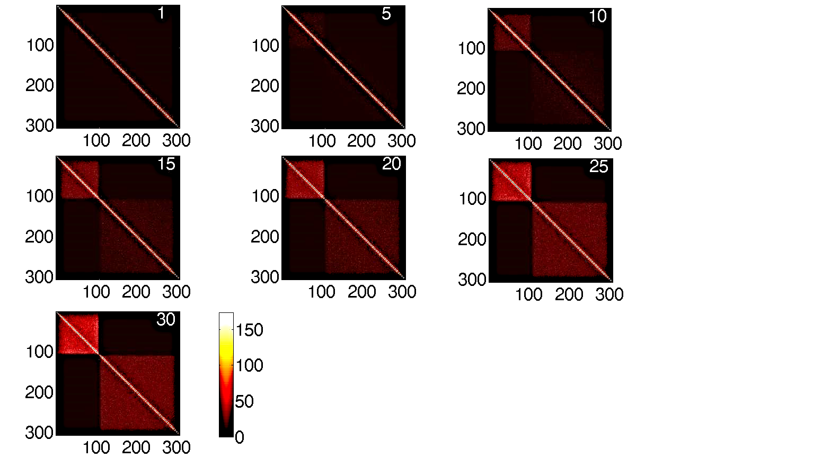
Random connector model
The data
Random connector model
Simulation result. Increasing number of connectors
Restrict random connectors between bead 1-107 (TAD D) and beads 108-307 (TAD E)
D
307 beads
E
*Number of connector in white

Slide 2
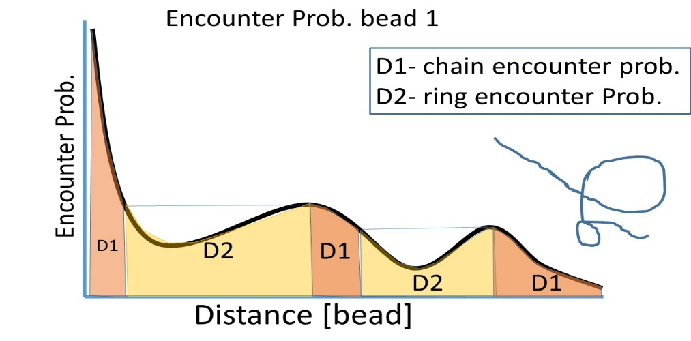
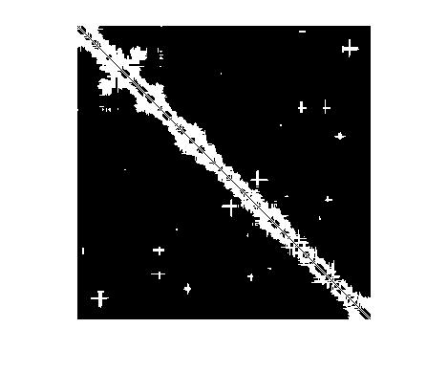
Reconstruction
In the Rouse model, equal encounter probabilities indicate equal distance
We “project” the encounter signal onto itself to distinguish between rings and chains
We apply this technique to the HiC data to find nearest neighbor beads (connectivity matrix)
Connectivity matrix
D
E

Slide 3
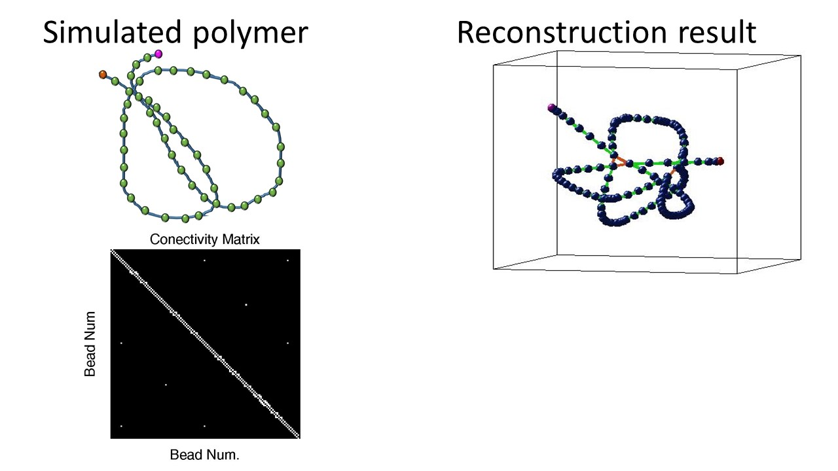
Example
128 bead chain. Connected beads [8,64,120], [36 92]

Slide 4
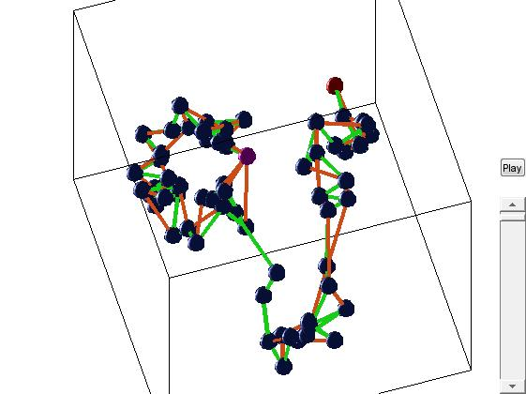
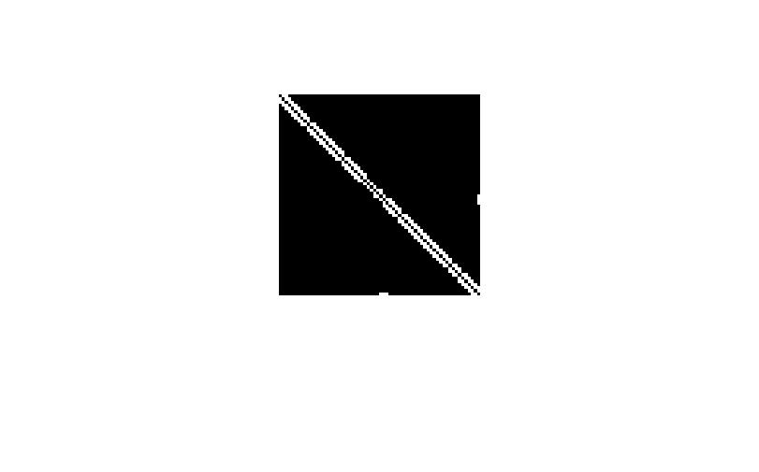
Example 2
Simulated polymer
Reconstruction result
Bead 64
Connectivity matrix
Bead Num
Bead 32 and 64 are connected
32
Bead 32
64
Bead Num.

