Slide 1
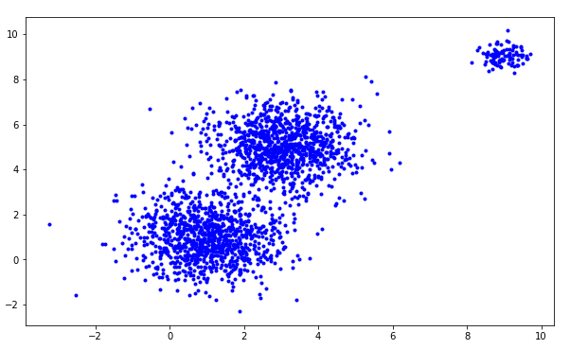
Limitation of K means algorithm

Slide 2


Limitation of K means algorithm (Real case)
Original image
K-means result
VS

Slide 3
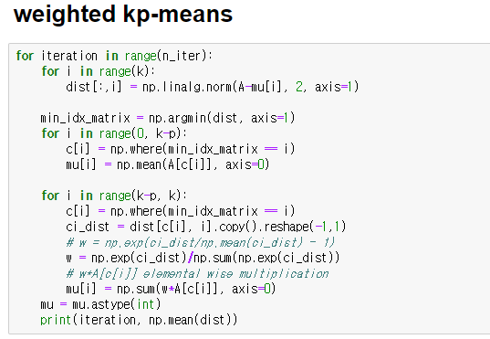
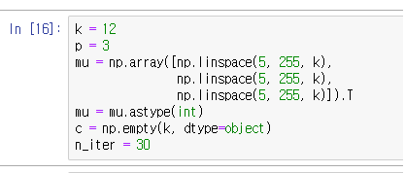
K-P Means Code
Explanation about K & P

Slide 4
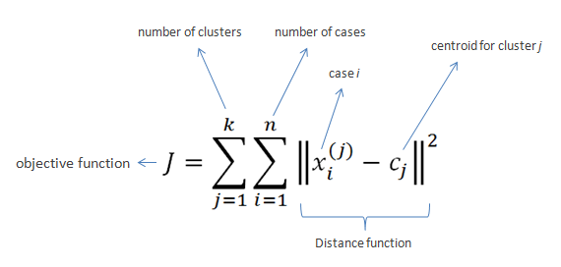
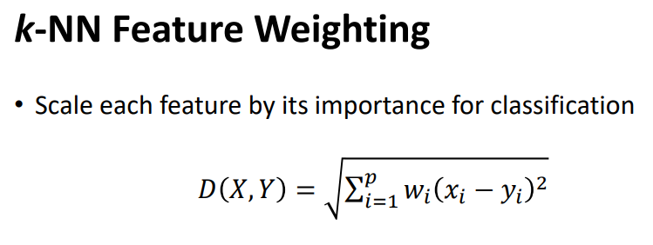
K-P means Formula (K-means + application of k-NN weighting )

Slide 5

Result of KP-means algorithm (Real case)
Original image
KP-means result
VS

Slide 6
Original
K-means
KP-means

Slide 7
Discussion
K 설정
K를 늘렸을떄 나오는 결과 값 비교

Slide 8
Discussion
2. Converge problem
도형이던 뭐든 만들기

Slide 9
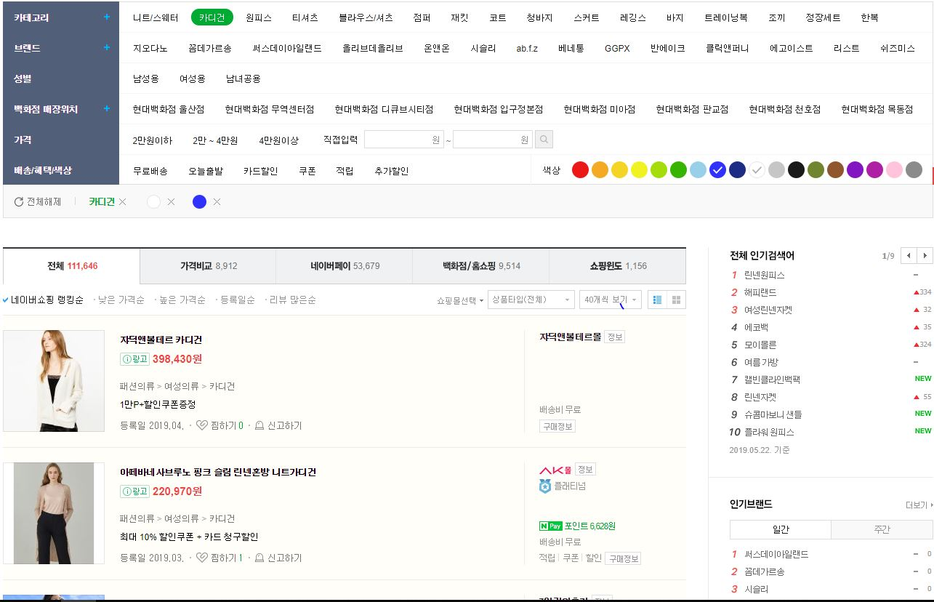
Application (Naver Shopping)

