Slide 1
외국어 시험 대체 강좌 – 시사영어
Current English

Slide 2

Table of Contents
경제
복지 / 빈부격차 / 물가
Key Expressions
Word List
Grammar: 수동태

Slide 3
02
경제
복지 / 빈부격차 / 물가

Slide 4

1. Key Expressions
[복지]
004 | A | The government should provide free school lunches to public school students across the board.
 | B | I don’t agree with that idea. Free school lunches should be selectively provided only to students from low families, rather than across the board.
 | Simple | Free school lunches should be indiscriminately provided to all the students.
 | Upgrade | Free school lunches should be provided to all the students across the board.
005 | A | I support the new government’s tax cut plans. They will help the poor through a trickle-down effect.
 | B | There’s no empirical evidence that tax cuts actually benefit the poor.
 | Simple | The tax cut will help the poor through spreading wealth from the rich to the poor.
 | Upgrade | The tax cut will help the poor through a trickle-down effect.
the + poor 가난한 사람들 / the + rich 부유한 사람들

Slide 5
1. Key Expressions
[복지]
006 | A | There needs to be some way to prevent people from abusing our welfare system.
 | B | There are individuals who leech on them. They take away the benefits from those who are really in need.
 | Simple | We should prevent people from illegally taking advantage of our welfare system.
 | Upgrade | We should prevent people from abusing our welfare system.

Slide 6
1. Key Expressions
[빈부격차]
007 | A | The disparity between the rich and the poor has been increasing over the past decade.
 | B | I know. The real problem is we don’t have any powerful countermeasures in our hands.
 | Simple | Rich people have become richer while poor people have become poorer.
 | Upgrade | The disparity between the rich and poor has been increasing.
008 | A | While Korea’s conglomerates enjoy the record profits, the middle class is being wiped out.
 | B | I don’t know when this problem of economic polarization will ever be resolved.
 | Simple | The middle class disappears.
 | Upgrade | The middle class is being wiped out.
disparity between = gap between

Slide 7
1. Key Expressions
[빈부격차]
009 | A | It’s difficult to live on the current minimum wage. One cannot maintain a livelihood with the present amount.
 | B | But a sharp increase in the amount would ultimately be a blow to small business owners.
 | Simple | It’s difficult to make a living with the current minimum wage.
 | Upgrade | It’s difficult to live on the current minimum wage.

Slide 8
1. Key Expressions
[물가]
010 | A | I went to a supermarket today and almost had a price shock.
 | B | The economy is slow, but prices for groceries and basic necessities are rising.
 | Simple | I was surprised to see how much prices have increased.
 | Upgrade | I had a price shock.
011 | A | I don’t understand how these stores can be allowed to make their products so expensive.
 | B | If there were stronger regulations on price gouging, we wouldn’t have this problem.
 | Simple | We need stronger regulations on unfair price increase.
 | Upgrade | We need stronger regulations on price gouging.
price shock = sticker shock

Slide 9
1. Key Expressions
[물가]
012 | A | My energy bills have almost doubled in amount since last year.
 | B | We have a right to basic necessities, so these companies are completely immoral for that.
 | Simple | We have a right to consume what is necessary for a living.
 | Upgrade | We have a right to basic necessities.
basic necessities = bare necessities

Slide 10
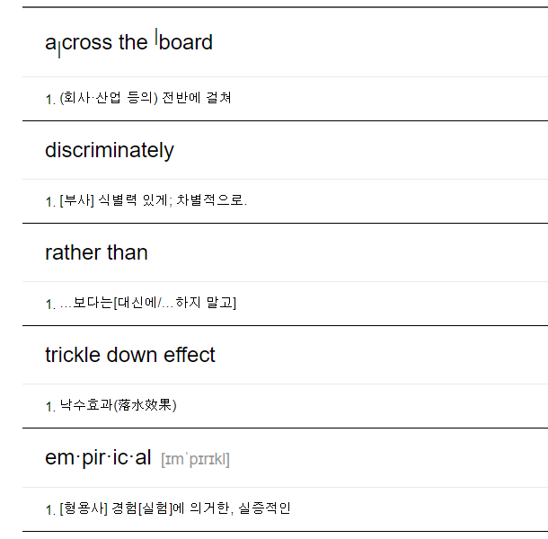
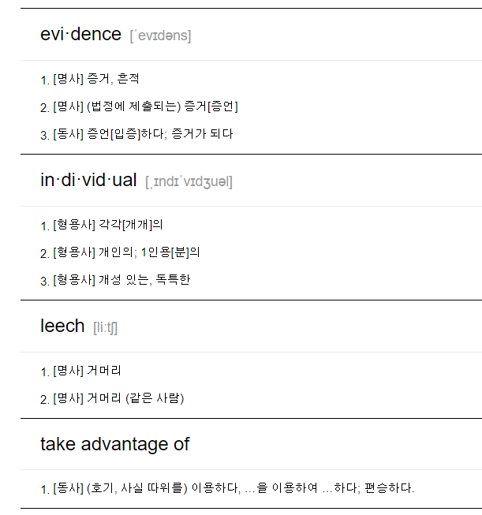
2. Word List

Slide 11
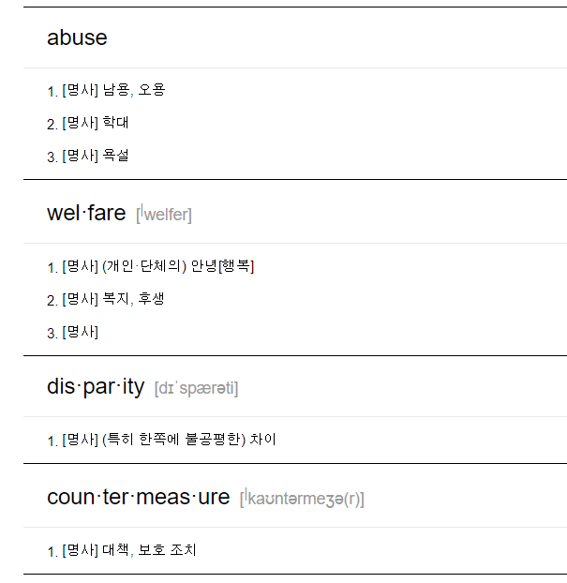
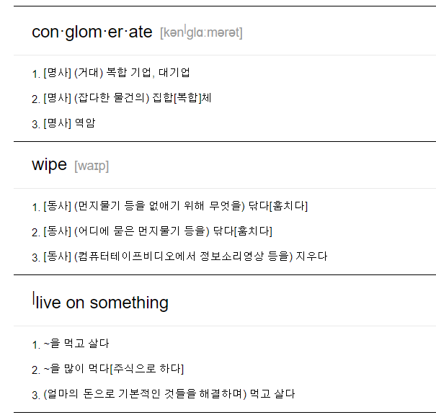
2. Word List

Slide 12
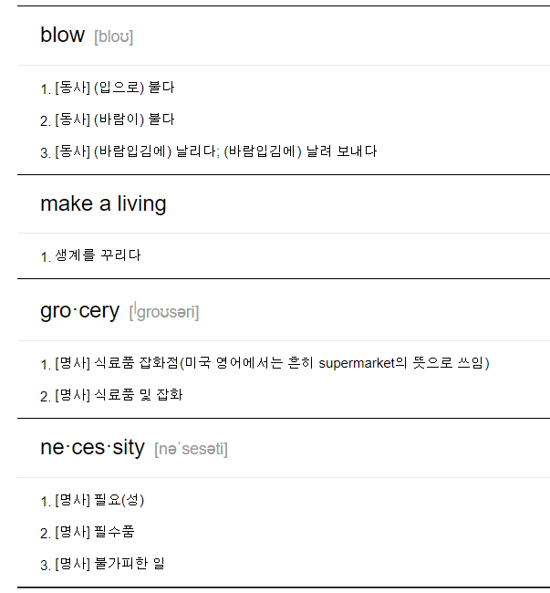
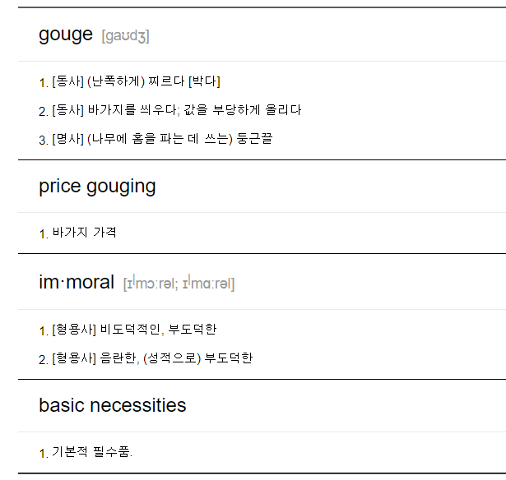
2. Word List

Slide 13
3. Grammar: 수동태
Free school lunches should be selectively provided only to student from low income families.
Free school lunches should be indiscriminately provided to all the students.
Free school lunches should be provided to all the students across the board.
수동태를 쓰는 이유
Rome was not built in a day. 로마는 하루 아침에 만들어지지 않았다.
→ 동사(build)의 주체를 특정하기가 힘듬 대상(Rome)을 주어로 수동태
English is spoken all over the world. 영어는 전 세계에서 사용된다.
→ 동사(speak)의 주체를 특정하기가 힘듬 대상(English)을 주어로 수동태
More than 96% of the world's annual rice crop is produced in the Far East. 전 세계 연간 벼의 96% 이상이 극동 지역에서 생산된다.
→ 동사(produce)의 주체를 특정하기가 힘듬 대상(More than 96% of the world's annual rice crop)을 주어로 수동태
Investigators discovered that a window had been broken from the outside. 수사관들은 외부에서 창문이 깨진 것을 발견했다.
→ 동사(break)의 주체를 모름 대상(a window)을 주어로 수동태

Slide 14

3. Grammar: 수동태
수동태를 쓰는 이유
The event will be held at the stadium. 행사는 경기장에서 진행될 것입니다.
→ 동사(hold)의 주체 보다는 대상이 중요 대상(The event)을 주어로 수동태
A mistake has been made. 착오가 있었다.
→ 동사(made)의 주체를 알지만 말하고 싶지 않음 대상(A mistake)을 주어로 수동태
위 문장을 능동태로 바꾸면 다음과 같습니다.
You have made a mistake. 당신은 실수를 했다.
→ 동사의 주체(You)가 주어 능동태
실수를 한 당사자를 지목하지 않기 위해서 수동태로 쓰면서 by + 동사의 주체를 생략하는 경우가 많습니다.
https://www.englishcube.net/grammar_exam.php?category2=41

Slide 15
3. Grammar: 수동태
수동태가 불가능한 동사
수동태는 동사의 대상이 주어가 되는 문장입니다. 동사의 대상이란 능동태에서 목적어를 말하는 것입니다.
능동태: 주어(주체) + 동사 + 목적어(대상)
수동태: 주어(대상) + be+ PP
→ 능동태에서 목적어가 없는 문장은 수동태로 바꿀 수 없습니다.
1형식 | 주어, 동사 수동태 불가
2형식 | 주어, 동사, 보어 수동태 불가
3형식 | 주어, 동사, 목적어
4형식 | 주어, 동사, 목적어, 목적어
5형식 | 주어, 동사, 목적어, 보어

Slide 16
3. Grammar: 수동태
수동태가 불가능한 동사
The hotel stands on the beach.
→ 주어(The hotel) + 동사(stands) + 수식어(on the beach) 1형식 수동태 불가
The accident happened close to the junction. The accident was happened close to the junction. 사고는 교차로 근처에서 발생했다.
→ 주어(The accident) + 동사(happened) + 수식어(close to the junction) 1형식 수동태 불가
The metal frame remained after the fire. The metal frame was remained after the fire. 화재 후 금속 프레임은 남아있었다.
→ 주어(The metal frame) + 동사(remained) + 수식어(after the fire) 1형식 수동태 불가
Then he disappeared behind the crowd. Then he was disappeared behind the crowd. 그런 다음 그는 군중 뒤로 사라졌다.
→ 주어(he) + 동사(disappeared) + 수식어(behind the crowd) 1형식 수동태 불가

Slide 17
3. Grammar: 수동태
수동태가 불가능한 동사
A minute later, she appeared around the corner with a wooden tray. A minute later, she was appeared around the corner with a wooden tray. 잠시 후, 그녀는 나무 쟁반을 들고 모퉁이를 돌면서 나타났다.
→ 주어(she) + 동사(appeared) + 수식어(around the corner with a wooden tray) 1형식 수동태 불가
아래와 같은 경우는 전치사와 함께 의미를 구성하는 구동사이지만 위와 같은 선상에서 이해하기 위해서 형식을 나눠 보겠습니다.
The group consists of a comedian, singers and actors. The group is consisted of a comedian, singers and actors. 그 그룹은 코미디언, 가수 및 배우로 구성되어 있다.
→ 주어(The group) + 동사(consists) + 수식어(of a comedian, singers and actors) 1형식 수동태 불가
The blue coat belongs to her. The blue coat is belonged to her. 푸른 코트는 그녀의 것이다.
→ 주어(The blue coat) + 동사(belongs) + 수식어(to her) 1형식 수동태 불가
He seems very quiet. He is seemed very quiet. 그는 매우 조용한 것 같다.
→ 주어(He) + 동사(seems) + 보어(very quiet) 2형식 수동태 불가

Slide 18
3. Grammar: 수동태
수동태가 불가능한 타동사
resemble (vt.): 닮다, 비슷하다
He resembles his father. He is resembled his father. His father is resembled by him. 그는 아빠를 닮았다.
→ 타동사이기는 하나 의미적으로 연결동사(2형식)와 유사 수동태 불가
become(vt.) 어울리다, 보기 좋다
This color really becomes you. This color is really become you. You are really become this color. 이 색은 정말 너한테 잘 어울려.
→ 타동사이기는 하나 의미적으로 연결동사(2형식)와 유사 수동태 불가
https://www.englishcube.net/grammar_exam.php?category2=46

