Slide 1
외국어시험 대체강좌 – 시사영어
Current English

Slide 2

Table of Contents
경제
나랏돈, 세금 / 청년실업 / 대기업
Key Expressions
Word List
Grammar: 수동태

Slide 3
03
경제
나랏돈, 세금 / 청년실업 / 대기업

Slide 4

1. Key Expressions
[나랏돈, 세금]
013 | A | It seems the government keeps adding new welfare programs, despite the recent tax cuts.
 | B | It won’t be long before all this spending empties out our national coffers.
 | 나랏돈을 다 탕진한다고 할 때
 | Simple | This spending will use up all of our nation’s money.
 | Upgrade | This spending will empty out our national coffers.
014 | A | Do you really think that more welfare without a tax hike is possible?
 | B | For the most part, yes. We can save a lot of money just by streamlining government expenditure.
 | 지출을 합리화한다고 할 때
 | Simple | We can save a lot of money just by saving government expenditure.
 | Upgrade | We can save a lot of money just by streamlining government expenditure.

Slide 5
1. Key Expressions
[나랏돈, 세금]
015 | A | Did you hear about those useless construction projects by the government that waste taxpayers’ money?
 | B | The government is diminishing the soundness of the national budget by doing that
 | 재무 건정성을 말할 때
 | Simple | The government is poorly managing the national budget.
 | Upgrade | The government is diminishing the soundness of the national budget.
016 | A | I don’t think individuals in the highest income bracket are paying the fair share of tax
 | B | It’s not just those in the highest income bracket. We have tax evasion issues with people from every walk of life.
 | 고소득층을 말할 때
 | Simple | People who make more money are not paying the fair share of taxes.
 | Upgrade | Individuals in the highest income bracket are not paying the fair share of taxes.
* bracket: 꺽쇠 괄호[ ], 구간

Slide 6
1. Key Expressions
[나랏돈, 세금]
017 | A | The public wants the government to improve our quality of life, but no one wants to pay for it.
 | B | The tax resistance we see is only there because our cost of living is already so high.
 | 조세 저항을 말할 때
 | Simple | Many people oppose to tax increase because our cost of living is already so high.
 | Upgrade | The tax resistance is there because our cost of living is already so high.
018 | A | If we reduce taxes on large corporations, they’ll be inclined to invest more in the economy.
 | B | Just because we give tax breaks doesn’t mean the money saved will be invested in new opportunities.
 | 세금혜택을 준다고 할 때
 | Simple | If we cut tax for large corporations, the money saved will be spent elsewhere.
 | Upgrade | If we give tax breaks to large corporations, the money saved will be spent elsewhere.
* tax breaks, tax benefits, tax credits: 조세 혜택

Slide 7
1. Key Expressions
[청년실업]
019 | A | The unemployment rate among people in their 20s and 30s is at its highest.
 | B | The jobs available for those fresh out of college are very limited.
 | 대학을 갓 졸업한 구직자를 말할 때
 | Simple | The jobs available for those who have just graduated from college are very limited.
 | Upgrade | The jobs available for those fresh out of college are very limited.
020 | A | Many young people are having trouble finding jobs, even if they’re highly skilled.
 | B | We’d better act fast, or we’ll end up having a lost generation from all these problems.
 | 청년실업으로 고생하는 세대를 말할 때
 | Simple | We’ll end up having a generation suffering from unemployment.
 | Upgrade | We’ll end up having a lost generation.

Slide 8
1. Key Expressions
[청년실업]
021 | A | Promoting the growth of the service industry could be one way to create jobs for youth.
 | B | Yeah, I agree. The government should do everything it can to help bring jobs to the younger generation.
 | 특정 산업을 육성한다고 할 때
 | Simple | Helping the service industry grow could be one way to create jobs.
 | Upgrade | Promoting the growth of the service industry could be one way to create jobs.
* promote 성장, 발전을 촉진하다 (=encourage, foster)

Slide 9
1. Key Expressions
[대기업]
022 | A | Chaebol’s reckless business expansion and unfair business practices were the reasons for Korea’s financial crisis in 1997.
 | B | I hope Korea’s large corporations have done away with all those old practices.
 | 재벌의 사업 확장을 말할 때
 | Simple | Chaebol’s careless business expansion was one of the reasons for the financial crisis.
 | Upgrade | Chaebol’s reckless business expansion was one of the reasons for the financial crisis.
023 | A | The Korean conglomerates have a very strong grip on the domestic market. I don’t think they’re ever going to fail at anything they do.
 | B | That’s why we need to open up the market to many foreign companies. The only way to break the too-big-to-fail myth is through competition.
 | 기업이 망하지 않을 거라고 할 때
 | Simple | The Korean conglomerates are so big that they aren’t going to go bankrupt.
 | Upgrade | The Korean conglomerates are too big to fail.

Slide 10
1. Key Expressions
[대기업]
024 | A | Why are hypermarkets closed every other Sunday in Korea?
 | B | The policy was put in place to help mom-and-pop stores that have been hit hard by large corporate retailers.
 | 골목상권을 말할 때
 | Simple | Small business have been hit hard by large corporate retailers.
 | Upgrade | Mom-and-pop stores have been hit hard by large corporate retailers.
025 | A | Consumers are pledging to boycott the company’s products following news reports that disclosed its illegal business activities.
 | B | I think the company deserves it. We should take this opportunity to root out such unfair business practices.
 | 불매운동을 벌인다고 할 때
 | Simple | Consumers are staging a campaign to stop buying the company’s products.
 | Upgrade | Consumers are pledging to boycott the company’s products.

Slide 11
1. Key Expressions
[대기업]
026 | A | The company once again resorted to strong-arm tactics when selling its products to the franchises.
 | B | They should be punished severely this time so that similar unfair practices are never repeated.
 | 강압적인 방식을 말할 때
 | Simple | The company once again resorted to threats or violence.
 | Upgrade | The company once again resorted to strong-arm tactics.
027 | A | Chaebols have their hands in every facet of Korean society. The government should expand the scope of industries that chaebols are banned from entering.
 | B | I agree. If those corner stores are all dominated by big business, those small-sized store owners will have nowhere to go.
 | 손을 대다라고 할 때
 | Simple | Chaebols are doing business in every sector.
 | Upgrade | Chaebols have their hands in every sector.

Slide 12
1. Key Expressions
[대기업]
028 | A | The large corporations are the reason for every problem we have in society.
 | B | If you keep demonizing them, you’ll never be able to address the underlying issues.
 | 지나치게 매도한다고 할 때
 | Simple | Stop describing large corporations too negatively.
 | Upgrade | Stop demonizing large corporations.
029 | A | It’s been twenty years already since the 1997 financial crisis. I think Korea’s economic system has gone through fundamental change over these past years.
 | B | Well, there hasn’t seemed to be much change in the way these conglomerates establish cozy ties with politicians.
 | 정경유착을 말할 때
 | Simple | Conglomerates set up close relationship with politicians
 | Upgrade | Conglomerates establish cozy tie with politicians.
* demonize 악마로 만들다, 악마로 묘사한다 (= vilify)

Slide 13
1. Key Expressions
[대기업]
030 | A | What should we do to prevent bribery cases involving politicians and large business owners?
 | B | Many people say we need more transparent corporate governance and more advanced corporate management.
 | 투명한 기업 지배구조를 말할 때
 | Simple | Korean companies should be directed and controlled more transparently.
 | Upgrade | Korean companies need more transparent corporate governance.

Slide 14
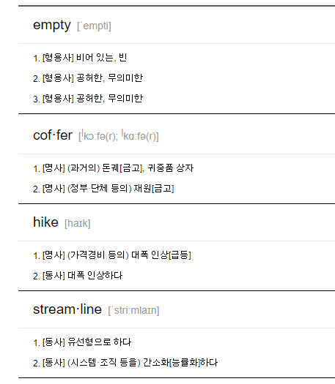
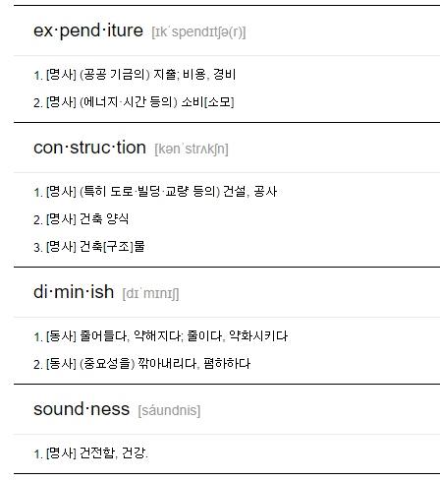
2. Word List

Slide 15
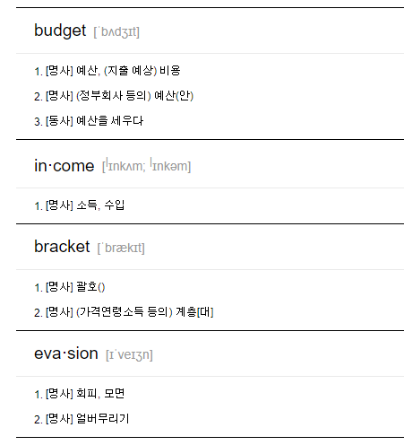
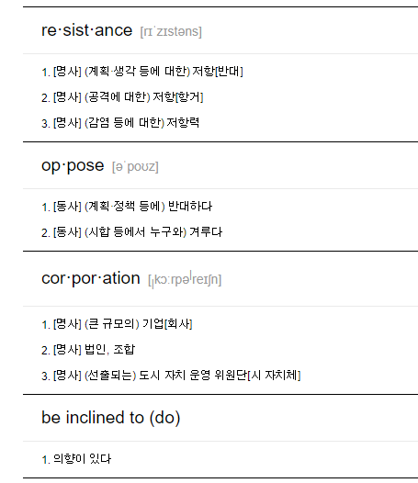
2. Word List

Slide 16
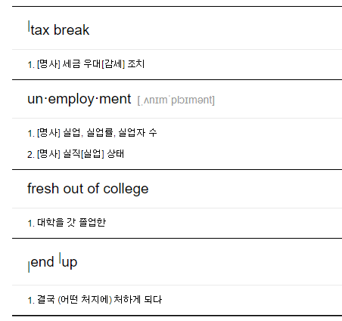
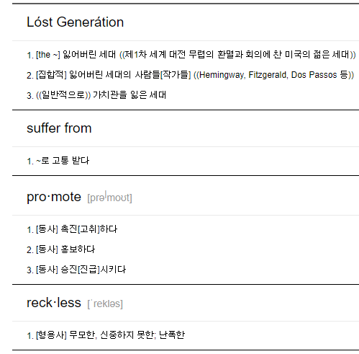
2. Word List

Slide 17
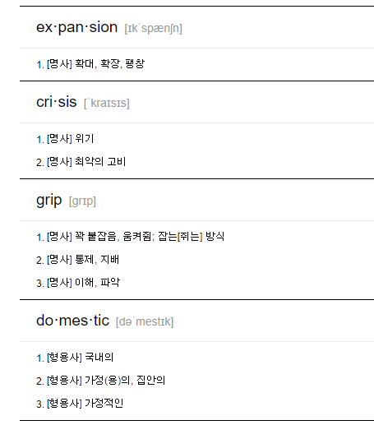
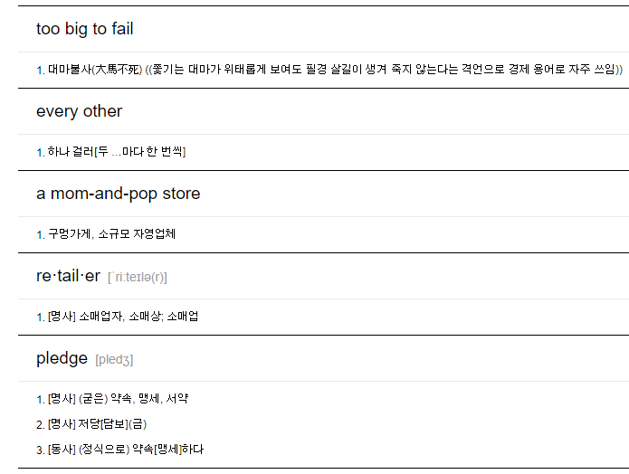
2. Word List

Slide 18
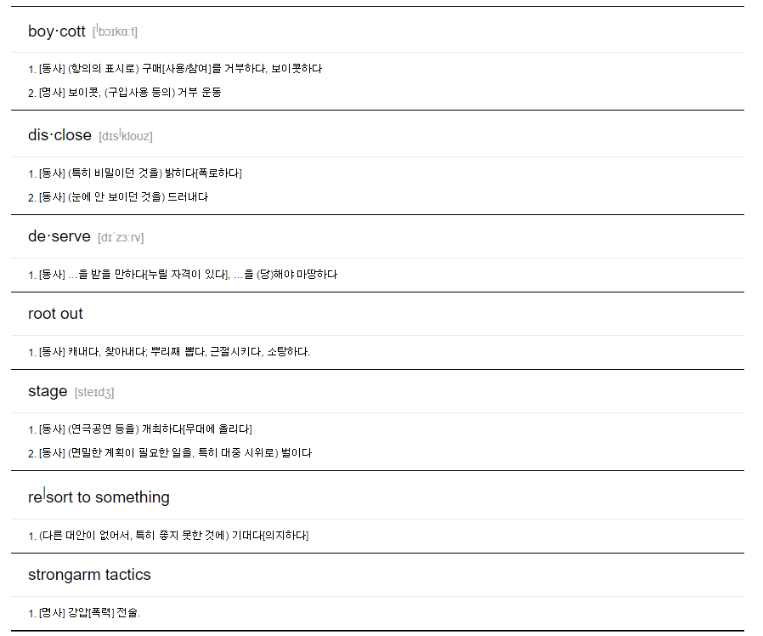
2. Word List

Slide 19
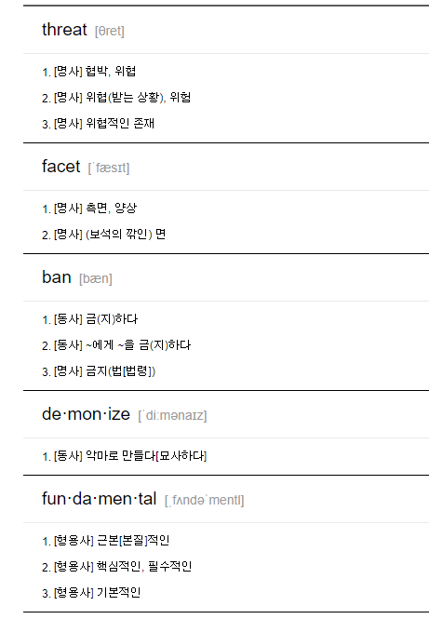
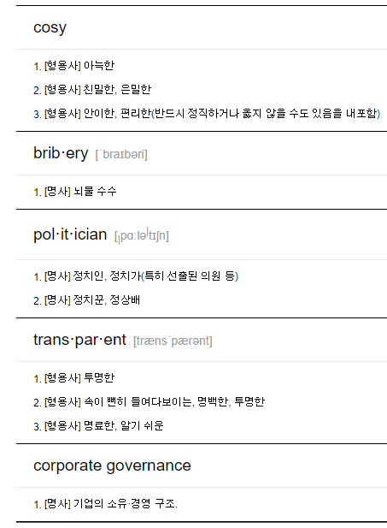
2. Word List

Slide 20
3. Grammar: 동명사
It seems the government keeps adding new welfare programs, despite the recent tax cuts.
This spending will use up all of our nation’s money.
This spending will empty out our national coffers.
We can save a lot of money just by saving government expenditure.
We can save a lot of money just by streamlining government expenditure.
We’ll end up having a generation suffering from unemployment.
We’ll end up having a lost generation.
Helping the service industry grow could be one way to create jobs.
Promoting the growth of the service industry could be one way to create jobs.
If you keep demonizing them, you’ll never be able to address the underlying issues.
Stop describing large corporations too negatively.
Stop demonizing large corporations.

Slide 21
3. Grammar: 동명사
동명사의 역할
(1) 주어
Running is the easiest way to lose weight.
달리기는 살을 빼는 가장 손쉬운 방법이다.
→ 주어(Running) + 동사(is) + 보어(the easiest way) + 수식어(to lose weight)
Writing a novel was one of my life goals. 소설을 쓰는 것은 내 인생 목표 중 하나였다.
→ 주어(Writing a novel) + 동사(was) + 보어(one of my life goals)

Slide 22
3. Grammar: 동명사
동명사의 역할
(2) 목적어
I like fishing and hunting 나는 낚시와 사냥을 좋아한다.
→ 주어(I) + 동사(like) + 목적어(fishing and hunting)
She enjoys cooking dinner for her family. 그녀는 가족을 위해 저녁을 요리하는 것을 즐긴다.
→ 주어(She) + 동사(enjoys) + 목적어(cooking dinner) + 수식어(for her family)
to부정사는 동사의 목적어만 가능하지만, 동명사는 동사 뿐 아니라 전치사의 목적어도 가능합니다.
He is good at singing. 그는 노래를 잘한다.
→ 주어(He) + 동사(is) + 보어(good) + 수식어(at singing)
→ 전치사(at) + 전치사의 목적어(singing)
She left without saying goodbye. 그녀는 작별 인사도 없이 떠났다.
→ 주어(She) + 동사(left) + 수식어(without saying goodbye)
→ 전치사(without) + 전치사의 목적어(saying goodbye)

Slide 23
3. Grammar: 동명사
동명사의 역할
(3) 보어
My hobby is listening to music. 내 취미는 음악 감상이다.
→ 주어(My hobby) + 동사(is) + 보어(listening to music)
One of his responsibilities is attending meetings​. 그의 책임 중 하나는 회의에 참석하는 것이다.
→ 주어(One of his responsibilities) + 동사(is) + 보어(attending meetings)
https://www.englishcube.net/grammar_exam.php?category2=41

Slide 24

3. Grammar: 동명사
동명사의 특성
(1) 동명사는 명사 역할을 하지만 명사와 달리 동사처럼 목적어와 보어를 취할 수 있습니다.
I like reading a detective story. 나는 탐정 소설 읽는 것을 좋아해.
→ 주어(I) + 동사(like) + 목적어(reading a detective story)
→ 목적어(reading a detective story): 동명사(reading) + 동명사의 목적어(a detective story)
Being a nurse is very rewarding. 간호사가 되는 것은 매우 보람 있는 일이다.
→ 주어(Being a nurse) + 동사(is) + 보어(very rewarding)
→ 주어(Being a nurse): 동명사(Being) + 동명사의 보어(a nurse)
(2) 명사는 부사의 수식을 받지 못하지만, 동명사는 동사의 성격이 있기 때문에 부사의 수식을 받을 수 있습니다.
Running slowly is the best way to build endurance, which you need to run long distances.
천천히 달리는 것은 장거리를 달리는 데 필요한 지구력을 기르는 가장 좋은 방법이다.
→ 주어(Running slowly) + 동사(is) + 보어(the best way to build endurance)
→ 동명사(Running) + 동명사 수식 부사(slowly)
We will get back to you after carefully reviewing your proposal. 당신의 제안을 신중하게 검토한 후 다시 연락 드리겠습니다.
→ 주어(We) + 동사(will get back) + 수식어(to you) + 수식어(after carefully reviewing your proposal)
→ 동명사 수식 부사(carefully) + 동명사(reviewing)
https://www.englishcube.net/grammar_exam.php?category2=122

Slide 25
3. Grammar: 동명사와 To부정사
to부정사 명사, 형용사, 부사
동명사 명사, 형용사, 부사
→to부정사와 동명사의 공통점은 둘 다 명사 역할을 할 수 있다는 점입니다.
I like to cook. = I like cooking. 나는 요리하는 것을 좋아한다.
동명사와 to부정사의 의미상 차이
일반적으로 미래의 일이나 구체적인 행위를 표현할 때는 부정사를 사용하고 과거의 일이나 일상적, 반복적인 일에는 동명사를 사용합니다.
→ 동명사 : 동사 + ing 명사처럼 사용 과거, 반복적
→ to 부정사 : to + 동사 명사처럼 사용 미래, 구체적(1회적)
To sell my old car was hard. 나의 헌차를 팔기가 어려웠다.
→ 나의 헌차를 파는 일, 구체적인 일, 1회적인 일, to 부정사(To sell )
Selling insurance is hard work. 보험을 파는 것은 어려운 일이다.
→ 보험을 파는 일 반복적인 일 동명사(Selling)
My wish is to transfer to Korea University. 내 소망은 고려대로 편입하는 것이다.
→ 편입하는 일, 구체적인 일, 1회적인 일 to 부정사(to transfer)
Her hobby is collecting foreign coins. 그녀의 취미는 외국 동전 모으기이다.
→ 동전 모으기, 반복적인 일, 동명사(collecting)

Slide 26
3. Grammar: 동명사와 To부정사
동사의 목적어로 사용되는 경우
to부정사와 동명사는 명사 역할을 할 수 있으므로 당연히 목적어로 가능합니다.
하지만 모든 동사가 이 둘을 목적어로 다 사용하지는 않습니다.
동사에 따라서 둘 중 "to부정사만" 또는 "동명사만" 목적어로 취하는 동사도 있습니다.
둘 다 가능한 경우도 있고, 이때 의미가 달라지는 경우도 있습니다.
즉 아래와 같이 4가지 경우로 정리할 수 있습니다.
(1) to부정사만 가능
(2) 동명사만 가능
(3) 둘 다 가능
1) 의미가 동일
2) 의미가 다름

Slide 27
3. Grammar: 동명사와 To부정사
동명사만 목적어로 취할 수 있는 동사
admit(인정하다), avoid(피하다), deny(부인하다), dislike(싫어하다), enjoy(즐기다), finish(끝내다), give up(포기하다), keep(계속 ~하다), mind(꺼리다), recommend(추천하다), suggest(제안하다), stop(멈추다) 등
위 동사들은 주로 소극적, 과거지향적(반복적)인 의미를 가지고 있습니다.
He admits having done it himself. 그는 자신이 직접 그것을 했다는 것을 인정한다.
→ 주어(He) + 동사(admits) + 목적어(having done it himself)
I could not avoid saying so. 나는 그렇게 말하지 않을 수 없었다.
→ 주어(I) + 동사(could not avoid) + 목적어(saying so)
She denied having been there at the time. 그녀는 당시 그곳에 있었다는 사실을 부인했다.
→ 주어(She) + 동사(denied) + 목적어(having been there at the time)
I dislike wasting my time on trivial matters. 나는 사소한 일에 시간을 낭비하는 것을 싫어한다.
→ 주어(I) + 동사(dislike) + 목적어(wasting my time) + 수식어(on trivial matters)
She enjoys playing squash with her husband. 그녀는 남편과 스쿼시를 즐긴다.
→ 주어(She) + 동사(enjoys) + 목적어(playing squash with her husband)

Slide 28
3. Grammar: 동명사와 To부정사
동명사만 목적어로 취할 수 있는 동사
He finished doing his homework. 그는 숙제를 끝냈다.
→ 주어(He) + 동사(finished) + 목적어(doing his homework)
The investment bank has given up trying to find a buyer. 투자 은행은 구매자를 찾는 것을 포기했다.
→ 주어(The investment bank) + 동사(has given up) + 목적어(trying to find a buyer)
I suggested going for a walk in the park before dinner. 나는 저녁 식사 전에 공원에 산책 가자고 제안했다.
→ 주어(I) + 동사(suggested) + 목적어(going for a walk ) + 수식어(in the park before dinner)
Please stop calling me. 나한테 전화하는 걸 중단해 주세요.
→ 동사(stop) + 목적어(calling me)
The bus stopped to pick up the children. 버스는 아이들을 태우기 위해 멈췄다.
→ 주어(The bus) + 동사(stopped) + 수식어(to pick up the children)
→ stop 다음의 to부정사는 목적어가 아닌 수식어(부사구)
https://www.englishcube.net/grammar_exam.php?category2=123

