Slide 1
외국어시험 대체 강좌 – 시사영어
Current English
15

Slide 2

Table of Contents
문화 과학
연예인/ SNS / 자율주행차/생명과학/인공지능
Key Expressions
Wordlist
Grammar
3.1 부정 대명사 Some, any

Slide 3
15
문화, 과학
연예인/ SNS / 자율주행차/생명과학/인공지능

Slide 4
1. Key Expressions
[연예인]
187 | A | Kim was caught drunk driving again and now it’s all over the media.
 | B | Celebrities are always in the public eye. They have to learn how to behave, or face the consequences.
 | 대중의 시선을 받는다고 할 때
 | Simple | The public always pay attention to celebrities.
 | Upgrade | Celebrities are always in the public eye.
188 | A | What do you think about celebrities who are outspoken on political issues?
 | B | I think they have to be careful as their voices carry more weight. Young fans can be easily swayed by the opinions of their idols.
 | 더 큰 영향력을 발휘한다고 할 때
 | Simple | Voices of celebrities can be more influential.
 | Upgrade | Voices of celebrities can carry more weight.

Slide 5
1. Key Expressions
[연예인]
189 | A | If you were to become a celebrity, would you try to be neutral on social issues or rather be politically involved?
 | B | I’d be politically involved, for sure. Entertainers have the right to say what they think is right or wrong.
 | 정치적으로 행동한다고 할 때
 | Simple | Would you try to be neutral on social issues or rather be actively interested in politics?
 | Upgrade | Would you try to be neutral on social issues or rather be politically involved?
190 | A | I suspect that some celebrities want to be socially aware simply to keep the spotlight on themselves.
 | B | Wouldn’t it be easier for them to stay neutral than to speak out? Let’s give them the benefit of the doubt.
 | 주목을 받는다고 할 때
 | Simple | Some celebrities want to be socially aware simply to receive public attention.
 | Upgrade | Some celebrities want to be socially aware simply to keep the spotlight on themselves.

Slide 6
1. Key Expressions
[연예인]
191 | A | I can’t understand Kim. He doesn’t seem to discern when to come forth and when to lay low.
 | B | Yeah, his arguments never sound well-thought-out. He just ends up sounding shallow.
 | 나서지 않는다고 할 때
 | Simple | He doesn’t know when to come forth and when to be quiet.
 | Upgrade | He doesn’t know when to come forth and when to be lay low.
192 | A | Don’t celebrities have an obligation to serve as an example to their young fans?
 | B | It’s hard to find a celebrity who’s both artistically inclined and well-behaved.
 | 예술가적 기질을 타고 났다고 할 때
 | Simple | It’s hard to find a celebrity who has a natural ability for art and is well-behaved.
 | Upgrade | It’s hard to find a celebrity who’s both artistically inclined and well-behaved.
* lie low 낮은 상태로 있다. 나서지 않고 조용히 지내는 모습을 표현 (원래 lie low라고 해야 옳지만 lie와 lay를 구분하지 않은 원어민들도 많아 lay low라고 쓰기도 함)

Slide 7
1. Key Expressions
[SNS]
193 | A | To avoid having my personal information seen by the world, I often clear my browsing history.
 | B | I’m afraid that doesn’t erase your digital footprint, since it’s more complicated than that.
 | 인터넷에서 남긴 기록을 없앤다고 할 때
 | Simple | I’m afraid that doesn’t erase your trace on the Internet.
 | Upgrade | I’m afraid that doesn’t erase your digital footprint.
194 | A | These days, I get information more from Facebook than any other media outlet.
 | B | Much of the information on Facebook is sensationalized beyond reality. You have to be careful.
 | 과장되어 있다고 할 때
 | Simple | Much of the information on Facebook is exaggerated.
 | Upgrade | Much of the information on Facebook is sensationalized.

Slide 8
1. Key Expressions
[SNS]
195 | A | The penetration rate of Cocoa Talk in the Korean market is over 90 percent. How can you not use it?
 | B | See. That’s a sign that we’re living in an era of oversharing. I have no problem not using it.
 | 정보를 지나치게 공유한다고 할 때
 | Simple | We share too much of our information with each other.
 | Upgrade | We’re living in an era of oversharing.

Slide 9
1. Key Expressions
[자율주행차]
196 | A | People say that self-driving cars will be in high demand, but I’m too afraid to entrust my safety to them.
 | B | Regardless of what kind of concerns you have, I think the day of humans taking their hands off the steering wheel will eventually come.
 | 인간이 자동차를 운전하지 않는다고 할 때
 | Simple | The day of humans not driving cars will eventually come.
 | Upgrade | The day of humans taking their hands off the steering wheel will eventually come.
197 | A | Do you think the era is just around the corner when humans don’t drive cars anymore?
 | B | Because of a liability issue about accidents, I don’t think the technology will be fully commercialized any time soon.
 | 사고의 법적인 책임을 말할 때
 | Simple | Because of a responsibility issue about accidents, the technology won’t be fully commercialized.
 | Upgrade | Because of a liability issue about accidents, the technology won’t be fully commercialized.

Slide 10
1. Key Expressions
[자율주행차]
198 | A | Do you think the day will really come when a driver leaves everything to the car and safely goes to sleep behind the wheel?
 | B | Even if that’s possible technologically, I don’t think many people would want it. The driver and the computer should share control over the vehicle.
 | 차를 같이 콘트롤한다고 할 때
 | Simple | The driver and the computer should control the vehicle together.
 | Upgrade | The driver and the computer should share control over the vehicle.

Slide 11
1. Key Expressions
[생명과학]
199 | A | I strongly support biotechnology, including even human cloning. New advances will open many doors for patients suffering from chronic or incurable diseases.
 | B | I know these patients have high hopes, but we need to think about the ethical aspects of biotech.
 | 많은 치료 기회를 제공한다고 할 때
 | Simple | New advances will provide many opportunities for patients.
 | Upgrade | New advances will open many doors for patients.
200 | A | The day may come when a new form of genetically modified animal is born in a lab.
 | B | That’s why some fear that scientists are trying too hard to play God.
 | 신의 영역을 침범한다고 할 때
 | Simple | That’s why some fear that scientists are trying too hard to imitate the role of God.
 | Upgrade | That’s why some fear that scientists are trying too hard to play God.

Slide 12
1. Key Expressions
[생명과학]
201 | A | Terminally and chronically ill patients will be the main beneficiaries of advancing biotechnologies.
 | B | I hope those benefits are not dominated by the rich and powerful.
 | 말기 환자를 말할 때
 | Simple | Patients with incurable diseases will be the main beneficiaries of advancing biotechnologies.
 | Upgrade | Terminally ill patients will be the main beneficiaries of advancing biotechnologies.

Slide 13
1. Key Expressions
[인공지능]
202 | A | We should consider how the breakthrough of AI might bring about different ethical issues in our society.
 | B | We don’t know yet what kind of unethical behavior could be committed by AI technologies.
 | 획기적인 발전을 말할 때
 | Simple | We should consider how the advancement of AI might bring about different ethical issues.
 | Upgrade | We should consider how the breakthrough of AI might bring about different ethical issues.
203 | A | One of these days, I believe robots will enslave humans and rule the world.
 | B | That sounds straight out of a sci-fi movie, because you’re clearly not being realistic.
 | 실현 가능성이 없다고 할 때
 | Simple | That sounds unrealistic.
 | Upgrade | That sounds straight out of a sci-fi movie.

Slide 14
1. Key Expressions
[인공지능]
204 | A | AI has more pros than cons. It will definitely make our lives easier and smoother.
 | B | But what if the technology ends up in the wrong hands? It may bring destructive results. Machines should be programmed to act as human-like as possible.
 | 나쁜 목적으로 활용된다고 할 때
 | Simple | If the technology is used by bad people, it may bring destructive results.
 | Upgrade | If the technology ends up in the wrong hands, it may bring destructive results.

Slide 15
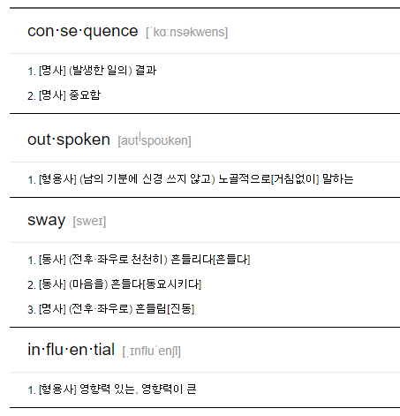
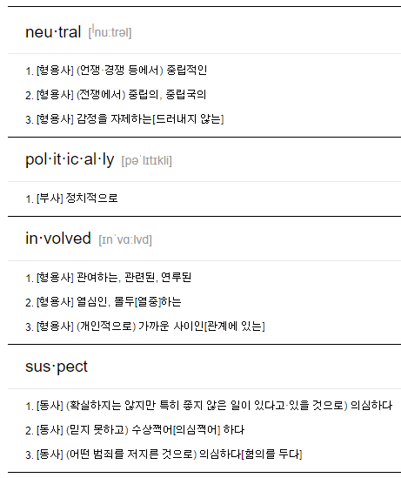
2. Word List

Slide 16
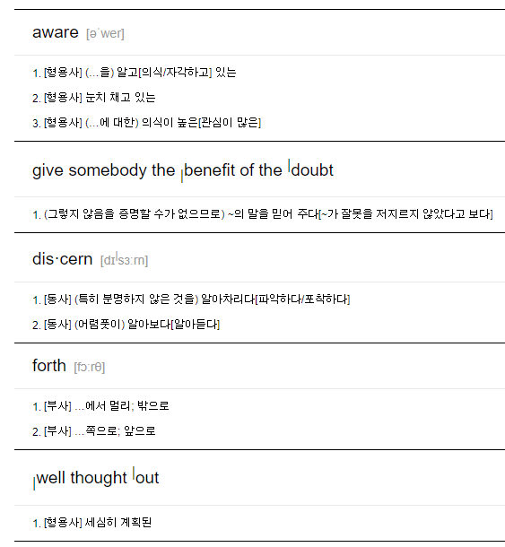
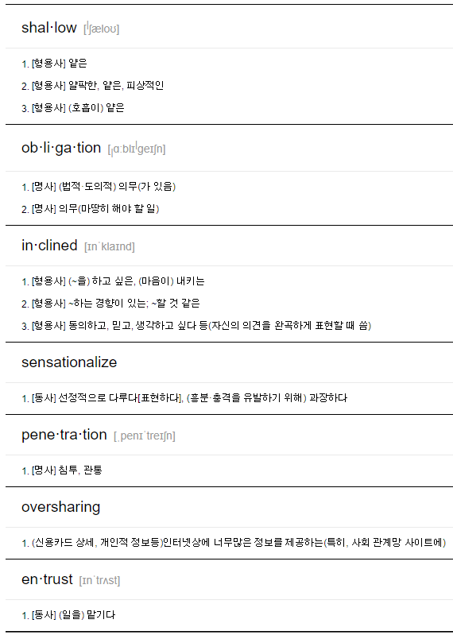
2. Word List

Slide 17
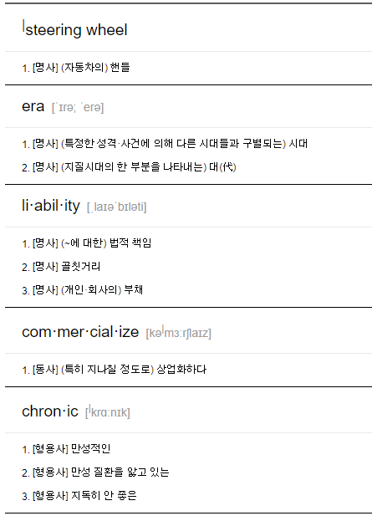
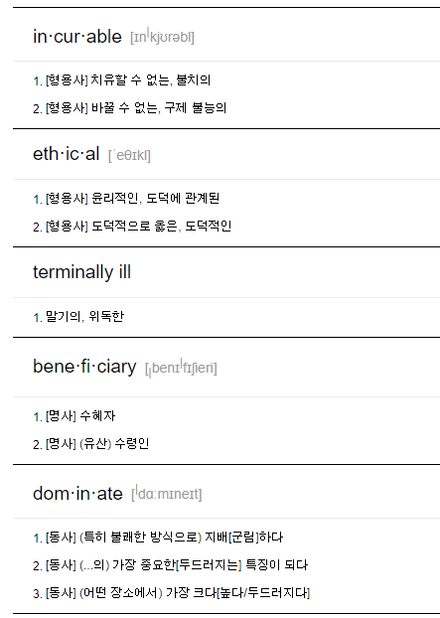
2. Word List

Slide 18
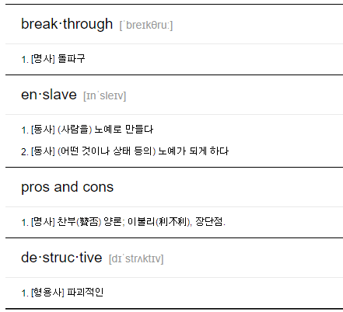
2. Word List

Slide 19
3.1 Grammar: 부정대명사 Some, Any
부정대명사(Indefinite Pronouns)란 어떤 특정한 사람이나 사물을 가리키지 않고 막연한 대상을 가리킵니다.
→ 부정(Indefinite): 정해지지 않은, 분명히 규정되지 않은, 막연한
Lucy gave me this book. 루시가 이 책을 줬다.
→ 책을 준 사람은 Lucy 명확하다(definite)
Someone gave me this book. 누군가 이 책을 줬다.
→ 책을 준 사람은 Someone 명확하지 않다(indefinite) 부정대명사(Indefinite Pronouns)
부정대명사는 아래와 같이 아주 다양합니다.
All, another, any, anybody/anyone, anything, each, everybody/everyone, everything, few, many, nobody, none, one, several, some, somebody/someone
이 중 상당수는 부정대명사로 쓸 수도 있고, 부정형용사(한정사)로 쓸 수도 있습니다. 의미는 동일하므로 부정대명사와 부정형용사(한정사) 구분 없이 설명하도록 하겠습니다.
I was just about to make some coffee. 나는 방금 막 커피 좀 끓이려고 했어요.
→ Some: 부정형용사(한정사) + 명사(coffee)
Some arrived at the camp. 일부는 캠프에 도착했다.
→ Some: 부정대명사

Slide 20
3.1 Grammar: 부정대명사 Some, Any
some과 any
some과 any의 기본적인 의미는 "조금, 약간"입니다. 적다는 의미라기 보다는, 불확실하다는 의미에 가깝습니다.
비슷하지만 some은 "조금 있다는 것을 가정할 때" 사용되며, any는 "있는지 없는지 확실하지 않을 때" 사용됩니다.
some: 긍정적, 존재할 때
any: 부정적, 존재하지 않거나 모를 때
그래서 보통 긍정문에서는 some을 사용하고, 부정문이나 의문문에서는 any를 사용합니다.

Slide 21
3.1 Grammar: 부정대명사 Some, Any
긍정문
긍정문에서 "조금, 약간"을 나타낼 때는 some을 사용합니다.
I have some money. 난 돈이 좀 있다.
→ some: 조금 있을 때
I need to buy some groceries before the store closes. 가게가 문을 닫기 전에 식료품을 좀 사야 한다.
→ some: 조금 사야 할 때
긍정문에서 "조금, 약간"을 나타낼 때 any를 사용할 수는 없습니다.
긍정문에서 any를 사용하면 "조금"이라는 의미가 아닌 "어떤 (것) 이라도"를 나타냅니다.
Any book will do. 어떤 책이라도 좋다.
→ Any: 어떤 ~ 이라도
You can choose any you like. 네가 좋아하는 어떤 것이라도 선택할 수 있다.
→ any: 어떤 것이라도

Slide 22
3.1 Grammar: 부정대명사 Some, Any
부정문
부정문에서 "조금, 약간"을 나타낼 때는 any를 사용해서 "조금의 ~도 없다"는 의미를 나타냅니다.
I couldn't find any. 나는 어떤 것도 찾을 수 없었다.
→ any: 조금의 것도(어떤 것도)
I don't have any money. 난 돈이 하나도 없다.
→ any money: 조금의 돈도
I didn't eat any food. 나는 음식을 조금도 먹지 않았다.
→ any food: 조금의 음식도
We should not make any noise in the library. 우리는 도서관에서 조금의 소음도 내지 말아야 한다.
→ any noise: 조금의 소음도

Slide 23
3.1 Grammar: 부정대명사 Some, Any
의문문
있는지 없는지 확실하지 않을 때 any를 사용된다고 했으니 의문문에서는 any를 사용합니다.
Are there any eggs? 달걀이 (조금이라도) 남아 있습니까?
→ 있는지 없는지 확실하지 않을 때 ⇒ any
Did you buy any clothes in the shop? 가게에서 옷 좀 샀어?
→ 있는지 없는지 확실하지 않을 때 ⇒ any
실제로 궁금해서 질문하는 것이 아니고 권유나 부탁할 때, 긍정적인 답변을 예상하거나 기대할 때는 some을 사용합니다.
Would you like some coffee? 커피 좀 드시겠습니까?
→ 권유 ⇒ 긍정적 답변 기대 ⇒ some
Can you give me some sugar for my coffee? 제 커피에 설탕을 좀 주시겠어요?
→ 부탁 ⇒ 긍정적 답변 기대 ⇒ some

Slide 24

3.1 Grammar: 부정대명사 Some, Any
조건문
조건문인 경우에도 "조금"을 나타낼 때는 some 보다는 any를 더 자주 씁니다.
"만약 ~이라면"의 의미이기에 통상적으로는 없을 가능성이 높기 때문입니다.
Let me know if there are any changes. 변경 사항이 있으면 알려주십시오.
→ 만약 변경이 있다면 통상적으로는 없을 가능성이 더 많음 ⇒ any
If they need any help, tell them to call me. 만약 그들이 도움이 필요하면 저에게 전화하라고 말해 주세요.
→ 만약 도움이 필요하다면 통상적으로는 없을 가능성이 더 많음 ⇒ any
https://www.englishcube.net/grammar_exam.php?category2=94

