Slide 1
외국어대체 강좌 – 시사영어
Current English
7

Slide 2

Table of Contents
사회
고령화, 저출산 / 흙수저, 금수저 / 교육
Key Expressions
Word List
Grammar:
3.1 관계대명사

Slide 3
07
사회
고령화, 저출산 / 흙수저, 금수저 / 교육

Slide 4
1. Key Expressions
[고령화, 저출산]
088 | A | Why do you think Korea’s birth rate keeps dropping?
 | B | Getting married and starting a family are too much of a financial burden, so many young people choose to live alone.
 | 경제적 부담이 된다고 할 때
 | Simple | Starting a family needs too much money.
 | Upgrade | Starting a family is too much of a financial burden.
089 | A | Youth unemployment is a major problem, and no one seems to have the solution.
 | B | Coupled with an aging workforce, I’m afraid our society is headed toward many troubles.
 | 노동인구를 말할 때
 | Simple | As the working population is growing older, our society is headed toward many troubles.
 | Upgrade | Due to an aging workforce, our society is headed toward many troubles.
* Aging workforce 노동인구가 노령화됨

Slide 5
1. Key Expressions
[고령화, 저출산]
090 | A | The demographics of Korean society are changing rapidly and many people now prefer living alone.
 | B | That’s why there’s been a change in the housing market. We have many facilities targeting those single-person households.
 | 인구 구성을 말할 때
 | Simple | The Korean society’s population structure is changing rapidly.
 | Upgrade | The demographics of Korean society are changing rapidly.

Slide 6
1. Key Expressions
[흙수저, 금수저]
091 | A | An analogy by spoon type is currently popular in Korea. Which category do you think you fall into?
 | B | I definitely wasn’t born with a good spoon, but I didn’t get a clay spoon, either.
 | 금수저 흙수저에 대해 말할 때
 | Simple | Linking economic status with a spoon type is currently popular in Korea.
 | Upgrade | An analogy by spoon type is currently popular in Korea.

Slide 7
1. Key Expressions
[흙수저, 금수저]
092 | A | A lot of young people believe that a happy life can only come from a wealthy upbringing.
 | B | That’s not always the case. Individuals should do their best to improve their own situations.
 | 부유한 환경에서 자란다고 할 때
 | Simple | A happy life can only come when one is born in a wealthy family.
 | Upgrade | A happy life can only come from a wealthy upbringing.
093 | A | When companies recruit college graduates, they should place less emphasis on fancy qualifications.
 | B | What’s important is not what certificates a person has but what he or she can really do.
 | 화려한 스펙을 말할 때
 | Simple | Companies should place less emphasis on good qualifications.
 | Upgrade | Companies should place less emphasis on fancy qualifications.

Slide 8
1. Key Expressions
[교육]
094 | A | Why is there such a strong craze over private education in Korea?
 | B | Competition for better schools and jobs is so fierce that parents have to resort to private education to get their children ahead of their peers.
 | 사교육 열풍을 말할 때
 | Simple | Why do parents depend too much on private education?
 | Upgrade | Why is there such a strong craze over private education?
095 | A | In Korea, education used to be a ladder that helped students climb their way up to higher social positions or higher income levels.
 | B | The problem now is the access to that ladder is pretty limited to those who have wealthy parents.
 | 신분 상승의 기회를 말할 때
 | Simple | Education helped students climb their way up to higher social positions.
 | Upgrade | Education used to be a ladder that helped students climb their way up to higher social positions.

Slide 9
1. Key Expressions
[교육]
096 | A | To improve the overall quality of our education, we need to set up more private schools to compete with public schools.
 | B | Aren’t you concerned that those schools only for the privileged will limit our social mobility?
 | 신분 상승의 기회를 말할 때
 | Simple | The system will prevent people from improving their social positions.
 | Upgrade | The system will limit our social mobility.
097 | A | Korean believe the college you attend will make or break your future.
 | B | I think part of the reason is our society is still very stingy in giving a second chance and puts too much focus on superficial qualifications rather than actual abilities.
 | 미래를 결정한다고 할 때
 | Simple | Korean believe the college you attend will decide your future.
 | Upgrade | Korean believe the college you attend will make or break your future.

Slide 10
1. Key Expressions
[교육]
098 | A | Why is it that parents send their children to private academies at such an early age?
 | B | With so much competition to enter the best schools, having a head start can be an advantage.
 | 남들보다 앞서 나간다고 할 때
 | Simple | Starting education ahead of other students can be an advantage.
 | Upgrade | Having a head start can be an advantage.
099 | A | Many students in Korea still have to hop around hagwons every day, even on their school breaks.
 | B | With so many “tiger mom” here, they really have no choice.
 | 교육열이 지나친 어머니를 말할 때
 | Simple | There are so many mothers in Korea who are overly enthusiastic about their children’s education.
 | Upgrade | There are so many “tiger moms” in Korea.

Slide 11
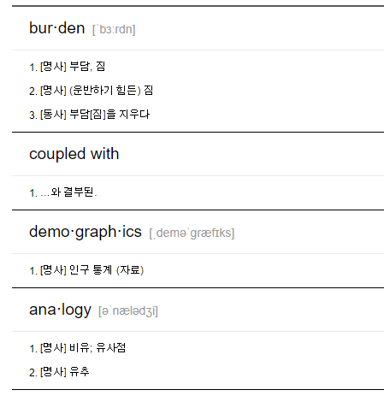
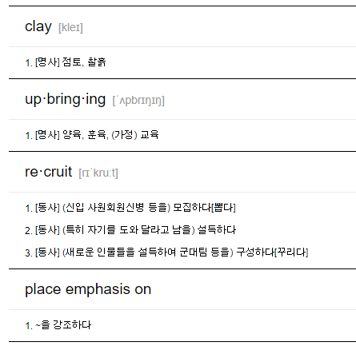
2. Word List

Slide 12
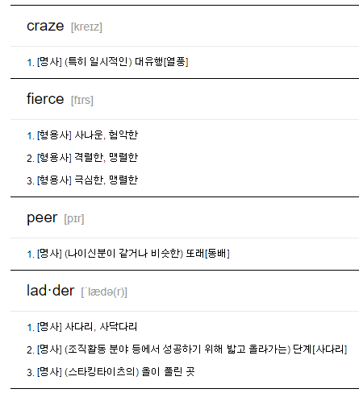
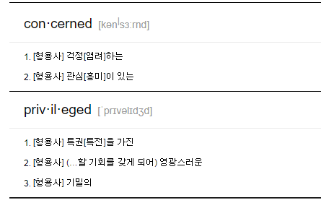
2. Word List

Slide 13
3.1 Grammar: 관계대명사 What
관계사는 일반적으로 선행사를 수식하는 형용사절을 이끕니다.
그래서 관계대명사 앞에는 항상 선행사가 위치하는데 관계대명사 what은 선행사를 포함하는 개념입니다. 선행사까지 포함하고 있기 때문에 what절이 형용사절이 아닌 명사절이 됩니다.
I haven't received what I ordered yet. 나는 주문한 것을 아직까지 받지 못하고 있다.
관계대명사 what: ~ 하는 것(the thing + which/that)
위 문장을 관계대명사(that)를 사용해서 표현하면 아래와 같습니다.
I haven't received the food that I ordered yet. 나는 주문한 음식을 아직까지 받지 못하고 있다.
즉 관계대명사 what = 선행사 + 관계대명사 이라고 표현할 수 있습니다.

Slide 14
3.1 Grammar: 관계대명사 What
명사절을 이끄는 what
보통 관계대명사 앞에는 선행사가 있고, 관계절이 이 선행사를 수식하기 때문에 관계절은 형용사절입니다.
I haven't received the food that I ordered yet. 나는 아직까지 주문한 음식을 받지 못하고 있다.
주어(I) + 동사(haven't received) + 목적어(the food) + 수식어(that I ordered) + 수식어(yet)
수식어(that I ordered): 목적어/선행사(the food)를 수식하는 형용사절
하지만 관계대명사 what은 선행사를 포함하기에 what절이 형용사절이 아닌 명사절이 되는 것입니다.
I haven't received what I ordered yet. 나는 아직까지 주문한 것을 받지 못하고 있다.
주어(I) + 동사(haven't received) + 목적어(what I ordered) + 수식어(yet)
관계대명사 what이 이끄는 절(what I ordered)은 동사(haven't received)의 목적어 역할을 하는 명사절

Slide 15
3.1 Grammar: 관계대명사 What
명사절을 이끄는 접속사와 차이점
관계대명사 what이 명사절을 이끄는 점에서 명사절을 이끄는 접속사와 비슷한 역할을 합니다.
명사절을 이끄는 접속사 that, if, whether
하지만 what은 관계절 내에서 대명사 역할을 하고 있기 때문에 접속사가 아닌 관계대명사로 분류합니다.
I didn't know that he was absent. 나는 그가 결석한 것을 몰랐다.
주어(I) + 동사(didn't know) + 목적어/명사절(that he was absent)
목적어/명사절(that he was absent): 접속사(that) + 주어(he) + 동사(was) + 보어(absent)
접속사(that) 다음에는 완전한 문장(he was absent)
반면 관계사대명사는 명사절 내에서 명사(주어, 목적어 등) 역할을 합니다.
I haven't received what I ordered yet. 나는 주문한 것을 아직까지 받지 못하고 있다.
주어(I) + 동사(haven't received) + 목적어/명사절(what I ordered) + 수식어(yet)
목적어/명사절(what I ordered): 관계대명사/목적어(what) + 주어(I) + 동사(ordered)
관계대명사(what) 다음에는 (목적어가 빠진) 불완전한 문장(I ordered)

Slide 16
3.1 Grammar: 관계대명사 What
관계대명사 what 예문
What she said made me angry. 그녀의 말은 나를 화나게 했다.
주어/명사절(What she said) + 동사(made) + 목적어(me) + 목적격 보어(angry)
주어/명사절(What she said): 관계대명사/목적어(What) + 주어(she) + 동사(said)
관계대명사(What) 다음에는 (목적어가 빠진) 불완전한 문장(she said)
I don't understand what you're talking about. 네가 하는 말이 이해가 안된다.
주어(I) + 동사(don't understand) + 목적어/명사절(what you're talking about)
목적어/명사절(what you're talking about): 관계대명사/목적어(what) + 주어(you) + 동사(are talking about)
관계대명사(what) 다음에는 (목적어가 빠진) 불완전한 문장(you're talking about)
I can't give you what you want. 나는 당신이 원하는 것을 줄 수 없습니다.
주어(I) + 동사(can't give) + 간접 목적어(you) + 직접 목적어/명사절(what you want)
직접 목적어/명사절(what you want): 관계대명사/목적어(what) + 주어(you) + 동사(want)
관계대명사(what) 다음에는 (목적어가 빠진) 불완전한 문장(you want)

Slide 17

3.1 Grammar: 관계대명사 What
관계대명사 what 예문
This is what I want. 이것이 내가 원하는거야.
주어(This) + 동사(is) + 보어/명사절(what I want)
보어/명사절(what I want): 관계대명사/목적어(what) + 주어(I) + 동사(want)
관계대명사(what) 다음에는 (목적어가 빠진) 불완전한 문장(I want)
I don't know what he became. 나는 그가 어떻게 되었는지 모른다.
주어(I) + 동사(don't know) + 목적어/명사절(what he became)
목적어/명사절(what he became): 관계대명사/보어(what) + 주어(he) + 동사(became)
관계대명사(what) 다음에는 (보어가 빠진) 불완전한 문장(he became)
Playing video games with my friends is what makes me happy. 친구들과 비디오 게임을 하는 것이 나를 행복하게 하는 것이다.
주어(Playing video games with my friends) + 동사(is) +보어/명사절(what make me happy)
보어/명사절(what make me happy): 관계대명사/주어(what) + 동사(make) + 목적어(me) + 목적격 보어(happy)
관계대명사(what) 다음에는 (주어가 빠진) 불완전한 문장(make me happy)
https://www.englishcube.net/grammar_exam.php?category2=120

