Slide 1
외국어시험 대체 강좌 – 시사영어
Current English
9

Slide 2

Table of Contents
사회
낙태/ 결혼 / 양성평등
Key Expressions
Word List
Grammar:
3.1 가정법 과거완료

Slide 3
09
사회
낙태 / 결혼 / 양성평등

Slide 4
1. Key Expressions
[낙태]
100 | A | What do you think about the candidate’s position on the absolute prohibition of abortion?
 | B | Personally, I’m pro-choice and believe that a woman’s right to choose what to do with her own body should come first.
 | 낙태에 찬성한다고 말할 때
 | Simple | I think women should have the right to abortion.
 | Upgrade | I’m pro-choice.
101 | A | Abortion is another form of taking away an individual’s life. That’s why I’m against it.
 | B | When pro-lifers say that an embryo is a form of life and abortion is basically murder, it does make sense. But I think we should consider the unfortunate situation the mother and baby would have to be in if abortion is completely banned.
 | 낙태에 반대한다고 할 때
 | Simple | Those who are against abortion say that an embryo is a form of life and abortion is basically murder.
 | Upgrade | Pro-lifers says that an embryo is a form of life and abortion is basically murder.

Slide 5
1. Key Expressions
[결혼]
103 | A | Don’t you think cohabitation before marriage is a good way to understand each other better?
 | B | Korean are conservative on the issue of cohabitation, probably due to underlying Confucian beliefs.
 | 유교 사상이 깊이 자리하고 있다고 할 때
 | Simple | Koreans are conservative on the issue of cohabitation, probably due to deep Confucian beliefs.
 | Upgrade | Koreans are conservative on the issue of cohabitation, probably due to underlying Confucian beliefs.
104 | A | Premarital cohabitation can’t be our solution to the high divorce rate. We just need to do our best to cultivate marriages rooted in a strong commitment to each other, through thick and thin.
 | B | I agree. If you think that you’ll live together first and then decide, it’s like creating an escape route in the back of your mind.
 | 배우자를 신뢰한다고 할 때
 | Simple | We need to cultivate marriages rooted in a strong trust to each other.
 | Upgrade | We need to cultivate marriages rooted in a strong commitment to each other.
* through thick and thin 좋을 때나 안 좋을 때나 언제든

Slide 6
1. Key Expressions
[결혼]
105 | A | Marriage isn’t an easy walk in the park. You have to be strongly committed to your spouse.
 | B | The younger generation seems to have a different view on that.
 | 만만한 일이 아니라고 할 때
 | Simple | Marriage isn’t easy.
 | Upgrade | Marriage isn’t a walk in the park.

Slide 7
1. Key Expressions
[양성평등]
106 | A | Korea still has much room for improvement when it comes to gender gap in household responsibilities.
 | B | Yes. Women take up most of the responsibilities even in dual-income households.
 | 부부간 가사일 분담을 말할 때
 | Simple | Korean needs to improve when it comes to sharing housework between husband and wife.
 | Upgrade | Korean needs to improve when it comes to gender gap in household responsibilities.
107 | A | Why are you against giving incentives to job applicants with military backgrounds?
 | B | The military incentive program wouldn’t provide a level playing field between men and women.
 | 공정한 경쟁이 되지 못한다고 할 때
 | Simple | The military incentive program wouldn’t ensure fair competition between men and women.
 | Upgrade | The military incentive program wouldn’t provide a level playing field between men and women.
* level playing field 평평한 운동장

Slide 8
1. Key Expressions
[양성평등]
108 | A | Women are discriminated against when they take state exams because of the military incentive program.
 | B | But don’t you think the ex-servicemen should be compensated for the time that could otherwise have been spent preparing for state exams or making a living?
 | 다른 일을 하면서 보낼 수 있었던 시간을 말할 때
 | Simple | The ex-servicemen should be compensated for the time that could have been spent for other purpose.
 | Upgrade | The ex-servicemen should be compensated for the time that could otherwise have been spent.
109 | A | Did you hear about the story of a man who murdered a random woman he ran into in a public restroom?
 | B | Yes, I did. He seemed to have some form of misguided hostility toward women.
 | 삐뚤어진 증오심을 말할 때
 | Simple | He seemed to have some hatred toward women.
 | Upgrade | He seemed to have some form of misguided hostility toward women.

Slide 9
1. Key Expressions
[양성평등]
111 | A | Most women identify with the victim and fear that they could become the target of a similar crime.
 | B | We have to admit that women are more vulnerable to violent crimes and do something to improve their safety.
 | 남의 일이 아니라고 생각한다고 할 때
 | Simple | Most women deeply sympathize with the victim.
 | Upgrade | Most women identify with the victim.
112 | A | More women in Korea are now fulfilling themselves by working full-time.
 | B | Compared to the past, that’s true. But the percentage of female executives is far lower than that of other OECD countries.
 | 자기 실현을 한다고 할 때
 | Simple | More women in Korea are now developing their potential by working full-time.
 | Upgrade | More women in Korea are now fulfilling themselves by working full-time.

Slide 10
1. Key Expressions
[양성평등]
113 | A | The company has an in-house childcare facility for working moms.
 | B | I saw that. It provides great benefits to mothers who want to balance work and family.
 | 일과 육아를 병행한다고 할 때
 | Simple | It provides great benefits to mothers who want to work and take care of the family at the same time.
 | Upgrade | It provides great benefits to mothers who want to balance work and family.
114 | A | Maternity leave is not fully granted in most companies even though it is legally mandated.
 | B | Unlike government employees, many mothers working in the private sector are under pressure not to fully use the maternity leave they are eligible for.
 | 법적으로 보장되어 있다고 할 때
 | Simple | Maternity leave is provided by the law.
 | Upgrade | Maternity leave is legally mandated.

Slide 11
1. Key Expressions
[양성평등]
114 | A | Maternity leave is not fully granted in most companies even though it is legally mandated.
 | B | Unlike government employees, many mothers working in the private sector are under pressure not to fully use the maternity leave they are eligible for.
 | 법적으로 보장되어 있다고 할 때
 | Simple | Maternity leave is provided by the law.
 | Upgrade | Maternity leave is legally mandated.

Slide 12
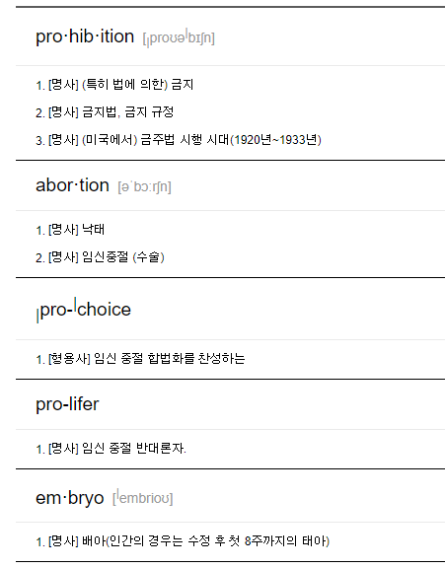
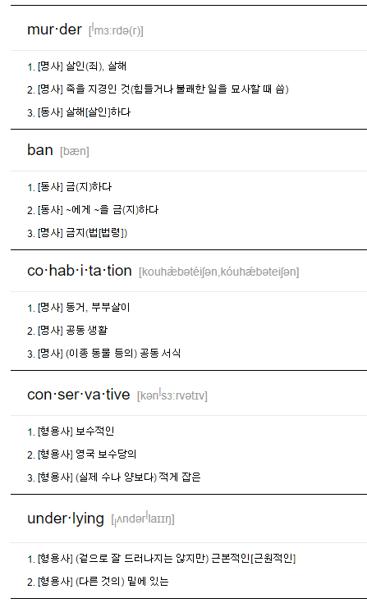
2. Word List

Slide 13
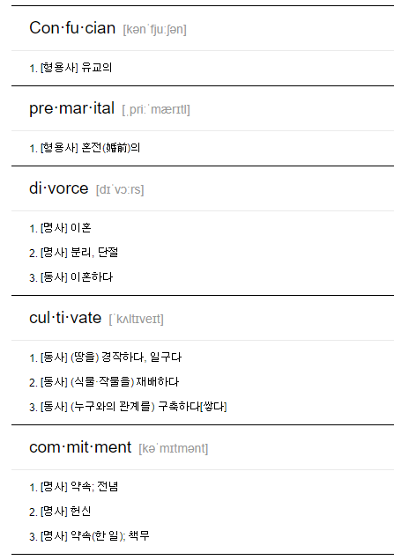
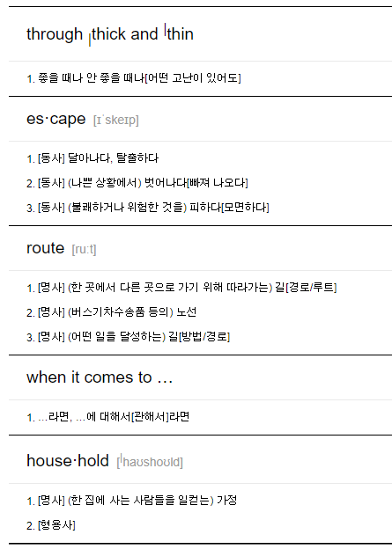
2. Word List

Slide 14
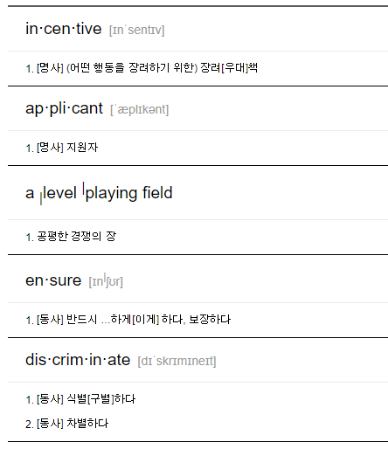
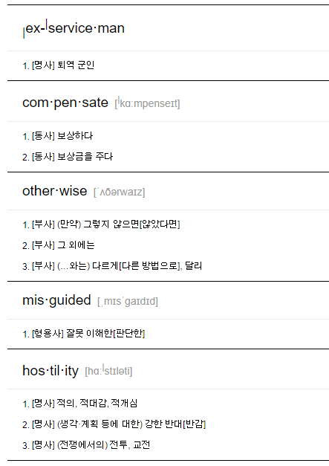
2. Word List

Slide 15
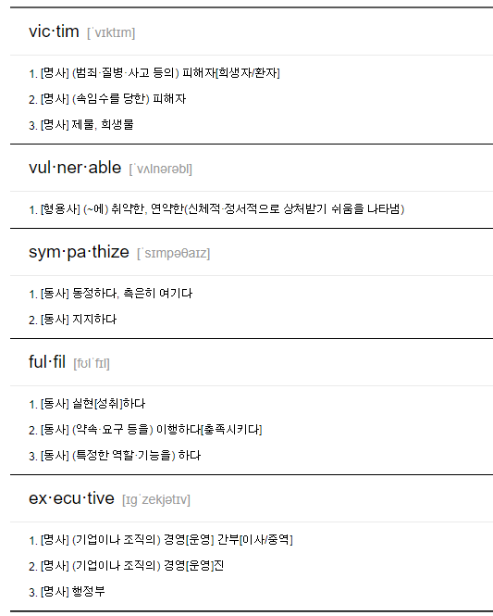
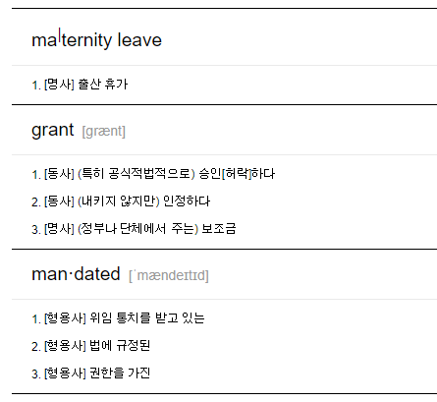
2. Word List

Slide 16
3. Grammar: 가정법 과거완료
가정법은 가정법 과거와 과거완료로 나눠집니다. 가정법 과거는 현재에 대한 가정이고, 가정법 과거완료는 과거에 대한 가정입니다.
 | if 부사절(조건/가정) | 주절(결과) | 해석
조건 (직설법) | 단순현재 | 단순현재 | ~하면 ~이다
 | 단순현재 | 미래 | ~하면 ~일 것이다
가정 (가정법) | 과거 | would + 동사원형 | 만약 ~하면 ~할 텐데
 | 과거완료 | would + have + 과거분사 | 만약 ~였더라면 ~했을 텐데
가정법 과거완료는 과거에 대해서 가정하는 것입니다.
As it snowed yesterday, we didn’t go out. 어제 눈이 내렸기 때문에 우리는 외출하지 못했다.
부사절: 과거(snowed)
주절: 과거(didn’t)
위와 같은 과거 시제 문장을 가정법으로 바꿀려면 가정법 과거완료로 표현해야 합니다.
If it had not snowed yesterday, we would have gone out. 만일 어제 눈이 내리지 않았더라면 우리는 외출 했었을 텐데.
부사절: 과거완료(had not snowed)
주절: would + have + 과거분사

Slide 17
3.1 Grammar: 가정법 과거완료
가정법 과거완료의 공식과 의미
가정법 과거완료 문장의 구조를 주절과 종속절로 나눠서 보면 다음과 같이 정리할 수 있습니다.
if절(부사절) | 주절
If it had not snowed yesterday, | we would have gone out.
과거완료 시제(had + 과거분사) | 조동사 과거 + have + 과거분사
과거 사실과 다른 가정 | 과거에 대한 아쉬움
만약 ~였더라면(했더라면) | ~했을 텐데
if절에서 과거에 대한 가정을 하기 위해서 과거완료 시제를 쓴다는 점에 유의해야 합니다. 가정을 하기 위해서 시제 왜곡이 필요하기 때문입니다.
과거를 나타냄(직설법) 과거
과거를 가정함(가정법) 시제 왜곡 필요 과거완료
주절에서는 조동사 과거 + 현재완료 형태로 사용되는데, 조동사 때문에 had(과거완료)가 have(현재완료)로 바뀐 것 뿐입니다.

Slide 18
3.1 Grammar: 가정법 과거완료
가정법 과거완료 예문
If I had studied harder, I would have passed the exam. 더 열심히 공부했다면 시험에 합격했을 텐데.
If + 과거완료(had studied): 과거 사실과 다른 가정
조동사 과거(would) + have + 과거분사(passed): 과거 사실에 대한 아쉬움이나 소망
I would have been happy if you had invited me to the party. 네가 나를 파티에 초대했다면 기뻤을 텐데.
조동사 과거(would) + have + 과거분사(been): 과거 사실에 대한 아쉬움이나 소망
If + 과거완료(had invited): 과거 사실과 다른 가정
He would have become a teacher if he had gone to university. 그는 대학에 갔다면 교사가 되었을 텐데.
조동사 과거(would) + have + 과거분사(become): 과거 사실에 대한 아쉬움이나 소망
If + 과거완료(had gone): 과거 사실과 다른 가정
If he had saved enough money, he would have bought a new car. 그가 돈을 충분히 모았다면 새 차를 샀을 텐데.
If + 과거완료(had saved): 과거 사실과 다른 가정
조동사 과거(would) + have + 과거분사(bought): 과거 사실에 대한 아쉬움이나 소망

Slide 19

3.1 Grammar: 가정법 과거완료
가정법 과거완료 예문
If I had had time, I could have made it more simple. 내가 만약 시간이 있었다면 더 간단하게 만들 수 있었을 텐데.
If + 과거완료(had had): 과거 사실과 다른 가정
조동사 과거(could) + have + 과거분사(made): 과거 사실에 대한 아쉬움이나 소망
If I had taken a taxi, I wouldn't have missed the train. 택시를 탔다면 기차를 놓치지 않았을 텐데.
If + 과거완료(had taken): 과거 사실과 다른 가정
조동사 과거(wouldn't) + have + 과거분사(missed): 과거 사실에 대한 아쉬움이나 소망
If there hadn't been so much traffic he wouldn't have missed his flight. 교통체증이 없었더라면 그는 비행기를 놓치지 않았을 텐데.
If + 과거완료(hadn't been): 과거 사실과 다른 가정
조동사 과거(wouldn't) + have + 과거분사(missed): 과거 사실에 대한 아쉬움이나 소망
https://www.englishcube.net/grammar_exam.php?category2=61

