Slide 1
MeteoMetrics Weather Station
Professional Weather Dashboard & Analytics Platform
By Tobi Odika

Slide 2
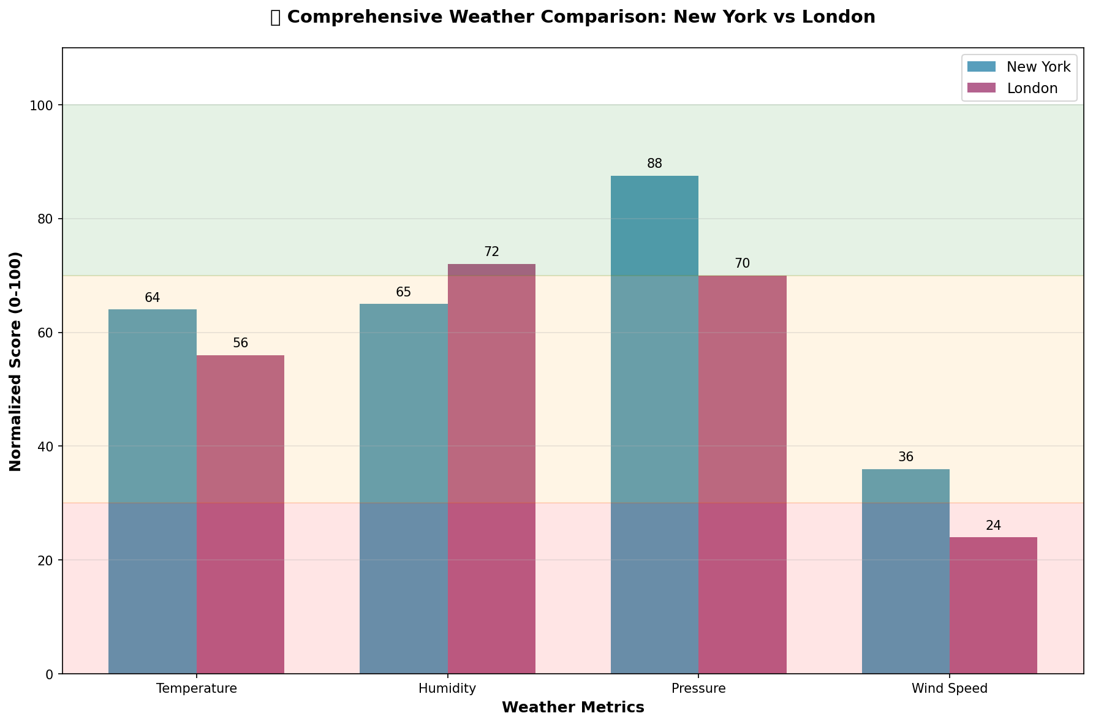
Application Overview
Professional-grade weather dashboard application
15+ functional tabs with comprehensive weather features
Real-time weather data and advanced analytics
Modern UI with intuitive navigation and professional styling

Slide 3
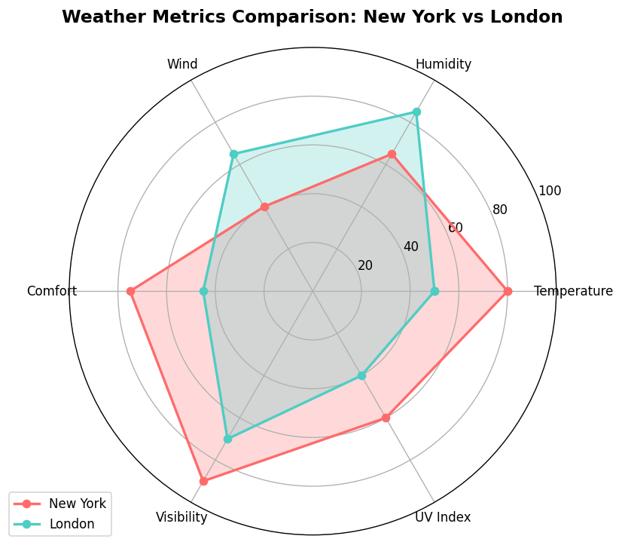
Advanced Weather Analytics
Comprehensive weather data visualization
Multi-metric analysis and comparison
Historical trends and predictive analytics

Slide 4
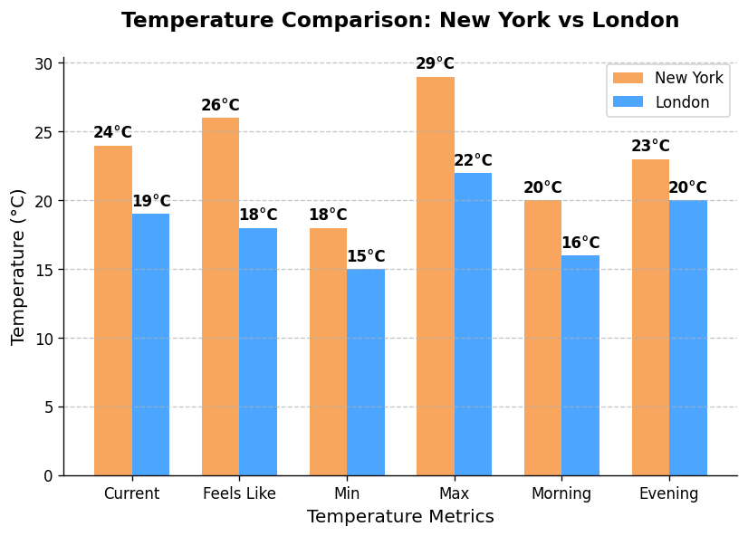
Multi-City Temperature Analysis
Compare temperatures across multiple cities
Historical temperature trends and anomalies
Interactive visualization with drill-down capabilities

Slide 5
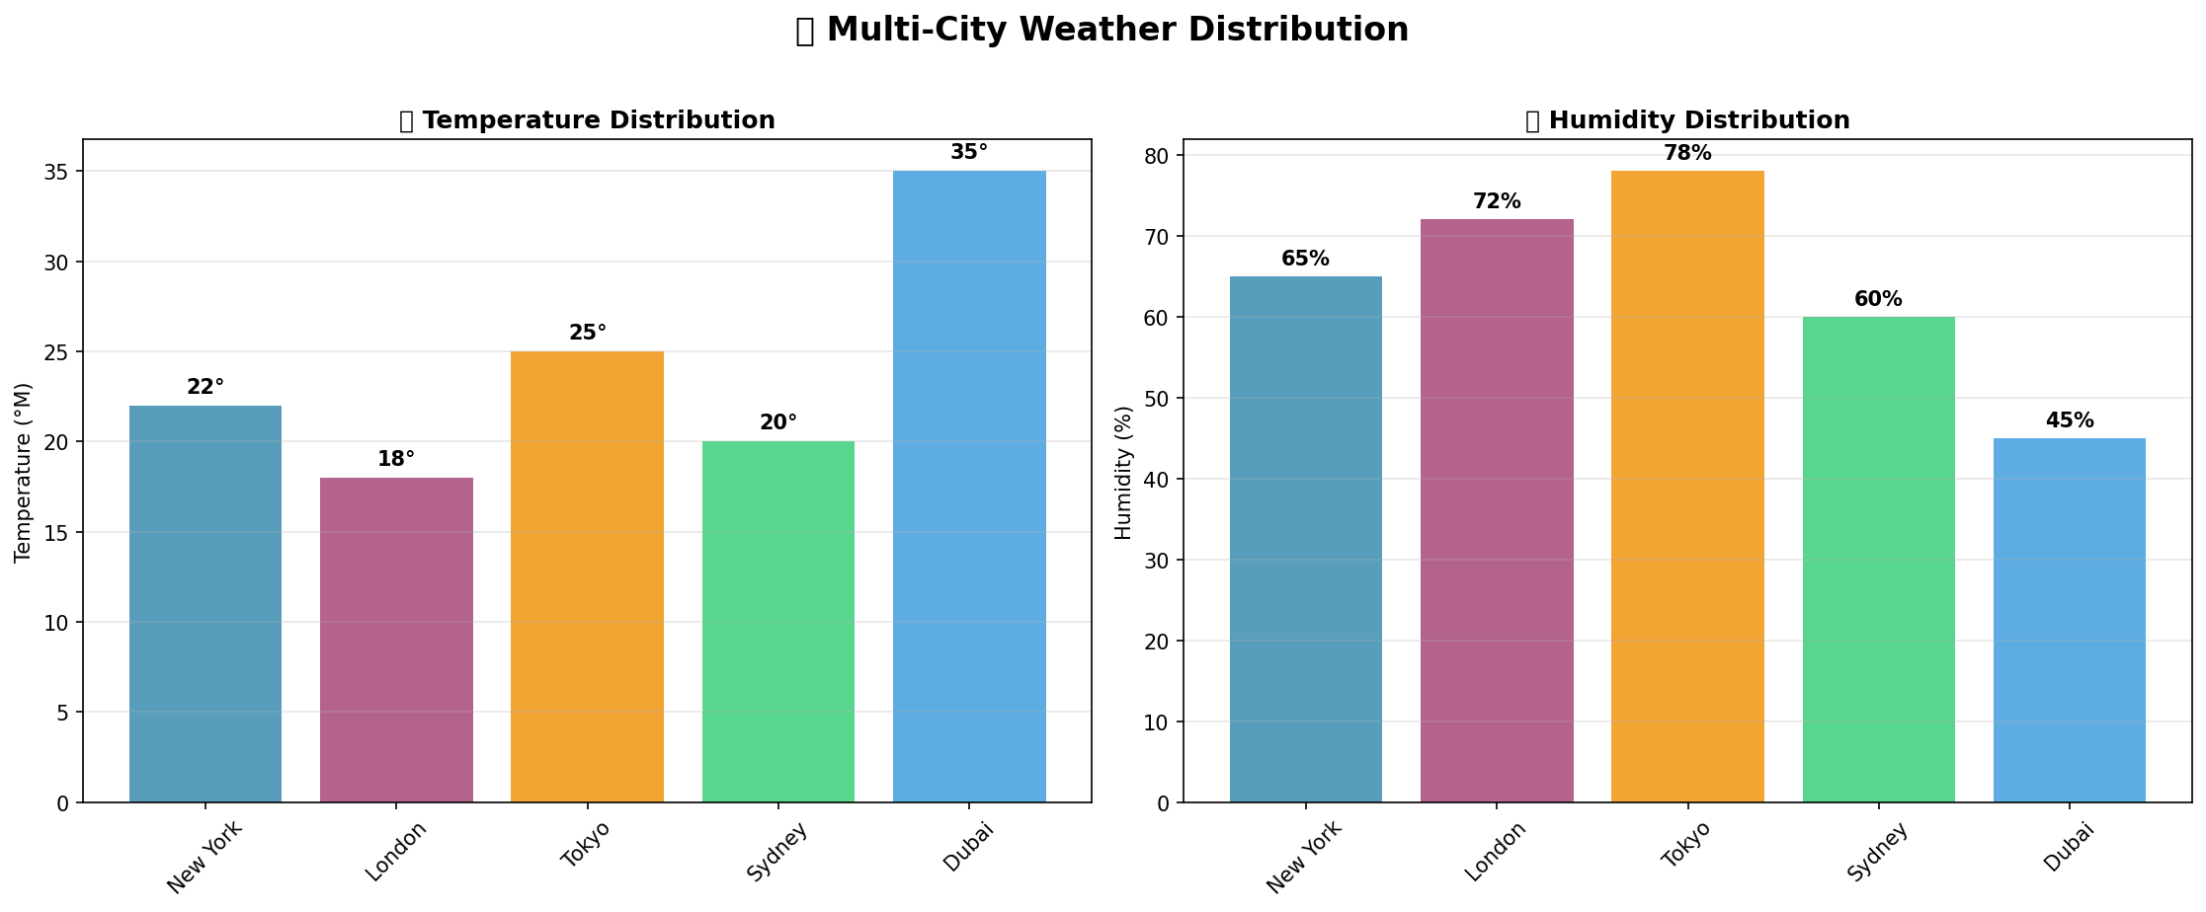
Weather Pattern Distribution
Advanced statistical analysis of weather patterns
Distribution of weather events and conditions
Anomaly detection and trend identification

Slide 6
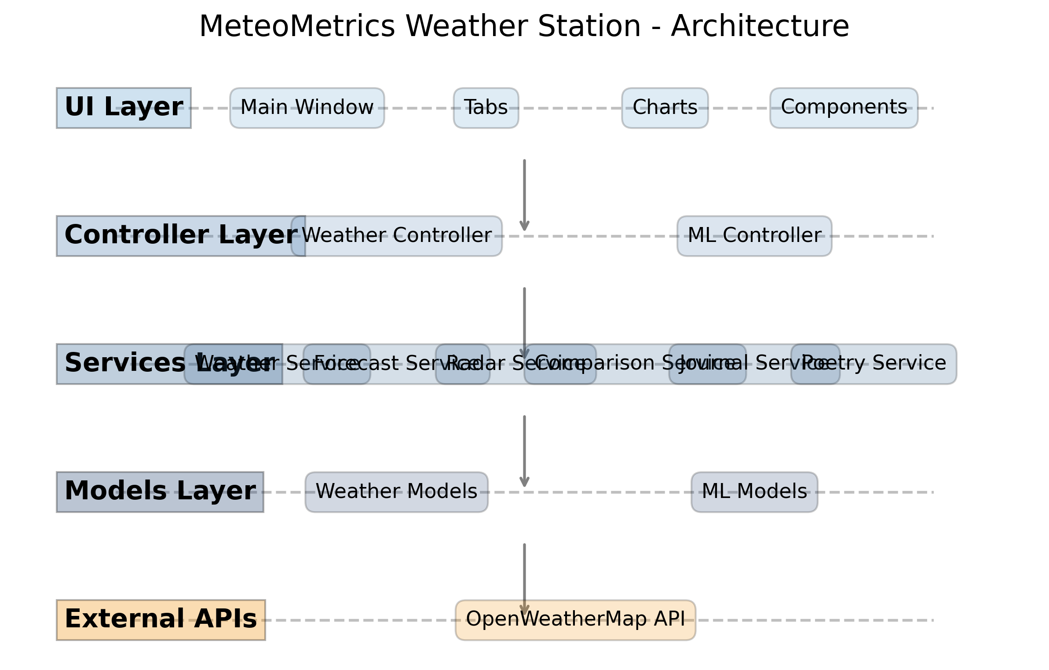
Technical Architecture
MVC Architecture with clean separation of concerns
UI Layer: Tkinter, matplotlib for visualization
Controller Layer: Application logic and event handling
Services Layer: API integration, data processing

Slide 7
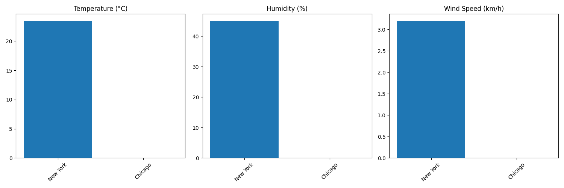
Thank You!
Comprehensive weather dashboard with 15+ functional tabs
Advanced visualization and analytics capabilities
Global weather coverage with support for multiple cities
Presentation by: Tobi Odika

