Slide 1
MeteoMetrics Weather Station
Comprehensive Weather Dashboard Application
Notes:
Welcome to the presentation of the MeteoMetrics Weather Station!
Key Points:
- This is a comprehensive weather dashboard application built with Python
- It provides real-time weather data, forecasts, and advanced analytics
- The application features a modern, intuitive user interface
- This presentation will highlight the key features and capabilities

Slide 2
Application Overview
🌦️ Professional-grade weather dashboard application
📊 15+ functional tabs with comprehensive weather features
🔍 Real-time weather data and advanced analytics
📱 Modern UI with intuitive navigation and professional styling
🔧 Built with Python using the MVC architecture pattern
🌍 Global weather coverage with multi-city support
Notes:
The MeteoMetrics Weather Station is a comprehensive weather application that provides:
- Real-time weather data from around the world
- 15+ functional tabs covering various aspects of weather information
- Advanced analytics and data visualization
- Clean, intuitive user interface
- Robust architecture using the MVC pattern
This slide gives the audience a high-level overview of what the application can do.

Slide 3
Core Features
🌦️ Real-time Weather Data with OpenWeatherMap API integration
🌡️ Multi-City Support for comparing weather across locations
📅 5-Day Forecasting with hourly details
🌩️ Doppler Weather Radar with severe weather tracking
📊 Advanced Visualization with 6+ chart types
🏥 Health & Wellness monitoring with UV index and air quality
🔍 Weather Analytics and trend analysis
Notes:
The MeteoMetrics Weather Station includes several key features:
- Real-time weather data using OpenWeatherMap API
- Support for viewing and comparing multiple cities
- 5-day forecasting with detailed hourly information
- Doppler radar for tracking severe weather conditions
- Advanced visualization using matplotlib for data analysis
- Health monitoring for UV index and air quality
- Comprehensive analytics for weather trends
These features make it a powerful tool for weather monitoring and planning.

Slide 4
UI and Visualization
🎨 Modern Split-Panel Layout with professional styling
📊 Interactive Charts using matplotlib integration:
• Line charts for temperature trends
• Bar charts for weather comparisons
• Radar charts for comprehensive data visualization
• Histograms for statistical analysis
📱 Tab-based Navigation with intuitive organization
🔄 Live Weather Animations and radar displays
Notes:
The user interface of the MeteoMetrics Weather Station is designed for clarity and efficiency:
- Modern split-panel layout provides an organized dashboard view
- Interactive charts powered by matplotlib offer data visualization
- Different chart types for different data analysis needs
- Tab-based navigation makes it easy to access all features
- Live animations and radar displays enhance the user experience
The UI combines functionality with professional styling.

Slide 5
Application Tabs
🚀 Quick Actions: Main dashboard with instant access to features
🌤️ Current Weather: Real-time conditions with detailed metrics
📅 Forecast: Short-term and 5-day weather predictions
🌦️ Live Weather: Real-time animations and radar display
📊 Analytics & Trends: Weather pattern analysis
🔍 City Comparison: Multi-city weather comparison with charts
🏥 Health & Wellness: UV index, air quality, activity recommendations
📝 Weather Journal: Personal weather logging and mood tracking
Notes:
The MeteoMetrics Weather Station is organized into multiple functional tabs:
- Quick Actions tab provides a central dashboard for common tasks
- Current Weather tab shows real-time weather conditions
- Forecast tabs offer short-term and extended weather predictions
- Live Weather tab features animations and radar for visual representation
- Analytics & Trends tab helps identify weather patterns
- City Comparison allows side-by-side weather comparisons
- Health & Wellness tab provides health-related weather information
- Weather Journal lets users track personal weather experiences
This tab-based organization keeps the interface clean while providing comprehensive functionality.

Slide 6
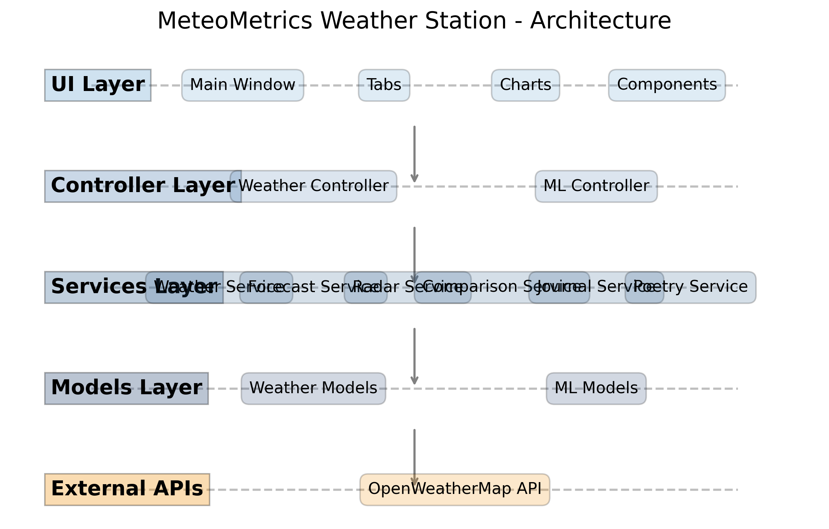
Technical Architecture
Notes:
The MeteoMetrics Weather Station follows a clean MVC (Model-View-Controller) architecture:
- UI Layer: Contains the main window, tabs, and UI components
- Controller Layer: Manages the application logic and coordinates between UI and services
- Services Layer: Provides specialized services for different weather features
- Models Layer: Defines data structures and handles data processing
- External APIs: Connects to OpenWeatherMap for real-time weather data
This architecture ensures a clean separation of concerns, making the code maintainable and extensible.

Slide 7
Thank You!
📱 MeteoMetrics Weather Station: A comprehensive weather dashboard
🌟 15+ functional tabs with professional features
📊 Advanced visualization and analytics
🌐 Global weather coverage with multi-city support
🔧 Clean architecture with extensibility
🚀 Ready for deployment and real-world use
Questions? Contact: your.email@example.com
Notes:
Thank you for your attention!
Key takeaways about the MeteoMetrics Weather Station:
- Comprehensive weather dashboard with 15+ functional tabs
- Advanced visualization and analytics capabilities
- Global weather coverage with support for multiple cities
- Clean, extensible architecture
- Ready for real-world use
Be sure to address any questions from the audience and provide contact information for follow-up.

