Slide 1
BRD
BANCA ROMA DIGITALE
Fraud Detection & Prevention System
Machine Learning | Rule-Based Strategies | Graph Analytics | Real-Time Scoring
Kareem Makki
Senior Data Analyst | Data Scientist

Slide 2
EXECUTIVE SUMMARY
TRANSACTIONS
FRAUD DETECTED
EXPOSURE
DETECTION
AUC-ROC
50,000
3,767
€10.8M
94.3%
0.9991
24 months
7.53% rate
Total losses
Model recall
Best model
Built an end-to-end fraud detection system for a Rome-based digital bank covering card-present, card-not-present, account takeover, synthetic identity, money mule, and phishing fraud across 50,000 transactions. The system combines supervised ML models (Gradient Boosting, Random Forest), unsupervised anomaly detection (Isolation Forest), graph-based network analysis, and expert rule-based strategies into a hybrid production-ready pipeline.

Slide 3
FRAUD LANDSCAPE
Fraud Type | Count | Exposure | % Total | Description
Account Takeover | 1,013 | €5.4M | 50.1% | Stolen credentials, unauthorized access
Phishing / ATO | 856 | €2.1M | 19.8% | Social engineering attacks
Card Not Present | 615 | €1.6M | 14.4% | Online/phone transactions
Card Present | 864 | €885K | 8.2% | Counterfeit/stolen cards at POS
First Party Fraud | 408 | €702K | 6.5% | False claims by account holder
Money Mule | 8 | €86K | 0.8% | Laundering through recruited accounts
Synthetic Identity | 3 | €16K | 0.2% | Fabricated identities
Account takeover represents 50% of total fraud exposure at EUR 5.4M — the single largest threat vector requiring immediate attention.

Slide 4
MODEL PERFORMANCE
Model | AUC-ROC | Precision | Recall | F1 Score | Status
Gradient Boosting | 0.9991 | 0.979 | 0.943 | 0.961 | BEST
Random Forest | 0.9985 | 0.973 | 0.921 | 0.947 | STRONG
Hybrid (ML+Rules) | 0.9969 | 0.960 | 0.910 | 0.940 | PRODUCTION
Decision Tree | 0.9788 | 0.765 | 0.954 | 0.849 | GOOD
Logistic Regression | 0.9661 | 0.534 | 0.878 | 0.664 | BASELINE
Isolation Forest | 0.730 | 0.464 | 0.462 | 0.463 | UNSUPERVISED

Slide 5
DETECTION TECHNIQUES
Top Fraud Signals
Techniques Applied
1. Unknown device flag
2. Foreign transaction indicator
3. Transaction amount (EUR)
4. No authentication flag
5. Amount-to-income ratio
6. Velocity (txn count last 1h)
7. Response time (ms)
8. Account age (days)
9. Credit score
10. Crypto exchange flag
Supervised ML
Gradient Boosting, Random Forest,
Decision Tree, Logistic Regression
Unsupervised
Isolation Forest anomaly detection
Graph Analytics
NetworkX community detection,
fraud ring identification
Rule Engine
10 expert rules with threshold tuning
Hybrid Model
60% ML score + 40% rule score
for production deployment

Slide 6
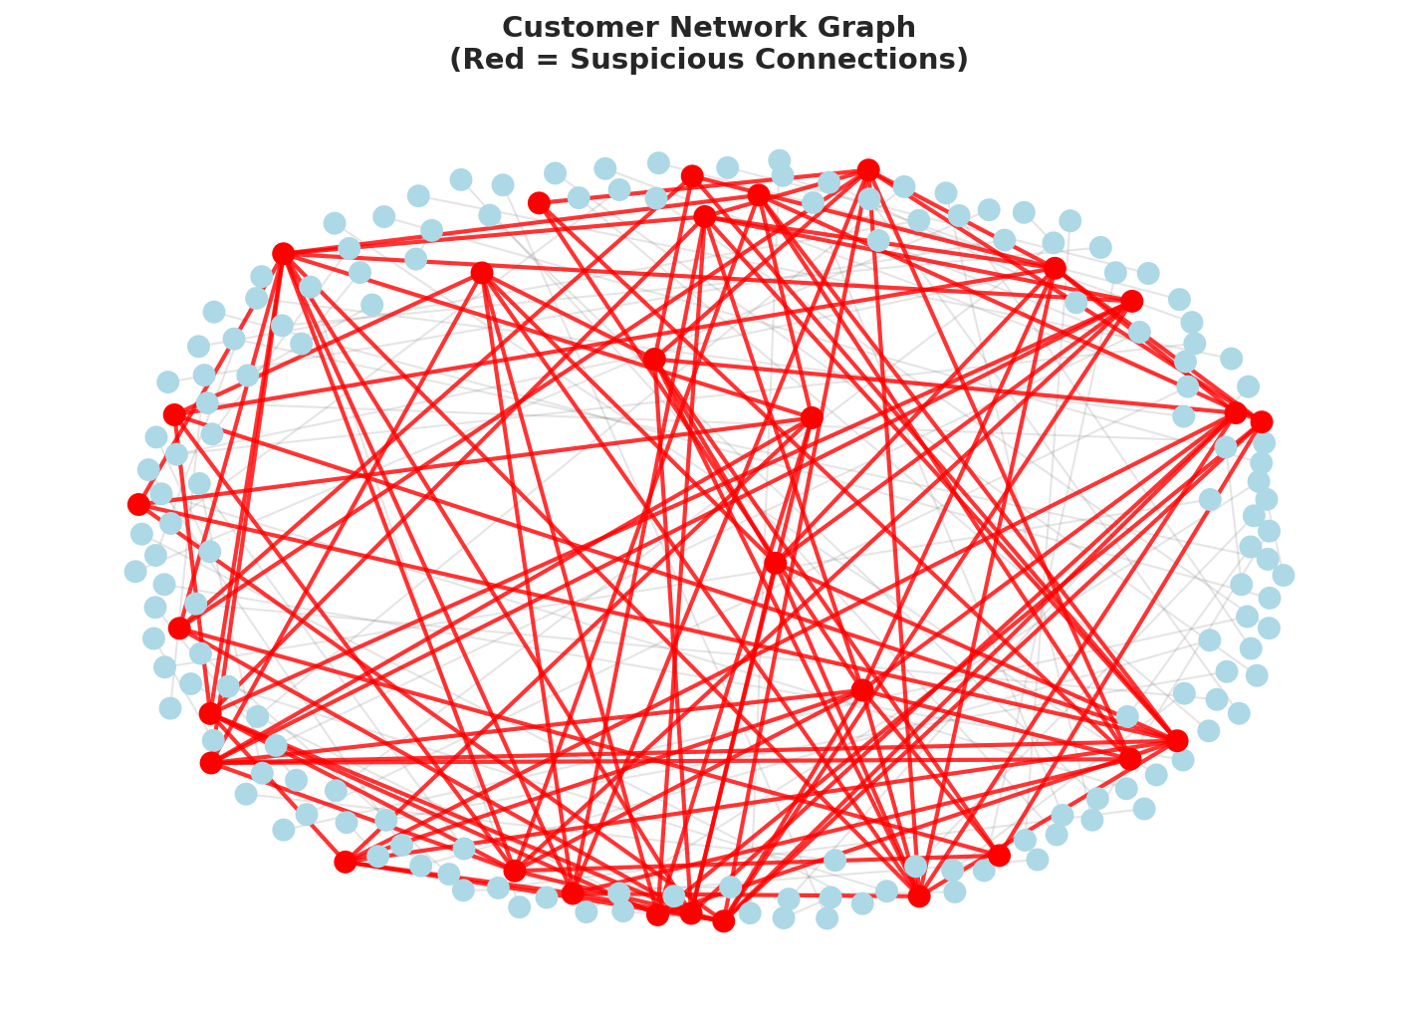
GRAPH-BASED FRAUD DETECTION
Network Analysis Results
Network Nodes
179
Network Edges
188
Connected Components
72
Suspicious Clusters
30+
Graph analysis identifies fraud rings by detecting customers sharing devices, IP addresses, and phone patterns — connections invisible to traditional transaction-level models.

Slide 7
RECOMMENDATIONS
1
Deploy Gradient Boosting for real-time scoring
CRITICAL
99.91% AUC-ROC with 97.9% precision minimizes false positives while catching 94.3% of fraud
2
Implement device fingerprint validation
CRITICAL
Unknown device flag is the strongest fraud signal — mandate device registration for transactions over EUR 500
3
Activate graph-based network monitoring
HIGH
Identified 30+ suspicious clusters; deploy continuous graph analysis to detect emerging fraud rings
4
Tighten velocity rules during off-hours
HIGH
Fraud rates spike 22:00-06:00 — reduce velocity thresholds from 5 to 3 transactions per hour during nights
5
Flag new accounts with large transfers
MEDIUM
Accounts under 30 days old making transfers above EUR 1,000 should trigger mandatory review
6
Automate monthly model monitoring
MEDIUM
Deploy the monitoring dashboard to track precision, recall, and AUC drift — retrain when AUC drops below 0.95

Slide 8
PRODUCTION ARCHITECTURE
Data Ingestion
Feature Engine
ML Scoring
Rule Engine
Decision
ERP, Card Network,
Device Signals
>
29 Features
Real-time Compute
>
Gradient Boosting
AUC 0.9991
>
10 Expert Rules
Threshold Tuning
>
Approve / Block
/ Review
Model Monitoring & Drift Detection
Monthly AUC tracking | Precision/Recall alerts | Feature drift detection | Automated retraining triggers | Alert rule performance analysis
Technology Stack
Python (Scikit-learn, Pandas, NetworkX) | SQL (SQLite) | Tableau | Power BI | SAS-compatible | REST API scoring

Slide 9
BRD
Thank You
Questions & Discussion
Kareem Makki
Senior Data Analyst | Data Scientist | Data Engineer
kareemmakki@gmail.com | +961 70 221 541
linkedin.com/in/kareemmakki | github.com/khm08
Coursera: coursera.org/projects/financial-reporting-with-tableau-parameters--filters

