Slide 1


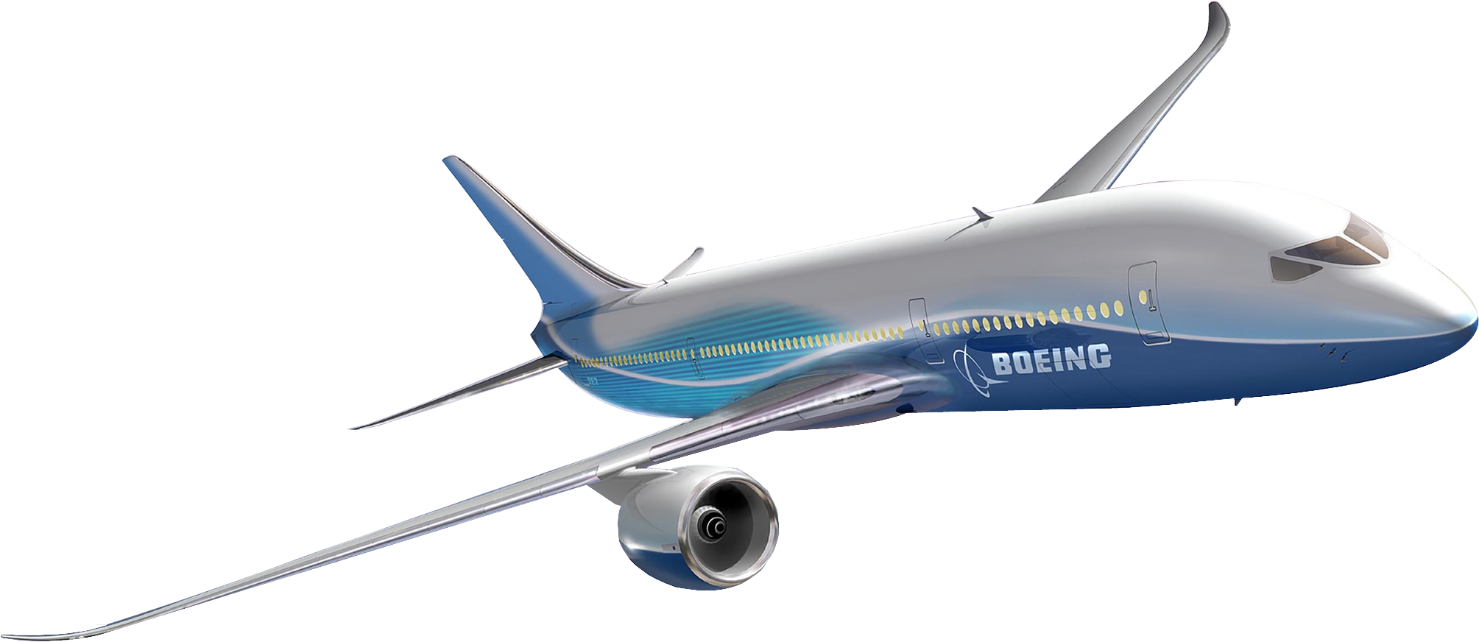
Tata Sons, Pvt. Ltd.
Air India
Air India Express
Air Asia India
Vistara

Slide 2
Tata Sons, Pvt. Ltd.
Air India
Air India Express
Air Asia India
Vistara

Slide 3

Air India
Vistara

