Slide 1
LeapMind NNP Trial1 - Week1
Kazuki FURUKAWA
Jun 30, 2022

Slide 2
Initial Settings
[Pre Synth] Learned TCL Basics
[Synth] Struggle with Library Settings
[init_design] Library Settings
[init_design] MCMM Settings
Short Results
Issues

Slide 3
Initial Settings

Slide 4
[Pre Synth] Learned TCL Basics
Inserted unintended strange characters
When copy text : Teams ▶ ETX
Found the problem to glob libraries
Trap when comment out
Tcl sees earliest } (closing brace)
Some proc to read & print files
Learned regular expressions
Use return to stop a tcl script
proc funnyProc {value} {
if {$value} {
return "TRUE"
# } elseif {[puts "COMMENT :)"] == ""} {
# return "COMMENT"
} else {
return "FALSE"
}
return "IT'S IMPOSSIBLE!!!"
}
proc read_list {filename} {
set f [open $filename r]
set tmp_list [split [read $f] "\n"]
set result [regsub -all \{|\} $tmp_list ""]
return $result
close $filename
}
proc print_file_list { items } {
foreach item $items {
echo [regsub -all ^.*/ $item ""]
}
}

Slide 5
[Synth] Struggle with Library Settings 1/2
Did glob wrong libraries
tcbn12ffcllbwp6t16p96cpdssgnp0p72vm40c_hm_ccs.db
tcbn12ffcllbwp6t16p96cpdssgnp0p72v125c_hm_ccs.db
tcbn12ffcllbwp6t16p96cpdssgnp0p72v0c_hm_ccs.db…
Warning (LINK-5)
Solved by trimming unnecessary libraries
Errors at set_driving_cell / set_load
They are : constraints derived from the outside condition
Cut off “ULVT”
set_driving_cell -lib_cell BUFFD8BWP6T16P96CPDULVT [all_inputs ]
set_load [get_attribute [index_collection [get_lib_pins */BUFFD8BWP6T16P96CPDULVT/I] 0] pin_capacitance] [all_outputs ]
set_driving_cell -lib_cell BUFFD8BWP6T16P96CPD [all_inputs ]
set_load [get_attribute [index_collection [get_lib_pins */BUFFD8BWP6T16P96CPD/I] 0] pin_capacitance] [all_outputs ]

Slide 6
[Synth] Struggle with Library Settings 2/2
Warning: The trip points for ... (TIM-164)
What is a Trip Point ?
Slew between upper & lower voltage threshold
e.g. 30-70%, 20-80% @ 0.0-0.72V (0-100%)
cf. Timing precision : CCS >> NLDM
Both CCS & NLDM are .lib files
In this trial, we should use CCS.
(TIM-164) seems ignorable for this trial.
Because every libraries define with different trip points.

Slide 7
[init_design] Library Settings
How treat $TECH_LIB, $TECH_FILE, $REFERENCE_LIBRARY ?
create_lib $DESIGN_LIBRARY -tech $TECH_FILE -use_technology_lib $TECH_LIB \
-ref_libs $REFERENCE_LIBRARY
create_lib -help
Usage: create_lib # Create a library
[-technology tech_path]
(Tech file path)
[-use_technology_lib tech_lib_name]
(Tech library name)
[-ref_libs paths] (Reference library paths)
set BASE_DIR /proj/ATEPairChip/RELEASE/Training_Phase1
set LIB_DIR ${BASE_DIR}/Library
set SC_NDM [list ${LIB_DIR}/ndm/tcbn12ffcllbwp6t16p96cpd_c_ccs.ndm]
set MEM_NDM [list ${LIB_DIR}/ndm/sram_macros.ndm]
set REFERENCE_LIBRARY [concat ${LIB_DIR}/ndm_20210611a/tech_only.ndm $SC_NDM $MEM_NDM]
set TECH_FILE ""
set TECH_LIB ${LIB_DIR}/ndm_20210611a/tech_only.ndm

Slide 8
[init_design] MCMM Settings 1/2
Sakata-san said : It should contain -late_spec for setup foreseeing.
foreach p [list $parasitic1 $parasitic2] {
puts "RM-info: read_parasitic_tech -tlup $tluplus_file($p) -layermap $layer_map_file($p) -name $p"
read_parasitic_tech -tlup $tluplus_file($p) -layermap $layer_map_file($p) -name $p
}
set_parasitic_parameters -corners ss72_cworst_CCworst_T_m40c -early_spec $parasitic1 \
-late_spec $parasitic1 -library tech_only
set_temperature -corners ss72_cworst_CCworst_T_m40c -40 -min -40
set_voltage -corners ss72_cworst_CCworst_T_m40c 0.72 -min 0.72
set_process_number -corners ss72_cworst_CCworst_T_m40c 1
set_parasitic_parameters -corners ss72_cworst_CCworst_T_125c -early_spec $parasitic1 \
-late_spec $parasitic1 -library tech_only
set_temperature -corners ss72_cworst_CCworst_T_125c 125 -min 125
set_voltage -corners ss72_cworst_CCworst_T_125c 0.72 -min 0.72
set_process_number -corners ss72_cworst_CCworst_T_125c 1
set_parasitic_parameters -corners ss72_rcworst_CCworst_T_m40c -early_spec $parasitic2 \
-late_spec $parasitic2 -library tech_only
set_temperature -corners ss72_rcworst_CCworst_T_m40c -40 -min -40
set_voltage -corners ss72_rcworst_CCworst_T_m40c 0.72 -min 0.72
set_process_number -corners ss72_rcworst_CCworst_T_m40c 1
set_parasitic_parameters -corners ss72_rcworst_CCworst_T_125c -early_spec $parasitic2 \

Slide 9
[init_design] MCMM Settings 2/2
Derate settings referred the TSMC document
set corner1 "ss72_cworst_CCworst_T_m40c"
set corner2 "ss72_rcworst_CCworst_T_m40c"
set corner3 "ss72_cworst_CCworst_T_125c"
set corner4 "ss72_rcworst_CCworst_T_125c"
set ss_all_corners [list $corner1 $corner2 $corner3 $corner4]
set_timing_derate -corners $ss_all_corners -cell_delay -clock -late [expr 1.0 + $cell_ocv_clock/100]
set_timing_derate -corners $ss_all_corners -cell_delay -data -late [expr 1.0 + $cell_ocv_data/100]
set_timing_derate -corners $ss_all_corners -cell_delay -data -early [expr 1.0 - $cell_ocv_data/100]
set_timing_derate -corners $ss_all_corners -net_delay -clock -late [expr 1.0 + $wire_ocv_clock/100]
set_timing_derate -corners $ss_all_corners -net_delay -clock -early [expr 1.0 - $wire_ocv_clock/100]
set_timing_derate -corners $ss_all_corners -net_delay -data -late [expr 1.0 + $wire_ocv_data/100]
set_timing_derate -corners $ss_all_corners -net_delay -data -early 1.0
set corners_m40c [list $corner1 $corner2]
set corners_125c [list $corner3 $corner4]
set_timing_derate -corners $corners_m40c -cell_delay -clock -early [expr 1.0 - ($cell_ocv_clock+$vt_ocv_m40c)/100]
set_timing_derate -corners $corners_125c -cell_delay -clock -early [expr 1.0 - ($cell_ocv_clock+$vt_ocv_125c)/100]

Slide 10
[place_opt] Stucked while legalization (Wed)
Modified pre_place_opt.tcl
set_app_options -name opt.tie_cell.max_fanout -value 8

Slide 11
Short Results

Slide 12
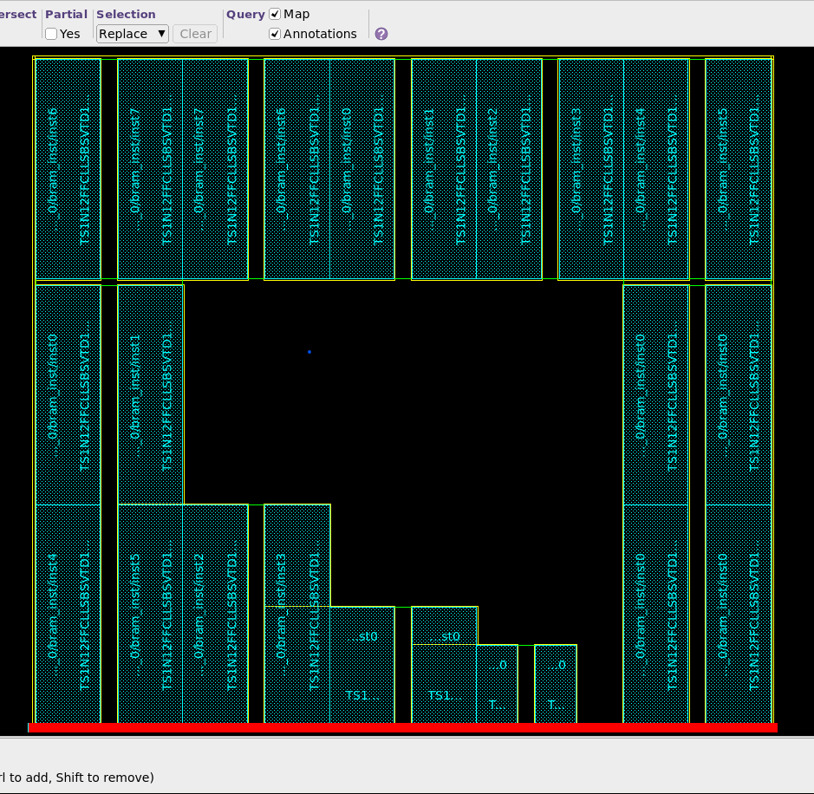
[init_design] Result
No std-cells can be seen (even when zoom in)

Slide 13
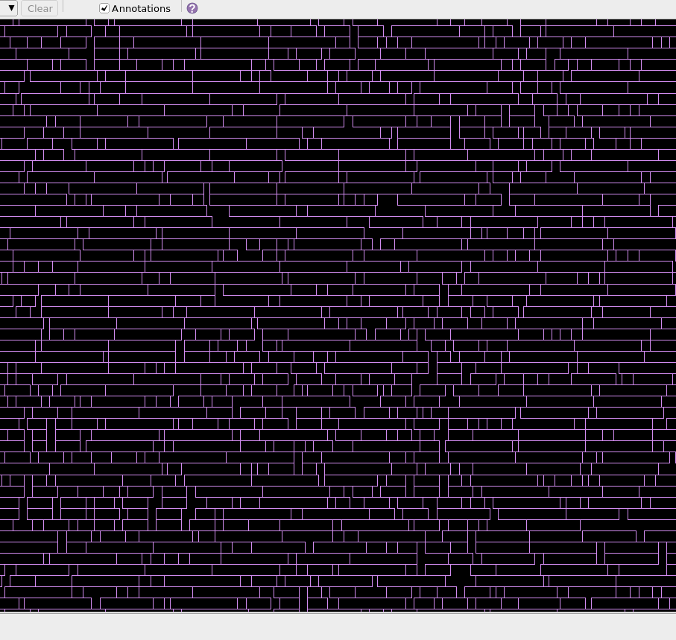
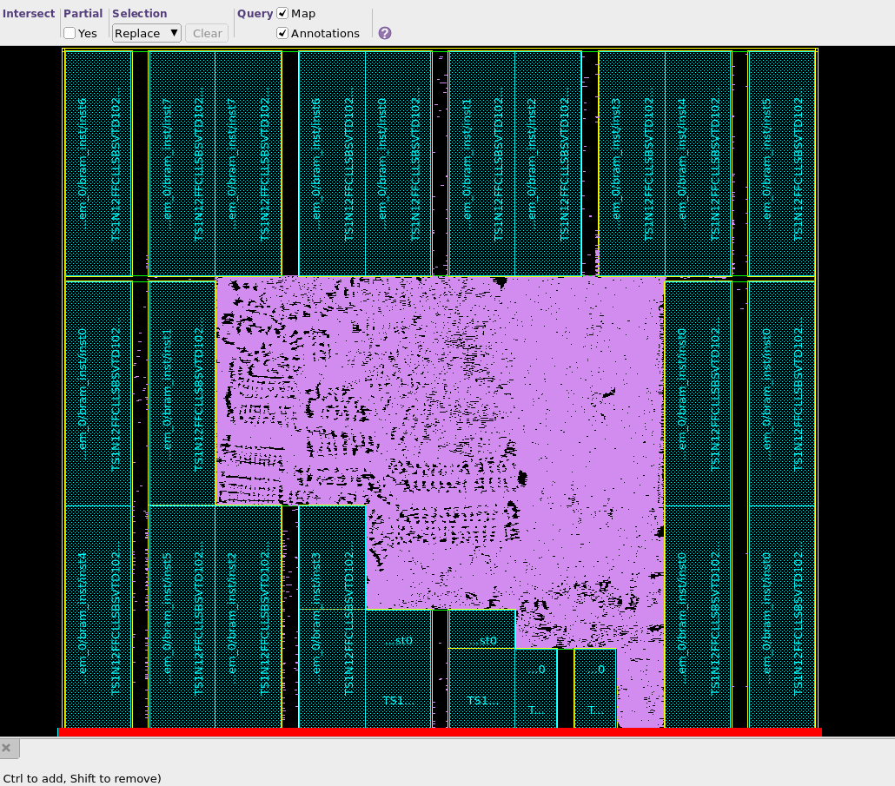
[clock_opt_cts] Result

Slide 14
[clock_opt_cts]
icc2_shell> report_timing -nosplit
****************************************
Report : timing
-path_type full
-delay_type max
-max_paths 1
-report_by design
-nosplit
Design : Bxb
Version: N-2017.09-SP4
Date : Wed Jun 29 17:53:03 2022
****************************************
Information: Timer using 'AWP'. (TIM-050)
Startpoint: idma/storeAdmaQueue/instCountInWord_reg_2_ (rising edge-triggered flip-flop clocked by cloc
k)
Endpoint: idma/storeAdmaQueue/lenMinus1_reg_1_ (rising edge-triggered flip-flop clocked by clock)
Mode: func
Corner: ss72_cworst_CCworst_T_m40c
Scenario: func::ss72_cworst_CCworst_T_m40c
Path Group: clock
Path Type: max
Point Incr Path
--------------------------------------------------------------------------------------------------
clock clock (rise edge) 0.0000 0.0000
clock network delay (ideal) 0.0000 0.0000
idma/storeAdmaQueue/instCountInWord_reg_2_/CP (SDFQD4BWP6T16P96CPD) 0.0000 0.0000 r
idma/storeAdmaQueue/instCountInWord_reg_2_/Q (SDFQD4BWP6T16P96CPD) 0.1005 0.1005 f
idma/storeAdmaQueue/place_opt_SGI80_78484/ZN (NR2D6BWP6T16P96CPD) 0.0206 0.1211 r
idma/storeAdmaQueue/place_opt_SGI81_78485/ZN (INVD4BWP6T16P96CPD) 0.0173 0.1384 f
idma/storeAdmaQueue/place_opt_SGI82_78486/ZN (NR3D8BWP6T16P96CPD) 0.0214 0.1598 r
idma/storeAdmaQueue/alchip32_dc/ZN (INR2D4BWP6T16P96CPD) 0.0403 0.2001 r
idma/storeAdmaQueue/alchip33_dc/ZN (INR2D4BWP6T16P96CPD) 0.0397 0.2398 r
idma/storeAdmaQueue/alchip31_dc/ZN (INR2D4BWP6T16P96CPD) 0.0397 0.2795 r
idma/storeAdmaQueue/alchip53_dc/ZN (INR2D4BWP6T16P96CPD) 0.0395 0.3190 r
idma/storeAdmaQueue/alchip30_dc/ZN (INR2D4BWP6T16P96CPD) 0.0415 0.3605 r
idma/storeAdmaQueue/place_opt_SGI100_78582/ZN (ND2D4BWP6T16P96CPD) 0.0238 0.3843 f
idma/storeAdmaQueue/place_opt_SGI101_78583/ZN (INVD4BWP6T16P96CPD) 0.0156 0.3999 r
idma/storeAdmaQueue/place_opt_SGI100_78537/ZN (ND2D4BWP6T16P96CPD) 0.0185 0.4183 f
idma/storeAdmaQueue/place_opt_SGI101_78538/ZN (INVD4BWP6T16P96CPD) 0.0159 0.4342 r
idma/storeAdmaQueue/place_opt_SGI109_78516/ZN (ND2D6BWP6T16P96CPD) 0.0168 0.4511 f
idma/storeAdmaQueue/place_opt_SGI110_78517/ZN (INVD4BWP6T16P96CPD) 0.0122 0.4633 r
idma/storeAdmaQueue/alchip22_dc/ZN (INR2D4BWP6T16P96CPD) 0.0340 0.4973 r
idma/storeAdmaQueue/alchip3_dc/ZN (INR2D4BWP6T16P96CPD) 0.0403 0.5376 r
idma/storeAdmaQueue/alchip9_dc/ZN (INR2D4BWP6T16P96CPD) 0.0399 0.5775 r
idma/storeAdmaQueue/alchip23_dc/ZN (INR2D4BWP6T16P96CPD) 0.0415 0.6189 r
idma/storeAdmaQueue/alchip24_dc/ZN (INR2D8BWP6T16P96CPD) 0.0416 0.6605 r
idma/storeAdmaQueue/alchip113_dc/ZN (INR2D8BWP6T16P96CPD) 0.0400 0.7006 r
idma/storeAdmaQueue/alchip114_dc/ZN (INR2D4BWP6T16P96CPD) 0.0401 0.7407 r
idma/storeAdmaQueue/alchip139_dc/ZN (INR2D4BWP6T16P96CPD) 0.0422 0.7828 r
idma/storeAdmaQueue/place_opt_SGI89_78496/ZN (INVD4BWP6T16P96CPD) 0.0188 0.8017 f
idma/storeAdmaQueue/place_opt_SGI91_78498/ZN (ND2D4BWP6T16P96CPD) 0.0137 0.8154 r
idma/storeAdmaQueue/place_opt_SGI92_78499/ZN (ND2D8BWP6T16P96CPD) 0.0224 0.8377 f
idma/storeAdmaQueue/alchip276_dc/ZN (INR4D4BWP6T16P96CPD) 0.0273 0.8651 r
idma/storeAdmaQueue/alchip277_dc/ZN (INR4D4BWP6T16P96CPD) 0.0656 0.9307 r
idma/storeAdmaQueue/alchip278_dc/ZN (INR4D4BWP6T16P96CPD) 0.0768 1.0074 r
idma/storeAdmaQueue/alchip15_dc/ZN (INR3D12BWP6T16P96CPD) 0.0703 1.0778 r
idma/storeAdmaQueue/alchip279_dc/Z (MUX2D1BWP6T16P96CPD) 0.0497 1.1275 r
idma/storeAdmaQueue/lenMinus1_reg_1_/D (SDFQD1BWP6T16P96CPD) 0.0001 1.1276 r
data arrival time 1.1276
clock clock (rise edge) 1.2500 1.2500
clock network delay (ideal) 0.0000 1.2500
idma/storeAdmaQueue/lenMinus1_reg_1_/CP (SDFQD1BWP6T16P96CPD) 0.0000 1.2500 r
clock uncertainty -0.1300 1.1200
library setup time -0.0684 1.0516
data required time 1.0516
--------------------------------------------------------------------------------------------------
data required time 1.0516
data arrival time -1.1276
--------------------------------------------------------------------------------------------------
slack (VIOLATED) -0.0761
1

Slide 15
Issues

Slide 16
Issues to Deal with
Some errors are described in the logs.
But NOT show the details.
I do not get how to find problems yet.
Still necessary to learn the GUI features.

