Slide 1
AI SYSTEM · PERSONALIZED VIDEO RECOMMENDATIONS
Lenta
A self-learning recommendation engine for a digital media platform —
built end-to-end, deployed, and running live.
● LIVE & DEPLOYED
Dashboard:
https://lenta-mvp.xyz
API & docs:
https://api.lenta-mvp.xyz/docs
Source:
github.com/khnur/lenta-mvp

Slide 2
01
The problem & the solution
The problem
The Lenta solution
• Users can't find content they'll enjoy as the library grows → engagement drops.
• Ranking lacks real-time personalization — it can't react to what a user does now.
• Audience analysis is manual, so the system never improves on its own.
• No measurement proving recommendations actually help.
• A personalized feed per user from a proven recommendation funnel.
• A real-time loop: every play reshapes the next feed.
• A self-learning loop: retrains on fresh behavior, hot-swaps the new model — zero downtime.
• A built-in A/B test + live dashboard measuring impact continuously.
Design principle: optimize WATCH-TIME, not clicks.
Ranking on clicks breeds click-bait; ranking on watch-time aligns the recommender with the platform's real goal — retention and engagement depth.

Slide 3
02
Architecture — the funnel + two loops
Catalog
→
Candidates
→
Ranking
→
Re-rank
→
Feed
all videos
ALS collaborative filtering
LightGBM · watch-time
diversity + freshness
personalized
⚡ Real-time loop (Redis)
🔁 Self-learning loop (Postgres)
• Every event updates the user's session profile instantly — recent genres, streaks, time-of-day.
• The ranker reads it live, so the very next feed reflects what the user just did.
• Behavior → Postgres → scheduled / on-demand retrain → versioned model registry.
• The API hot-swaps to the new model with zero downtime — no redeploy.
Deployed as separate services:
core (shared ML lib) · api (FastAPI) · trainer (worker) · dashboard (React) · Postgres + Redis

Slide 4
03
How each feature works — and why it matters
Candidate generation —
ALS collaborative filtering finds “videos for you”; content & popularity fallbacks for cold-start users and new uploads.
Ranking on watch-time —
LightGBM predicts how much of each video the user will watch — optimizing retention, not click-bait. One feature spec = no train/serve skew.
Diversity & freshness re-rank —
Caps per genre/creator + reserved slots for new uploads, so feeds stay varied and new content gets discovered.
Real-time session features —
Redis updates per event; the feed reacts within the session, before any retraining.
Self-learning + model registry —
Recency-weighted retraining; every version's quality is tracked and the best one is served live.
Built-in A/B test —
Recommender vs popularity baseline, with live CTR / watch-time / session-length lift — honest proof of value.

Slide 5
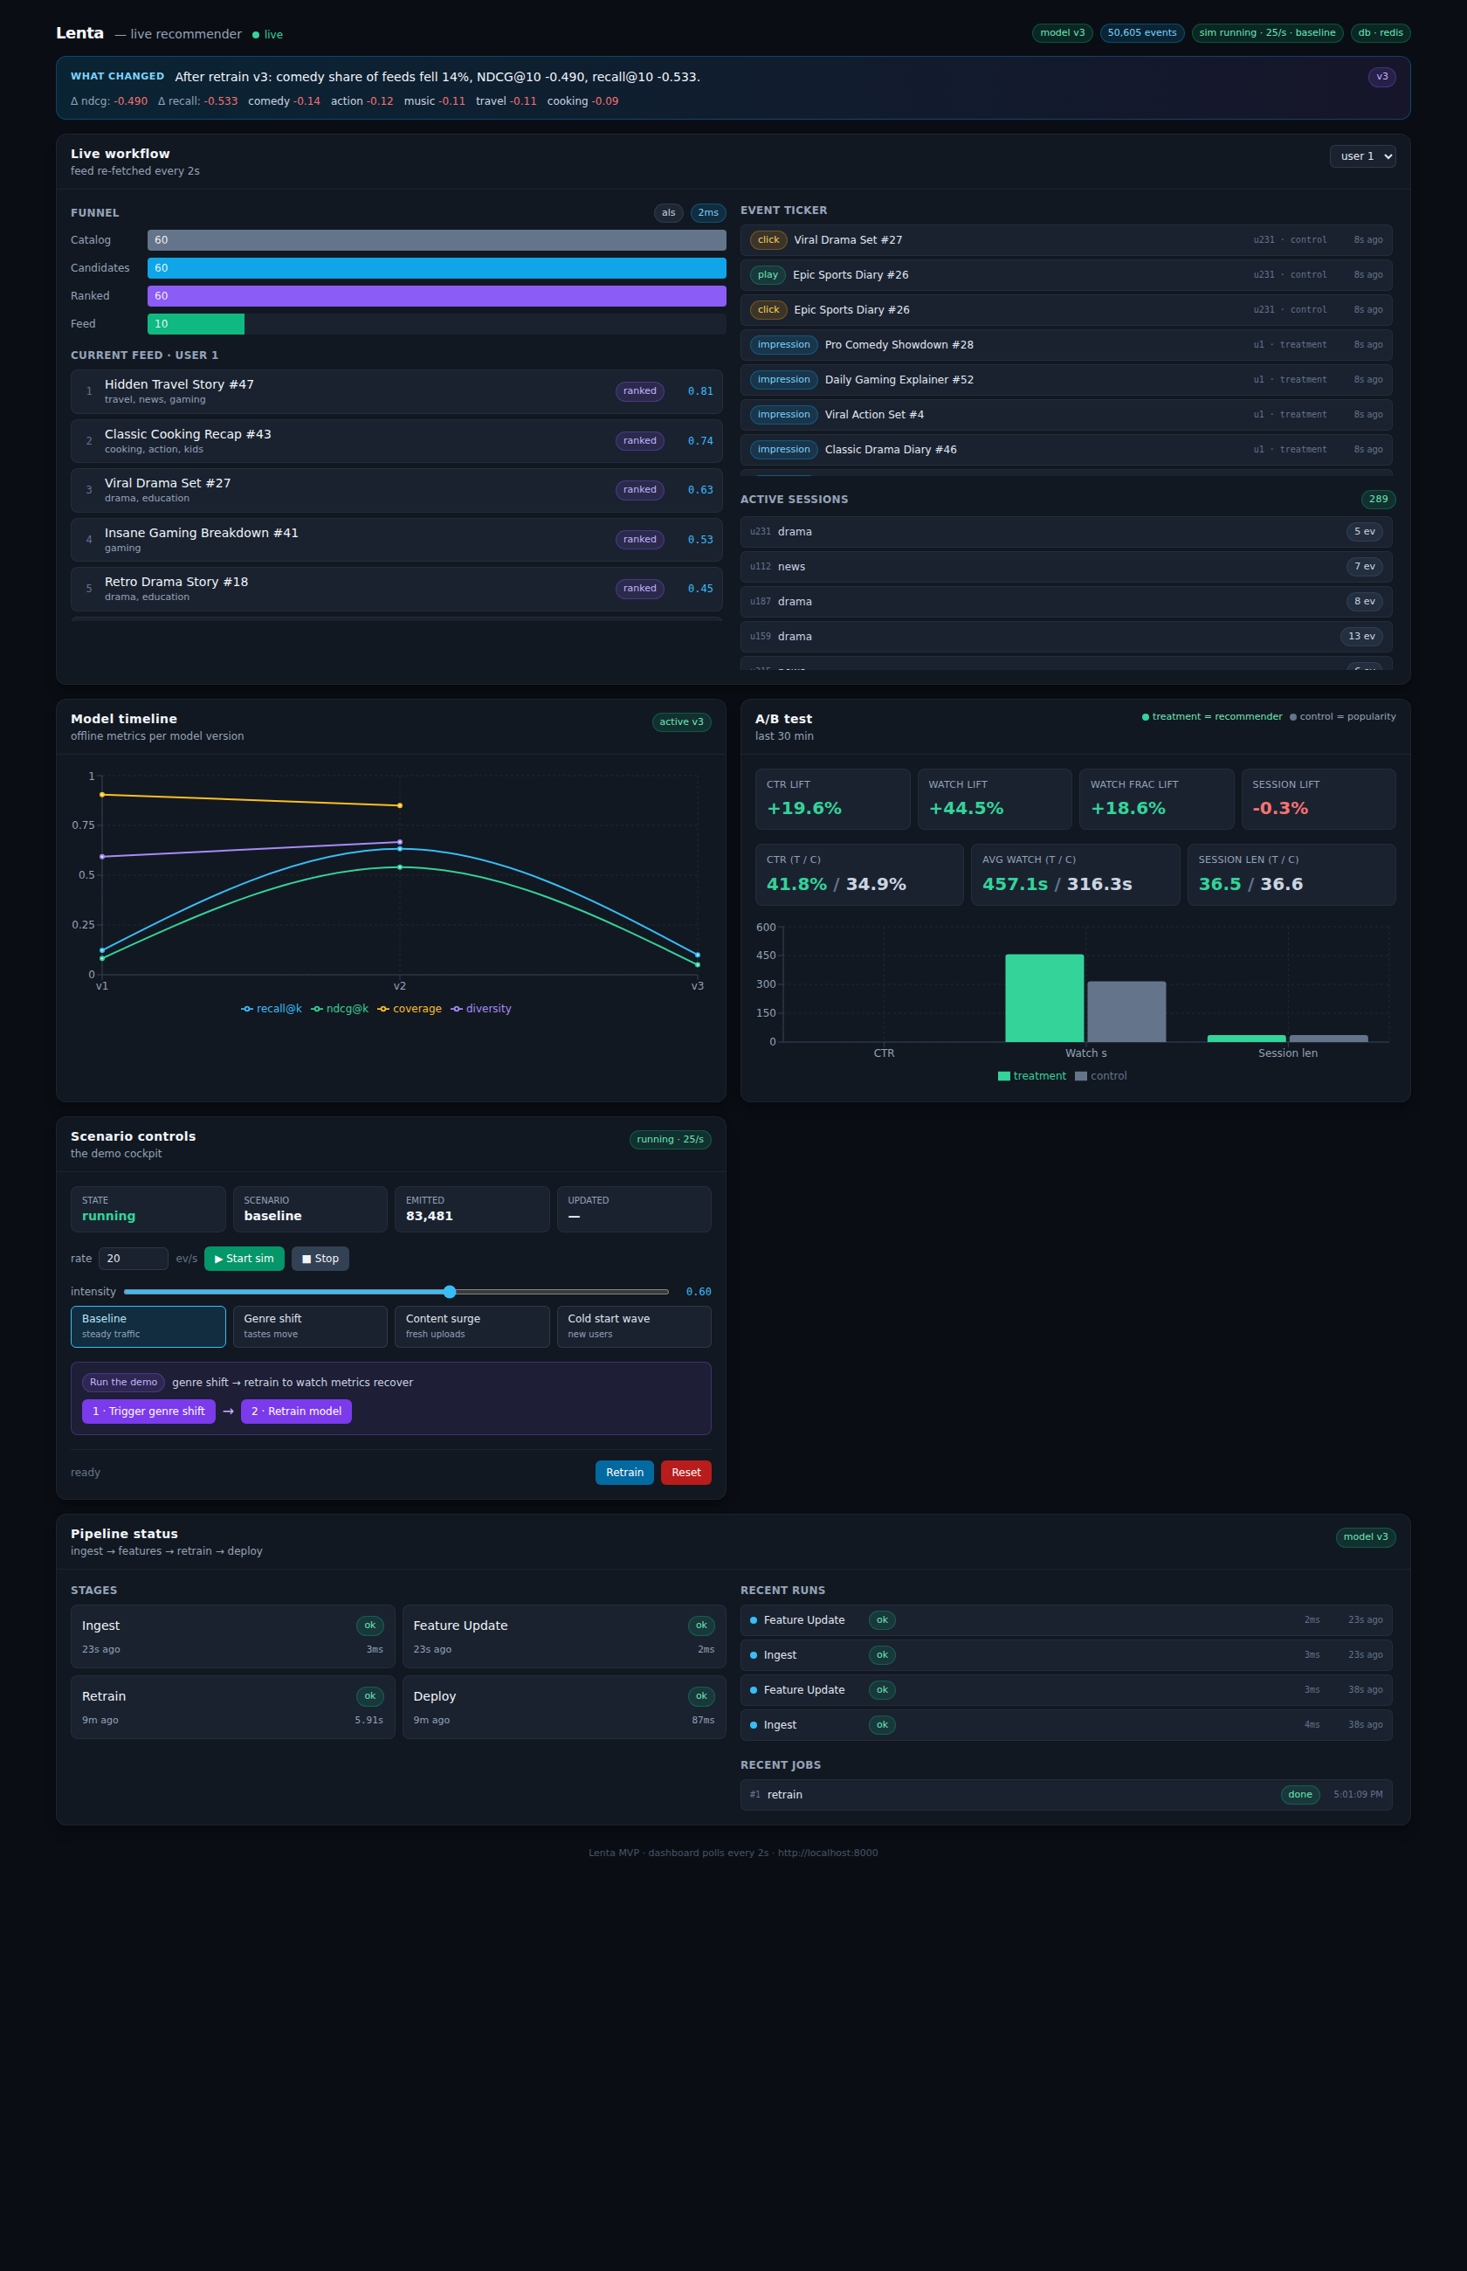
04
The live monitoring dashboard
Five panels, all updating live (~2s):
1 · Live workflow —
funnel counts, a live feed, event ticker, active sessions
2 · Model timeline —
model quality across versions as it learns
3 · A/B test —
recommender vs popularity, with the lift readout
4 · Scenario controls —
the demo cockpit — sim, scenarios, retrain, reset
5 · Pipeline status —
ingest → feature update → retrain → deploy, live
A banner prints a plain-English summary after each retrain — e.g. “after retrain v7, comedy share of feeds rose 18%, NDCG@10 +0.04.”

Slide 6
05
How to use it — the live demo (~1 minute)
1
Start the simulation —
synthetic users flow through the real recommender; the dashboard comes alive.
2
Read the A/B panel —
the recommender already beats the popularity baseline — most on watch-time.
3
Inject genre_shift —
a cohort suddenly prefers a new genre (a “tastes changed” event).
4
Trigger retrain —
a new model trains, is evaluated, and goes live in ~10 seconds.
5
Watch it adapt —
the banner, the model timeline, and the user's feed all shift to the new genre.
Other scenarios (same inject → retrain pattern):
new_content_surge · cold_start_wave · baseline

Slide 7
06
Results — proven impact
Live A/B test: recommender (treatment) vs popularity (control)
Metric | Meaning | Lift
Avg watch-time | the retention signal | ≈ +45%
Watch-fraction | how much gets watched | ≈ +34%
Session length | videos per session | ≈ +26%
Click-through rate | secondary signal | positive
Why watch-time leads
• Lenta optimizes watch-time, so that — not raw clicks — is the headline.
• It also ~doubles the popularity baseline on offline ranking (Recall@K / NDCG@K).
Built like production, not a prototype:
• Zero-downtime model hot-swaps.
• Train/serve feature parity.
• Runs indefinitely — event log, artifacts & tables auto-bounded.
• Deterministic, typed, health-checked, tested.
• Cloud-deployed on Railway (per-service containers).
• Managed Postgres + Redis; GitHub auto-deploy.
• Stack: Python · FastAPI · implicit (ALS) · LightGBM · React/TypeScript.
• Custom domains; live now.

Slide 8
07
Applying Lenta to your platform
API-first — keep your stack, integrate at just two touch-points:
① Render feeds — GET /feed
② Stream behavior — POST /event
• Call /feed?user_id=&k= on home / browse / “up next” and render the returned videos.
• Send impression / click / play with watch_seconds & watch_fraction — the fuel the model learns from.
Then it's automatic:
the trainer retrains on your events and the API hot-swaps the new model. Roll out safely with the built-in A/B (start 5–10% treatment → ramp).
Two deployment patterns
Phased, safe migration
• Sidecar microservice (recommended): run Lenta next to your platform; call it over HTTP. Language-agnostic, low coupling.
• Embedded library: import the core Python package and call it in-process.
• Shadow — log events & generate feeds without showing them.
• Canary A/B — 5–10% of users on Lenta.
• Ramp — 50/50 → full, keep a small control to quantify value.
• Full guide: docs/INTEGRATION.md

Slide 9
08
Scaling to thousands → millions of users
Same multi-stage funnel Netflix / YouTube / Amazon use — so scaling is localized, low-risk upgrades, not rewrites.
Component | MVP today | At scale (10k → 10M+)
API serving | single instance | N stateless replicas + autoscaling
Candidate gen | ALS over full catalog | Two-tower + ANN index (FAISS/ScaNN/pgvector) — <10ms over 100M+
Ingestion | sync POST → Postgres | Kafka / Redpanda stream → Redis + batch-write
Artifacts | Postgres bytea | object storage (S3 / Cloudflare R2)
Already built for it
• Stateless serving + hot-swap registry · auto-bounded event log/artifacts → serving DB stays lean at any volume.
• Recency-weighted, event-capped training stays fast regardless of history · built-in A/B = safe canary for every model. (Full guide: docs/SCALING.md)

Slide 10
Try it now
Press Start → genre_shift → Trigger retrain and watch Lenta learn in real time.
Dashboard:
https://lenta-mvp.xyz
API & docs:
https://api.lenta-mvp.xyz/docs
Source code:
github.com/khnur/lenta-mvp
Working · Deployed · Live · Open-source Thank you for reviewing Lenta.

