Slide 2


Mock Project -Bootloader

Slide 3


GROUP 3
Lương Việt Khoa
Nguyễn Đình Tùng
Leader
Trương Phi Long
Nguyễn Hữu Tuấn
Lê Duy Hoàng Minh

Slide 4
LESSION OBJECTIVE
01
03
02
04
Introduce the Bootloader
Bootloader Program
Implementation
Principle diagram

Slide 5
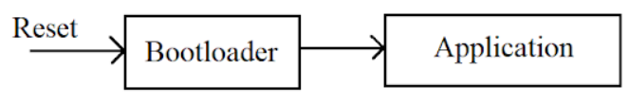
1. INTRODUCTION
Bootloader is like a firmware that is loaded into the computer memory and called every time the computer boots
If there is a Bootloader program loaded into the microcontroller, it will first jump into this Bootloader program, do some work then switch to the application program to do it.

Slide 6
Why is Bootloader needed ?
Firmware Update is very important, especially for IoT products
Security, which is absolutely important with embedded/IOT products.

Slide 7
2. IMPLEMENTATION
1. Hardware and software:
Hardware: Kit FRDM-KL46Z
Software: IAR EW for Arm
2. Firmware
The firmware that we will write here includes the Bootloader program, and two application programs for us to try the firmware update feature.
We can switch between two Firmware by button

Slide 8
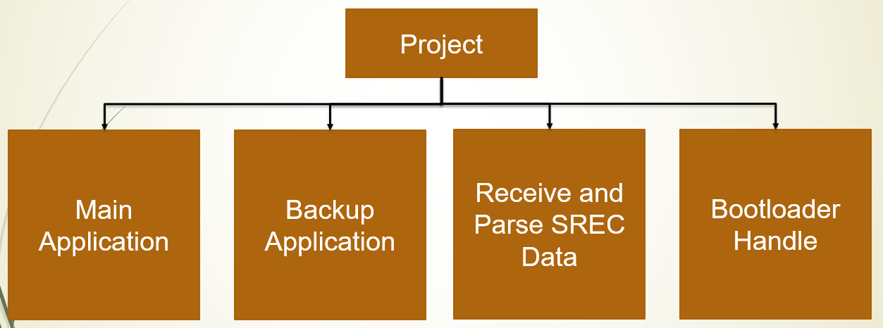

Slide 9
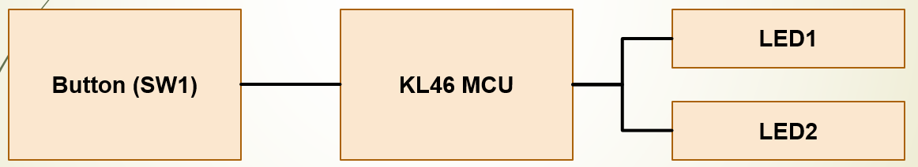
#Application 1: Blink Led
Click 1 time – both LED1 and LED2 blink with T = 200ms
Click 2 times – 2 led blink one after another with T = 200ms
Flashing to Sector 4

Slide 10
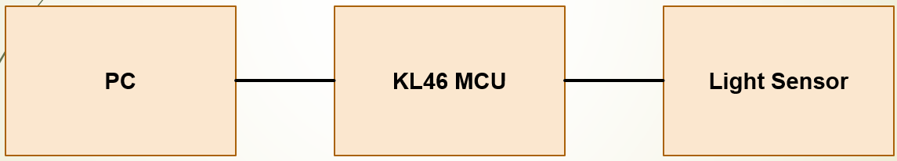
#Application 2: ADC Light Sensor
Read Light Sensor each 1s and save 10 times of data
When PC send a command (0x55) to MCU, it send last 10 times of
data to PC.
- Flashing to Sector 10

Slide 11
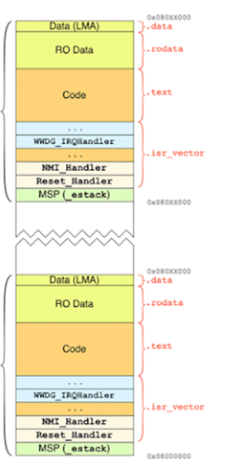
Firmware 2
Firmware 1

Slide 12
3. Bootloader Program
Reset
Jump Address
Main() function
Get address the current firmware on flash
Bootloader() function
Jump Curent Firmware
Application code
Soft Reset
Super loop

Slide 13
Specifically about the Bootloader() function
Start
Get the address of the Firmware to jump to.
Disable system interrupts and clear pending Interrupts, to avoid interrupting the Boot program.
Set MSP - Main Stack Pointer and SCB_VTOR register with the aforementioned effect.
Set PC - Program Counter points to Reset_Handler() of the new Firmware.
Call Reset_Handler() to reset the program. Now, the processor will start with the new Firmware.
Get address to jump to
Disable all interrupt
Disable Faul Handler
Set main stack point
Set program counter
Jump to application

Slide 14
4. Principle diagram
Reset
SW1
SW2
Delay 5s
Firm 2
Load Firm
Firm 1

Slide 15

Thanks for watching!

