Slide 1
Java core review

Slide 2
Portability
Byte code (.class)
Java Virtual
Machine for Windows
Java Virtual
Machine for Unix
Java Virtual
Machine for Linux
Java Virtual
Machine for Mac

Slide 3
Program Development Process (Java)
Text editor
Saves Java statements
Source code
(.java)
Is read by
Byte code (.class)
Java compiler
Produces
Is interpreted by
Program
Execution
Java
Virtual
Machine
Results in

Slide 4
Object-Oriented Programming
Object
Data (Fields) typically private to this object
Methods That Operate on the Data
Code Outside the Object

Slide 5
Converting the UML Diagram to Code
public class Rectangle
{
private double width;
private double length;
public void setWidth(double w)
{ width = w;
}
public void setLength(double len)
{ length = len;
}
public double getWidth()
{ return width;
}
public double getLength()
{ return length;
}
public double getArea()
{ return length * width;
}
}
Once the class structure has been tested, the method bodies can be written and tested.
Rectangle
width : double
length : double
+ setWidth(w : double) : void
+ setLength(len : double): void
+ getWidth() : double
+ getLength() : double
+ getArea() : double

Slide 6
Overloaded Method add Fill in the box the method signature)
public int add(int num1, int num2)
{
int sum = num1 + num2;
return sum;
}
public String add (String str1, String str2)
{
String combined = str1 + str2;
return combined;
}

Slide 7
Method Signature and Binding
Signatures of the add methods of previous slide
A method signature consists of the method’s name and the data types of the method’s parameters, in the order that they appear. The return type is not part of the signature.
add(int, int)
add(String, String)
The process of matching a method call with the correct method is known as binding. The compiler uses the method signature to determine which version of the overloaded method to bind the call to.

Slide 8
A .java file may contain many classes but may only have one public class? True or False
Primitive Data Types; They are (at least 5): _________; ___________; ____________; _____________; ________ …
3. Strings are Immutable Objects. Give an example

Slide 9
Describe Objects ; Classes; instance
Classes: Where Objects Come From
Each object that is created from a class is called an instance of the class.

Slide 10
Instance Fields and Methods
public class Rectangle
{
private double width;
private double length;
public void setWidth(double w)
{ width = w;
}
public void setLength(double len)
{ length = len;
}
public double getWidth()
{ return width;
}
public double getLength()
{ return length;
}
public double getArea()
{ return length * width;
}
}
Objects created from a class each have their own copy of instance fields.
Instance methods are methods that are not declared with a special keyword, static.
Instance fields and instance methods require an object to be created in order to be used.
Rectangle kitchen = new Rectangle();
Rectangle bedroom = new Rectangle();

Slide 11
Static Class Members
What are Static Fields? (Draw a picture to describe)
instanceCount field
(static)
3
Object1
Object2
Object3

Slide 12
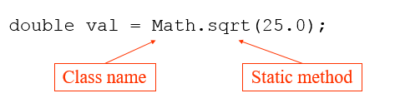
What are Static Methods
Using static Methods
Static methods are convenient because they may be called at the class level.
They are typically used to create utility classes, such as the Math class in the Java Standard Library.
Static methods may not communicate with instance fields, only static fields.

Slide 13
Passing Objects as Arguments
Draw how the object box passing as argument
A Rectangle object
length:
width:
12.0
displayRectangle(box);
5.0
Address
public static void displayRectangle(Rectangle r)
{
// Display the length and width.
System.out.println("Length: " + r.getLength() +
" Width: " + r.getWidth());
}

Slide 14
Returning Objects from Methods
account = getAccount();
A BankAccount Object
balance:
3200.0
address
public static BankAccount getAccount()
{
…
return new BankAccount(balance);
}

Slide 15
What will be printed out?
Stock xyzCompany = new Stock ("XYZ", 9.62);
System.out.println("The stock data is:\n" + xyzCompany);

Slide 16
What of the objects are compared by default operation of the
equals method & == operator

Slide 17
Methods That Copy Objects
Reference only copy (give example for Stock class)
Deep copy (correct; give example)

Slide 18
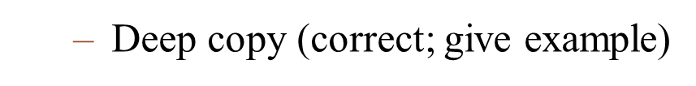
Reference only copy
A BankAccount object
Balance:
account1
Address
500.0
account2
Address
// Create a Stock object
Stock company1 = new Stock("XYZ", 9.62);
//Create company2, a copy of company1
Stock company2 = new Stock(company1);

Slide 19
Aggregation in UML Diagrams
Write the constructor & Get methods of Course class
Course
- courseName : String
- Instructor : Instructor
- textBook : TextBook
+ Course(name : String, instr : Instructor, text : TextBook)
+ getName() : String
+ getInstructor() : Instructor
+ getTextBook() : TextBook
+ toString() : String
Instructor
TextBook
lastName : String
firstName : String
officeNumber : String
title : String
author : String
publisher : String
+ Instructor(lname : String, fname : String,
office : String)
+Instructor(object2 : Instructor)
+set(lname : String, fname : String,
office : String): void
+ toString() : String
+ TextBook(title : String, author : String, publisher :
String)
+ TextBook(object2 : TextBook)
+ set(title : String, author : String, publisher : String)
: void
+ toString() : String

Slide 20
public Course(String name, Instructor instr, TextBook text)
{
// Assign the courseName.
courseName = name;
// Create a new Instructor object, passing
// instr as an argument to the copy constructor.
instructor = new Instructor(instr);
// Create a new TextBook object, passing
// text as an argument to the copy constructor.
textBook = new TextBook(text);
}
public Instructor getInstructor()
{
// Return a copy of the instructor object.
return new Instructor(instructor);
}

Slide 21
Enumerated Types
Use enum to declare branches: DANANG, HCM, CANTHO
(Definition, Declaration, Assignment)

Slide 22
And complete the code in main function
/**
Candidate (firstname, lastname, branch);
branch is an emum type.
*/
public static void main(String[] args)
{
// Create a new Candidate object.
Candidate newCandidate = .............................
}
new Candidate(“Balloon”, “Nguyen”, branch.HCM);

Slide 23
Explain: What & Why we use them? Give examples
String Methods
The StringBuilder Class

Slide 24
String vs StringBuilder
The StringBuilder class is similar to the String class.
However, you may change the contents of StringBuilder objects.
You can change specific characters,
insert characters,
delete characters, and
perform other operations.
A StringBuilder object will grow or shrink in size, as needed, to accommodate the changes.

Slide 25
The numeric primitive wrapper classes are:
Wrapper Class | Numeric Primitive Type It Applies To
 | byte
 | double
 | float
 | int
 | long
 | short
Wrapper Class | Numeric Primitive Type It Applies To
Byte | byte
Double | double
Float | float
Integer | int
Long | long
Short | short
If the String object does not represent a numeric value. The parse method will throw what exception?
NumberFormatException

Slide 26
Give example for: Autoboxing and Unboxing
You can declare a wrapper class variable and assign a value:
Integer number;
number = 7;
You nay think this is an error, but because number is a wrapper class variable, autoboxing occurs.
Unboxing does the opposite with wrapper class variables:
Integer myInt = 5; // Autoboxes the value 5
int primitiveNumber;
primitiveNumber = myInt; // unboxing

Slide 27
What is “is a” Relationship? Give example about it?
Insect
Contains those attributes and methods that are shared by all insects.
BumbleBee
Grasshopper
Contains those attributes and methods that specific to a Bumble Bee.
Contains those attributes and methods that are specific to a Grasshopper.

Slide 28
Access Specifiers??
Access Modifier | Accessible to a subclass inside the same package? | Accessible to all other classes inside the same package?
default (no modifier)
Public
Protected
Private
Access Modifier | Accessible to a subclass outside the package? | Accessible to all other classes outside the package?
default (no modifier)
Public
Protected
Private

Slide 29
Access Specifiers
Access Modifier | Accessible to a subclass inside the same package? | Accessible to all other classes inside the same package?
default (no modifier) | Yes | Yes
Public | Yes | Yes
Protected | Yes | Yes
Private | No | No
Access Modifier | Accessible to a subclass outside the package? | Accessible to all other classes outside the package?
default (no modifier) | No | No
Public | Yes | Yes
Protected | Yes | No
Private | No | No

Slide 30
Polymorphism and Dynamic Binding
GradedActivity
setScore, getScore, and getGrade
FinalExam
getPointsEach, getNumMissed
PassFailActivity
getGrade (@Override)
Each line is correct?
GradedActivity exam = new PassFailExam(100, 10, 70);
System.out.println(exam.getScore()); System.out.println(exam.getGrade());
System.out.println(exam.getPointsEach());
PassFailExam
getPointsEach, getNumMissed
Notes:
Java performs dynamic binding or late binding when a variable contains a polymorphic reference.
The Java Virtual Machine determines at runtime which method to call, depending on the type of object that the variable references.

Slide 31
Abstract Classes
The abstract class represents the generic or abstract form of all the classes that are derived from it.
public abstract class ClassName
Interfaces
The purpose of an interface is to specify behavior for other classes.
It is often said that an interface is like a “contract,” and when a class implements an interface it must adhere to the contract.

Slide 32
Polymorphism with Interfaces
Java allows you to create reference variables of an interface type.
An interface reference variable can reference any object that implements that interface, regardless of its class type.

Slide 33
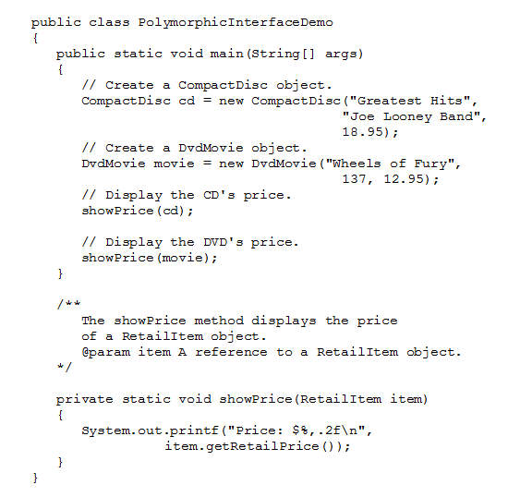
Example:
RetailItem.java
CompactDisc.java
DvdMovie.java
PolymorphicInterfaceDemo.java
public interface RetailItem
{
public double getRetailPrice();
}

