Slide 1


W E L C O M E
to our Computer Vision project presentation topic:
Surface Crack Classification
Team members
Pham Van Khoa – 20176796
Hoang Tuan Anh Van – 20170224
Tran Le Hoang – 20176764
Tran Hai Son – 20176861
Vu Hai Dang – 20176711

Slide 2
C O N T E N T S
Introduction
Context
The Dataset
Different methods
Convolutional Neural Network
VGG-16 Deep Learning
Image Processing

Slide 3
I . I n t r o d u c t i o n
Context:
Concrete surface cracks are major defect in civil structures. Building Inspection which is done for the evaluation of rigidity and tensile strength of the building.
Crack detection plays a key role in the building inspection, finding the cracks and determining the building health.

Slide 4
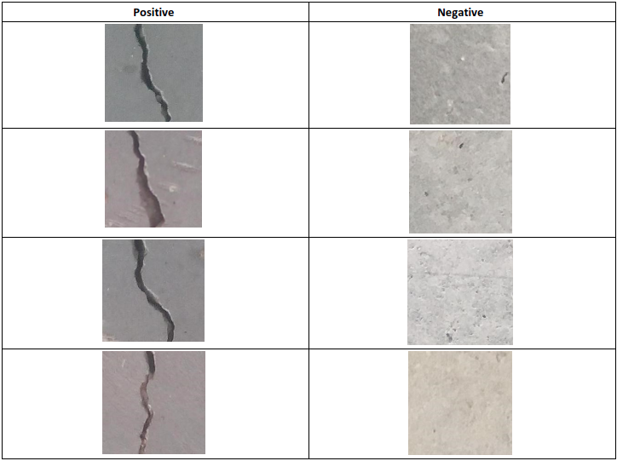
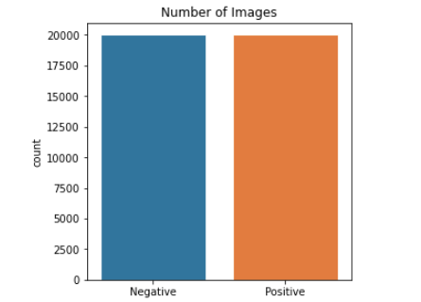
I . I n t r o d u c t i o n
The Dataset:
The dataset contains images of various concrete surfaces with and without crack. The image data are divided into two classes: negative (without crack) and positive (with crack).
Each class has 20000 images, 40000 images in total. Every images are in RGB channels with the size of 227 x 227.

Slide 5
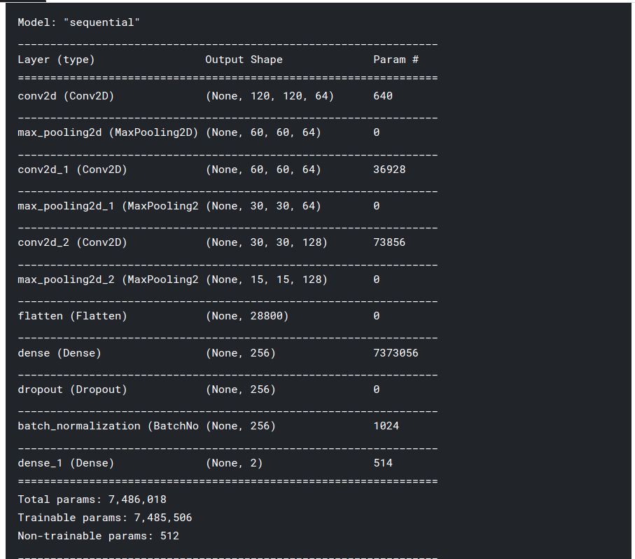
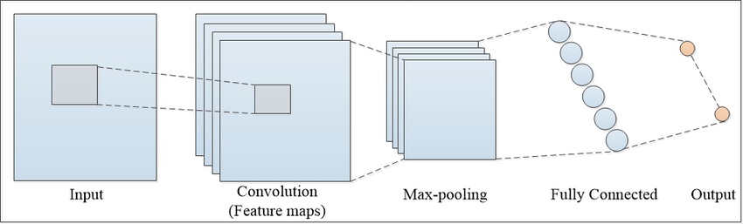
I I . Convolutional Neural Network
Introduction:
A Convolutional neural network (CNN) is a neural network that has one or more convolutional layers and are used mainly for image processing, classification, segmentation,…
Rather than looking at an entire image at once to find certain features it can be more effective to look at smaller portions of the image.
Our Convolutional Neural Network with 11 layers
Architecture of a convolutional neural network with 3 layers
Notes:
Standardizing the activations of the prior layer means that assumptions the subsequent layer makes about the spread and distribution of inputs during the weight update will not change, at least not dramatically. This has the effect of stabilizing and speeding-up the training process of deep neural networks.

Slide 6
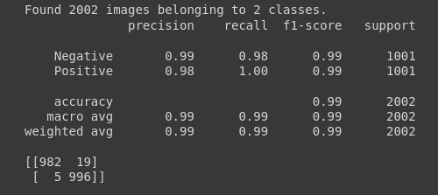
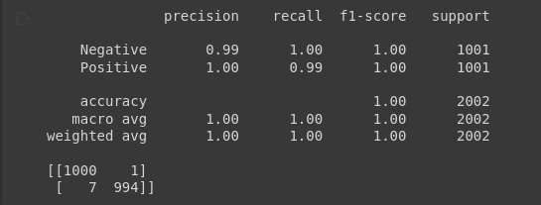
I I . Convolutional Neural Network
Result:
The result without augmentation is slightly better than one with augmentation. However, both ways still perform outstandingly with the F1-score of 99%.
The model with data augmentation might require more time and epochs to learn since the number data samples is significantly increased.
Without augmentation
With augmentation
Notes:
Standardizing the activations of the prior layer means that assumptions the subsequent layer makes about the spread and distribution of inputs during the weight update will not change, at least not dramatically. This has the effect of stabilizing and speeding-up the training process of deep neural networks.

Slide 7
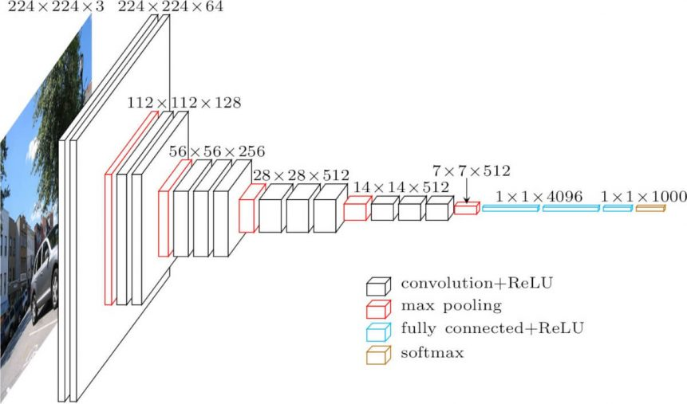
I I . VGG-16
VGG-16:
First proposed by K.Sumonyan and A.Zisserman
VGG-16 made an improvement over AlexNet architecture by replacing 11 and 5 kernel-sized filters in the first and second convolutional layer, correspondingly, with multiple 3x3 kernel-sized filters one after another.

Slide 8
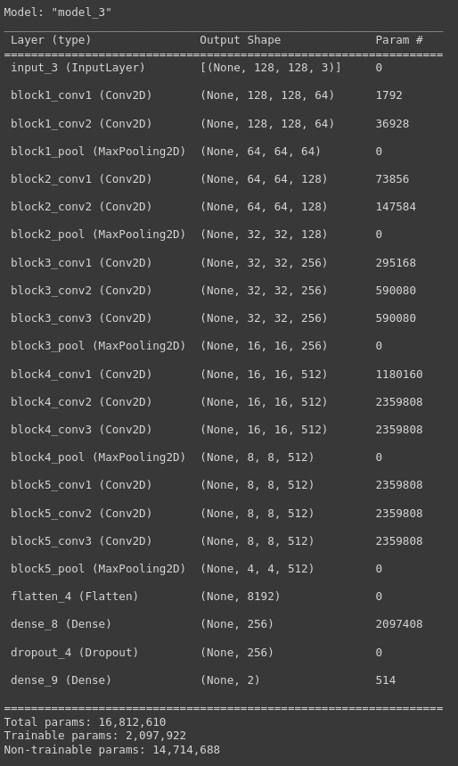
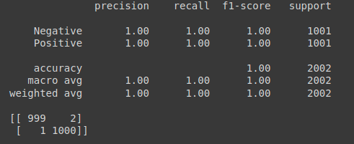
I I . VGG-16
Our model:
We used pretrained VGG-16 model connected to custom fully connected layers
This model correctly predicted almost all images in the test set

Slide 9
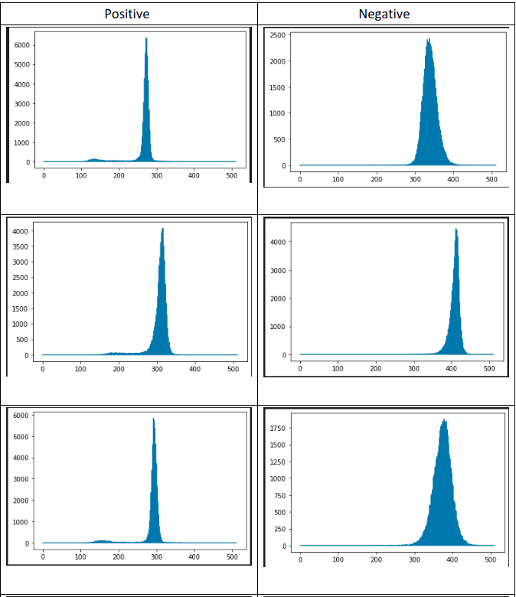
I I . Image Processing
Inspecting image data:
The crack region has darker color and they take up a noticeable amount of space in the image. With this information, we decided to take advantages over the differential between pixel value of two regions: Region that contains the crack and the region that does not.
Histogram of several images

Slide 10
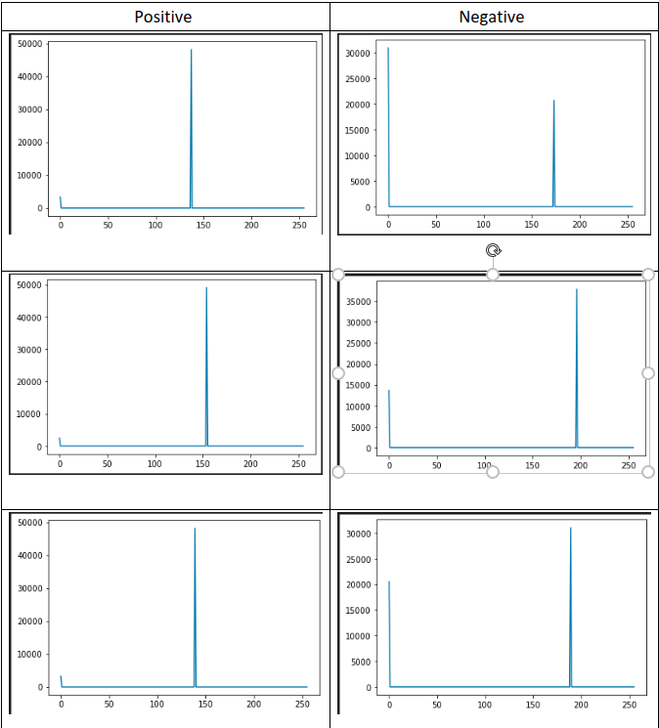
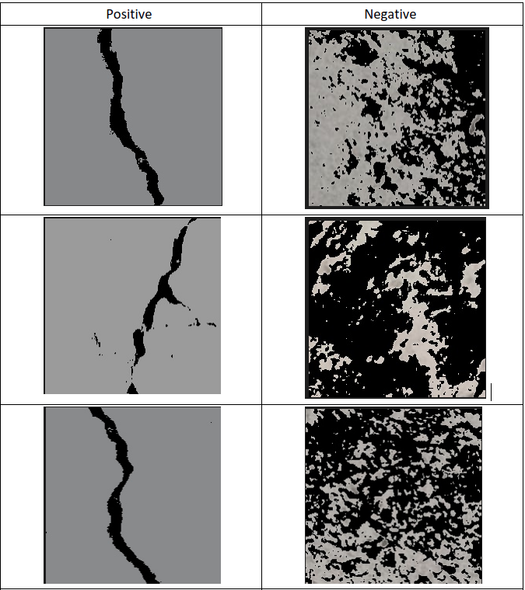
I I . Image Processing
Inspecting image data:
Using color clustering algorithm to segment our images based on color pixel value.
KMeans with K=2
Histogram of image results from KMeans
Result of KMeans

Slide 11
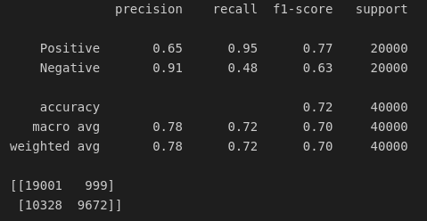
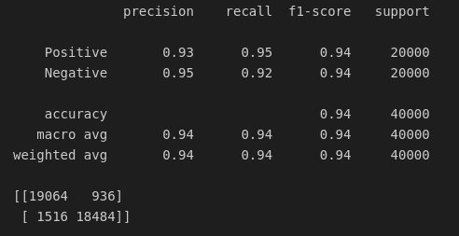

I I . Image Processing
Result:
Initial centroids have a major impact on KMeans performance.
OpenCV KMeans, K=2, Random Initial Centroids, Threshold: 0.75
Sklearn KMeans, K=2, kmeans++, Threshold: 0.8
This method using Image processing and KMeans performs well and the best result reaches the F1-score of 94%, and Positive recall of 95%. We want to focus on the Positive recall accuracy here since it is particularly important due to the characteristics of this problem, we do not want to miss any surfaces that have crack, it may lead to severe consequences.

Slide 12


T H A N K Y O U !
Team members
Pham Van Khoa – 20176796
Hoang Tuan Anh Van – 20170224
Tran Le Hoang – 20176764
Tran Hai Son – 20176861
Vu Hai Dang – 20176711

