Slide 2

Young Professional Program 4th
bbv Software Services AG | 24/08/2025

Slide 3




Milestone Review Presentation
Khoa Do | 24/08/2025

Slide 4
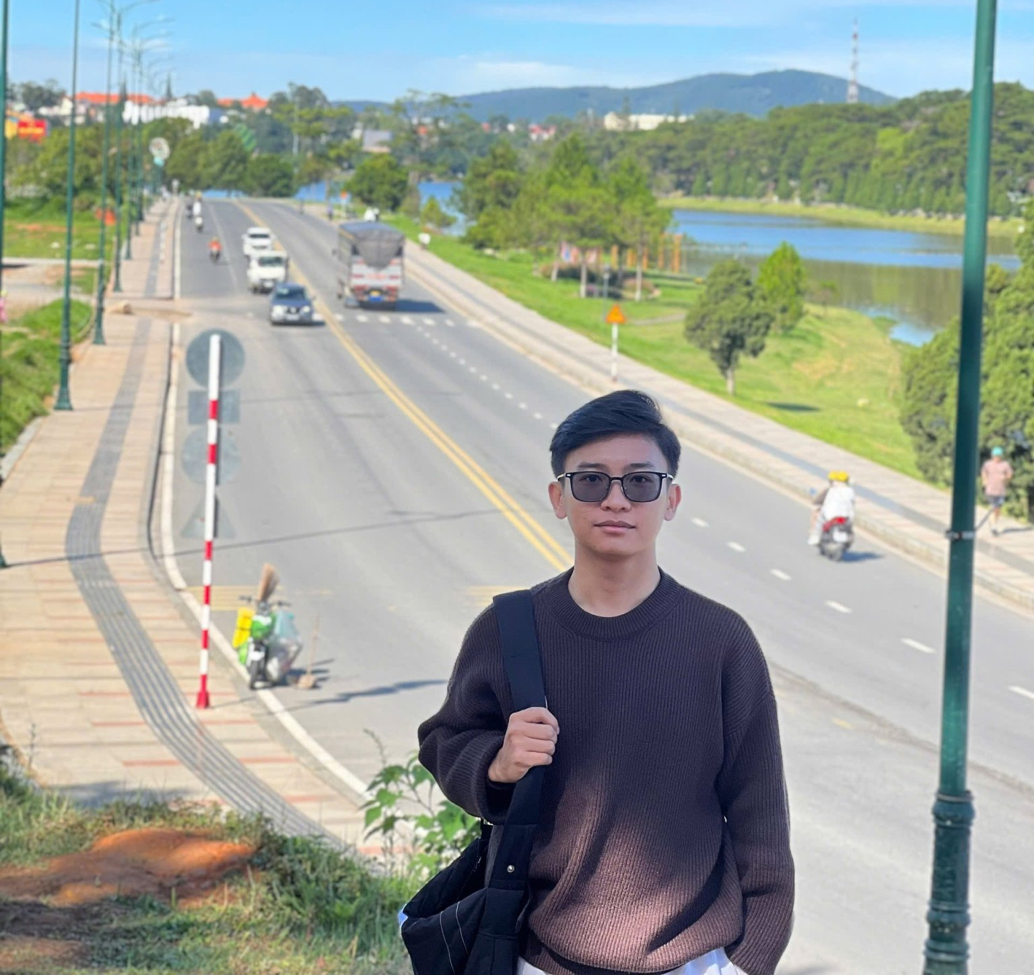
Opening
Name: Khoa Do
Education: FPT University Can Tho
Hometown: Dong Thap province
Goal: Become Software Engineering

Slide 5
Agenda
Learning Journey
Challenges & How I Overcame Them
Growth & Improvements
Cultural Experience
Summary & Takeaways
Q&A

Slide 6

Learning Journey
Technical & Non-Technical

Slide 7
Learning Journey
Technical
Database Design
Queries & Unit Testing
Dependency Injection
MVC Proof-of-Concept
Notes:
dùng timeline để thể hiện quá trình tuần tự.

Slide 8
Learning Journey
Non-technical
Workshops (soft skills)
Effective Communication
Critical Thinking & Decision Making
Problem Solving
Time Management
English Club
Movie/TV
Money vs Happiness
Big City or Small Town
Notes:
dùng timeline để thể hiện quá trình tuần tự.

Slide 9

Challenges & Overcoming

Slide 10

Challenges & Overcoming
Challenges
Solution
Time Management
English communication
Prioritization of tasks
Handling complex technical concepts
Applied Top-down approach
Practiced English
Daily self-learning
Teamwork & feedback loops
Notes:
2 cột “Challenge vs Solution”

Slide 11
Growth

Slide 12

Growth
Improved coding style & query optimization
Stronger teamwork & communication
Better presentation & top-down explanation skills
Broader cultural awareness
Notes:
Có thể làm 1 slide so sánh Before vs After.

Slide 13
Cultural Experience

Slide 14
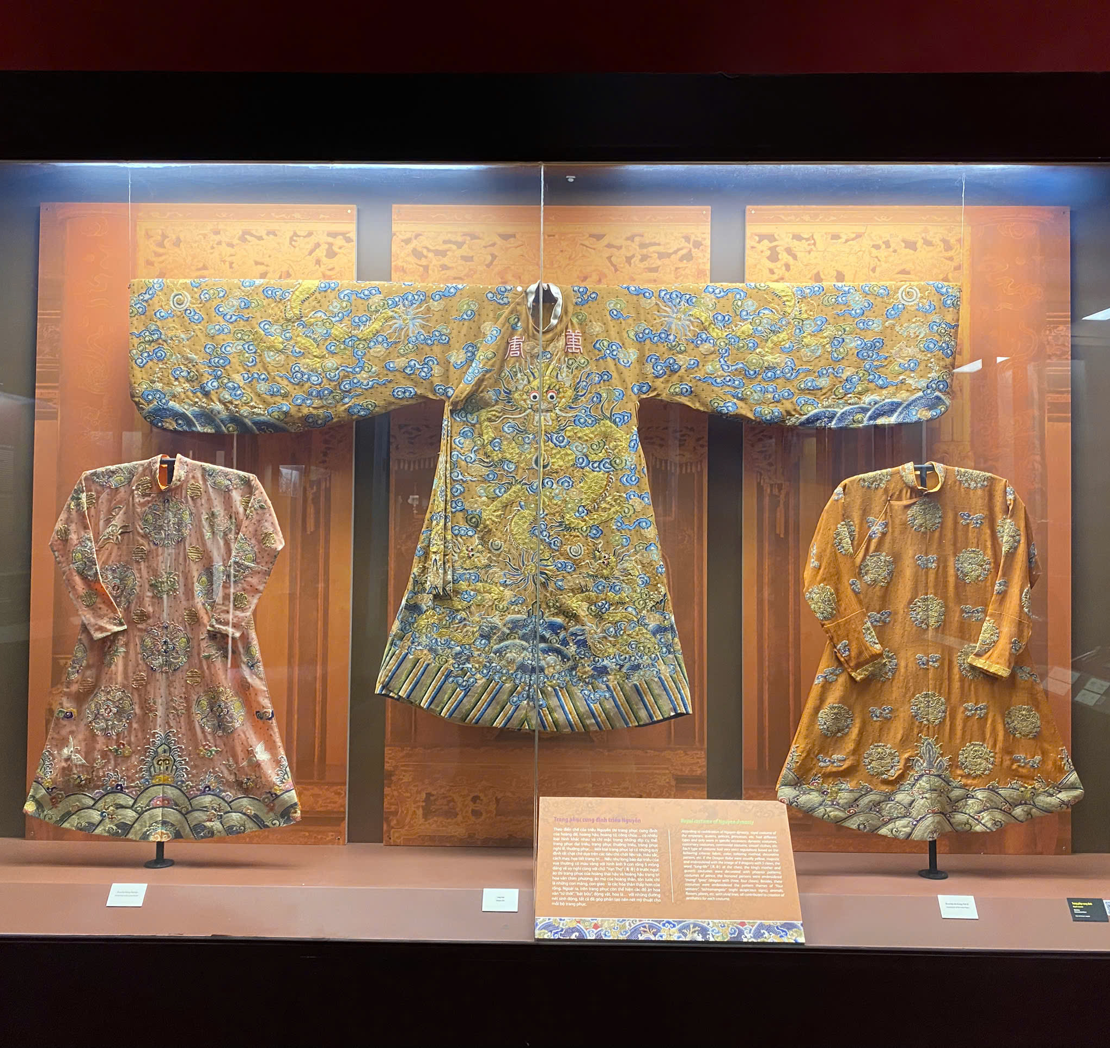
Cultural Experience
Why the Visit
Part of internship program → cultural exchange
Learn Vietnamese history across periods

Slide 15
Cultural Experience
Highlights
Timeline
Ancient Vietnam
Champa culture
Colonial period
Modern era
Key artifacts showing heritage and transformation

Slide 16

Cultural Experience
Personal Reflection
Practiced English with foreigners
Learned to explain history top-down
Connection between culture & technology
Notes:
Dùng ảnh hiện vật + timeline lịch sử.

Slide 17
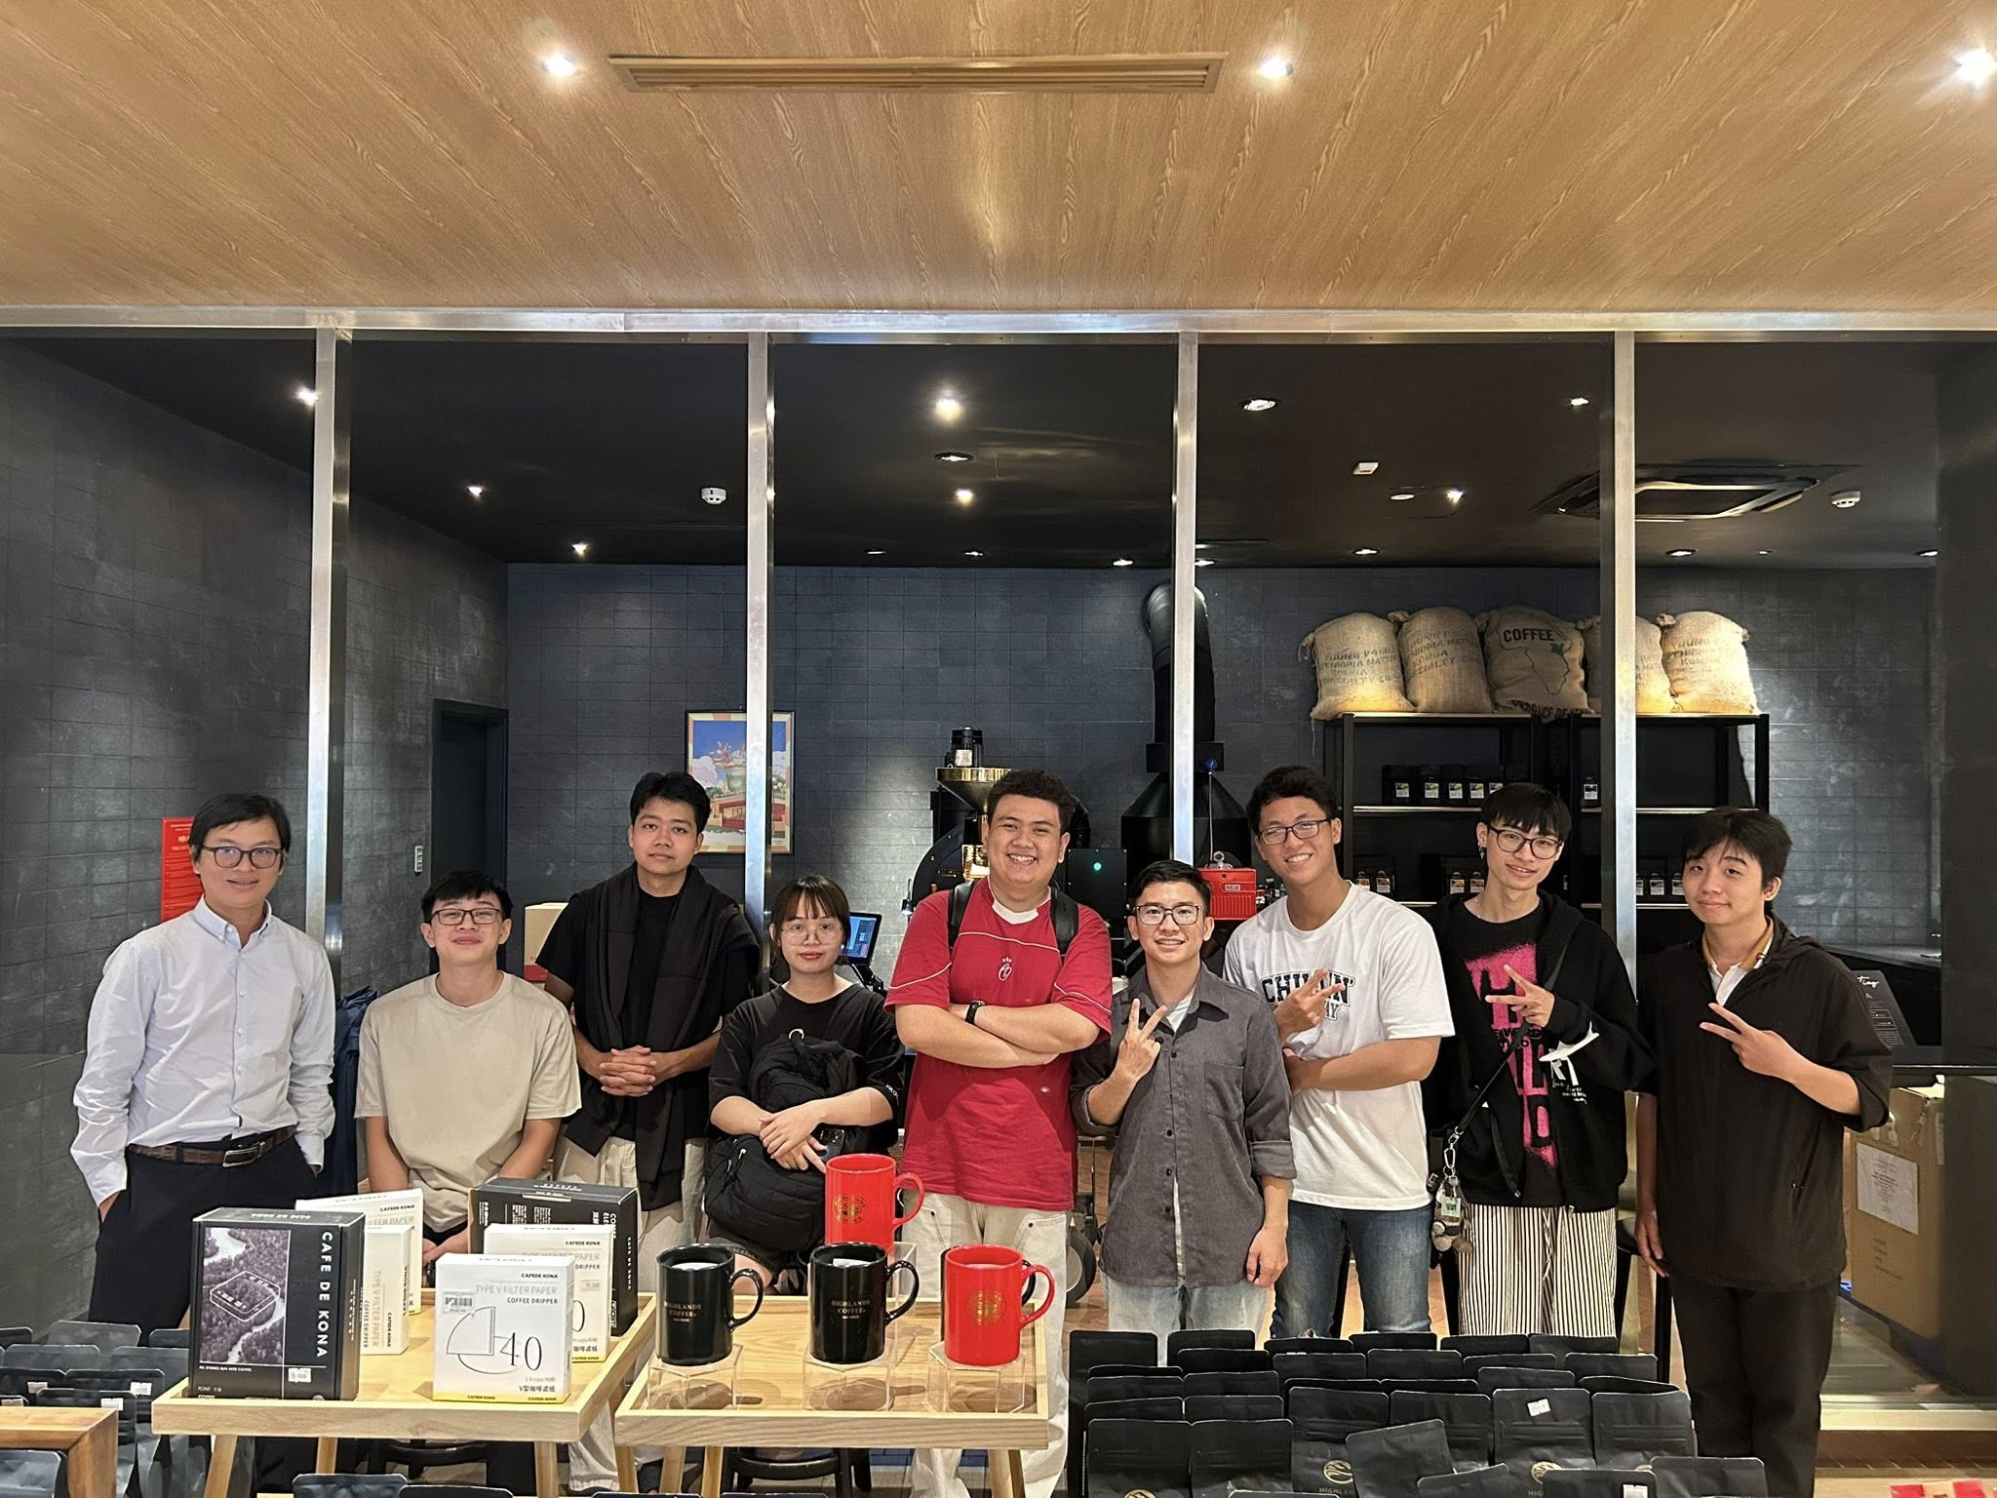
Closing
Summary of learning journey + cultural value
Message: Continuous growth & openness to learning

Slide 18

Q&A

