Slide 2

YPP 4th
bbv Software Services AG | Date

Slide 3




Presentation on Trello Functionalities
bbv Software Services AG | Date: 05/08/2025

Slide 4
Agenda
Introduction
Key Functionalities
Screens in Trello
Entities and Relationship in Trello
Q&A

Slide 5

INTRODUCTION
What is Trello?

Slide 6
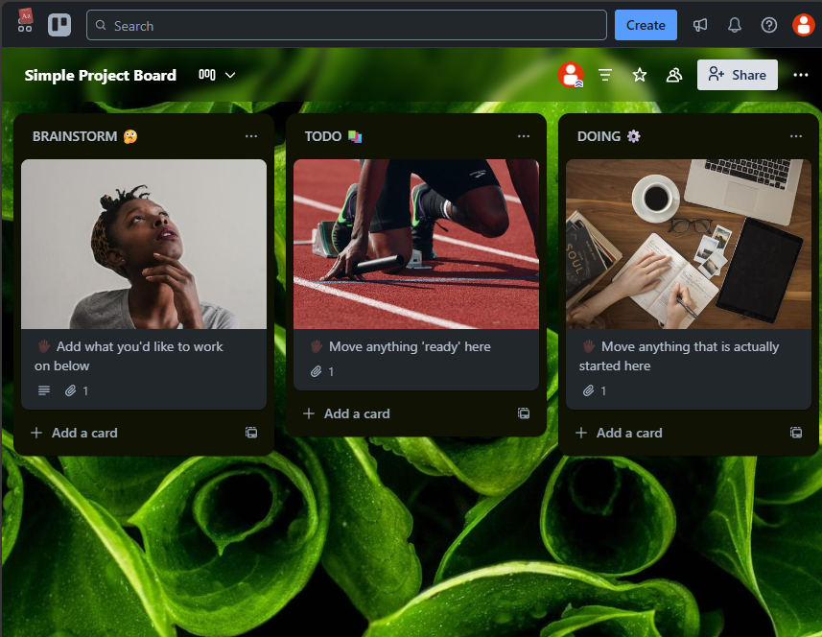
INTRODUCTION
Trello is a visual project management tool
Workspace → Board → Stage → Card to organize tasks
Collaborate with teams.
Intuitive drag-and-drop interface
Ideal for task management, kanban boards, and collaboration
Works for teams of any size

Slide 7

Key Functionalities

Slide 8
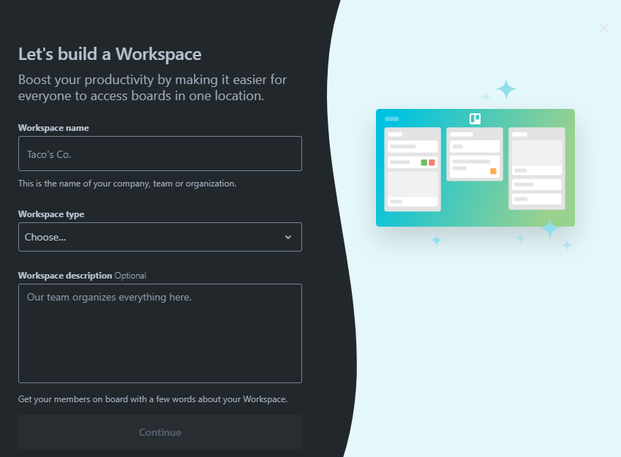
Key Functionalities of Trello
Create Workspaces and Boards
Create Stages within Boards
Create Cards (task items) inside Stages
Add custom fields to Cards
Assign Members to Cards
Add Labels, Due Dates, Checklists, and Attachments
Comment and track Activity on Cards
Manage Permissions and Sharing
Use Templates for quick project setup

Slide 9
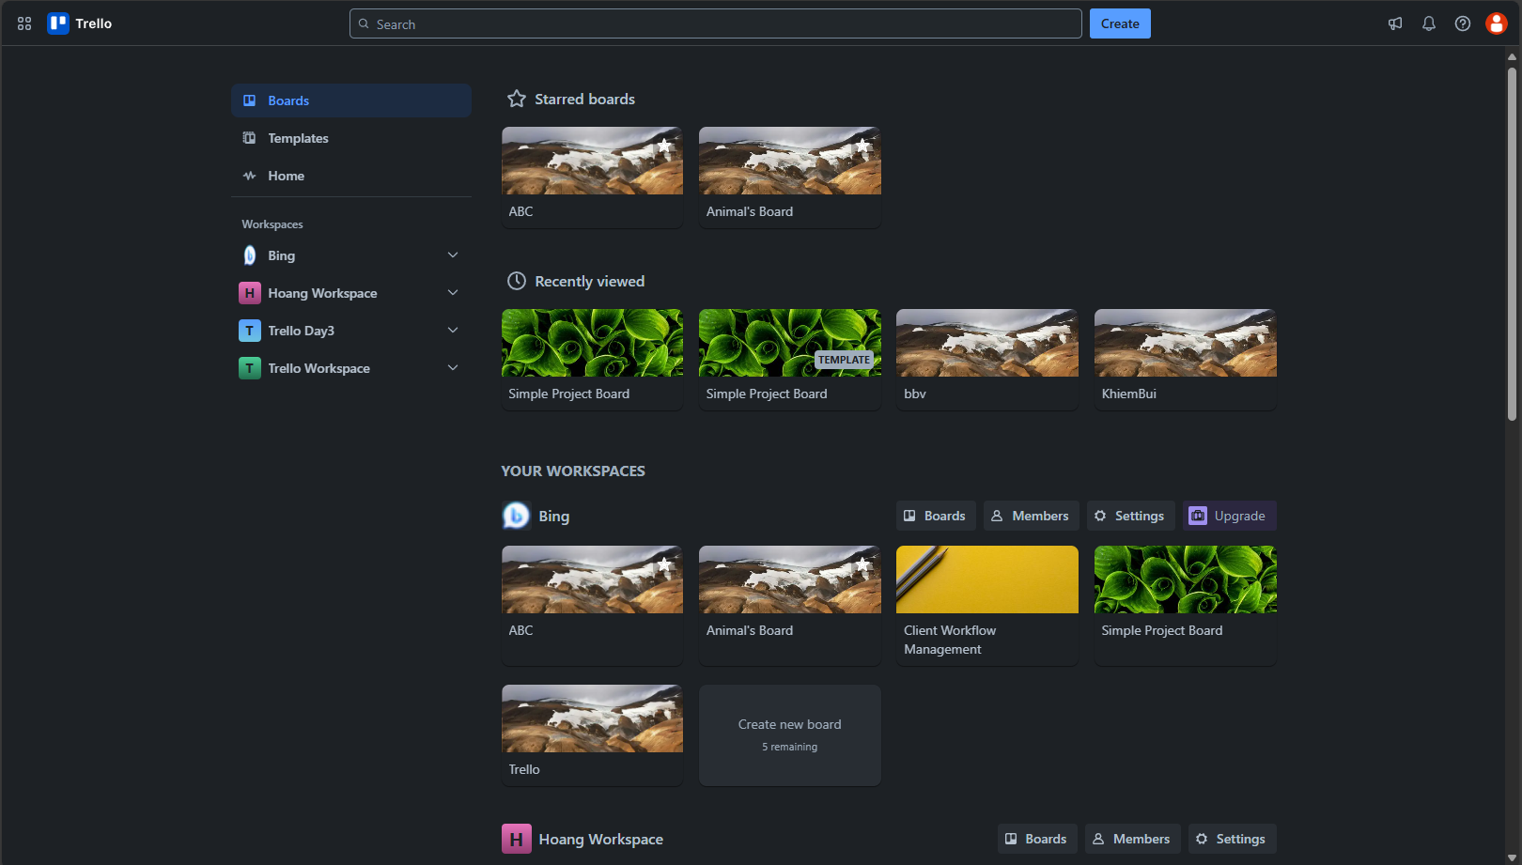
Dashboard Screen
Board
UserStarredBoard
Template
BackgroudUrl
BoardName
UserViewHistory
IsTemplate
Notification
User
Workspace
Member
LogoUrl
WorkspaceName
Board was starred
Notes:
1. List all Board that the user has starred.
SELECT
usb.UserId,
brd.Id BoardId,
brd.BackgroundUrl,
brd.BoardName,
brd.BoardStatus
FROM UserStarredBoard usb
JOIN Board brd ON brd.Id = usb.BoardId
WHERE UserId = 1 AND brd.BoardStatus = 'active'
ORDER BY usb.CreatedAt DESC
2. List all Board that the user has accessed recently SELECT
brd.Id board_id,
brd.BoardName board_name,
brd.BackgroundUrl,
uvh.AccessedAt,
brd.BoardStatus
FROM UserViewHistory uvh
JOIN Board brd ON brd.Id = uvh.OwnerId
JOIN OwnerType owt ON owt.Id = uvh.OwnerTypeId
WHERE uvh.UserId = 5 AND owt.OwnerTypeValue = 'BOARD'
ORDER BY uvh.AccessedAt DESC;
3. List all Workspace that the current user is a member of.
SELECT
wsp.Id WorkspaceId,
wsp.WorkspaceName,
wsp.LogoUrl
FROM Workspace wsp
JOIN Members me ON me.OwnerId = wsp.Id
JOIN OwnerType owt ON owt.Id = me.OwnerTypeId
WHERE owt.OwnerTypeValue = 'WORKSPACE' AND me.UserId = 1
ORDER BY wsp.CreatedAt;
4. List all Board that the current user is a member of belonging to a specific workspace.
SELECT
brd.Id BoardId,
brd.BoardName AS board_name,
brd.BackgroundUrl AS board_background,
wo.WorkspaceName AS workspace_name
FROM Board brd
JOIN Members me ON me.OwnerId = brd.Id
JOIN Workspace wo ON wo.Id = brd.WorkspaceId
JOIN OwnerType owt ON owt.Id = me.OwnerTypeId
WHERE me.UserId = 1 AND owt.OwnerTypeValue = 'BOARD'
ORDER BY brd.CreatedAt;

Slide 10
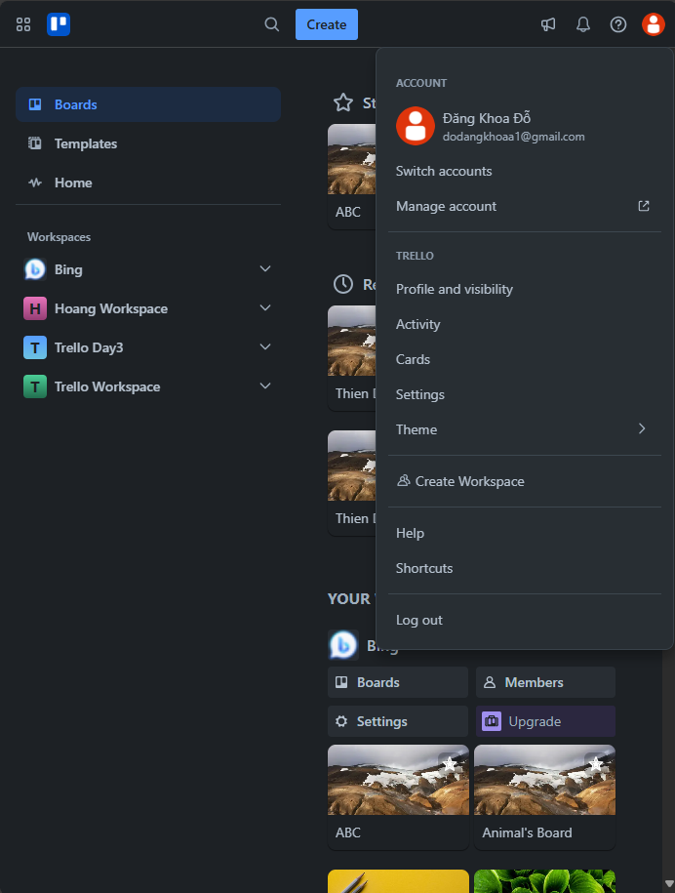
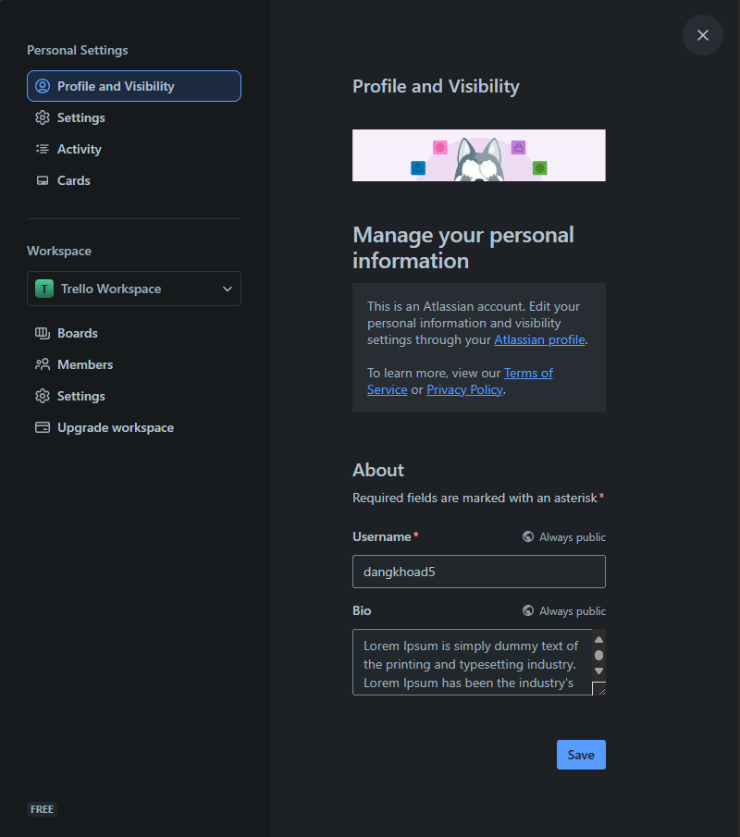
User Screen
User
PictureUrl
Email
Username
Bio
Notes:
1. Query information of a user
SELECT
Id,
PictureUrl,
Email,
Username,
Bio
FROM [User]
WHERE Email = 'james85@booth-daniels.net'

Slide 11
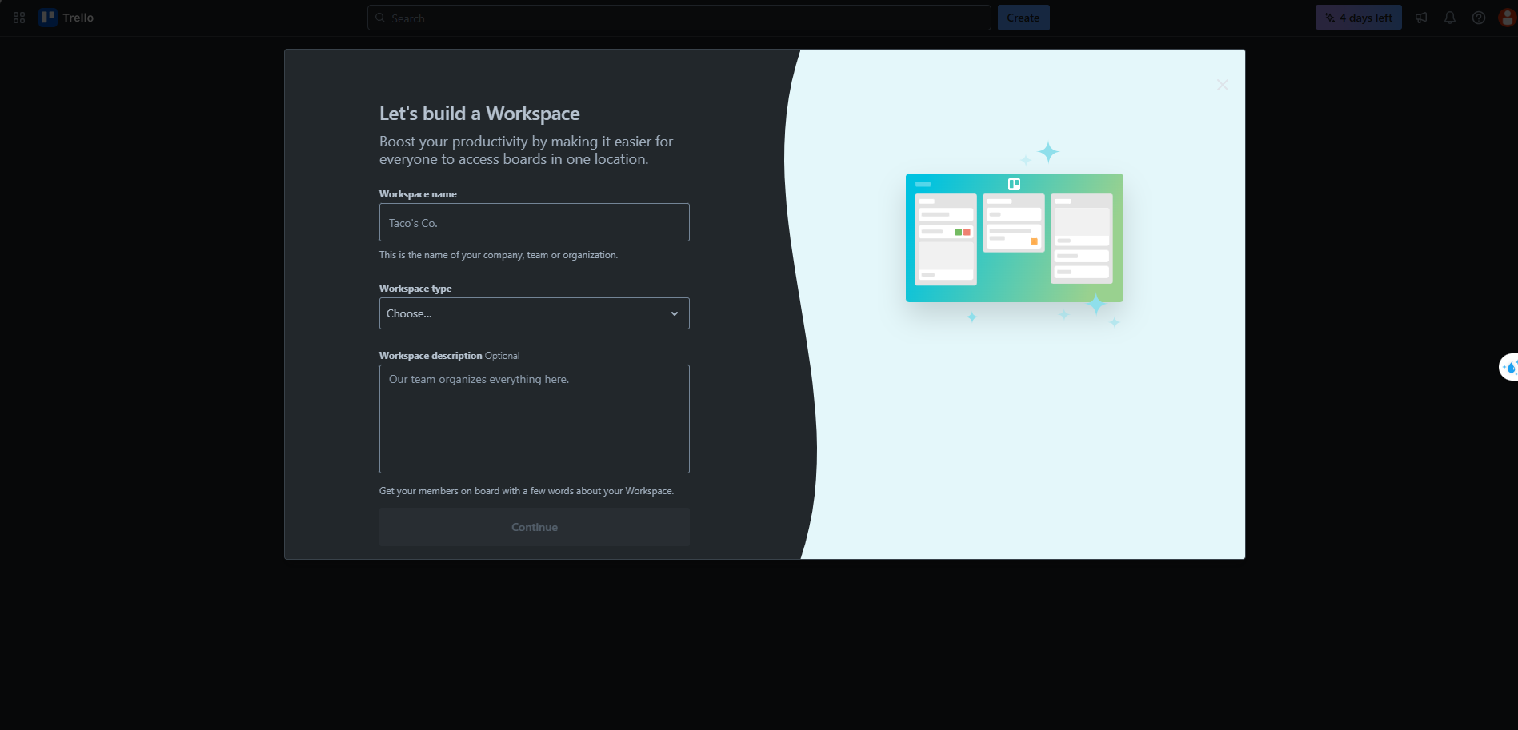
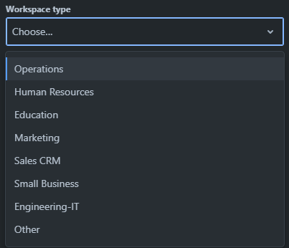
Workspace Creation
Workspace
WorkspaceType
WorkspaceName
WorkspaceTypeId
WorkspaceTypeName
WorkspaceDescription
Notes:
1. Retrieve all workspace types
SELECT
Id WorkspaceTypeId,
TypeValue,
DisplayValue
FROM
WorkspaceType

Slide 12
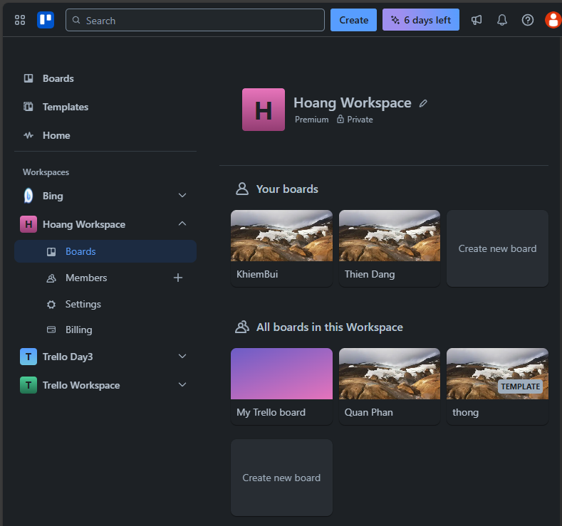
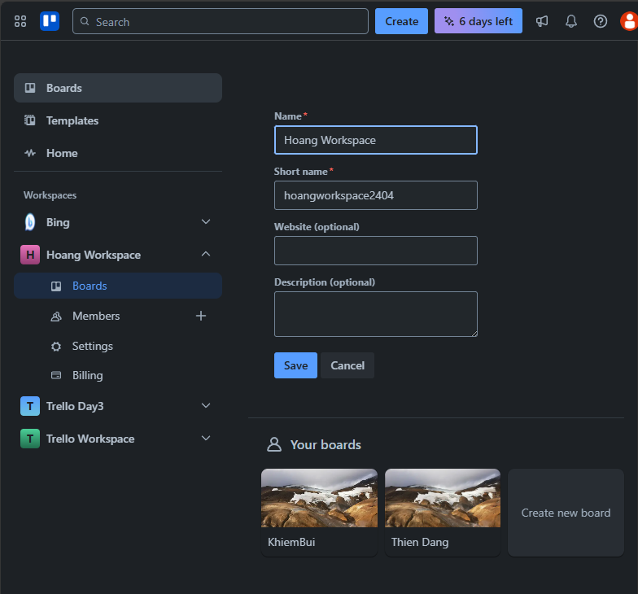
Workspace Screen
Workspace
WorkspaceName
WorkspaceName
LogoUrl
ShortName
SettingKey
BillingPlan
Subscription
SettingValue
Board
CreatedBy
Website
Description
IsTemplate
Member
Board
Notes:
List all boards in a specific workspace, created by a specific user, where the current user is a member.
SELECT
brd.Id BoardId,
brd.BoardName AS board_name,
brd.BackgroundUrl AS board_background,
wo.WorkspaceName AS workspace_name,
brd.CreatedBy,
me.UserId
FROM Board brd
JOIN Members me ON me.OwnerId = brd.Id
JOIN Workspace wo ON wo.Id = brd.WorkspaceId
JOIN OwnerType owt ON owt.Id = me.OwnerTypeId
WHERE
me.UserId = 4 AND owt.OwnerTypeValue = 'BOARD' AND brd.CreatedBy = me.UserId
ORDER BY brd.CreatedAt;
2. List all Board that the current user is a member of belonging to a specific workspace.
SELECT
brd.Id BoardId,
brd.BoardName AS board_name,
brd.BackgroundUrl AS board_background,
wo.WorkspaceName AS workspace_name
FROM Board brd
JOIN Members me ON me.OwnerId = brd.Id
JOIN Workspace wo ON wo.Id = brd.WorkspaceId
JOIN OwnerType owt ON owt.Id = me.OwnerTypeId
WHERE me.UserId = 1 AND owt.OwnerTypeValue = 'BOARD'
ORDER BY brd.CreatedAt;
3. Retrieve workspace information.
SELECT
Id WorkspaceId,
LogoUrl,
WorkspaceName,
ShortName,
Website,
WorkspaceDescription
FROM Workspace
WHERE Id = 1

Slide 13
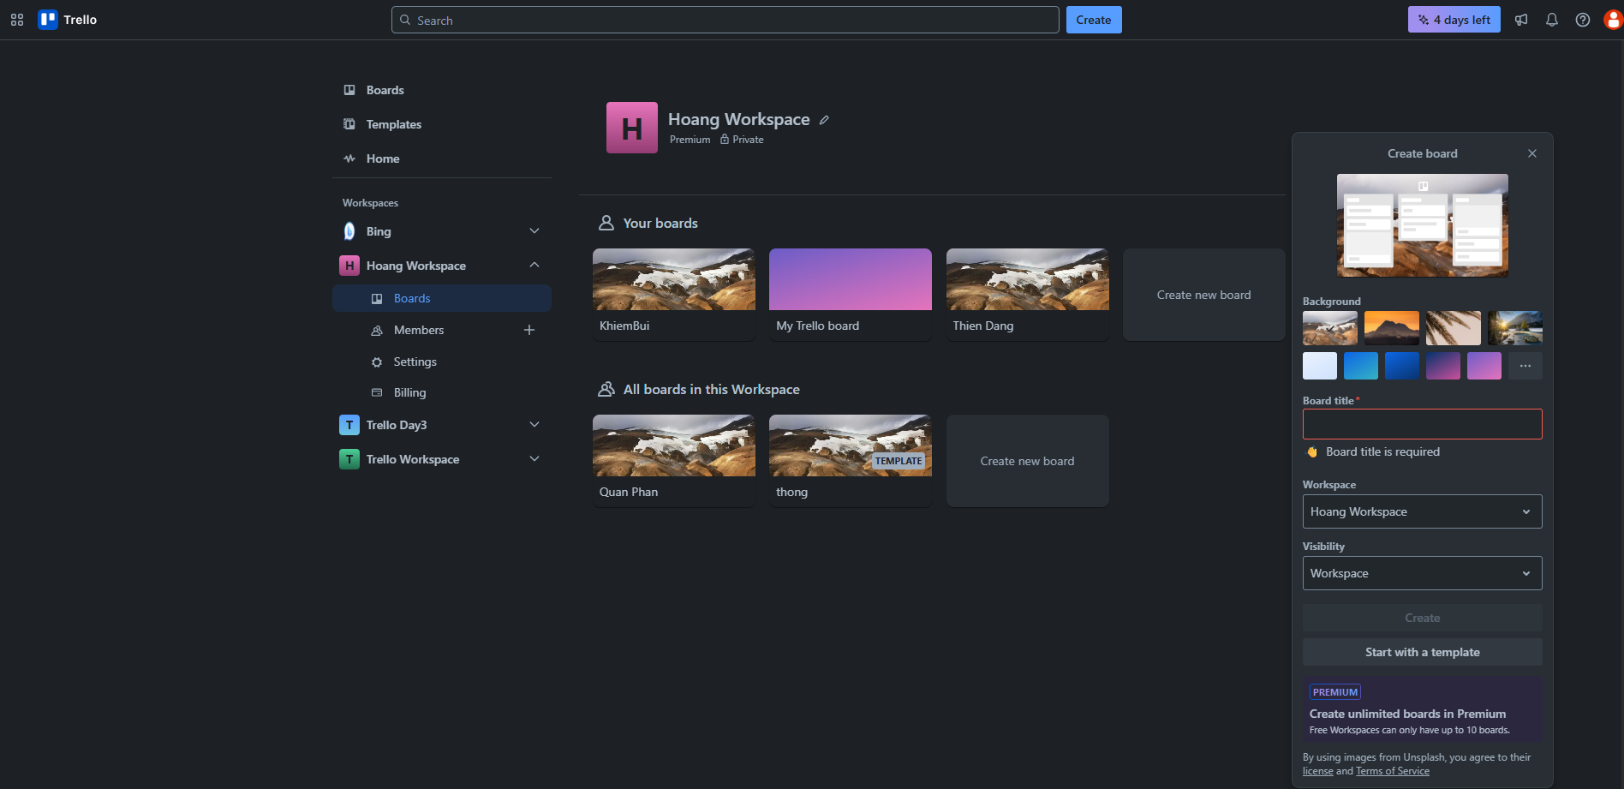
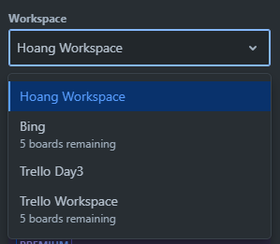
Board Creation
Board
BackgroundUrl
BoardTitle
Workspace
WorkspaceName
WorkspaceId
Workspace
SettingKey
SettingValue
Notes:
1. List all Workspace that the current user is a member of.
SELECT
wsp.Id WorkspaceId,
wsp.WorkspaceName,
wsp.LogoUrl
FROM Workspace wsp
JOIN Members me ON me.OwnerId = wsp.Id
JOIN OwnerType owt ON owt.Id = me.OwnerTypeId
WHERE owt.OwnerTypeValue = 'WORKSPACE' AND me.UserId = 1
ORDER BY wsp.CreatedAt;

Slide 14
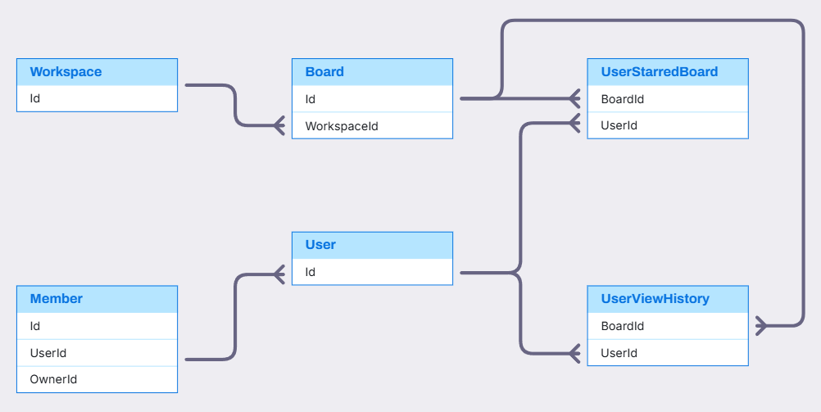
Workspace, Board, User Relationship

Slide 15
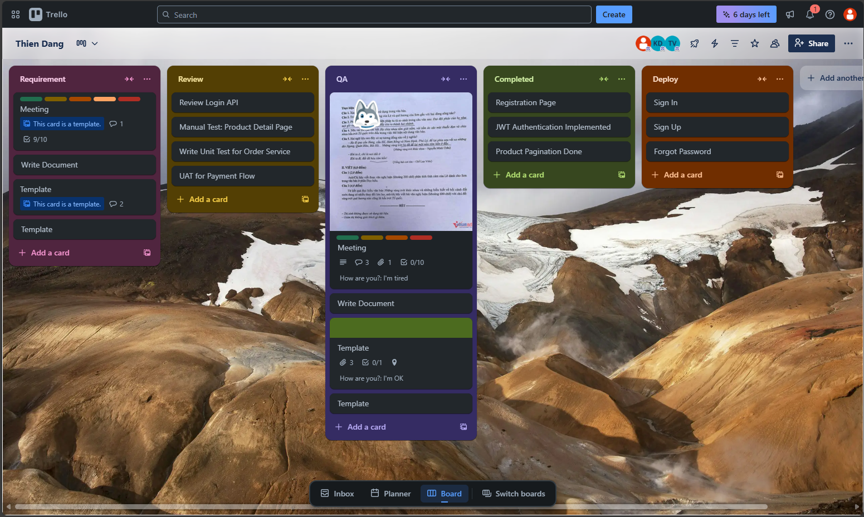

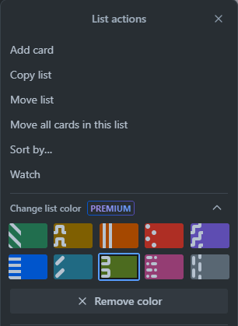
Board Screen
BoardTitle
Member
StageTitle
Position
Label
Sticker
Stage
Card
CardTitle
Comment
CheckList
IsTemplate
CheckListItem
CoverValue
ColorHex
Description
Attachment
CustomField
ColorIcon
IsCompleted
FieldValue
Color
Location
Notes:
1. Query all stage in a specific board and all card in each stage
WITH CardComment AS (
SELECT
crd.Id CardId,
COUNT(crd.Id) NumberOfComments
FROM Cards crd
JOIN Comment cmt ON cmt.CardId = crd.Id
GROUP BY crd.Id
),
CardCheckListItem AS (
SELECT
crd.Id CardId,
COUNT(crd.Id) NumberOfCheckListItem
FROM Cards crd
JOIN CheckList chl ON chl.CardId = crd.Id
JOIN CheckListItem cli ON cli.CheckListId = chl.Id
GROUP BY crd.Id
),
CardAttachment AS (
SELECT
crd.Id CardId,
COUNT(crd.Id) NumberOfAttachment
FROM Cards crd
JOIN Attachment atm ON atm.CardId = crd.Id
GROUP BY crd.Id
)
SELECT
crd.Position CardPosition,
stg.Position StagePosition,
crd.Id CardId,
crd.Title CardTitle,
crd.CardLocation,
crd.CoverValue CardCover,
ccm.NumberOfComments,
cci.NumberOfCheckListItem,
cam.NumberOfAttachment,
stg.Id StageId,
stg.Title StageTitle,
clr.ColorName StageColor,
brd.Id BoardId,
brd.BoardName
FROM Cards crd
JOIN Stage stg ON stg.Id = crd.StageId
JOIN Color clr ON clr.Id = stg.ColorId
JOIN Board brd ON brd.Id = stg.BoardId
LEFT JOIN CardComment ccm ON ccm.CardId = crd.Id
LEFT JOIN CardCheckListItem cci ON cci.CardId = crd.Id
LEFT JOIN CardAttachment cam ON cam.CardId = crd.Id
WHERE brd.Id = 1
ORDER BY stg.Position, crd.Position
2. Query avatar's member in a specific board
SELECT
usr.Id UserId,
usr.PictureUrl UserPicture,
owt.OwnerTypeValue,
mmb.OwnerId BoardId
FROM Members mmb
JOIN OwnerType owt ON owt.Id = mmb.OwnerTypeId
JOIN [User] usr ON usr.Id = mmb.UserId
WHERE owt.OwnerTypeValue = 'BOARD' AND mmb.OwnerId = 1

Slide 16
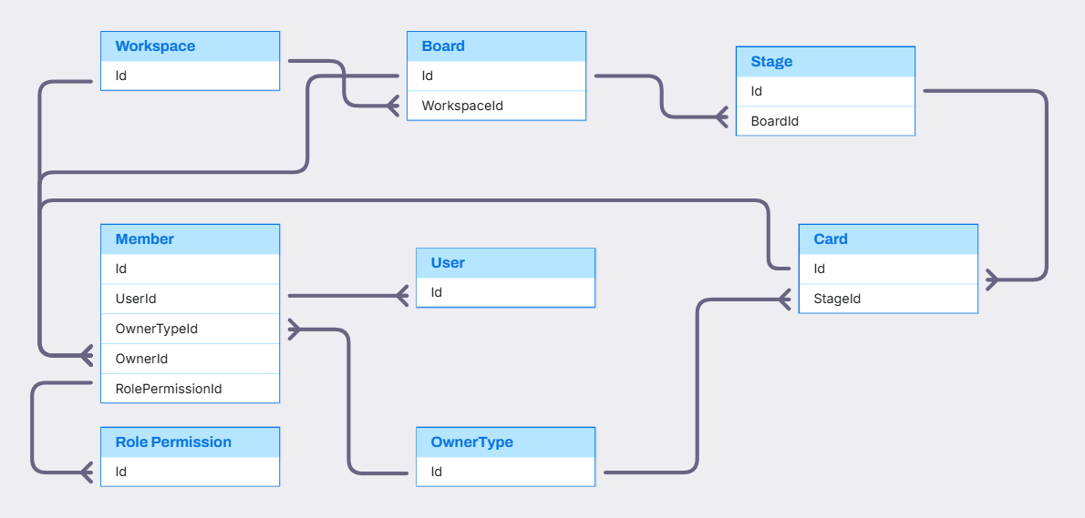
Workspace, Board, Card, Member Relationship

Slide 17
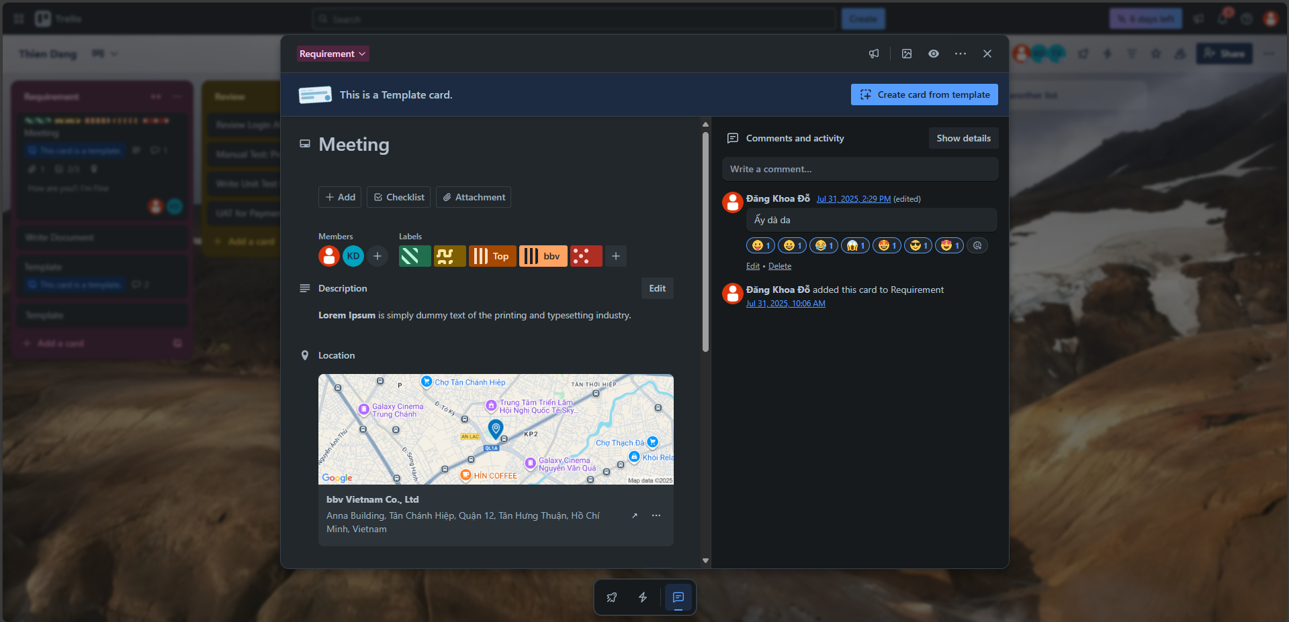
Card Screen
StageTitle
Show only main activities
Card
IsTemplate
User
CreatedAt
ColorIcon
Comment
CardLabel
LabelTitle
Label
CardTitle
Color
Fullname
Content
CommentReaction
Member
Reaction
Description
Activity
PictureUrl
CreatedAt
ActivityDescription
Location
Notes:
1. query information of specific card
SELECT
crd.Id CardId,
crd.Title CardTitle,
crd.CardDescription,
crd.CardLocation,
stg.Title StageTitle
FROM Cards crd
JOIN Stage stg ON stg.Id = crd.Id
WHERE crd.Id = 1
2. query avatar of members in a specific card
SELECT
usr.Id UserId,
usr.PictureUrl UserPicture,
crd.Id CardId
FROM Cards crd
JOIN Members mmb ON mmb.OwnerId = crd.Id
JOIN OwnerType owt ON owt.Id = mmb.OwnerTypeId
JOIN [User] usr ON usr.Id = mmb.UserId
WHERE owt.OwnerTypeValue = 'CARD' AND crd.Id = 1
3. query labels in a specific card
SELECT
crd.Id CardId,
lbl.Id LabelId,
lbl.Title LabelTitle,
clr.ColorName,
clr.Icon
FROM Cards crd
JOIN CardLabel clb ON clb.CardId = crd.Id
JOIN [Label] lbl ON lbl.Id = clb.LabelId
JOIN Color clr ON clr.Id = lbl.ColorIdquery
4. query comments and reactions in a specific card
SELECT
usr.Id UserId,
usr.PictureUrl UserPicture,
usr.Username,
cmt.Content,
cmt.Id CommentId,
cmt.CreatedAt,
cmt.UpdatedAt,
crd.Id CardId,
rct.Id ReactionId,
rct.ReactionName,
COUNT(rct.Id) ReactionCount
FROM
Cards crd
JOIN Comment cmt ON cmt.CardId = crd.Id
JOIN [Users] usr ON usr.Id = cmt.CreatedBy
JOIN CommentReaction cmr ON cmr.CommentId = cmt.Id
JOIN Reaction rct ON rct.Id = cmr.ReactionId
WHERE
crd.Id = 1
GROUP BY
usr.Id,
usr.PictureUrl,
usr.Username,
cmt.Content,
cmt.Id,
cmt.CreatedAt,
cmt.UpdatedAt,
crd.Id,
cmt.Id,
rct.Id,
rct.ReactionName;
5. query activity in specific card
SELECT
usr.Id UserId,
usr.PictureUrl UserPicture,
usr.Username,
atv.Id ActivityId,
atv.ActivityDescription,
atv.CreatedAt,
owt.OwnerTypeValue Category,
atv.OwnerId CardId
FROM Activity atv
JOIN OwnerType owt ON owt.Id = atv.CategoryId
JOIN [User] usr ON usr.Id = atv.UserId
WHERE owt.OwnerTypeValue = 'CARD' AND atv.OwnerId = 1

Slide 18
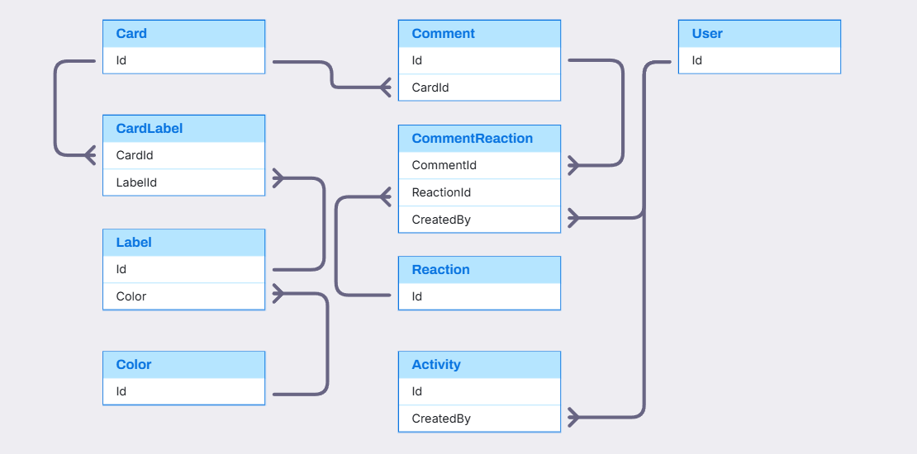
Card and Card Detail Relationship

Slide 19
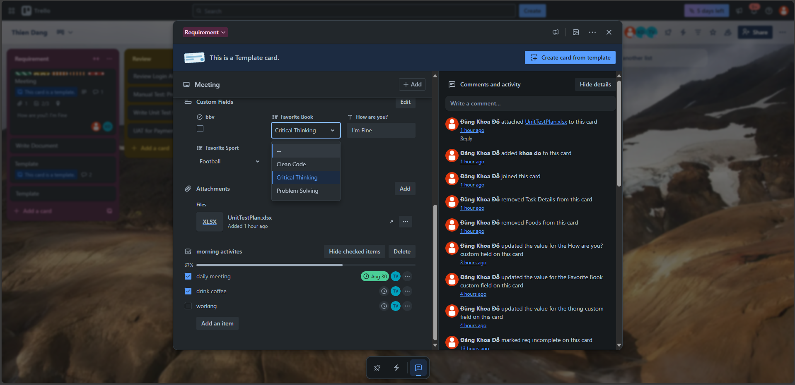

Card Screen
Show more activities
Card
DataType
DataTypeIcon
Title
FieldContent
User
CustomField
FieldValue
ActivityDescription
CreatedAt
FieldItem.Value
Activity
FieldItem
Notes:
1. query retrieves all custom fields for a specific board, along with their possible options if the field type is dropdown
SELECT
crd.Id CardId,
brd.Id BoardId,
ctf.Id CustomFieldId,
ctf.Title CustomFieldTitle,
dtt.DataTypeValue,
ftm.Id FieldItemId,
ftm.FieldItemValue,
ctf.Position
FROM Cards crd
JOIN Stage stg ON stg.Id = crd.StageId
JOIN Board brd ON brd.Id = stg.BoardId
JOIN CustomField ctf ON ctf.BoardId = brd.Id
JOIN DataType dtt ON dtt.Id = ctf.DataTypeId
LEFT JOIN FieldItem ftm ON ftm.CustomFieldId = ctf.Id
WHERE crd.Id = 1
ORDER BY ctf.Position;
2. query retrieves all custom fields for a specific board, along with their value
WITH FieldValueCast AS (
SELECT
fvl.Id,
fvl.CardId,
fvl.CustomFieldId,
dtt.DataTypeValue,
CASE
WHEN dtt.DataTypeValue = 'DROPDOWN'
AND ISNUMERIC(fvl.FieldValue) = 1
THEN CAST(fvl.FieldValue AS INT)
ELSE NULL
END AS ItemId,
fvl.FieldValue
FROM FieldValue fvl
JOIN CustomField ctf ON ctf.Id = fvl.CustomFieldId
JOIN DataType dtt ON dtt.Id = ctf.DataTypeId
)
SELECT
crd.Id CardId,
brd.Id BoardId,
ctf.Id CustomFieldId,
ctf.Title CustomFieldTitle,
fvc.DataTypeValue,
fvc.FieldValue,
ftm.FieldItemValue,
ctf.Position
FROM Cards crd
JOIN Stage stg ON stg.Id = crd.StageId
JOIN Board brd ON brd.Id = stg.BoardId
JOIN CustomField ctf ON ctf.BoardId = brd.Id
LEFT JOIN FieldValueCast fvc ON fvc.CardId = crd.Id AND fvc.CustomFieldId = ctf.Id
LEFT JOIN FieldItem ftm ON ftm.Id = fvc.ItemId
WHERE crd.Id = 1
ORDER BY ctf.Position;

Slide 20
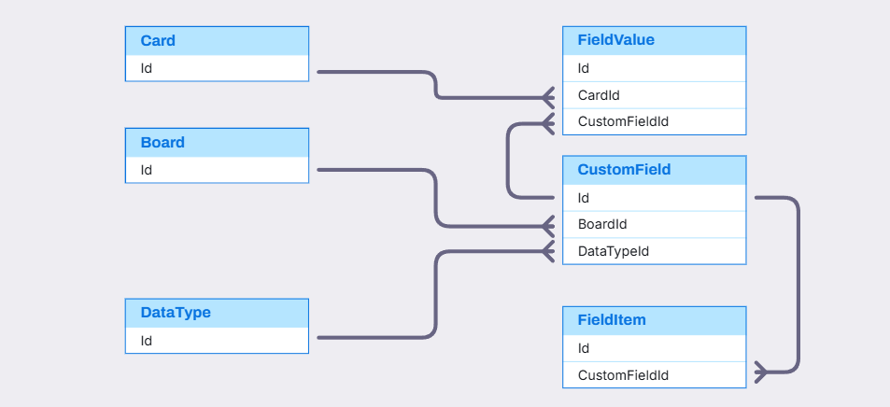
CustomField, FieldValue, FieldItem Relationship

Slide 21
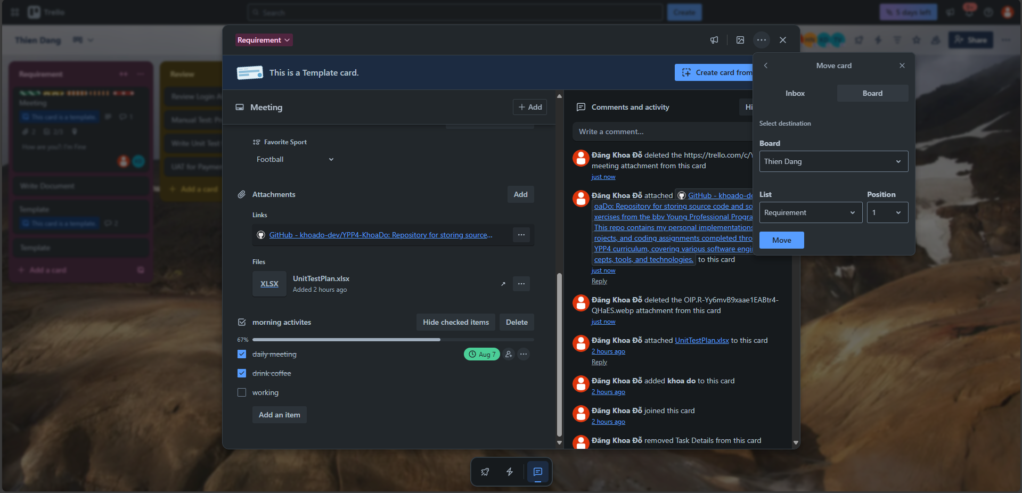
Card Screen
Card
Board
AttachmentType
Position
AttachmentPath
AttachmentName
Stage
AttachmentName
Attachment
UploadedAt
Notes:
1. List all attachments belonging to a specific card, including their file details and upload information
SELECT
atm.Id AttachmentId,
att.DisplayValue AttachmentType,
atm.AttachmentName,
atm.AttachmentPath,
atm.Size,
atm.CreatedAt,
atm.CreatedBy,
atm.IsCover,
atm.CardId
FROM Attachment atm
JOIN AttachmentType att ON att.Id = atm.AttachmentTypeId
WHERE atm.CardId = 1

Slide 22
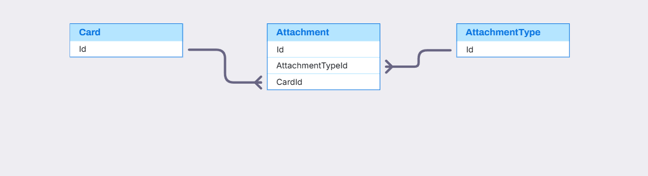
Attachment Relationship

Slide 23
Card Screen
Show more activities
Card
CheckList
CheckListName
CheckListItem
CheckListItemStatus
DueDate
User
Member
CheckListItemName
Notes:
1. Retrieve all checklists and their items for a specific card, including item details such as status, assigned members, and due dates
SELECT
clt.Id AS ChecklistId,
clt.ChecklistName,
cli.Id AS ChecklistItemId,
cli.CheckListItemName,
cli.CheckListItemStatus,
cli.Position CheckListItemPosition,
cli.DueDate,
cli.MemberId,
usr.PictureUrl
FROM Checklist clt
JOIN ChecklistItem cli ON cli.ChecklistId = clt.Id
LEFT JOIN Members mmb ON mmb.Id = cli.MemberId
LEFT JOIN [User] usr ON usr.Id = mmb.UserId
WHERE clt.CardId =1
ORDER BY clt.Id, cli.Position;

Slide 24
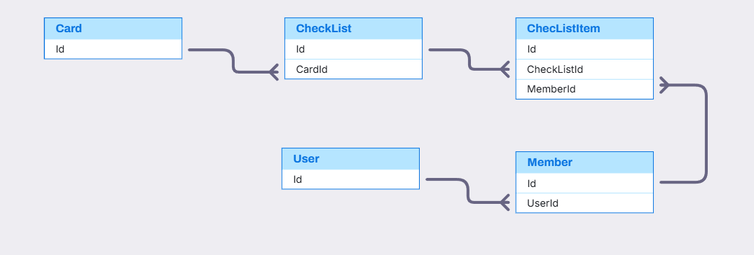
CheckList and CheckListItem Relationship

Slide 25
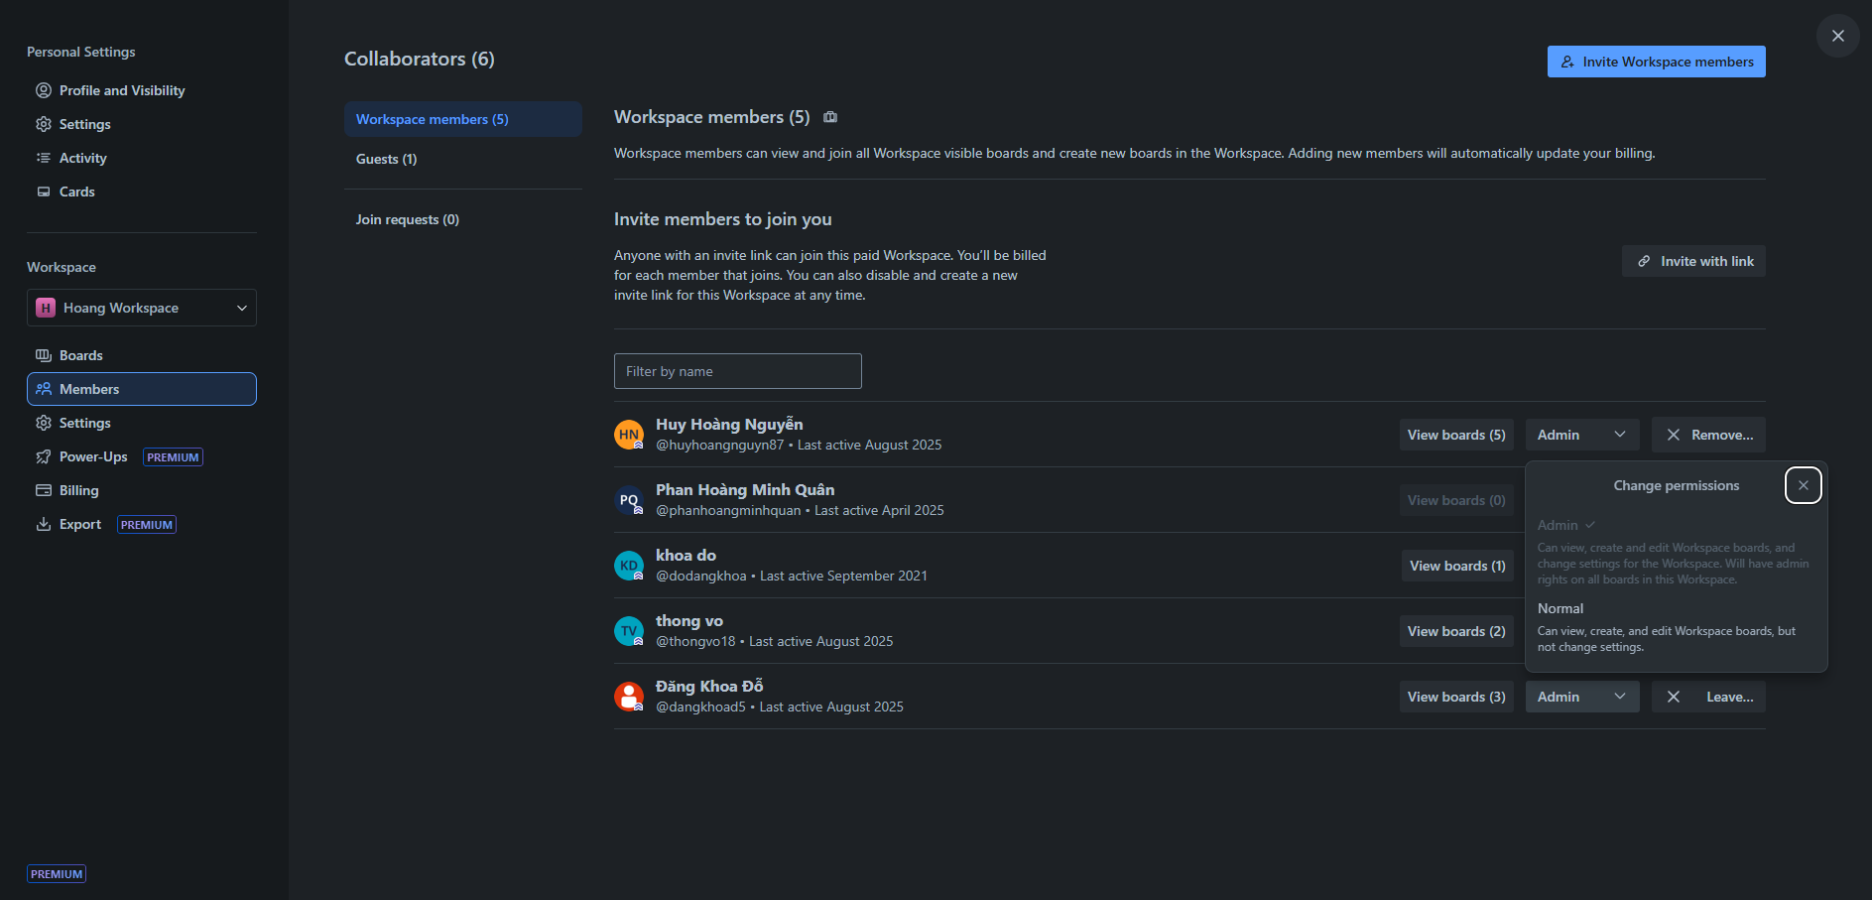
Workspace Member
ShareLink
OwnerType
UserViewHistory
User
Member
PictureUrl
Username
RolePermission
Notes:
1. List all members in the workspace along with their permission on roles.
WITH BoardCountByEachUser AS(
SELECT
UserId,
COUNT(UserId) AS BoardCount
FROM Members mmb
JOIN OwnerType owt ON owt.Id = mmb.OwnerTypeId
JOIN Board brd ON brd.Id = mmb.OwnerId
WHERE OwnerTypeValue = 'BOARD' AND brd.WorkspaceId = 11
GROUP BY UserId
)
SELECT
us.PictureUrl AS UserPicture,
us.Username,
us.Email AS UserEmail,
us.LastActive AS UserLastActive,
pe.PermissionName,
bcb.BoardCount
FROM Members mmb
JOIN OwnerType owt ON owt.Id = mmb.OwnerTypeId
JOIN RolePermission pe ON pe.Id = mmb.RolePermissonId
JOIN [User] us ON us.Id = mmb.UserId
JOIN BoardCountByEachUser bcb ON bcb.UserId = mmb.UserId
WHERE owt.OwnerTypeValue = 'WORKSPACE' AND mmb.OwnerId = 11
ORDER BY mmb.JoinedAt;
2. List All Role Permission
SELECT
Id RolePermissionId,
PermissionName,
PermissionCode
FROM RolePermission

Slide 26
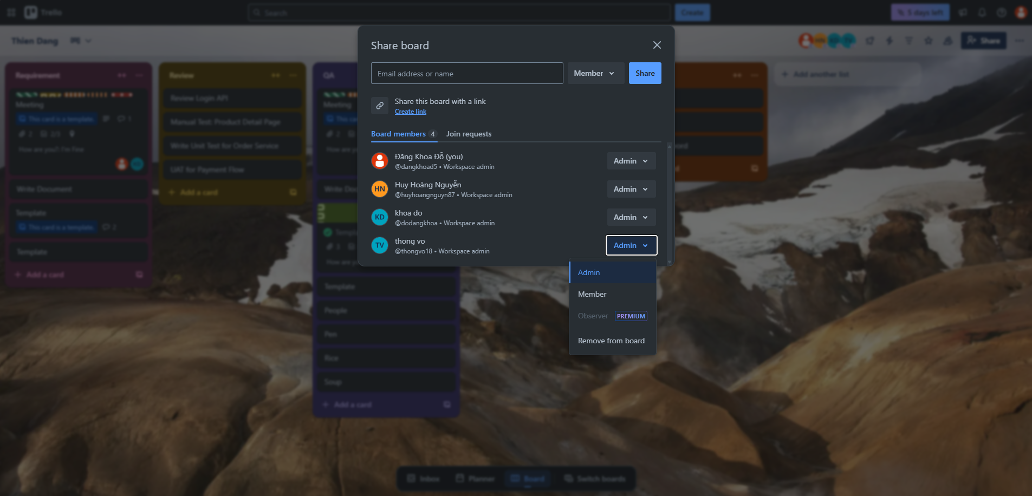
Board Member
ShareLink
OwnerType
Member
PictureUrl
Username
RolePermission
PermissionName
Notes:
1. List all members in the board along with their permission on roles.
SELECT
us.Id UserId,
us.PictureUrl user_picture,
us.Username,
us.Email user_mail,
pe.PermissionName
FROM Members mmb
JOIN OwnerType owt ON owt.Id = mmb.OwnerTypeId
JOIN RolePermission pe ON pe.Id = mmb.RolePermissonId
JOIN Board bo ON bo.Id = mmb.OwnerId
JOIN [User] us ON us.Id = mmb.UserId
WHERE OwnerTypeValue = 'BOARD' AND mmb.OwnerId = 1
2. List all Role Permission in Board Member
SELECT
Id RolePermissionId,
PermissionName,
PermissionCode
FROM RolePermission;

Slide 27
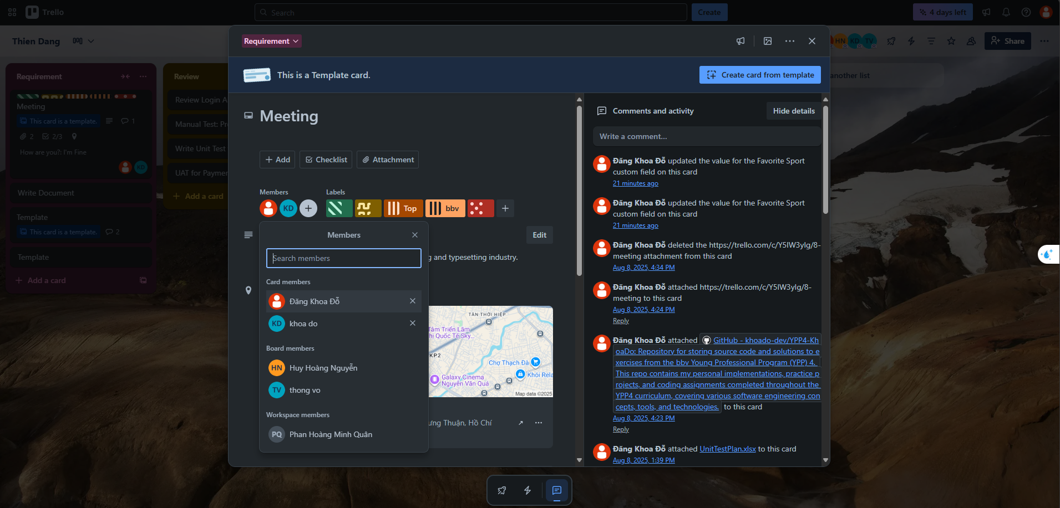
Card Member
Member
OwnerType
User
Notes:
1. List all members available for selection on the card, including members from the workspace and from the board containing that card.
WITH CardWithBoardWorkspace AS (
SELECT
crd.Id CardId,
crd.Title CardTitle,
brd.Id BoardId,
brd.BoardName,
wsp.Id WorkspaceId,
wsp.WorkspaceName
FROM Cards crd
JOIN Stage stg ON stg.Id = crd.StageId
JOIN Board brd ON brd.Id = stg.BoardId
JOIN Workspace wsp ON wsp.Id = brd.WorkspaceId
WHERE crd.Id = 1
)
SELECT
usr.Id UserId,
usr.PictureUrl UserPicture,
usr.Username,
OwnerTypeValue,
JoinedAt
FROM Members mmb
JOIN OwnerType owt ON owt.Id = mmb.OwnerTypeId
JOIN CardWithBoardWorkspace cwbw ON
(OwnerTypeValue = 'CARD' AND cwbw.CardId = mmb.OwnerId) OR
(OwnerTypeValue = 'BOARD' AND cwbw.BoardId = mmb.OwnerId) OR
(OwnerTypeValue = 'WORKSPACE' AND cwbw.WorkspaceId = mmb.OwnerId)
JOIN [User] usr ON usr.Id = mmb.UserId
ORDER BY owt.Id DESC, JoinedAt DESC

Slide 28
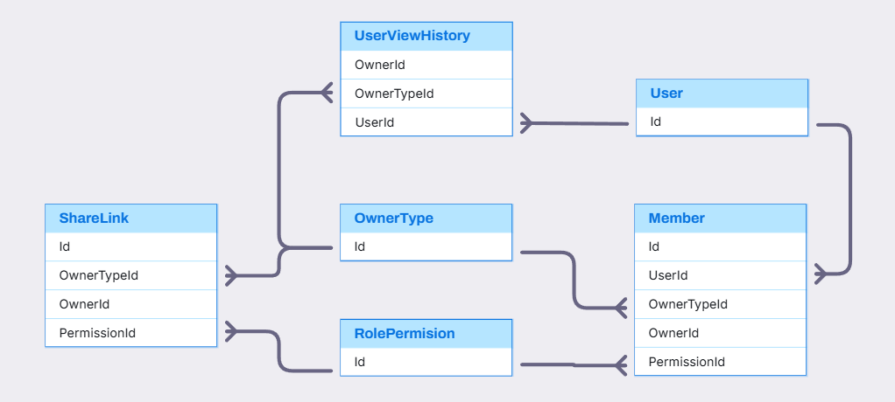
Member, RolePermission, ShareLink Relationship

Slide 29
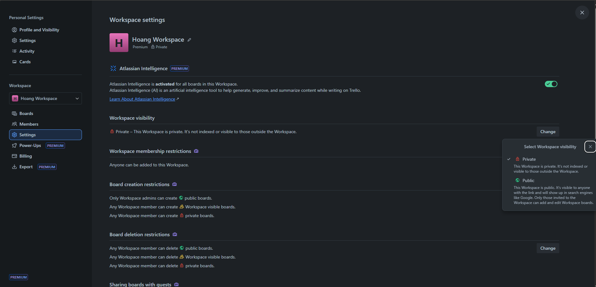
Workspace Setting Screen
OwnerType
Workspace
KeyName
SettingKey
SettingValue
SettingContent
DisplayName
SettingOption
SettingKeySettingOption
Notes:
1. List all workspace setting keys with the current user's selected values.
SELECT
sk.KeyName,
COALESCE(sv.SettingContent, sk.DefaultValue) AS Value
FROM SettingKey sk
JOIN OwnerType owt ON owt.Id = sk.OwnerTypeId
LEFT JOIN SettingValue sv ON sv.SettingKeyId = sk.Id
WHERE OwnerTypeValue = 'WORKSPACE' AND sv.OwnerId = 1;
2. List all options of setting is not boolean in workspace setting.
SELECT
sk.KeyName AS setting_key,
sk.SettingKeyDescription,
so.DisplayValue AS setting_option_display_value
FROM SettingKey sk
JOIN OwnerType owt ON owt.Id = sk.OwnerTypeId
JOIN SettingKeySettingOption sso ON sso.SettingKeyId = sk.Id
JOIN SettingOption so ON so.Id = sso.SettingOptionId
WHERE OwnerTypeValue = 'WORKSPACE'
ORDER BY sk.KeyName;

Slide 30
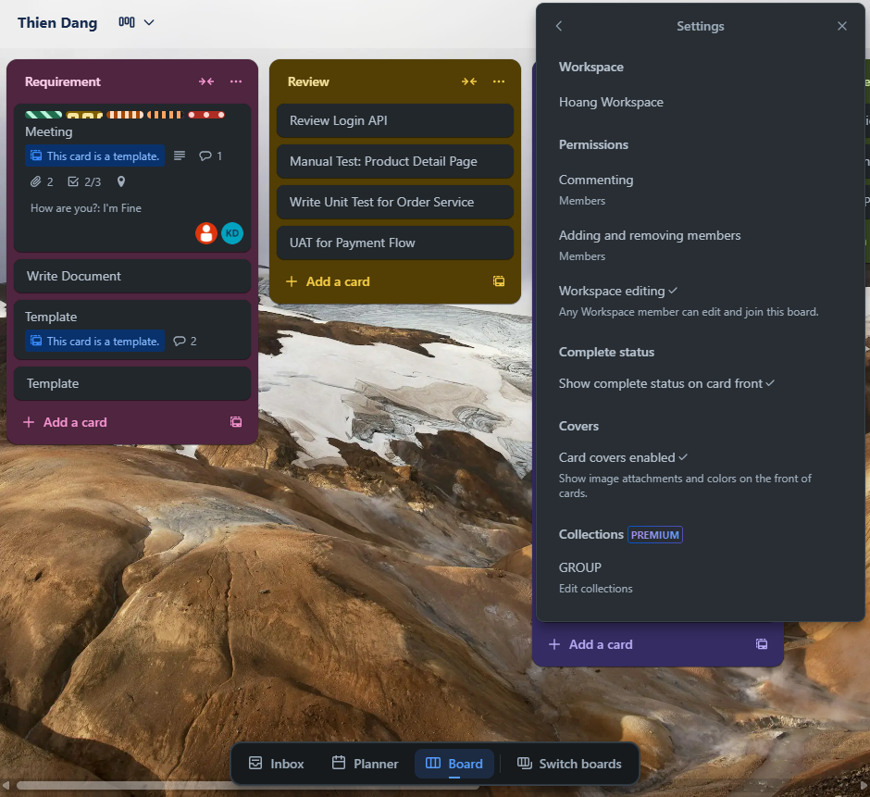
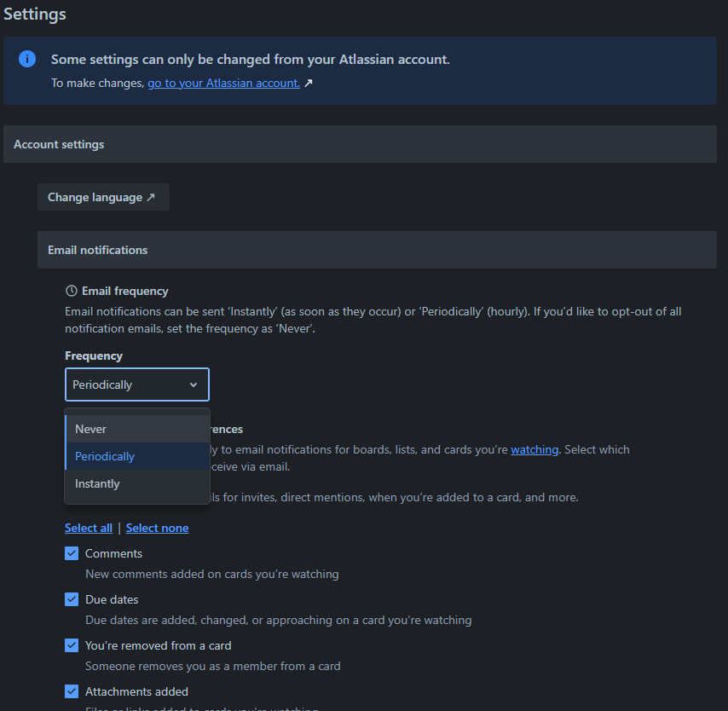
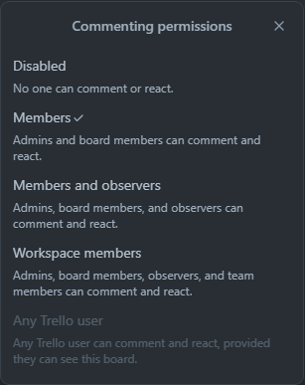
Board and User Setting Screen
Board Setting
User Setting
KeyName
SettingKey
SettingValue
SettingOption
SettingKey
KeyName
SettingValue
SettingOption
IsBoolean
Notes:
1. List all board's setting key and user's choice of a specific user
SELECT
sk.KeyName,
COALESCE(sv.SettingContent, sk.DefaultValue) AS Value
FROM SettingKey sk
JOIN OwnerType owt ON owt.Id = sk.OwnerTypeId
LEFT JOIN SettingValue sv ON sv.SettingKeyId = sk.Id
WHERE OwnerTypeValue = 'BOARD' AND sv.OwnerId = 1;
2. List all options of setting is not boolean in board setting.
SELECT
sk.KeyName AS setting_key,
sk.SettingKeyDescription,
so.DisplayValue AS setting_option_display_value
FROM SettingKey sk
JOIN OwnerType owt ON owt.Id = sk.OwnerTypeId
JOIN SettingKeySettingOption sso ON sso.SettingKeyId = sk.Id
JOIN SettingOption so ON so.Id = sso.SettingOptionId
WHERE OwnerTypeValue = 'BOARD'
ORDER BY sk.KeyName;
3.List all workspace setting keys with the current user's selected values.
SELECT
sk.KeyName,
COALESCE(sv.SettingContent, sk.DefaultValue) AS Value
FROM SettingKey sk
JOIN OwnerType owt ON owt.Id = sk.OwnerTypeId
LEFT JOIN SettingValue sv ON sv.SettingKeyId = sk.Id
WHERE OwnerTypeValue = 'USER' AND sv.OwnerId = 1;
4. List all options of setting is not boolean in board setting.
SELECT
sk.KeyName AS setting_key,
sk.SettingKeyDescription,
so.DisplayValue AS setting_option_display_value
FROM SettingKey sk
JOIN OwnerType owt ON owt.Id = sk.OwnerTypeId
JOIN SettingKeySettingOption sso ON sso.SettingKeyId = sk.Id
JOIN SettingOption so ON so.Id = sso.SettingOptionId
WHERE OwnerTypeValue = 'USER'
ORDER BY sk.KeyName;

Slide 31
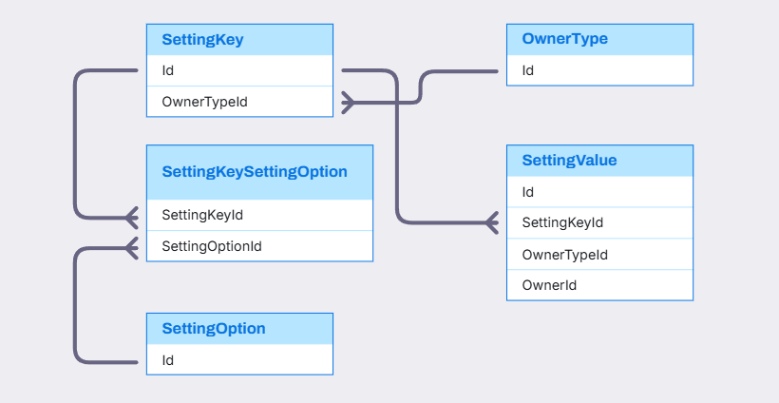
Setting Relationship

Slide 32
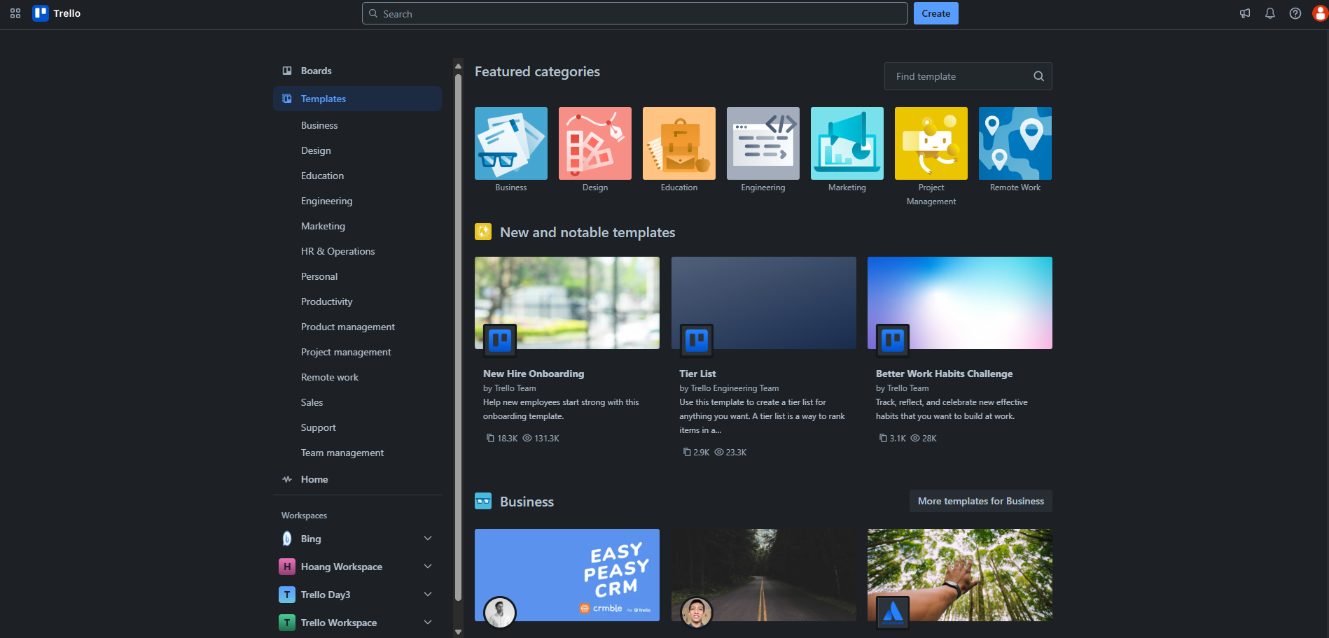
Template Category Screen
TemplateCategory
IconUrl
TemplateCategoryName
BackgroundUrl
User
CreateBy
Board
Template
PictureUrl
Title
CreatedBy
TemplateDescription
UserTemplateCopied
UserTemplateViewed
Notes:
1. List all template categories available for filtering.
SELECT
tpc.Id TemplateCategoryId,
tpc.IconUrl,
tpc.DisplayValue
FROM TemplateCategory tpc;
2. -- Select a template category to display all templates within that category.
SELECT
tpl.Id TemplateId,
tpl.Title TemplateTitle,
tpl.TemplateDescription,
tpl.Viewed,
tpl.Copied,
tpl.UpdatedAt,
tpc.Id TemplateCategoryId,
tpc.DisplayValue TemplateCategory
FROM Template tpl
JOIN TemplateCategory tpc ON tpc.Id = tpl.CategoryId
WHERE tpc.Id = 1
ORDER BY tpl.UpdatedAt DESC;

Slide 33
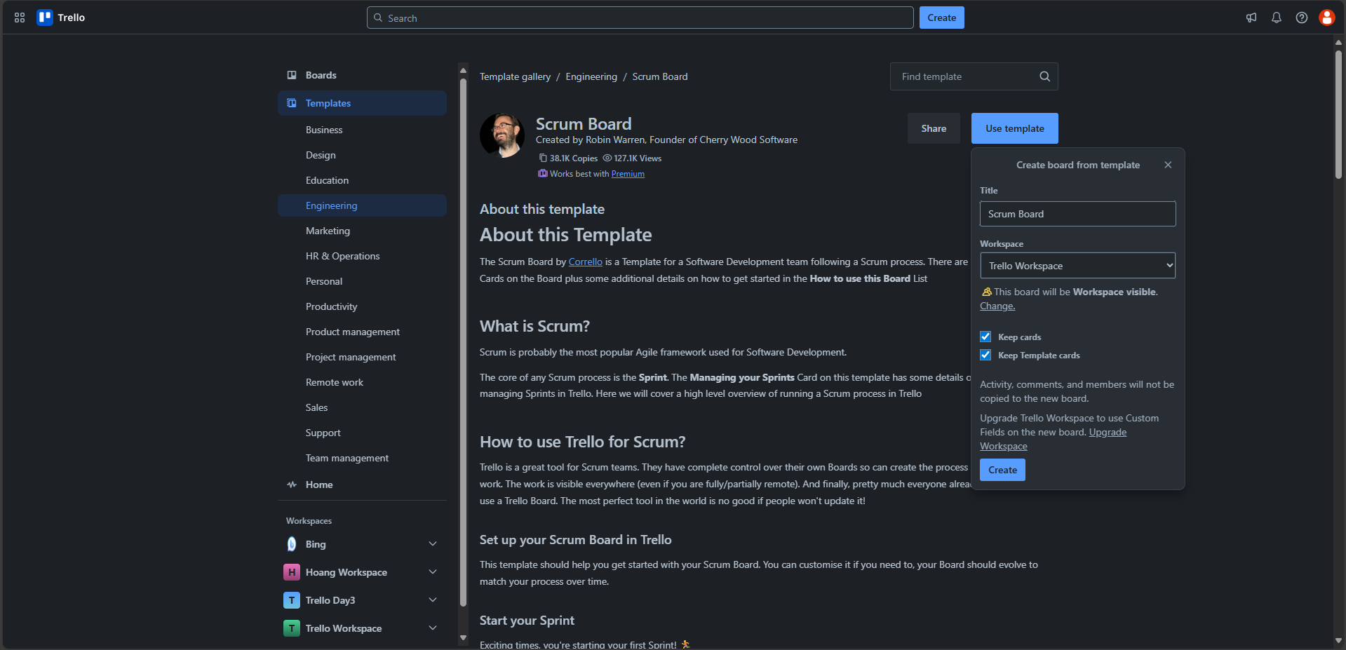
Template Screen
Template
PictureUrl
TemplateTitle
User
Fullname
Bio
UserTemplateCopied
UserTemplateCopied
BoardName
TemplateDescription
Workspace
SettingValue
Notes:
Select specific template, show information of a specific template.
SELECT
tpl.Id TemplateId,
us.PictureUrl AS user_picture,
tpl.TemplateDescription AS template_description,
tpl.Title AS template_title,
us.Username,
tpl.Copied AS copied_number,
tpl.Viewed AS viewed_number,
tpl.BoardId
FROM Template tpl
JOIN [User] us ON us.Id = tpl.CreatedBy
WHERE tpl.Id = 1;

Slide 34
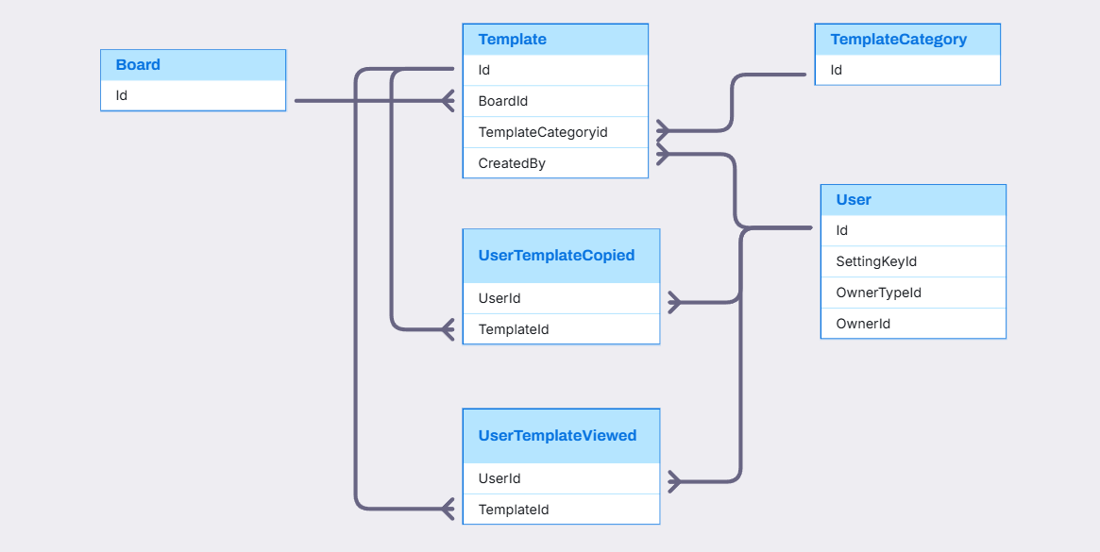
Template Relationship

Slide 35
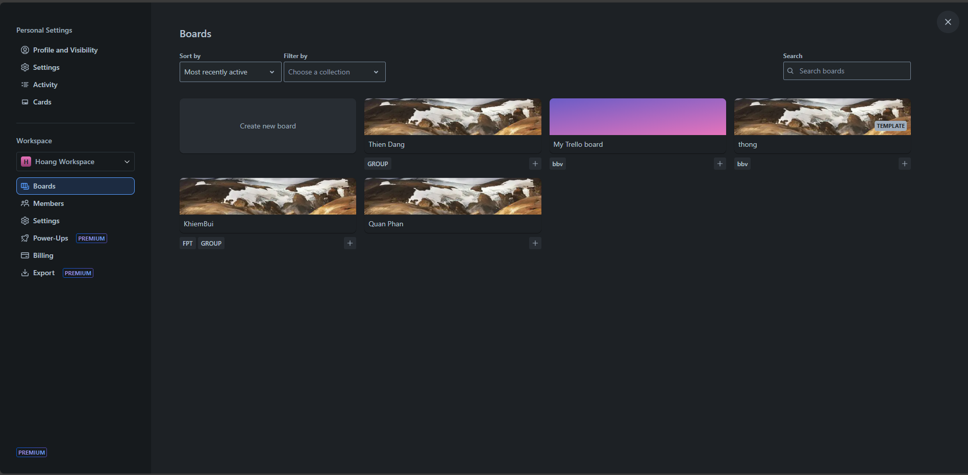
Collection and Board Screen
BoardCollection
Board
BackgroundUrl
Workspace
LogoUrl
BoardName
IsTemplate
WorkspaceName
Collection
CollectionName
Notes:
1. Show board and collection its belong with in a specific workspace
SELECT
bo.Id board_id,
bo.BoardName board_name,
bo.BackgroundUrl BoardBackgroundImage,
co.Id collection_id,
co.CollectionName,
bo.WorkspaceId WorkspaceId
FROM Board bo
JOIN BoardCollection bc ON bc.BoardId = bo.Id
JOIN Collections co ON co.Id = bc.CollectionId
WHERE bo.WorkspaceId = 1 AND co.WorkspaceId = bo.WorkspaceId
ORDER BY bo.CreatedAt

Slide 36
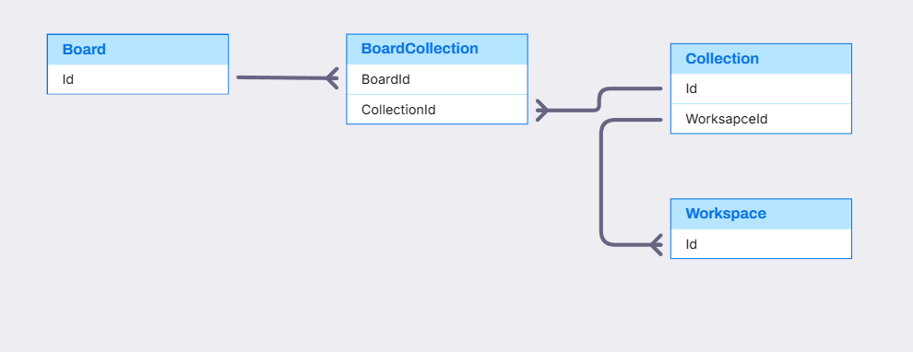
Board and Collection Relationship

Slide 37
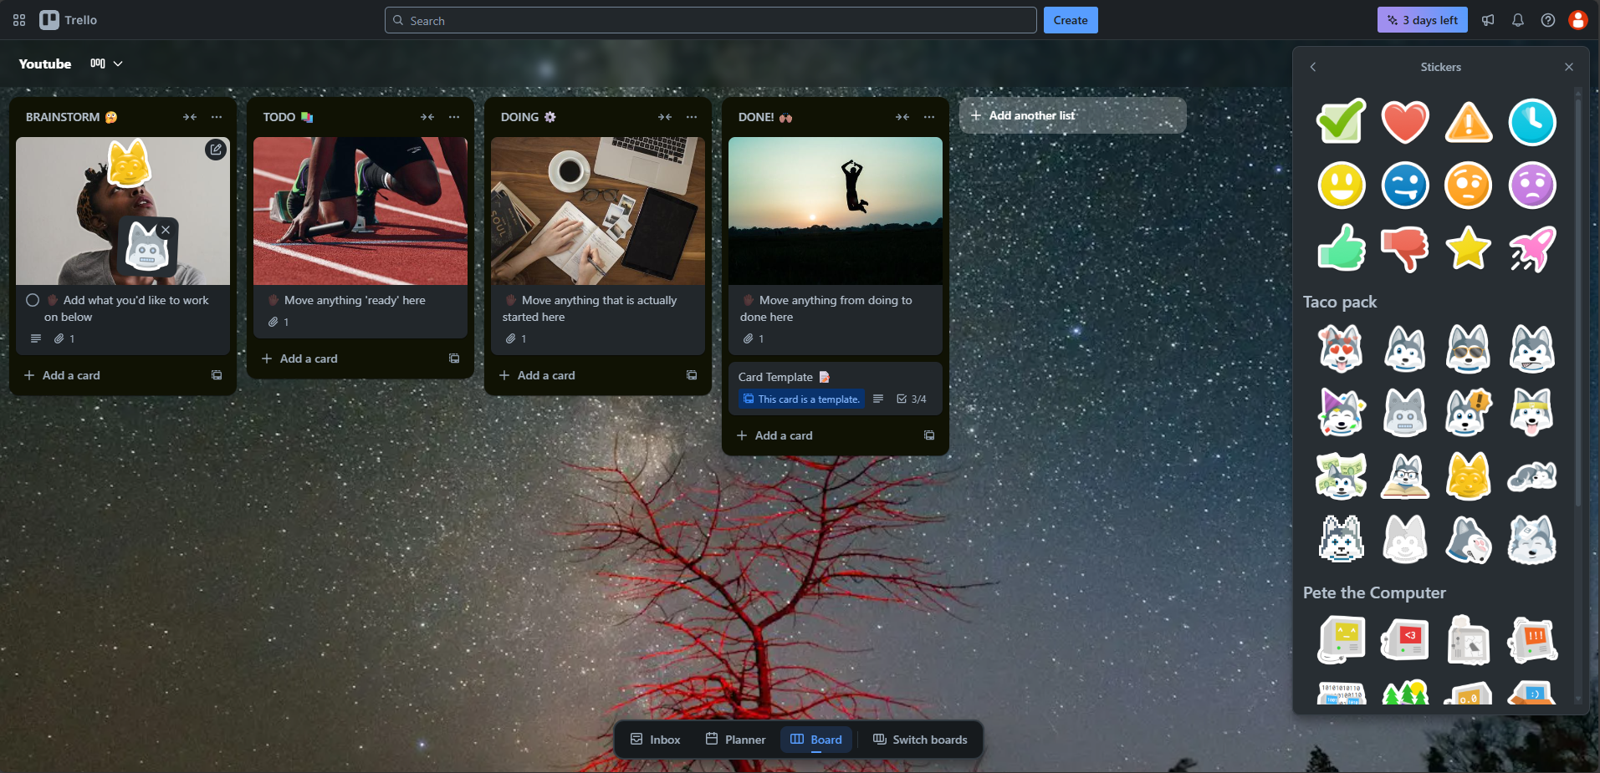
Card Sticker Screen
CardSticker
Sticker
Card
CategoryValue
StickerCategory
StickerUrl
Stage
Notes:
1. Show list of general sticker can select
SELECT
stk.Id StickerId,
stk.StickerName,
stk.StickerUrl,
skc.Id StickerCateogry,
skc.DisplayValue
FROM Sticker stk
JOIN StickerCategory skc ON skc.Id = stk.CategoryId
WHERE DisplayValue != 'Custom Stickers’;
2. show list of custom sticker can select
SELECT
stk.Id StickerId,
stk.StickerName,
stk.StickerUrl,
skc.Id StickerCateogry,
skc.DisplayValue
,stk.CreatedBy
FROM Sticker stk
JOIN StickerCategory skc ON skc.Id = stk.CategoryId
WHERE DisplayValue = 'Custom Stickers' AND stk.CreatedBy = 1;
3. show sticker in cover of a card
SELECT
st.Id AS sticker_id,
st.StickerName AS sticker_name,
st.StickerUrl AS sticker_url,
PositionX,
PositionY,
IndexZ,
CardId AS card_id
FROM CardSticker cs
JOIN Sticker st ON st.Id = cs.StickerId
WHERE CardId = 1;

Slide 38
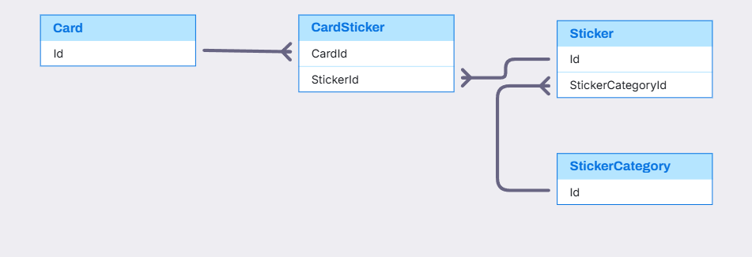
Card and Sticker Relationship

Slide 39
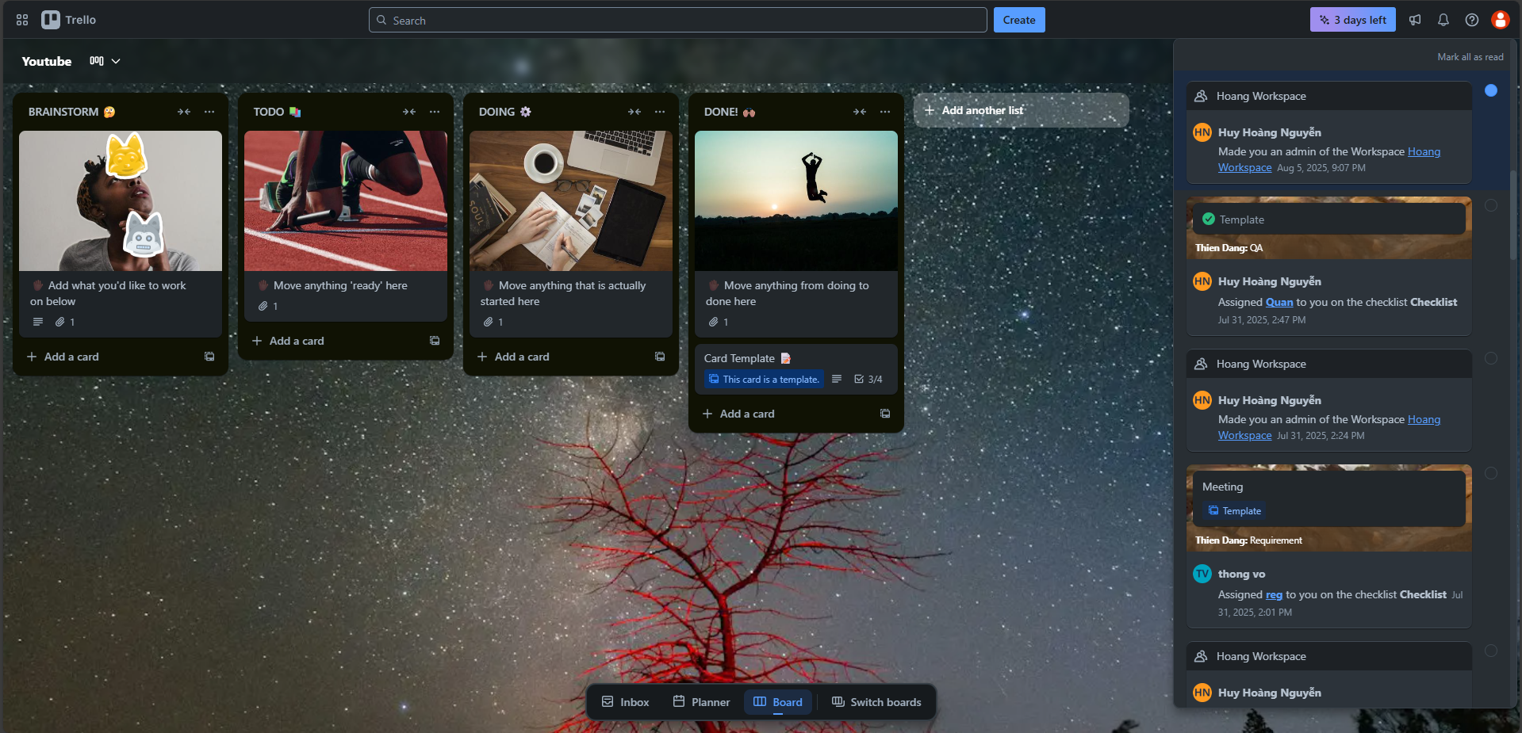
Notification and Activity Screen
Notification
WorkspaceName
IsRead
OwnerType
Activity
User
Description
CreatedAt
Card
Board
Notes:
1. Show all notification are unread
SELECT
noti.Id AS notification_id,
us.Id UserId,
us.PictureUrl AS user_picture,
us.Username,
ac.ActivityDescription AS activity_description,
noti.IsRead,
owt.OwnerTypeValue,
ac.OwnerId
FROM [Notification] noti
JOIN Activity ac ON ac.Id = noti.ActivityId
JOIN OwnerType owt ON owt.Id = ac.CategoryId
JOIN [User] us ON us.Id = ac.UserId
WHERE ac.UserId = 2 AND noti.IsRead = 0;
2. Show all notification are read
SELECT
noti.Id AS notification_id,
us.Id UserId,
us.PictureUrl AS user_picture,
us.Username,
ac.ActivityDescription AS activity_description,
noti.IsRead,
owt.OwnerTypeValue,
ac.OwnerId
FROM [Notification] noti
JOIN Activity ac ON ac.Id = noti.ActivityId
JOIN OwnerType owt ON owt.Id = ac.CategoryId
JOIN [User] us ON us.Id = ac.UserId
WHERE ac.UserId = 2 AND noti.IsRead = 1;

Slide 40
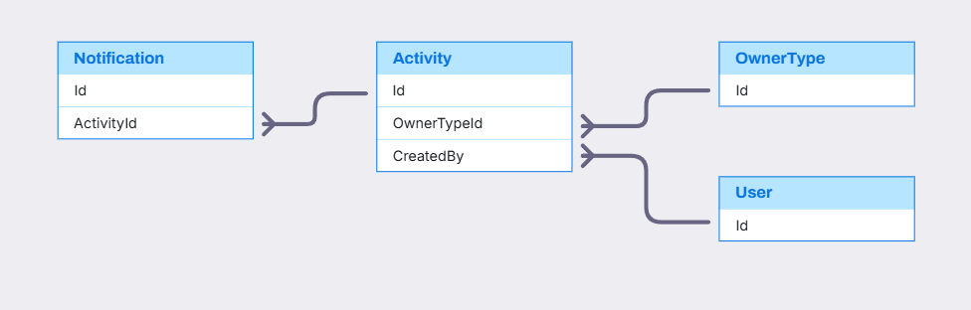
Notification and Activity Relationship

Slide 41

Q&A

Slide 43
bbv template EN
How-to guides

Slide 44
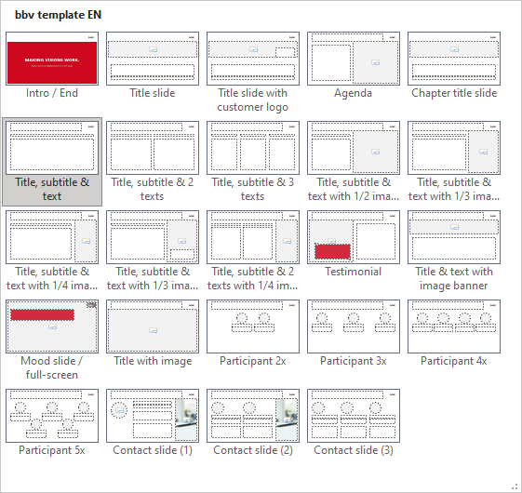
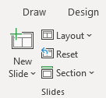

bbv Master layouts & slide library
Insert new slide
1
Click on «New Slide»
1
2
Select layout
Choose the desired layout from the pre-programmed master layouts.
2
→
Or select layout from slide library

Slide 45
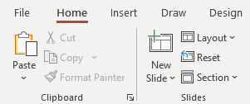
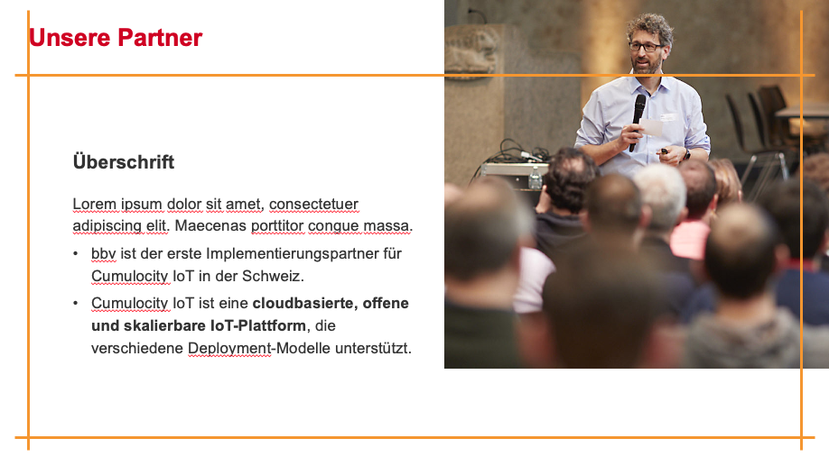
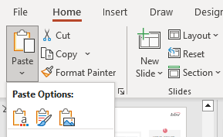
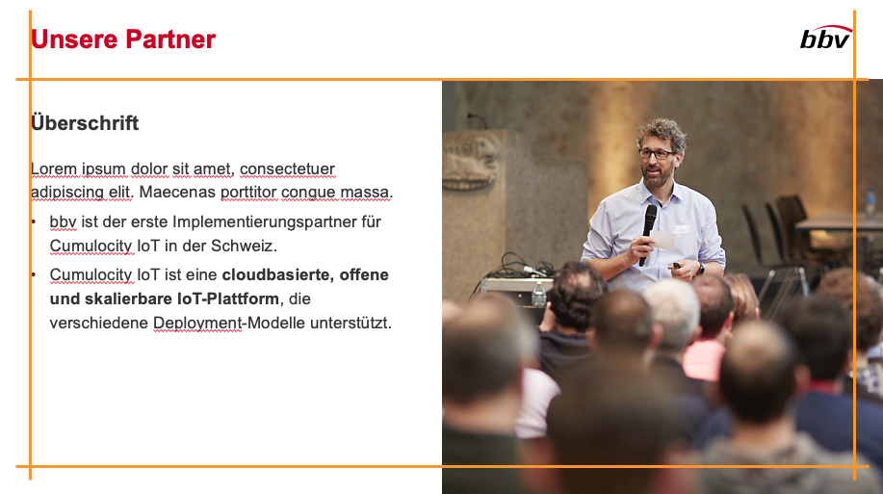
Transfer of existing slides into the new Master
1
2
3
4
Insert original slide
Copy slide in original presentation with Ctrl+C.
In the target presentation, select the slide after which the original slide is to be inserted.
Select in the tab «Home / Paste / Use Destination Theme».
Assign slide layout
Select the inserted slide
Select the desired layout in the tab «Home / Layout».
Adjust slide manually
Check all slide contents such as text blocks, images, etc. for position and size and manually adjust them to the new layout grid.
Check design
Independently check:
Font type, sizes and font colours
Colours of graphic elements
Text alignment
Coherence of the overall picture
Important:
When transferring existing slides, always carry out all four steps.

Slide 46
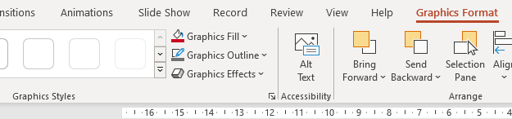

Change icon colour
Approach
Notes
Select icon
In the tab «Graphics Format» under «Graphics Styles», use «Graphics Fill» to change the colour
For some icons, the colour can be changed by using «Graphics Outline» instead of «Graphics Fill».
The colour cannot be changed if an icon is inserted as a picture. In this case, after selecting the icon, the tab «Picture Format» appears instead of «Graphics Format».
Best vector file format for icons: *.svg

Slide 47



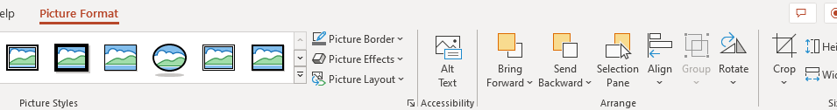


Insert image into placeholder
Insert image from external source
Click on the image icon, select image from Sharepoint or other source
The bbv image library is here locally located: C:\Users\Public\bbv_templates\Marketing\PPT-Bibliotheken\Bilder-Bibliothek
Or: copy image from external source with Ctrl+C, select the placeholder, then paste with Ctrl+V
Adjust
Select the image
Click in the tab «Picture Format» on «Crop»
Adjust the image composition by moving the image
Resize the image by clicking and dragging the outer circles.
Click again on «Crop» to finish the adjustments

Slide 48


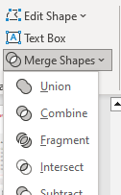

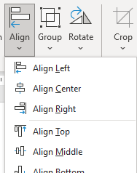

Insert image into mock-up screen (mobile/laptop)
Mock-up
Paste image
Copy image from external source with Ctrl+C and paste with Ctrl+V
Image mask
Adjust size & determine image area:
Place image behind image mask
Adjust image size and determine image area
Image mask
Crop image to image mask
Select image
Select image mask
Click in the tab «Shape Format / Merge Shapes» on «Intersect»
Combine image with mock-up
Place image behind mock-up
Activate image and mock-up and align both horizontally (Align Center) and vertically (Align Middle)
Group image and mock-up with Ctrl+G

Slide 49
bbv template EN
Style guide

Slide 50


Working area, guides & ruler
Working area
Depending on the slide, a single-column layout, a 2-column or 3-column layout is used.
Display the ruler and guides in the «View» tab.

Slide 51


bbv colour theme
Always OK!
Never, please!
Default text colours
Main accent
Colours for diagrams, charts, graphs etc.
Use selectively and sparingly
Never, please!
Colours for diagrams, charts, graphs etc.
Colours for diagrams, charts, graphs etc.

