Slide 2
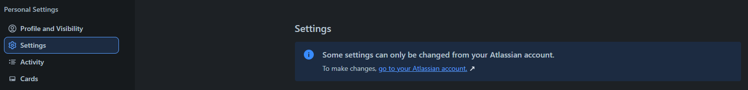



FUNCTIONALITY IN THE TRELLO SYSTEM
bbv Software Services AG | 21/07/2025

Slide 3
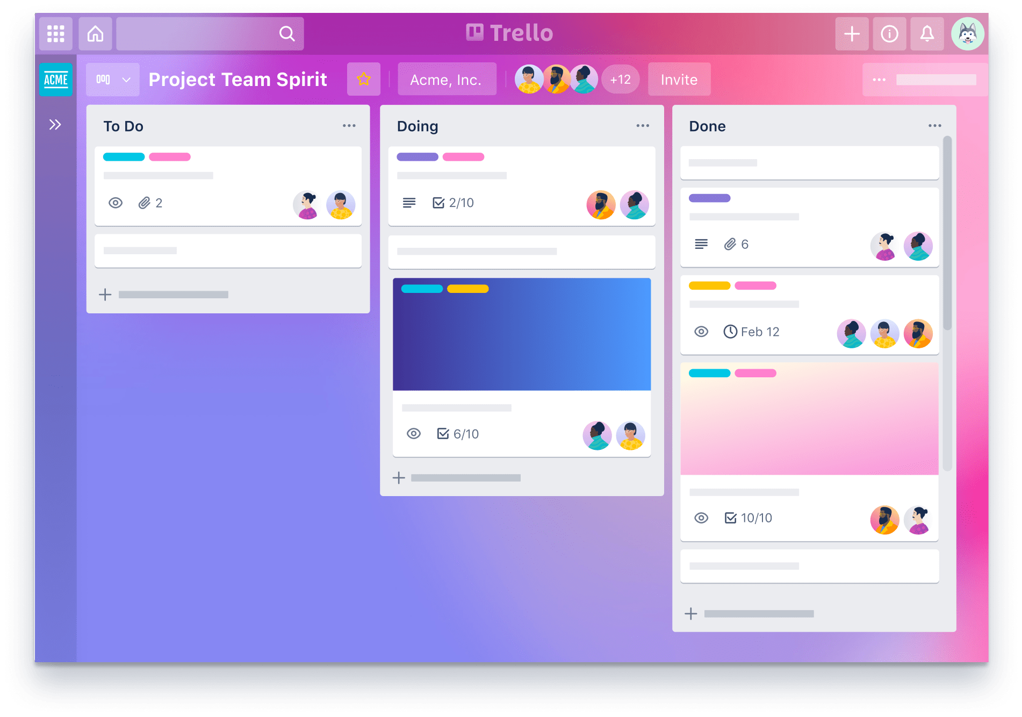
Agenda
Introduction to Functionality
UI in the Trello System
Entities in Trello System
Q&A

Slide 4
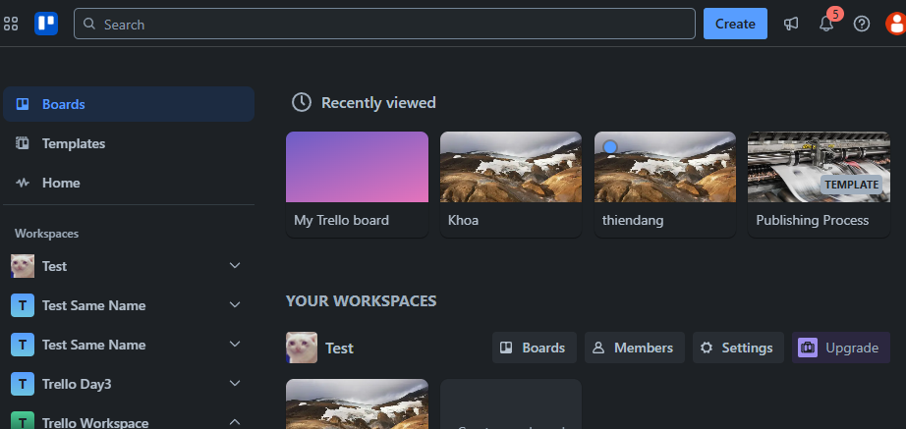
BOARDS TAB IN TRELLO SYSTEM
Board
Workspace
Notes:
1.Slide 4 | Home Page on the Boards tab → Recently viewed section, list all boards that the user has accessed recently.
2.Slide 4 | Home Page on the Boards tab → Your Workspaces section, list all workspaces that the current user is a member of.
3.Slide 4 | Home Page on the Boards tab → Workspace item → Boards button, list all boards that the current user is a member of belonging to a specific workspace.
4.Slide 4 | Home Page on the Header (top right corner), query boards have name that contains the keyword 'ab’
5.Slide 4 | Home Page on the Header (top right corner), show the total number of unread notifications of the user.

Slide 5
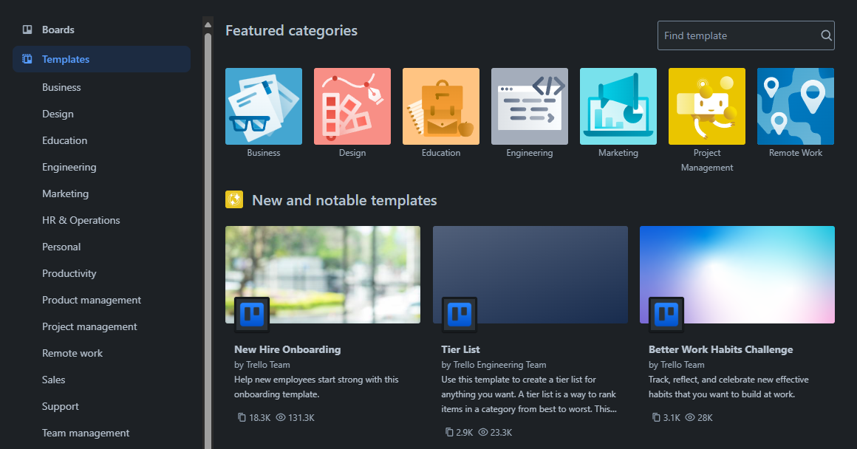
TEMPLATE TAB IN TRELLO SYSTEM
TemplateCategory
Template
Notes:
6.Slide 5 | Home Page on the Templates tab → Main area, list all available public or user-created templates.
7.Slide 5 | Home Page on the Templates tab → Sidebar, list all template categories available for filtering.
8.Slide 5 | Home Page on the Templates tab, query templates have title that contains the keyword 'da'

Slide 6
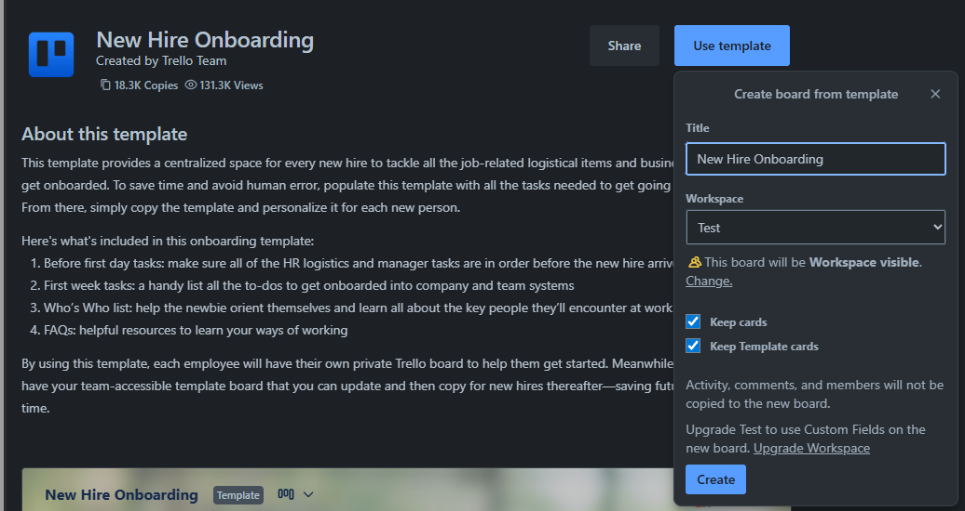
TEMPLATE IN TRELLO SYSTEM
Template
Board
Notes:
9. Slide 6 | Home Page on the Templates tab → Main area → Select specific tempalte, show information of a specific template.

Slide 7
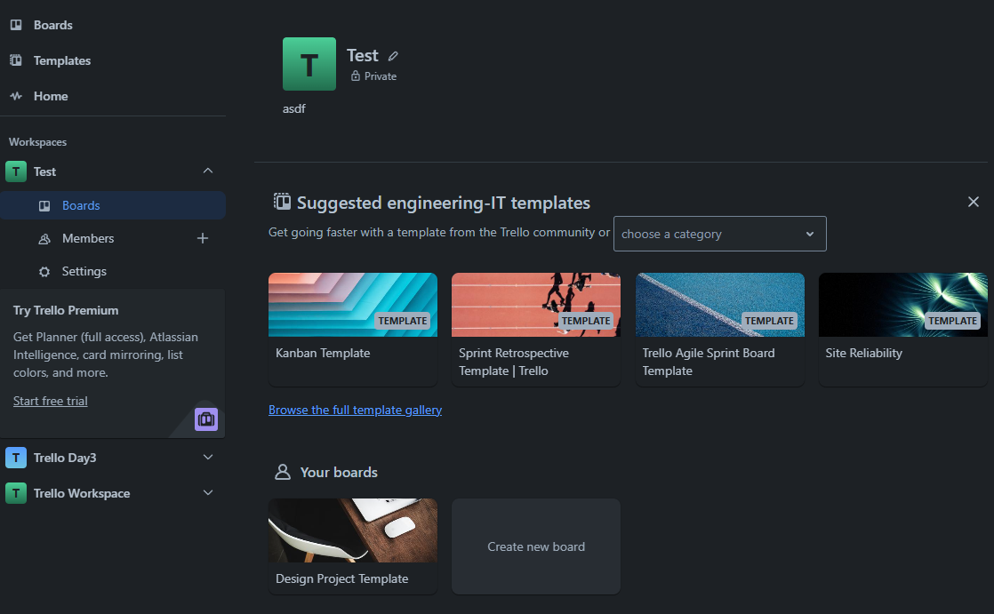
WORKSPACE IN TRELLO SYSTEM
Click here
Template
Board
Notes:
13.Slide 9 Home Page on the Workspace page → Boards section, list all boards under the selected workspace.

Slide 8
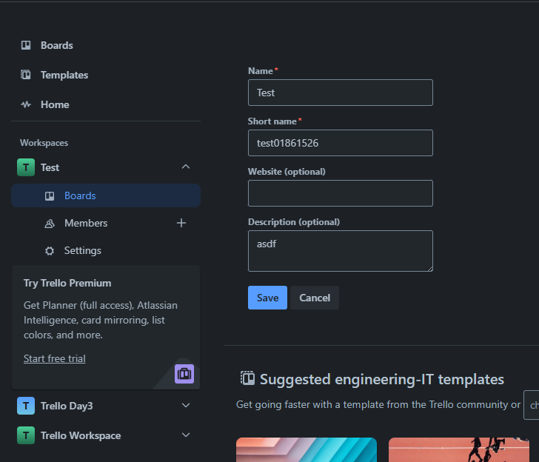
WORKSPACE IN TRELLO SYSTEM
Workspace Detail Information

Slide 9
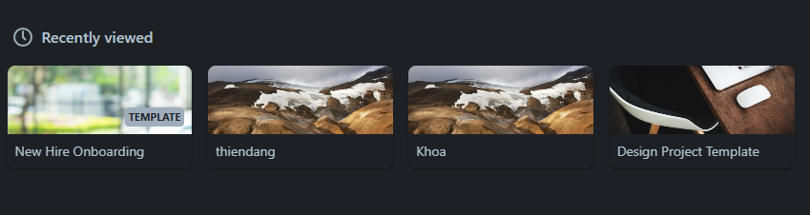
USERBOARDRECENTLYVIEW
IN TRELLO SYSTEM
UserBoard
Notes:
Home Page Home Page Home Page on the Boards tab → Recently viewed section, list all boards that the user has accessed recently.

Slide 10
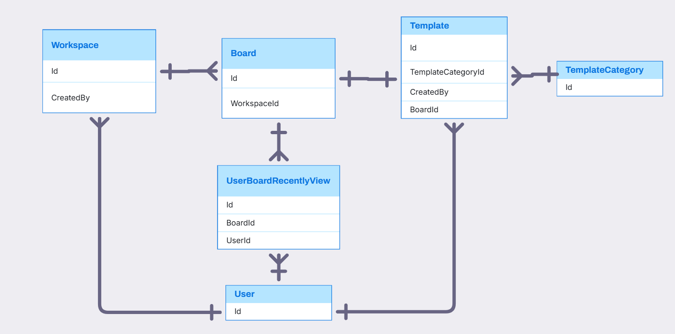
USER, WORKSPACE, BOARD, TEMPLATE, TEMPLATECATEGORY, USERBOARD RELATIONSHIP

Slide 11
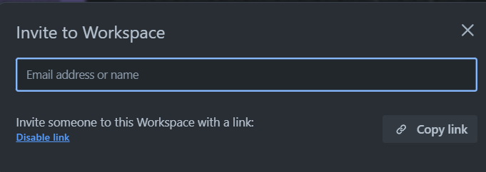
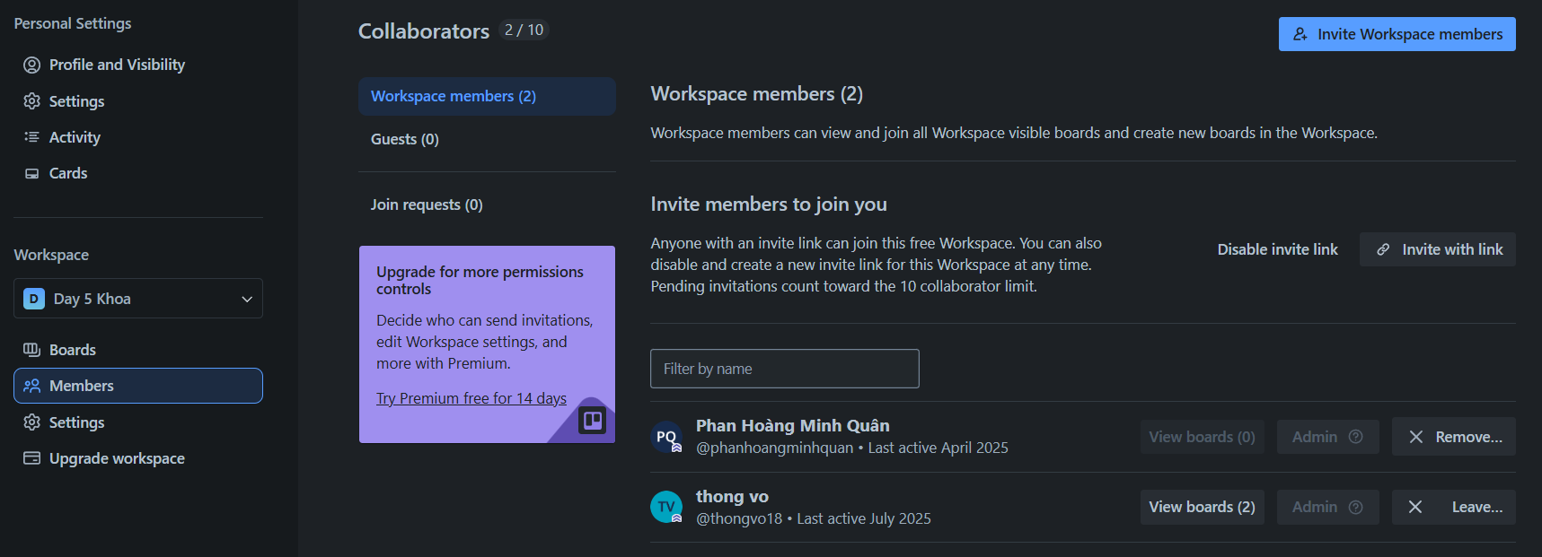
WORKSPACE IN TRELLO SYSTEM
ShareLink
Member
Permission
Notes:
14.Slide 13 Home Page on the Workspace page → Members section, list all members in the workspace along with their permission on roles.
15.Slide 13 Home Page on the Workspace page → Members section, count the total number of members in the selected workspace.

Slide 12
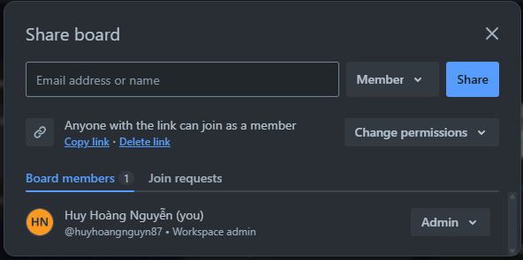
BOARD SHARE IN TRELLO SYSTEM
Add member to board with permission
Member Permission
Share link with permission
Notes:
16.Slide 14 Board Page on the Share Board pop-up, list all members in the board along with their permission on roles.

Slide 13
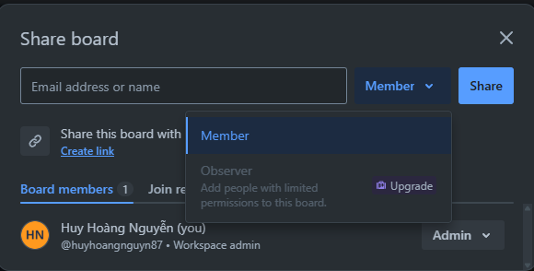
BOARD SHARE IN TRELLO SYSTEM
Permission code with admin, member, observer
Notes:
17.Slide 15 Board Page on the Share Board pop-up, list all permission options can choose

Slide 14
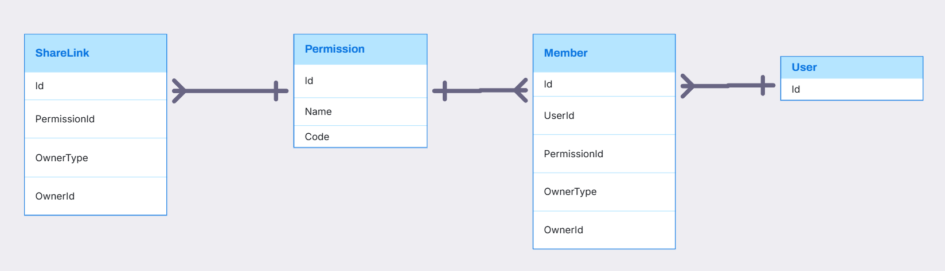
SHARELINK, PERMISSION, MEMBER RELATIONSHIP

Slide 15
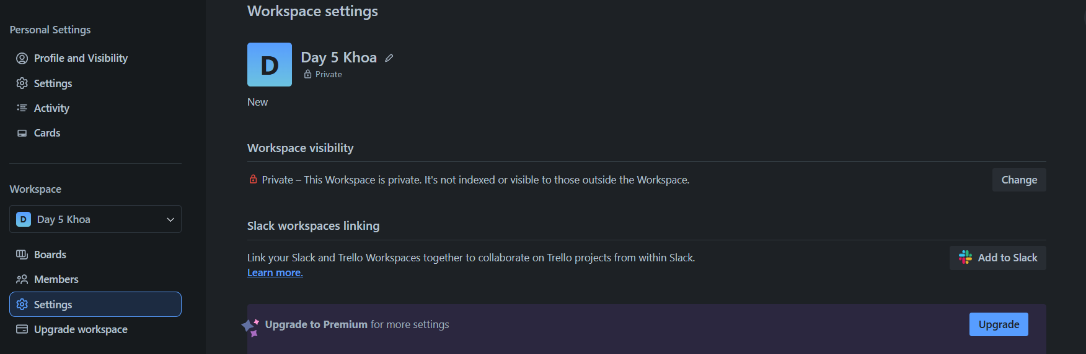
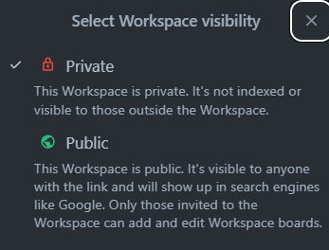
WORKSPACE SETTING IN TRELLO SYSTEM
SettingKey
SettingOption
SettingValue
Notes:
18.Slide 17 Home Page on the Workspace page → Settings section, list all workspace setting keys with the current user's selected values.
19.Slide 17 Home Page on the Workspace page → Settings section, list all settingoption of a specific workspace setting.

Slide 16
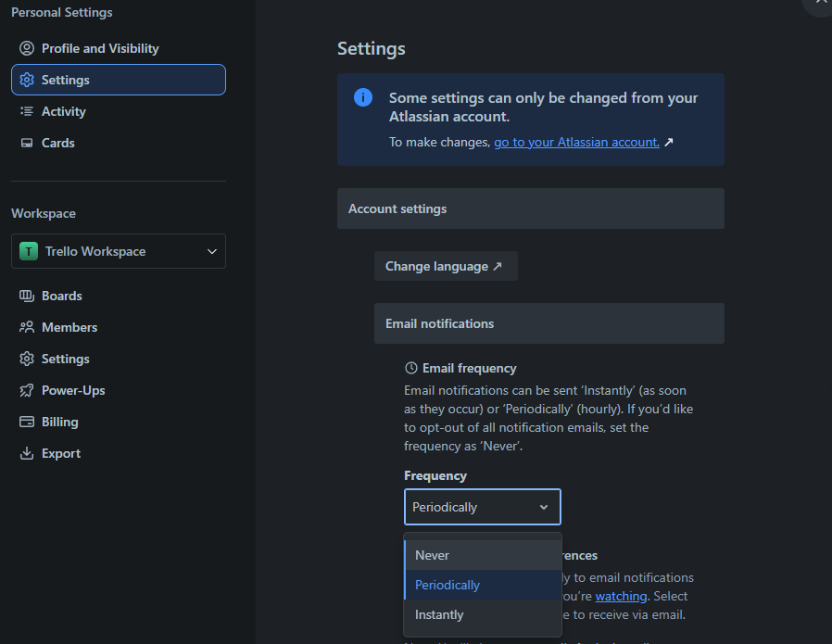
USER SETTING IN TRELLO SYSTEM
SettingKey
SettingValue
SettingOption

Slide 17
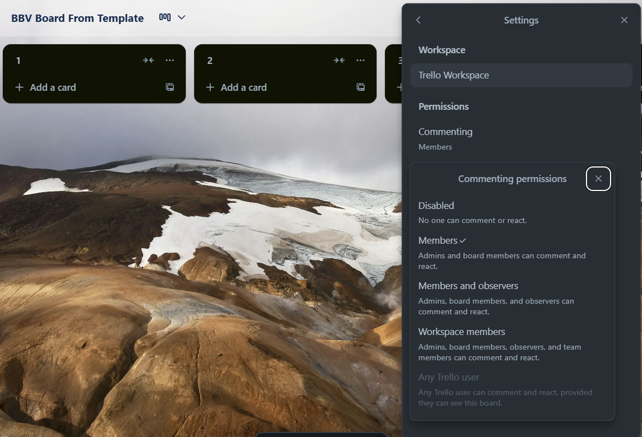
BOARD SETTING IN TRELLO SYSTEM
SettingKey
SettingValue
SettingOption
Notes:
20.Slide 19 Board Page on the Setting pop-up, list all board's setting key and user's choice of a specific user

Slide 18
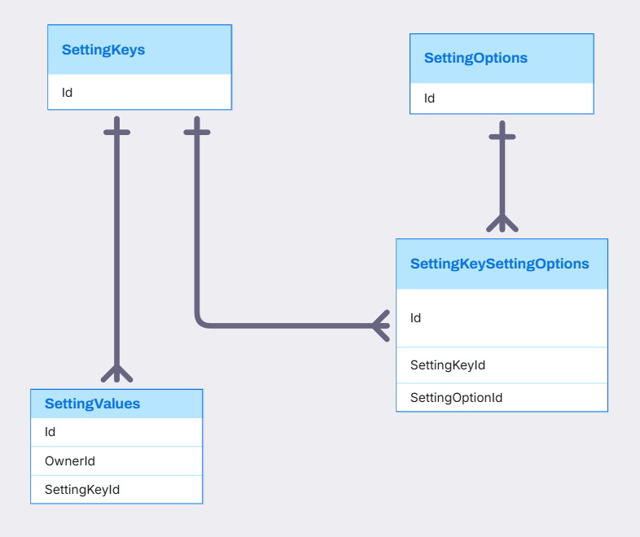
SETTINGKEY, SETTINGOPTION, SETTINGVALUE, SETTINGKEYSETTINGOPTION RELATIONSHIP

Slide 19
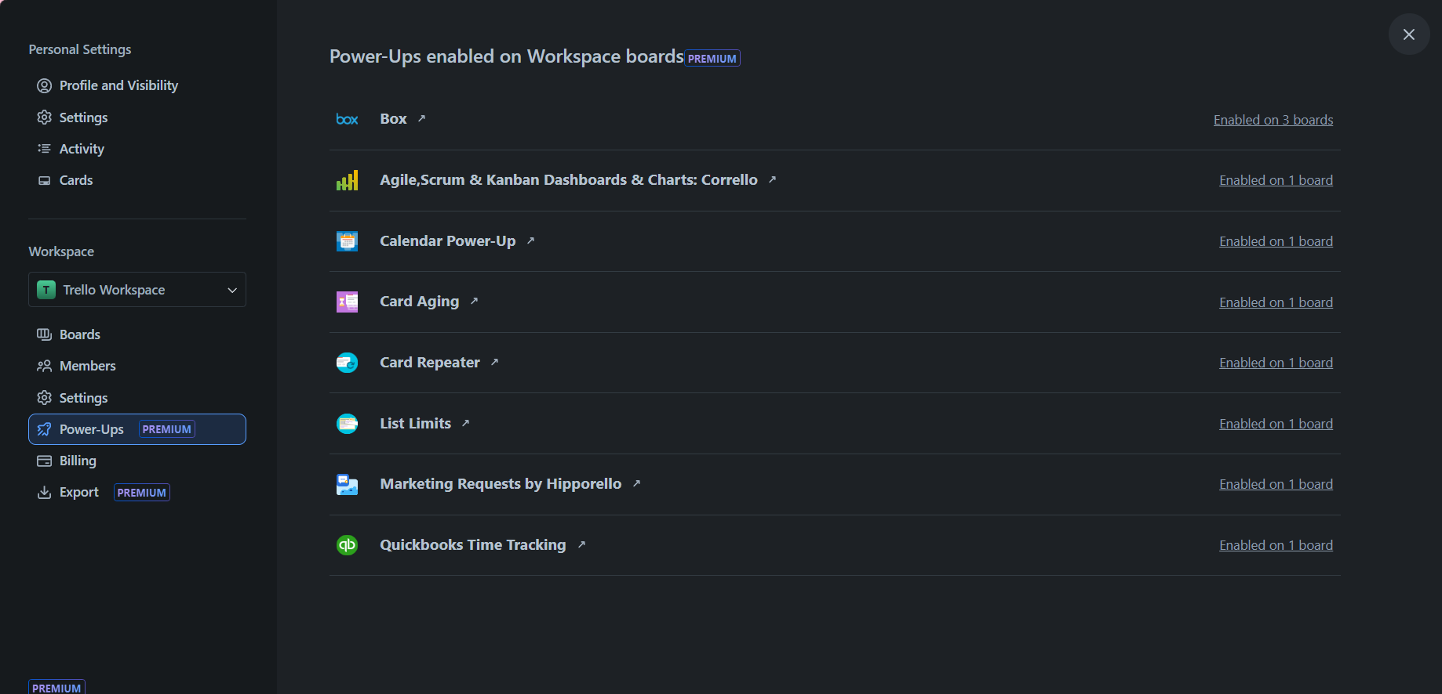
WORKSPACE IN TRELLO SYSTEM
Power-up
Notes:
21.Slide 21 Home Page on the Workspace page → Power-Ups section, list on power-ups of a specific workspace are using

Slide 20
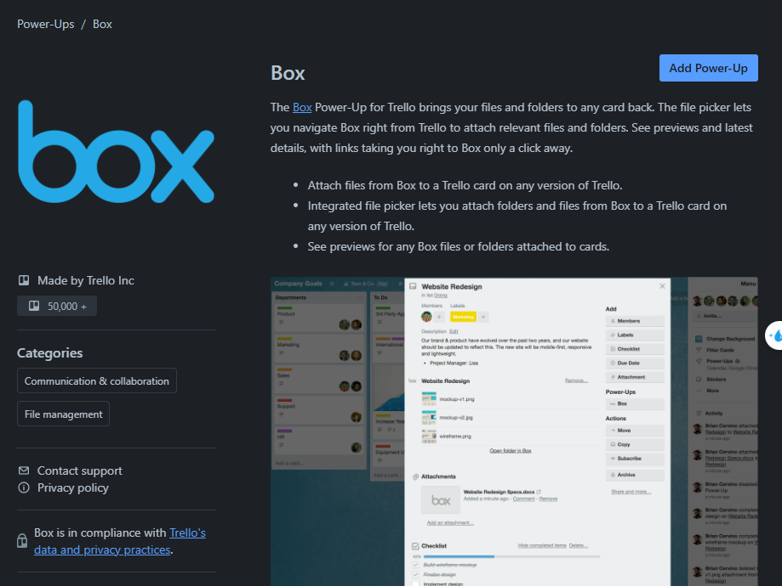
WORKSPACE IN TRELLO SYSTEM
Title
Description
AuthorName
PowerUpsCategory
Notes:
22.Slide 22 Home Page on the Workspace page → Power-Ups section → click a specific power-ups, show information of a specific power-up

Slide 21
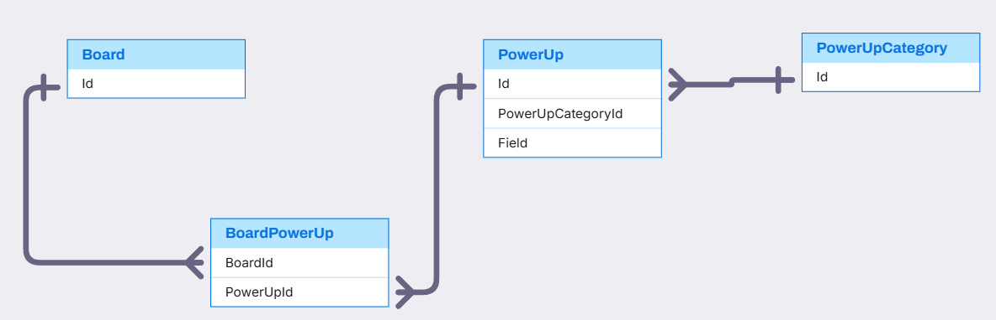
BOARD, POWERUP,POWERUPCATEGORY RELATIONSHIP
PowerUp,PowerUpCategory,Board(Quan)

Slide 22
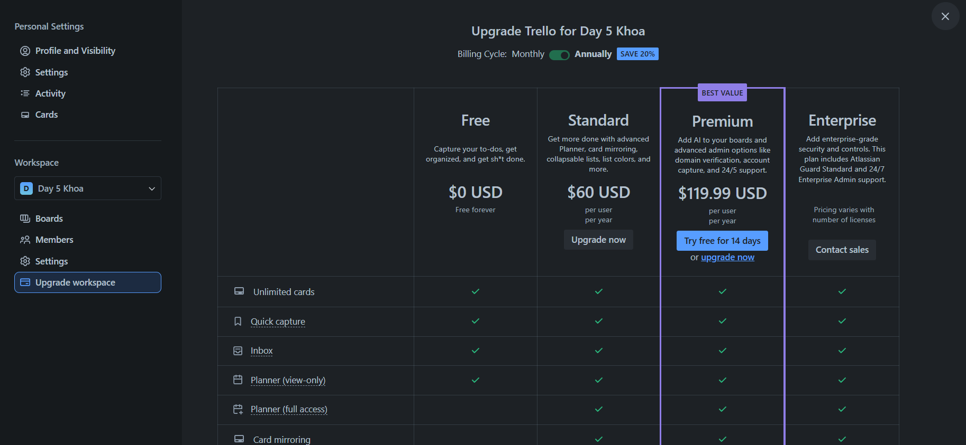
WORKSPACE IN TRELLO SYSTEM
BillingPlan
Notes:
23.Slide 24 Home Page on the Workspace page → Upgrade section, list all available billing plans that the workspace can upgrade to.

Slide 23
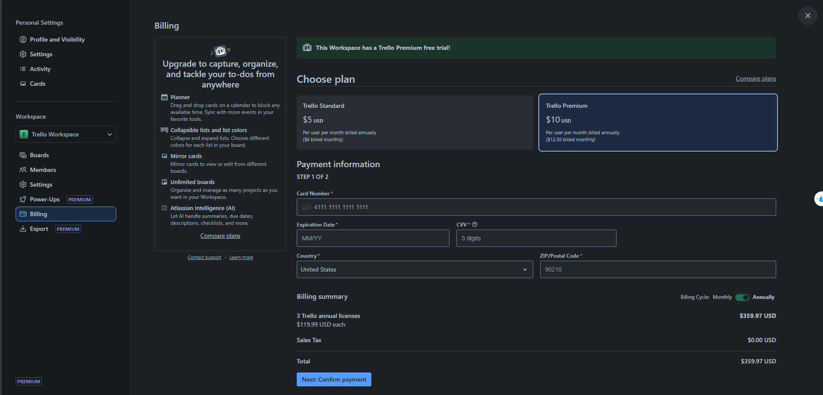
WORKSPACE IN TRELLO SYSTEM
BillingPlan
PaymentInformation
Notes:
Home Page on the Workspace page → Upgrade section, list all available billing plans that the workspace can upgrade to.

Slide 24
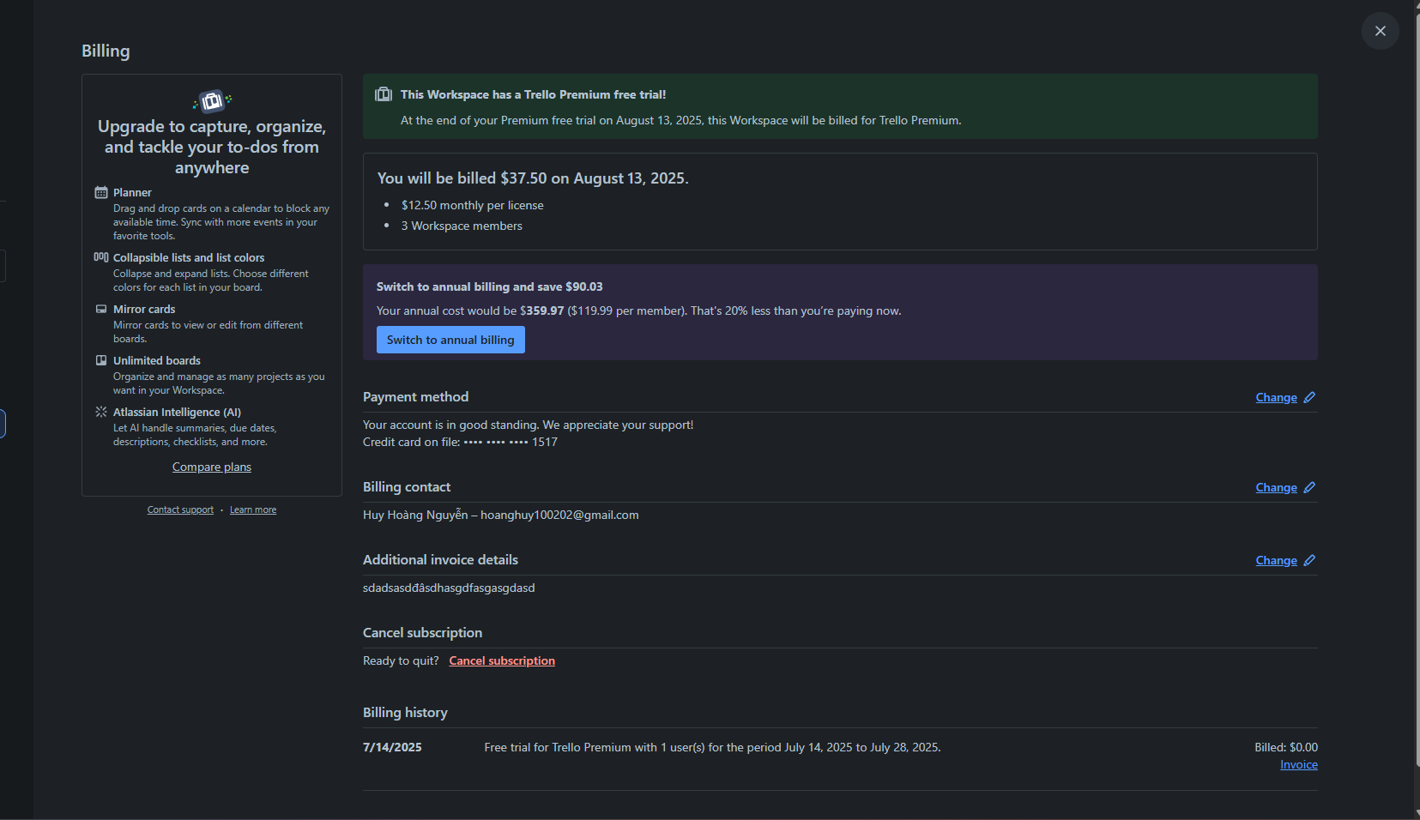
BILLING IN TRELLO SYSTEM
Subscription
Billing.AdditionalInvoiceDetail
Query from subscription
Notes:
24.Slide 26.Home Page on the Workspace page → Billing section, show information of payment and billing

Slide 25
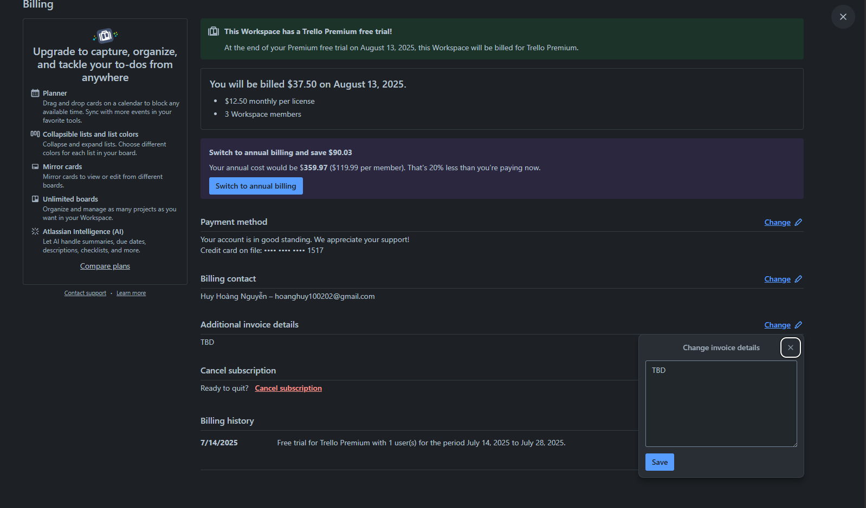
BILLING IN TRELLO SYSTEM
Billing.AdditionalInvoiceDetail

Slide 26
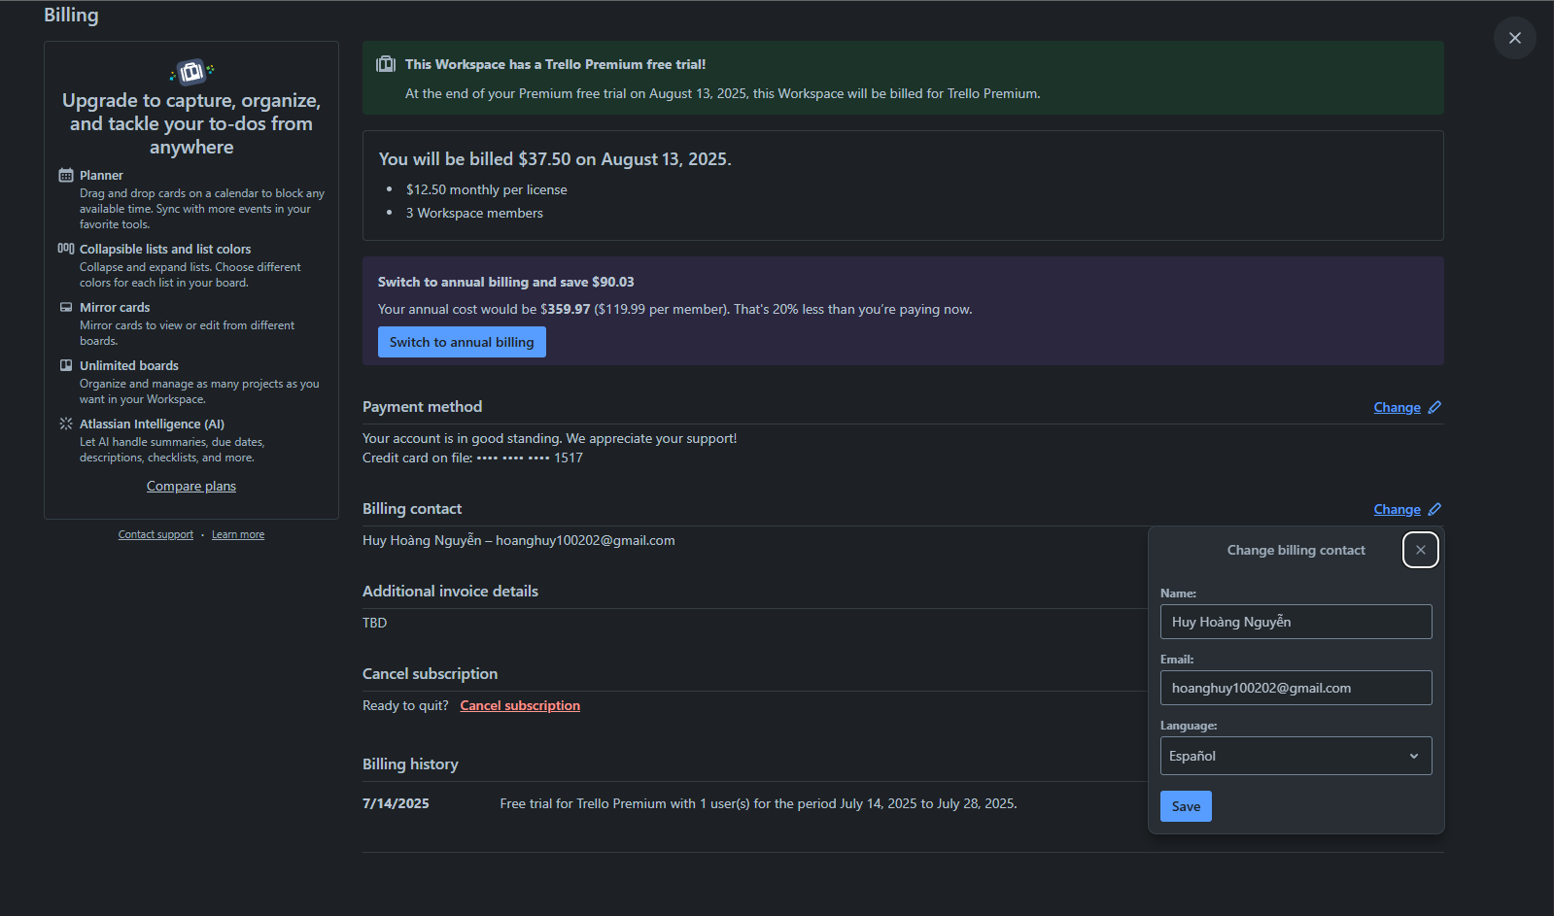
BILLING IN TRELLO SYSTEM
BillingContact

Slide 27
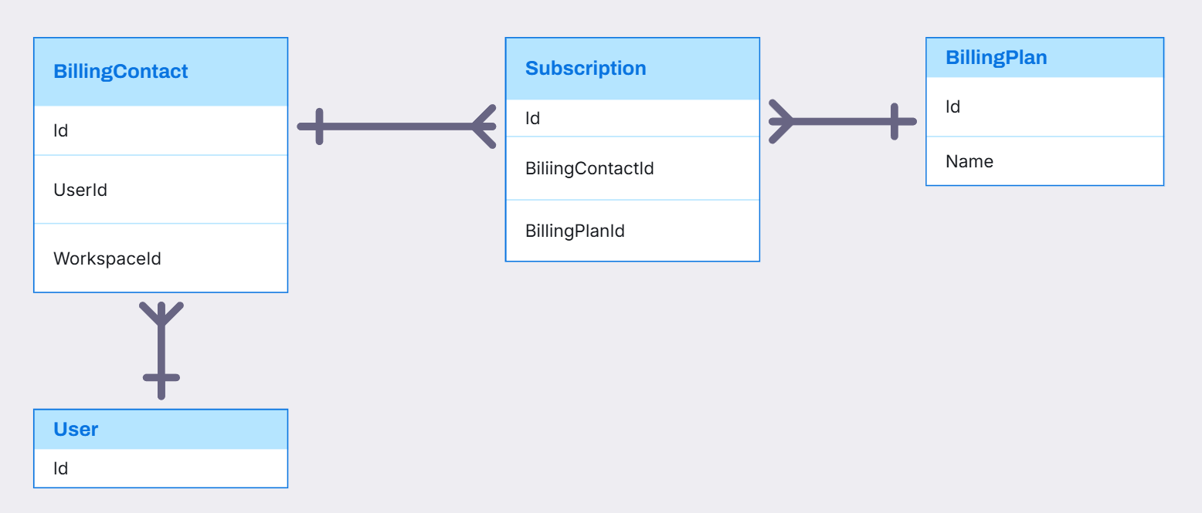
BILLINGCONTACT, BILLINGPLAN, SUBSCRIPTION RELATIONSHIP

Slide 28
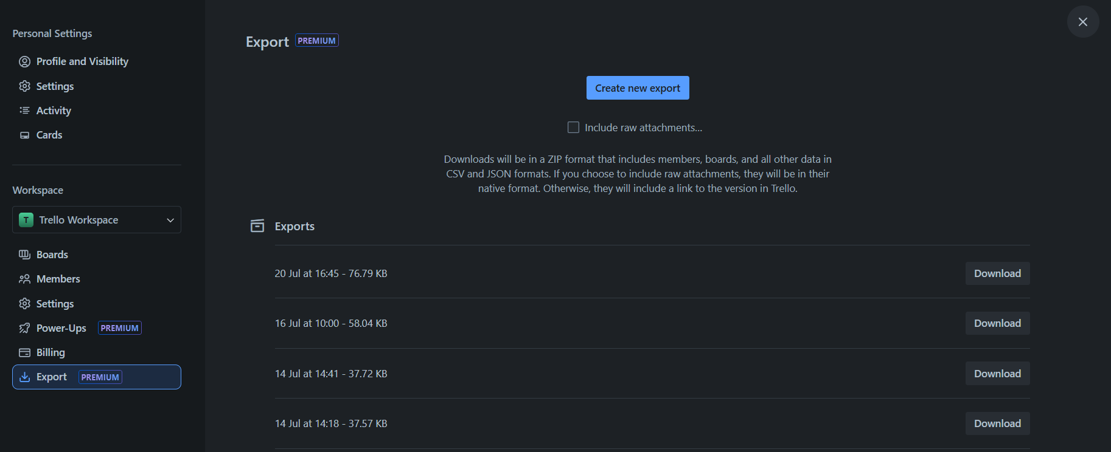
WORKSPACE IN TRELLO SYSTEM
Export
Notes:
Slide 30. Home Page on the Workspace page → Export section, list all history exports of a selected workspace

Slide 29
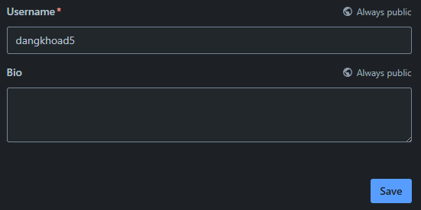
USER IN TRELLO SYSTEM
Username
UserBio

Slide 30
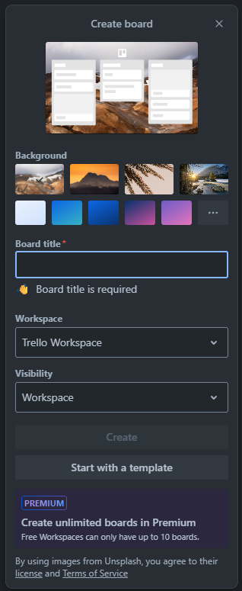
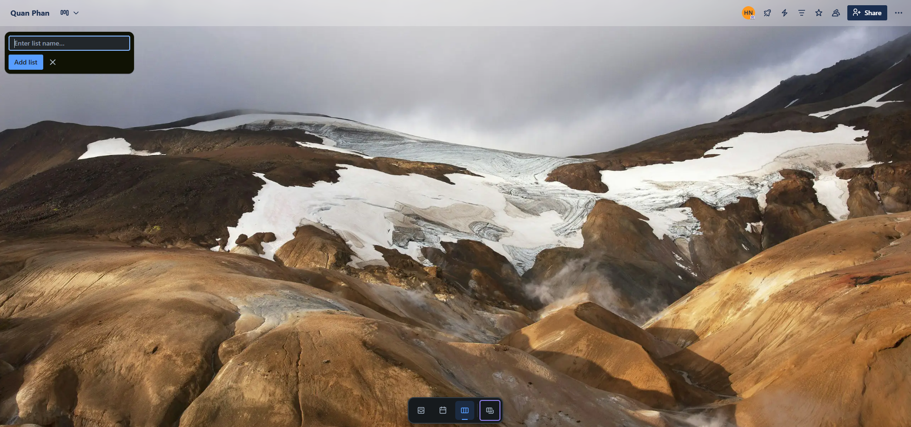
BOARD IN TRELLO SYSTEM
Stage
Board

Slide 31
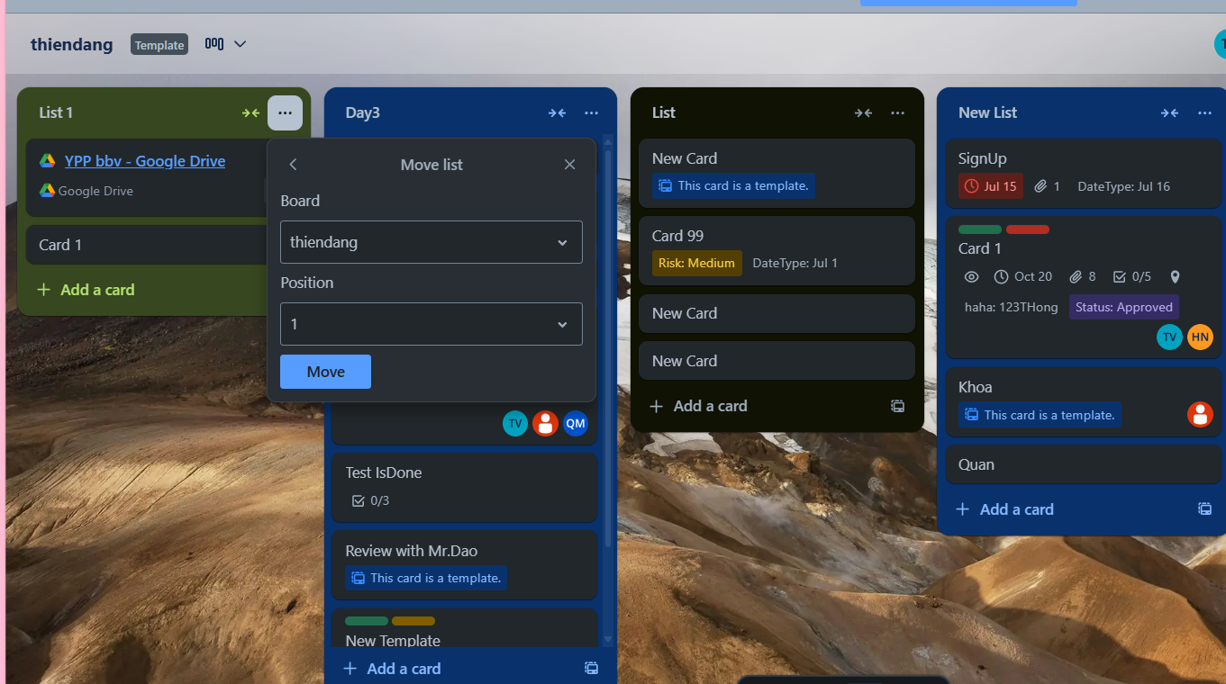
STAGE IN TRELLO SYSTEM
Stage Position
Notes:
Slide 33. Select a board → Board page, list all Stage in a selected board include Card

Slide 32
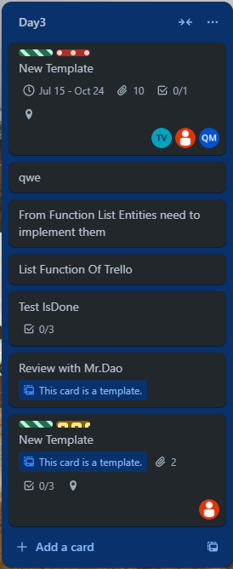
STAGE IN TRELLO SYSTEM
Stage
Card
Notes:
27. Slide 34. Select a board → Board page → in a stage, show information of a stage

Slide 33
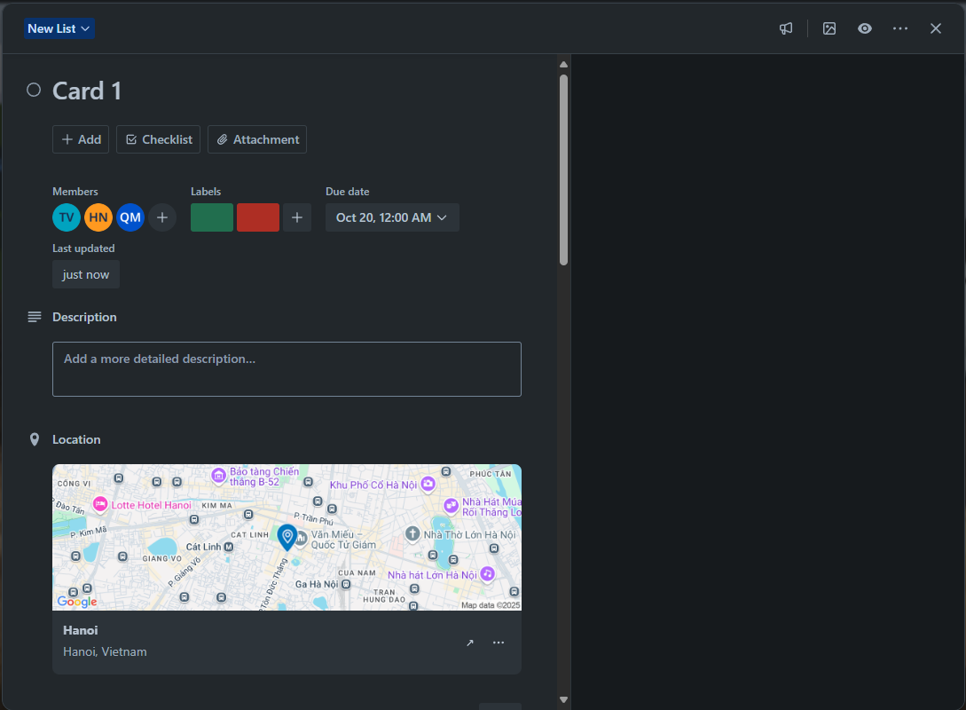
CARDS IN TRELLO SYSTEM
Member
CardDate
Label
CardDescription
CardLocation
Notes:
29. Slide 35. Select a board → Board page → in a stage → select a card, show labels of a card

Slide 34
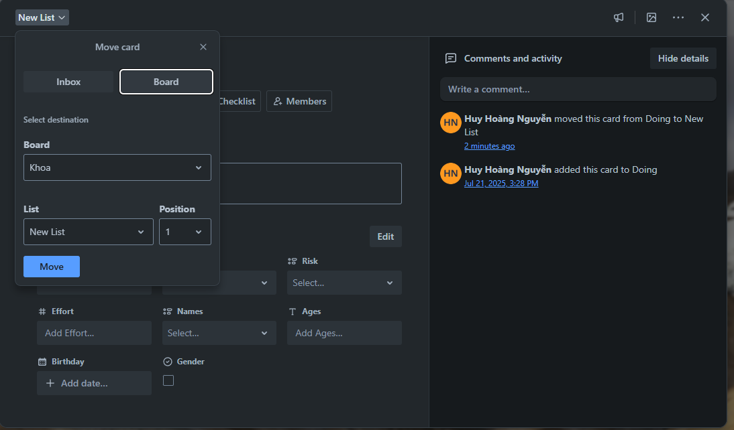
CARDS IN TRELLO SYSTEM
Card Activity
Card Position
Notes:
30. Slide 36. Select a board → Board page → in a stage → select a card, show activities in a specific card

Slide 35
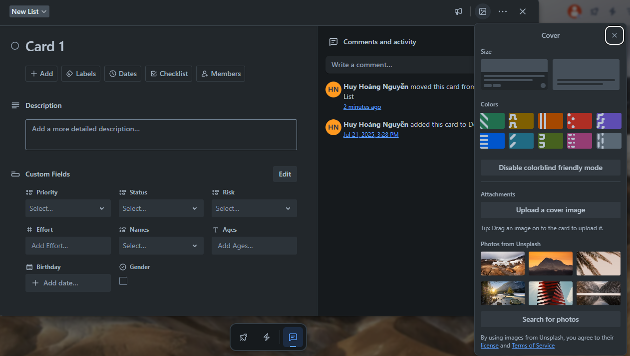
CARDS IN TRELLO SYSTEM
Color
Attachment
Card Cover
UnsplashImg
Notes:
31. Slide 37. Select a board → Board page → in a stage → select a card → click on cover, show list of colors with icon can selected

Slide 36
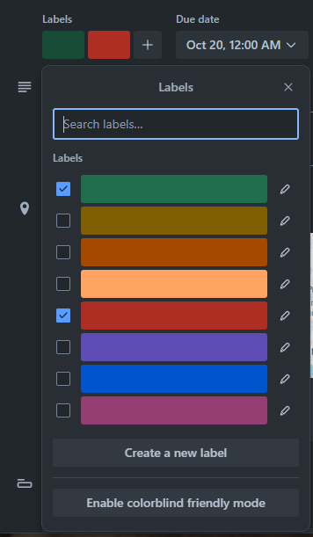
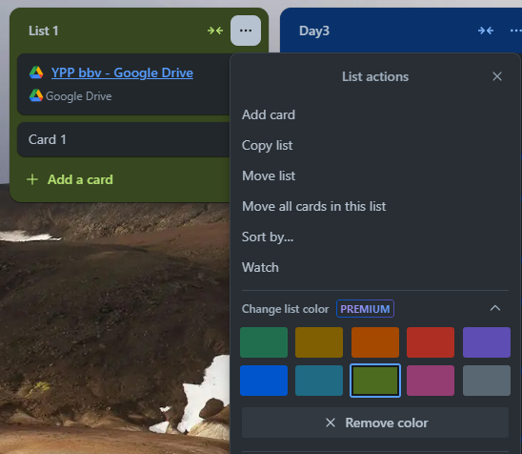
LABEL AND COLOR IN TRELLO SYSTEM
Label
Color
Notes:
32. Slide 38. Select a board → Board page → in a stage → select a card, show list of labels with color that card selected

Slide 37
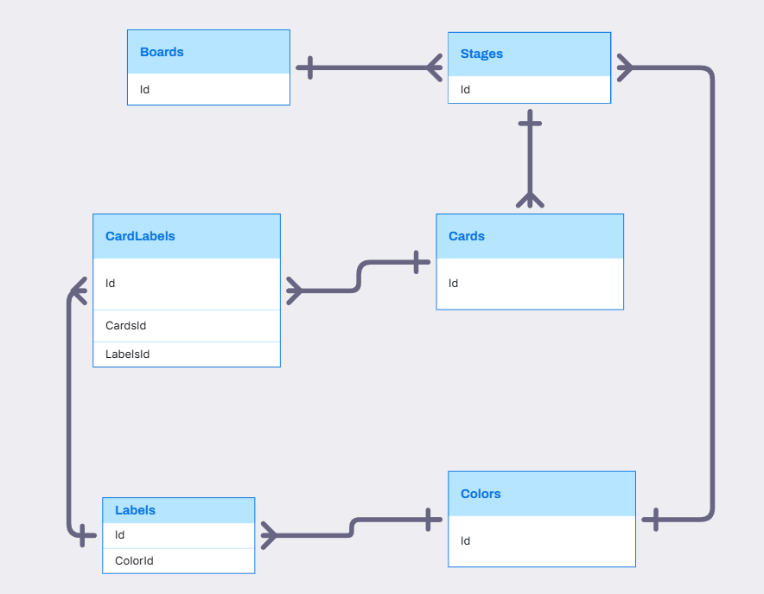
BOARD, STAGE, CARD, LABEL, COLOR RELATIONSHIP

Slide 38
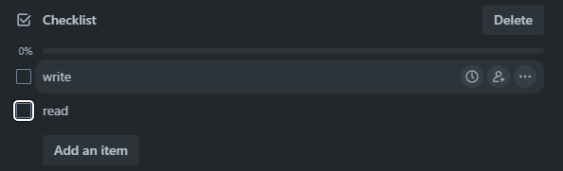
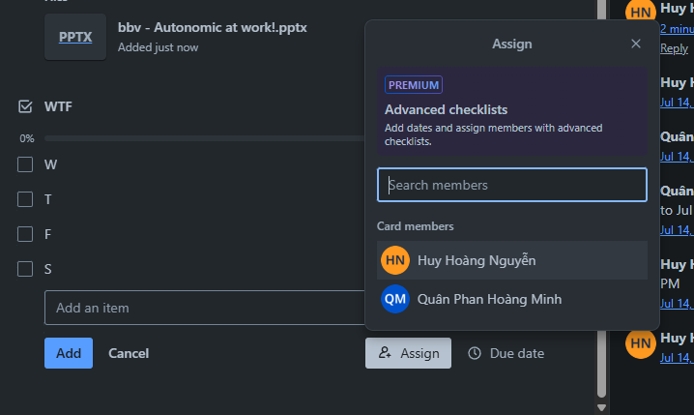
CHECKLIST IN TRELLO SYSTEM
CheckListItem
CheckList
Assign Member Into CheckListItem
Notes:
33. Slide 40. Select a board → Board page → in a stage → select a card → checklist section, checklist and its item in a specific card
34. Slide 40. Select a board → Board page → in a stage → select a card → checklist section, list members in card, board contains this card, workspace contains this board to assign in checklist's item

Slide 39
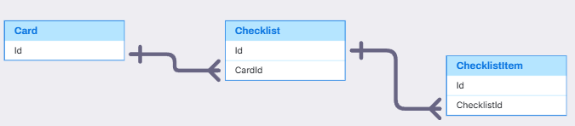
CARD, CHECKLIST, CHECKLISTITEM
Card, CheckList, CheckListItem(Quân)
,
,

Slide 40
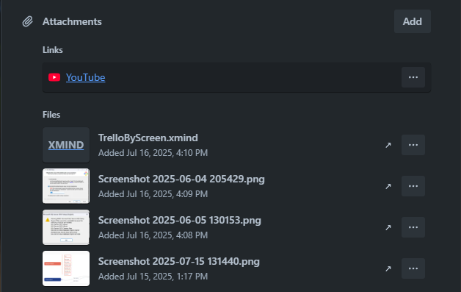
ATTACHMENT IN TRELLO SYSTEM
Attachment
Notes:
35. Slide 42. Select a board → Board page → in a stage → select a card → attachment section, show all attachment have LINK type in a specific card
36. Slide 42. Select a board → Board page → in a stage → select a card → attachment section, show all attachment have FILE type in a specific card

Slide 41
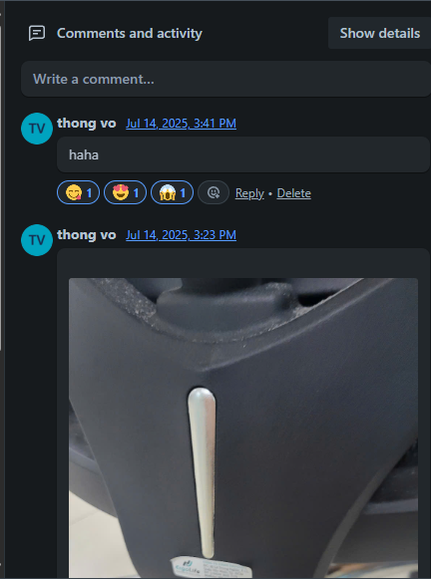
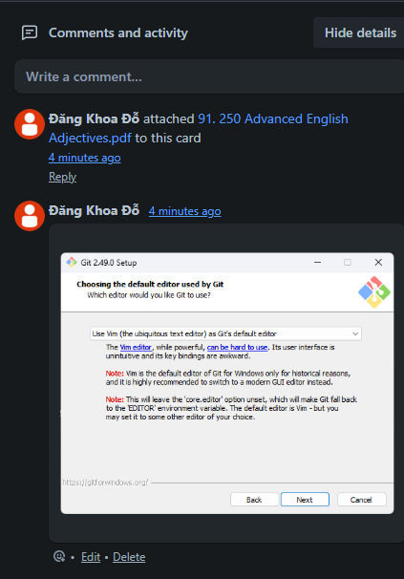
COMMENT IN TRELLO SYSTEM
Activity
Comment
Notes:
37. Slide 43. Select a board → Board page → in a stage → select a card → comment section, show all comment in a specific card(123)
38. Slide 43. Select a board → Board page → in a stage → select a card → comment section, show all reactions in a comment(104) of a specific card
39. Slide 43. Select a board → Board page → in a stage → select a card → comment section → show detail, show all activities of a specific card.

Slide 42
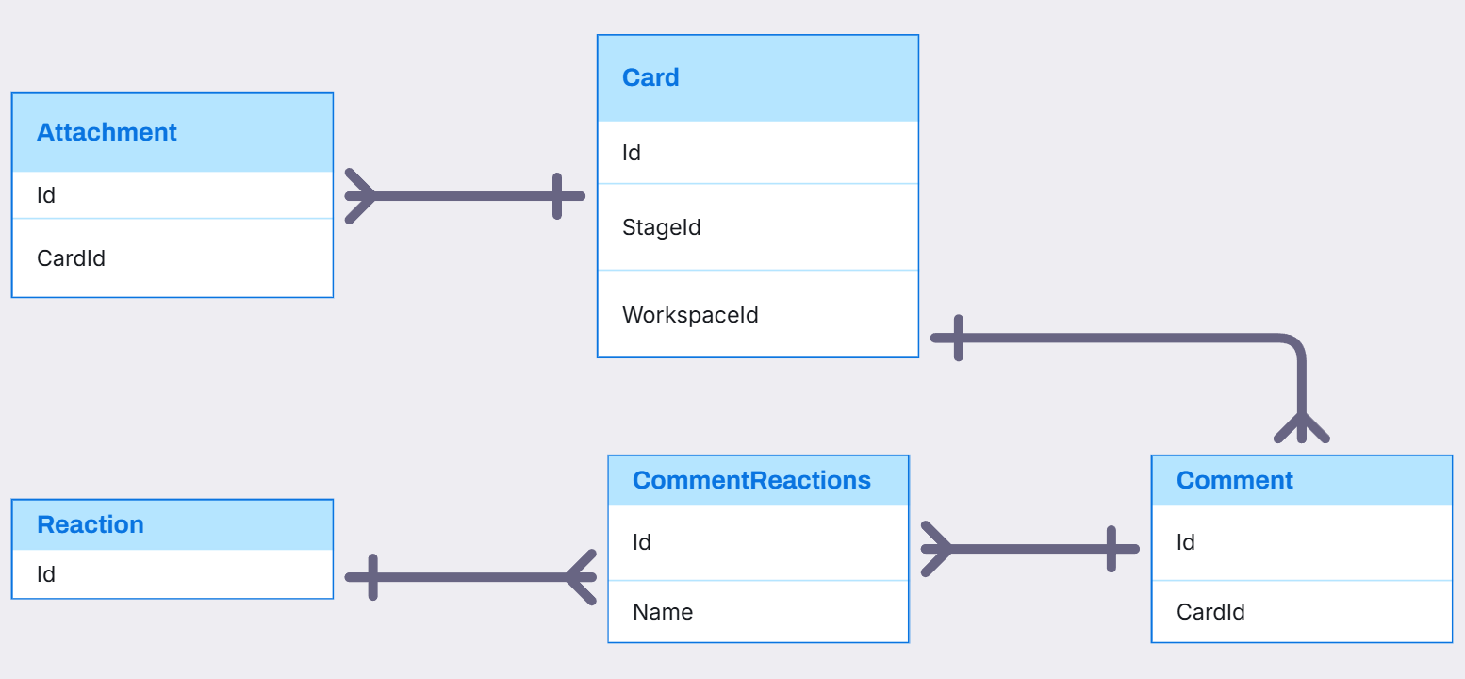
CARD, ATTACHMENT, COMMENT, REACTION RELATIONSHIP

Slide 43
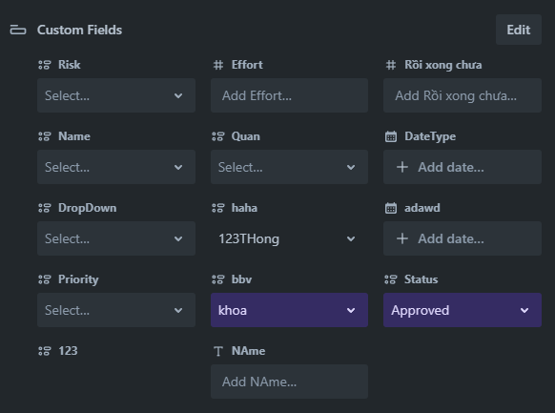
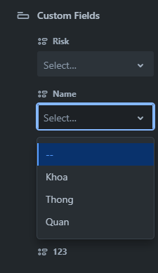
CARDS IN TRELLO SYSTEM
FieldItem
CustomField
FieldValue
FieldItem
Notes:
40. Slide 45. Select a board → Board page → in a stage → select a card → CustomField section, show all CustomField and Selection of a specific card
41. Slide 45. Select a board → Board page → in a stage → select a card → CustomField section, show all options of a custom field with DROPDOWN type with Id = 13

Slide 44
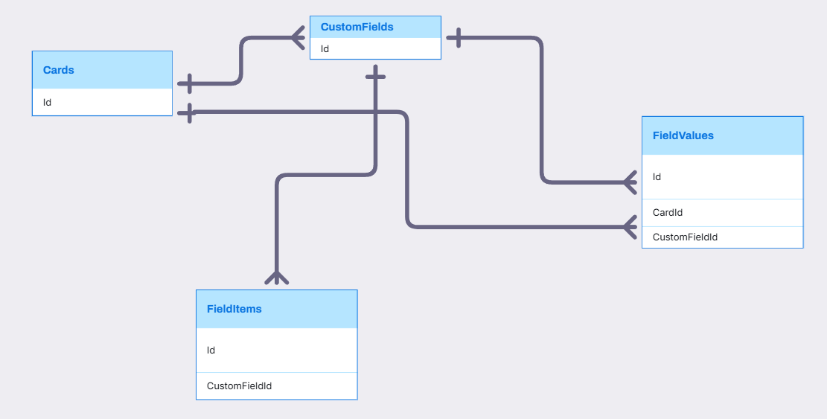
Visily
Card, CustomField, FieldValue, FieldItem(Thông)
,
,

Slide 45



STICKERS IN TRELLO SYSTEM
Click Here
Drag To Here
Sticker
Notes:
42. Slide 47. Select a board → Board page → Setting section → Click stickers, show list of sticker can select
43. Slide 47. Select a board → Board page → in a stage, show sticker in cover of a card

Slide 46

STICKERS IN TRELLO SYSTEM

Slide 47

NOTIFICATION IN TRELLO SYSTEM
Notification
Notes:
44. Slide 49. Click notification icon, show all notification are unread
45. Slide 49. Click notification icon, show all notification are read

Slide 48

HOME TAB IN TRELLO SYSTEM
Activity
TemplateCategory
Template

Slide 49

ACTIVITY, NOTIFICATION RELATIONSHIP

Slide 50

COLLECTION IN TRELLO SYSTEM
Collection
Board
Notes:
46. Slide 52. Click setting of a workspace → click board tab, show board and collection its belong with

Slide 51

COLLECTION, BOARD, BOARDCOLLECTION RELATIONSHIP

Slide 52

HOME TAB IN TRELLO SYSTEM
Template
Board
CheckListItem
Activity
Notes:
10.Slide 7 | Home Page on the Home tab → Checklist section, list all checklist items assigned to the user with status set to false (incomplete).
11.Slide 7 Home Page on the Home tab → Assigned cards section, list all cards that are currently assigned to the user.
12.Slide 7 Home Page on the Home tab → Activity feed section, list all recent card's activities in the user's card.

Slide 53

CREATE WORKSPACE IN TRELLO SYSTEM
Comment

Slide 54

Q&A
Thank you
Intern | Trello Team

Slide 55

CREATE WORKSPACE IN TRELLO SYSTEM
Card.URL

Slide 56
CREATE WORKSPACE IN TRELLO SYSTEM
Card.URL

Slide 57

CREATE WORKSPACE IN TRELLO SYSTEM
Stickers
StickerCategories
Custom Sticker

Slide 58

CREATE WORKSPACE IN TRELLO SYSTEM
CustomField.IsFrontCardShowed

Slide 60
bbv template EN
How-to guides

Slide 61


bbv Master layouts & slide library
Insert new slide
1
Click on «New Slide»
1
2
Select layout
Choose the desired layout from the pre-programmed master layouts.
2
🡪
Or select layout from slide library

Slide 62




Transfer of existing slides into the new Master
1
2
3
4
Insert original slide
Copy slide in original presentation with Ctrl+C.
In the target presentation, select the slide after which the original slide is to be inserted.
Select in the tab «Home / Paste / Use Destination Theme».
Assign slide layout
Select the inserted slide
Select the desired layout in the tab «Home / Layout».
Adjust slide manually
Check all slide contents such as text blocks, images, etc. for position and size and manually adjust them to the new layout grid.
Check design
Independently check:
Font type, sizes and font colours
Colours of graphic elements
Text alignment
Coherence of the overall picture
Important:
When transferring existing slides, always carry out all four steps.

Slide 63


Change icon colour
Approach
Notes
Select icon
In the tab «Graphics Format» under «Graphics Styles», use «Graphics Fill» to change the colour
For some icons, the colour can be changed by using «Graphics Outline» instead of «Graphics Fill».
The colour cannot be changed if an icon is inserted as a picture. In this case, after selecting the icon, the tab «Picture Format» appears instead of «Graphics Format».
Best vector file format for icons: *.svg

Slide 64






Insert image into placeholder
Insert image from external source
Click on the image icon, select image from Sharepoint or other source
The bbv image library is here locally located: C:\Users\Public\bbv_templates\Marketing\PPT-Bibliotheken\Bilder-Bibliothek
Or: copy image from external source with Ctrl+C, select the placeholder, then paste with Ctrl+V
Adjust
Select the image
Click in the tab «Picture Format» on «Crop»
Adjust the image composition by moving the image
Resize the image by clicking and dragging the outer circles.
Click again on «Crop» to finish the adjustments

Slide 65






Insert image into mock-up screen (mobile/laptop)
Mock-up
Paste image
Copy image from external source with Ctrl+C and paste with Ctrl+V
Image mask
Adjust size & determine image area:
Place image behind image mask
Adjust image size and determine image area
Image mask
Crop image to image mask
Select image
Select image mask
Click in the tab «Shape Format / Merge Shapes» on «Intersect»
Combine image with mock-up
Place image behind mock-up
Activate image and mock-up and align both horizontally (Align Center) and vertically (Align Middle)
Group image and mock-up with Ctrl+G

Slide 66
bbv template EN
Style guide

Slide 67



Working area, guides & ruler
Working area
Depending on the slide, a single-column layout, a 2-column or 3-column layout is used.
Display the ruler and guides in the «View» tab.

Slide 68


bbv colour theme
Always OK!
Never, please!
Default text colours
Main accent
Colours for diagrams, charts, graphs etc.
Use selectively and sparingly
Never, please!
Colours for diagrams, charts, graphs etc.
Colours for diagrams, charts, graphs etc.

