Slide 2

Ypp 4
bbv Software Services AG | Date

Slide 3




Presentation title with customer logo
bbv Software Services AG | Date

Slide 4
Agenda
Welcome & introduction of bbv
First name Last name
Proposed solution
First name Last name
Approach, method and deadlines
First name Last name
Collaboration model
First name Last name
Offer
First name Last name
Offer benefits incl. references
First name Last name
Next agenda topic
First name Last name

Slide 5
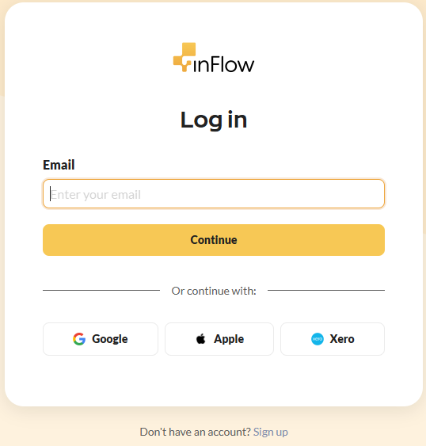
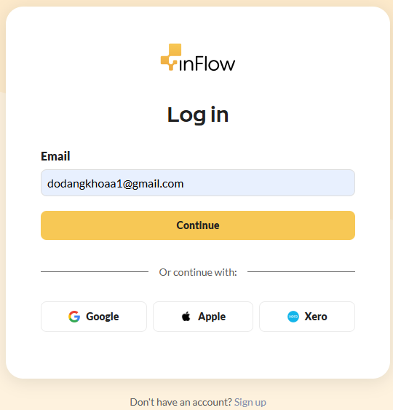
Sign In UI

Slide 6
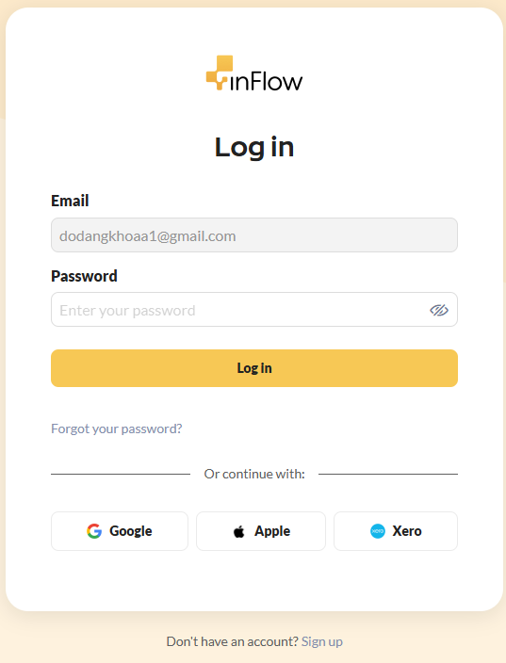
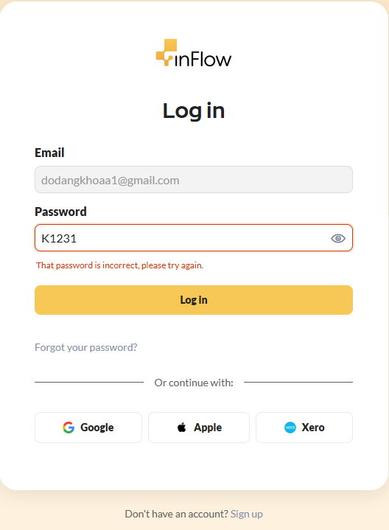
Sign In UI – Wrong Password

Slide 7
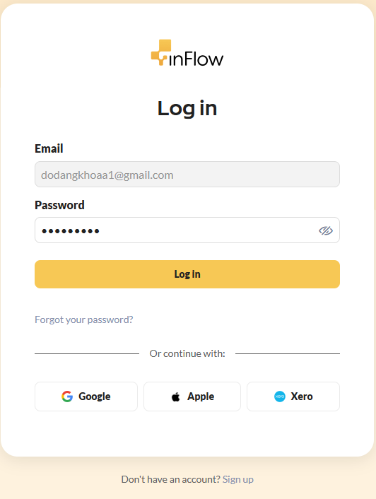
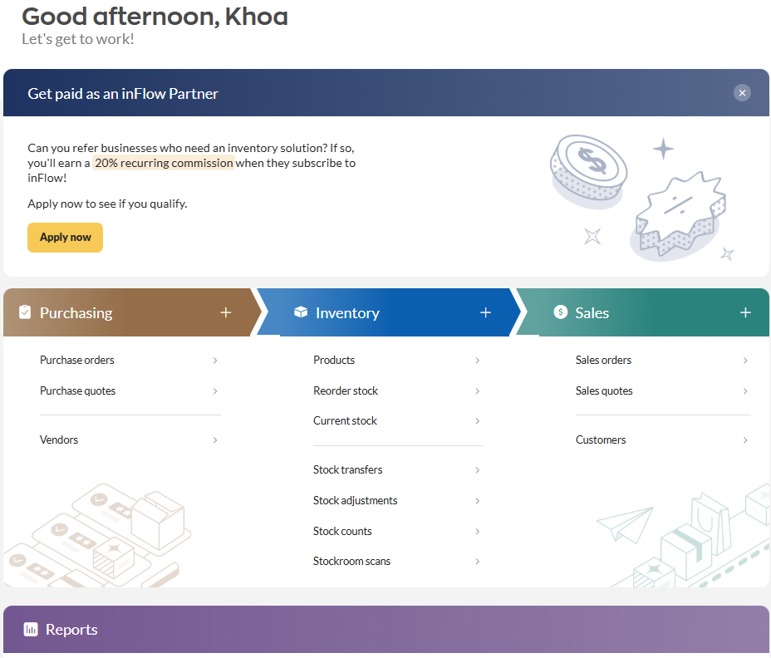
Sign In UI - Correct Password

