Slide 1
Digital Combination Lock

Slide 2
01
DECIMAL TO BCD
Mỹ Duyên

Slide 3
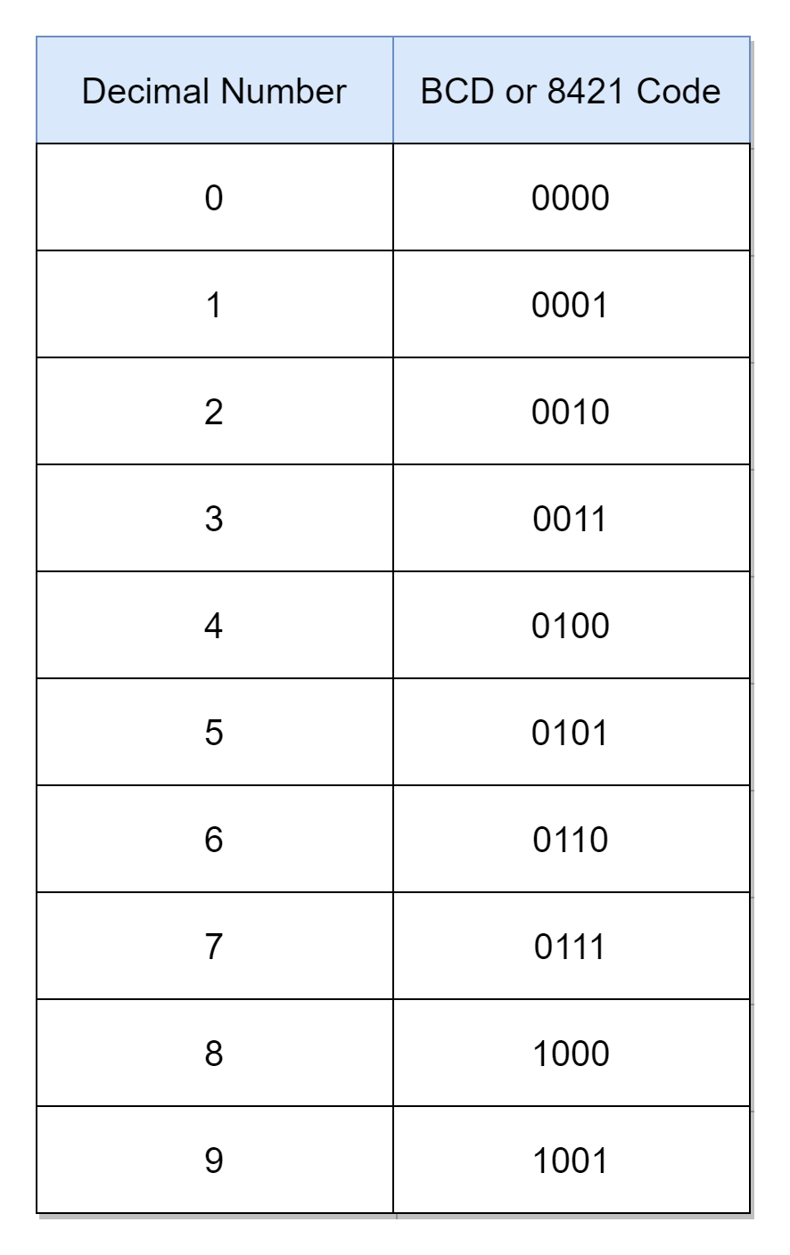
Decimal to BCD Encoding – BCD Code (Binary-Coded Decimal)
A decimal to BCD encoder is a combinational circuit that converts a decimal digit (0–9) into its 4-bit binary-coded decimal (BCD) form.
Mỹ Duyên

Slide 4
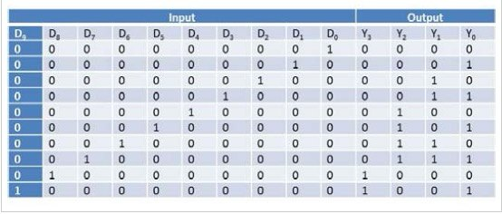
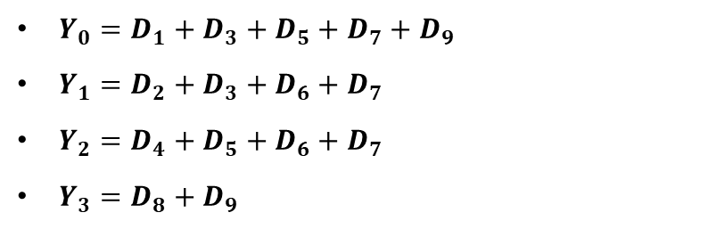
TRUTH TABLE :
Mỹ Duyên

Slide 5
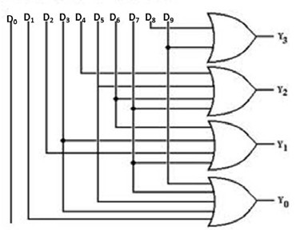
Mỹ Duyên

Slide 6
02
MEMORY INPUT & WRITE CONTROL UNIT
Đăng Khoa

Slide 7
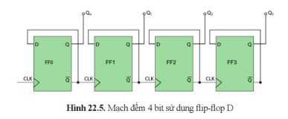
MEMORY INPUT
- Received signals from user will be saved at Memory Block, used to compare with Password Memory Block.
Đăng Khoa

Slide 8
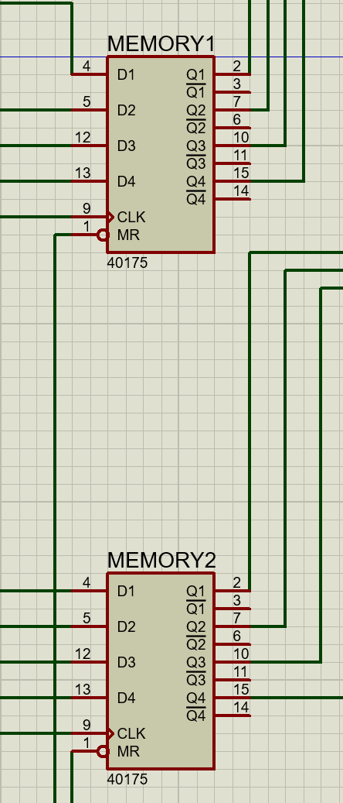
IC 74LS175
- It consists 4 D flip-flops and used to store 4-bit data (equivalent to one digit from 0 to 9)
- Terminals:
D1–D4: Received from switches.
Q1–Q4: Lead to Decoder’s pins.
CLK: When leading edges appeared, the signals on D1–D4 are latched into Q1–Q4.
Đăng Khoa

Slide 9
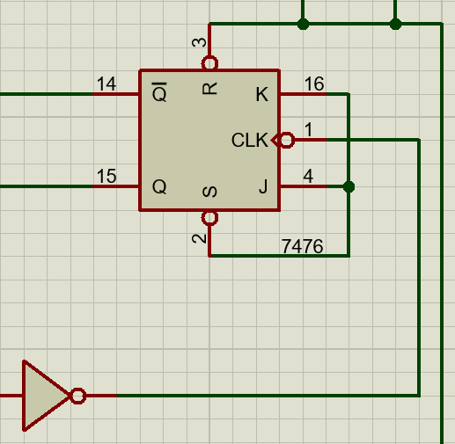
JK FLIP-FLOP BLOCK
What is a write control unit ?
-The write control unit uses a JK flip-flop to determine signals received from 74LS175.
Function
The JK flip-flop is used as a switch to control the written signals for storage:
• When Q = 1: data is allowed to be written into memory signals.
• When Q = 0: writing process is disabled (retains its previous value)
→ The flip-flop controls the “write or no write” state each time the button is pressed.
Đăng Khoa

Slide 10
OPERATION PRINCIPLE
Using 10 switches to enter a signal and transfer to D1-D4
When you press the button:
+ A clock pulse is generated.
+ On the rising edge (as specified in the datasheet, this IC is positive edge triggered), the data on D1–D4 is latched into Q1-Q4.
→ The IC captures the values currently present on D1–D4 and stores in its flip-flops.
After being latched, the outputs Q1–Q4 hold the stored value stably until the next CLK pulse occurs.

Slide 11
Operation principle
• J = K = 1 → operates in toggle mode.
• Each time the button is pressed, the JK flip-flop receives a pulse → toggles it's Q state (from 0 → 1 → 0, etc.).
• The Q output of the JK flip-flop is connected to the CLK input of the 74LS175 (either directly or through an AND gate with the button pulse).
+ When Q = 1 and a pulse from the button is present: data on D is latched into Q of the 74LS175.
+ When Q = 0: the clock path is blocked, and the 74LS175 does not perform a write operation.

Slide 12
03
Password Memory
Block
Duy Bảo

Slide 13
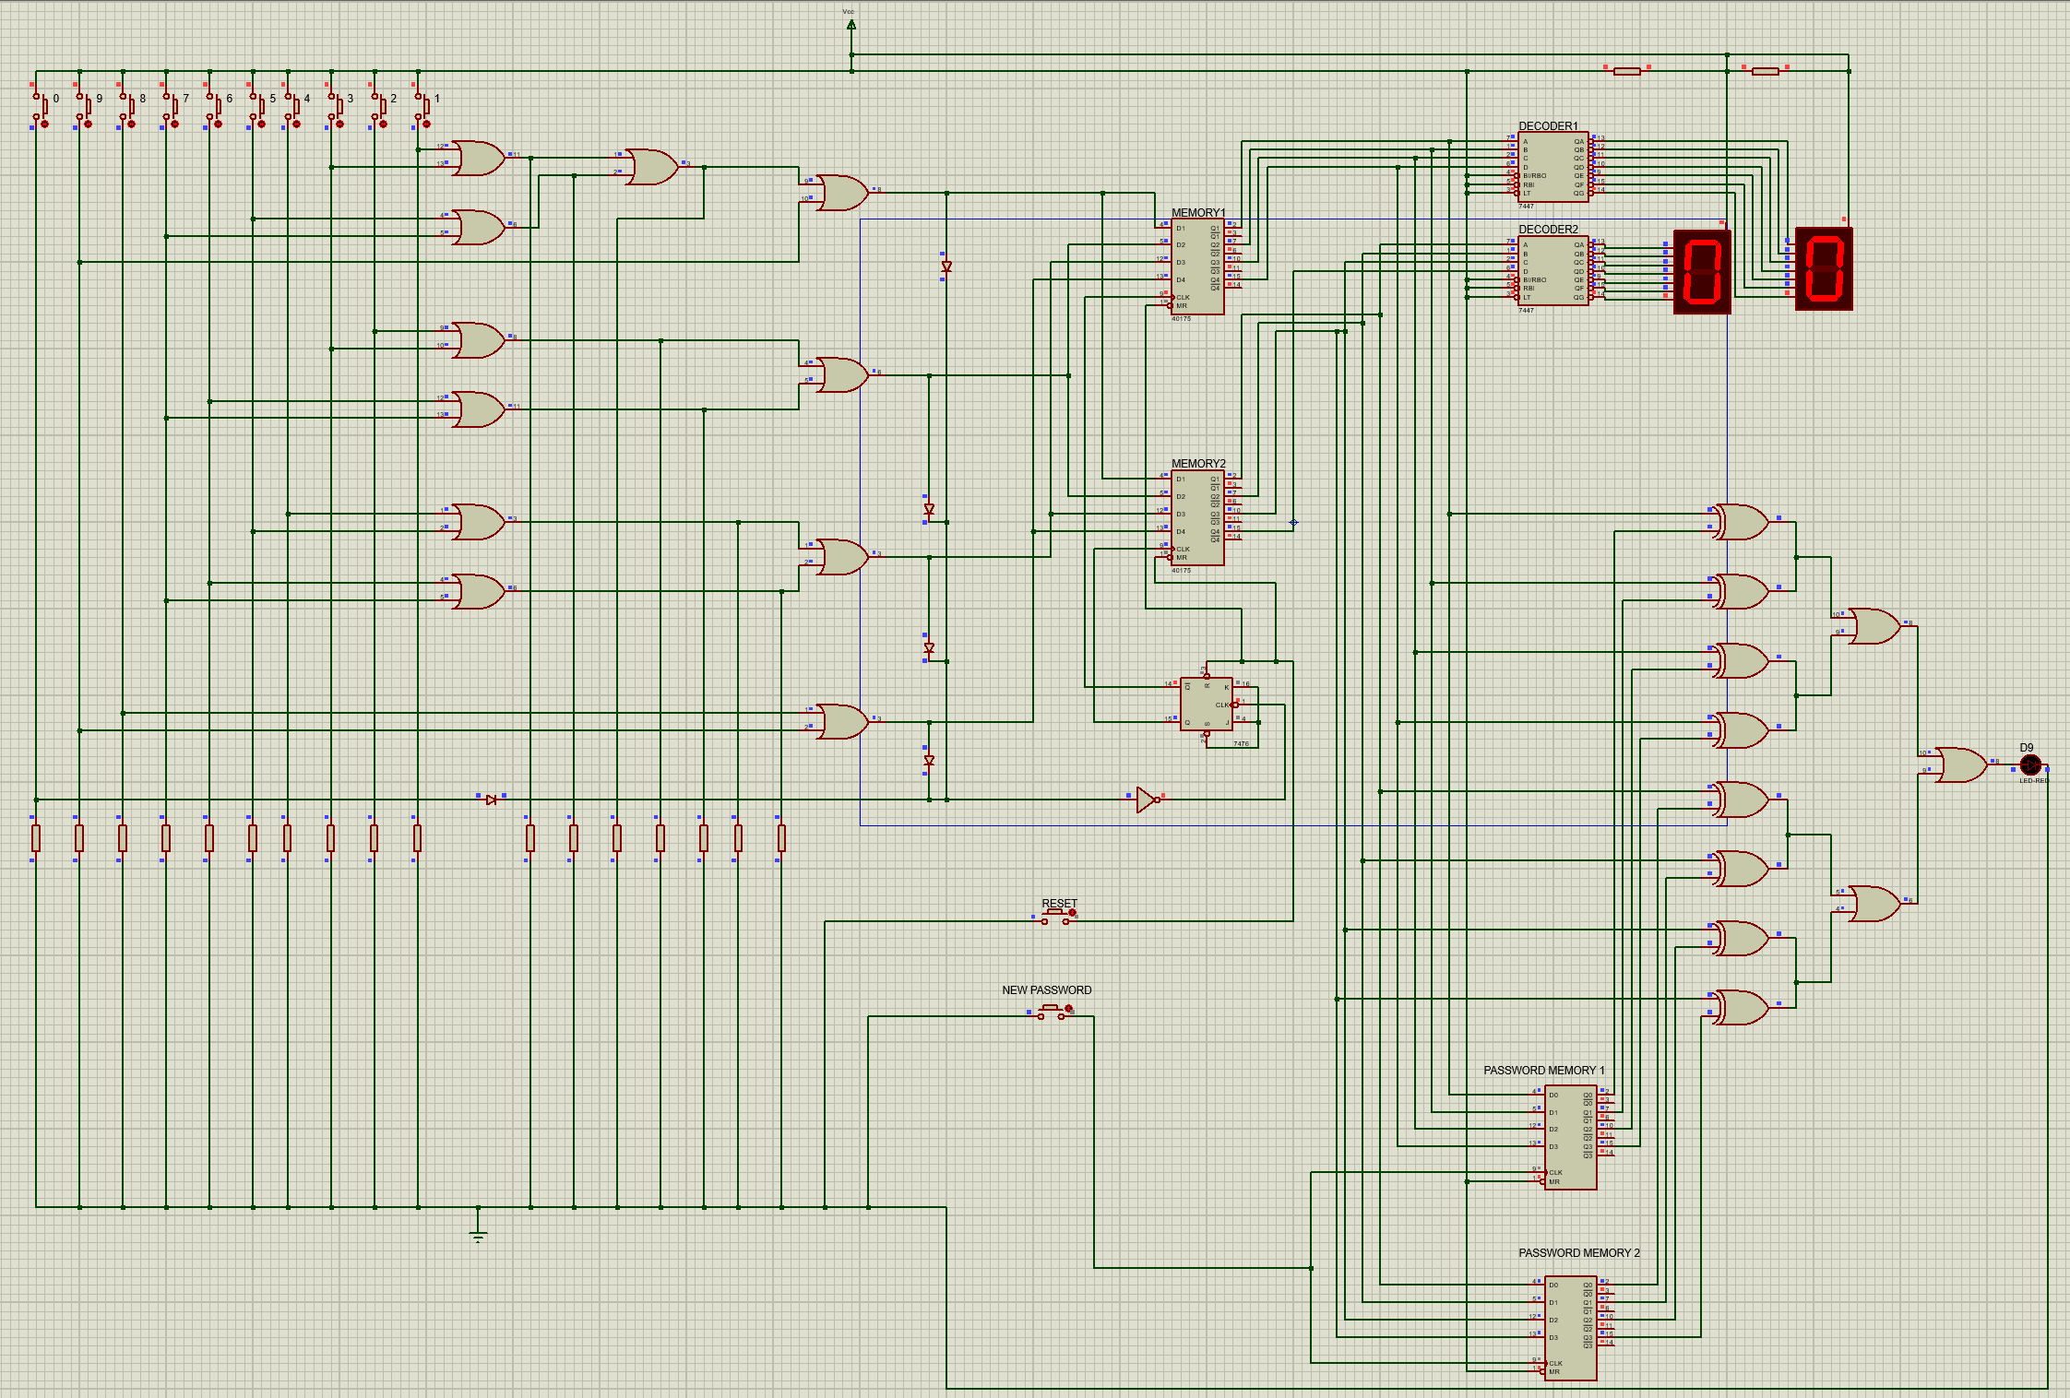
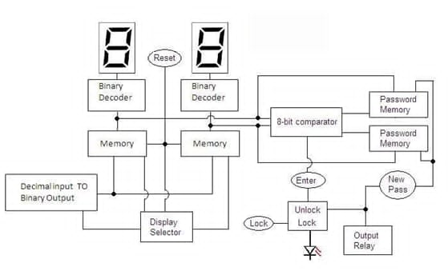
Duy Bảo

Slide 14
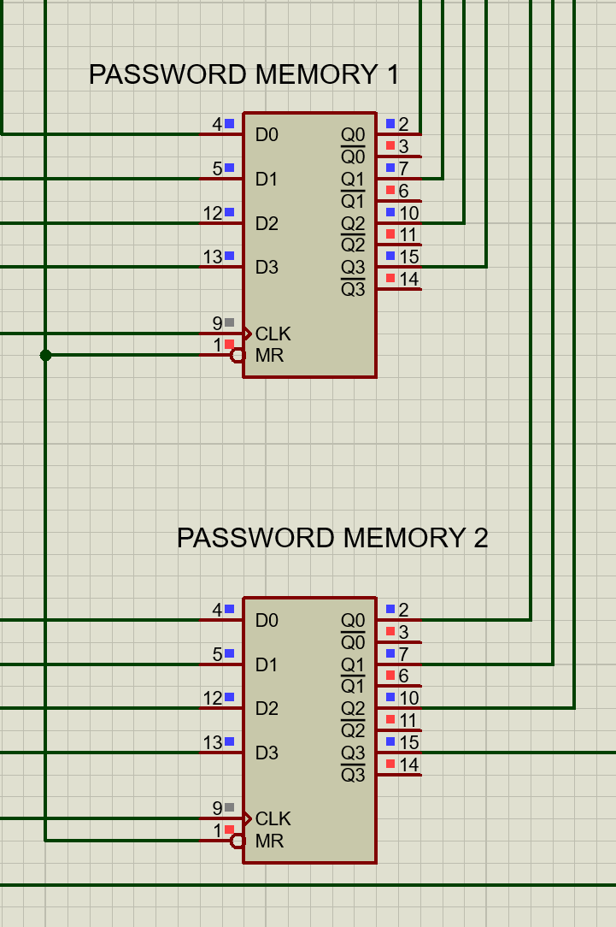
Password memory blocks
Duy Bảo
- Password Memory 1 saves the first number on the LED
- Password Memory 2 saves the second number on the LED

Slide 15
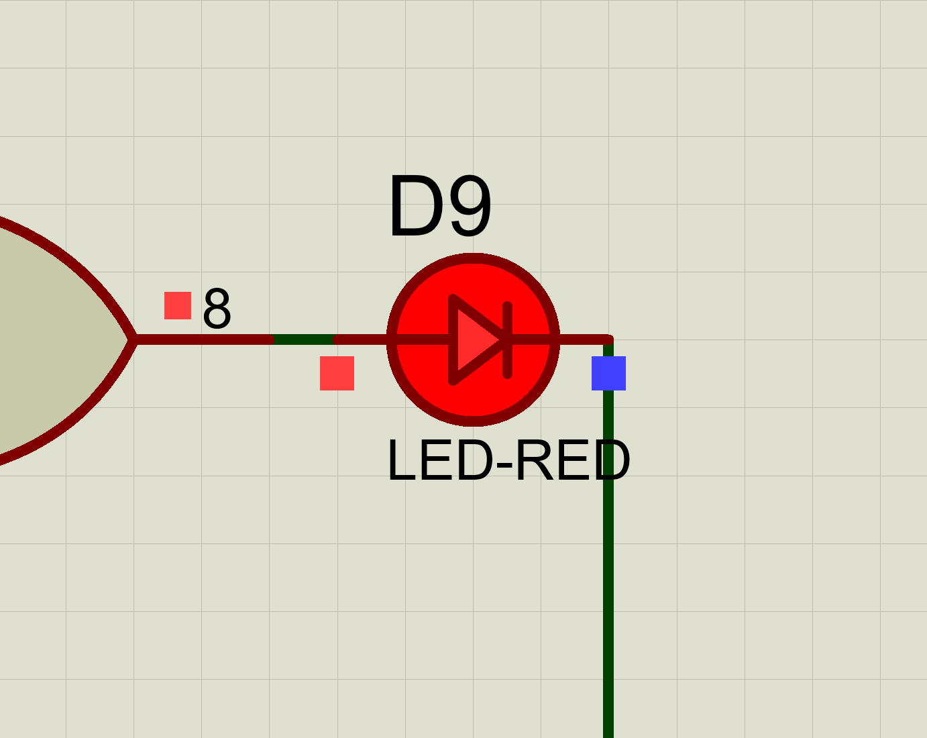
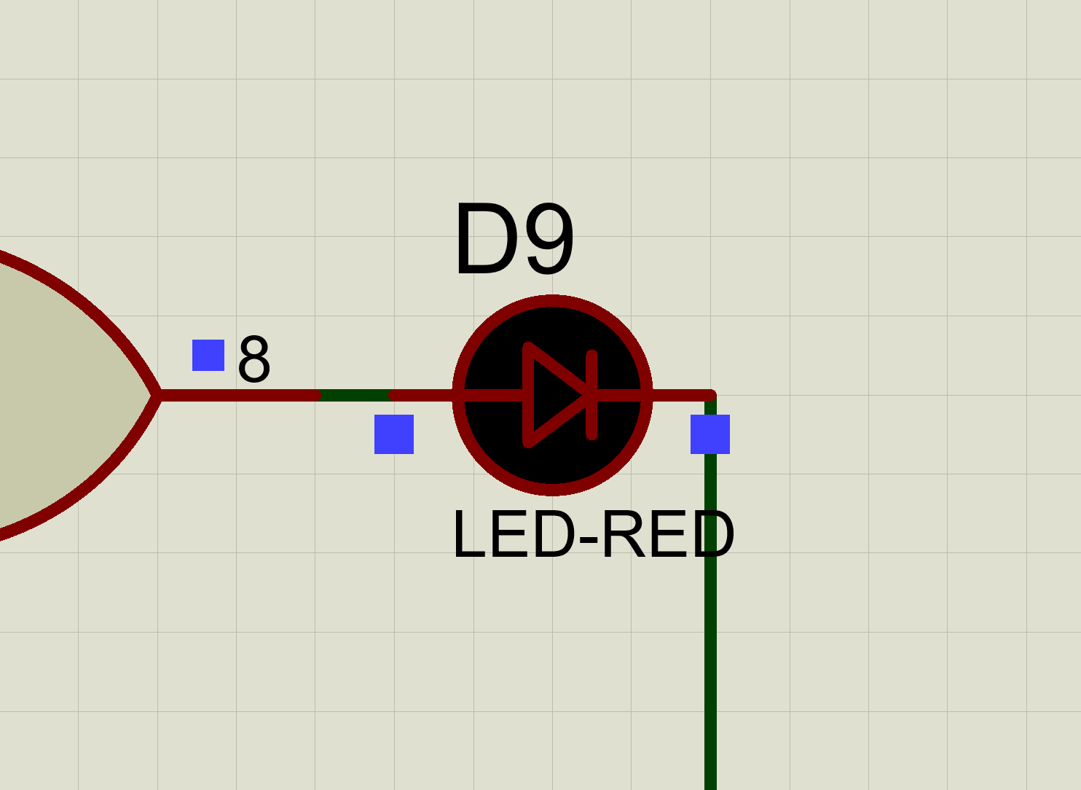
Duy Bảo
Password memory blocks
- Password is wrong, the lock is closed
- Password is right, the lock is opened

Slide 16
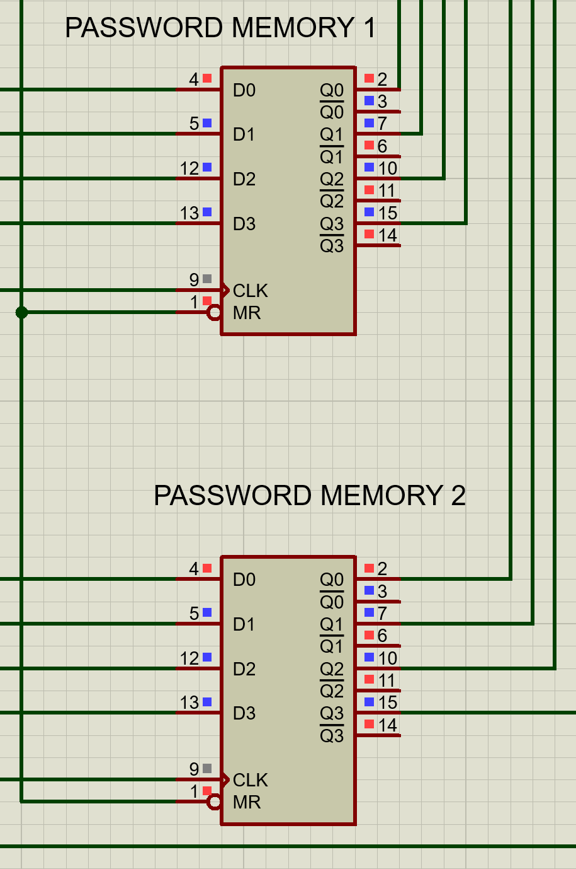
How does it work ?
Duy Bảo
Entering password
through switches
1
4
✅ Comparator unlocks the lock system
Signals are stored
in Memory Blocks and converted to binary
2
5
❌ Comparator behaves nothing
8-bit Comparator compares these inputs
3
6
“New Password” triggered, signals stored in PMB, updating user’s new code

Slide 17
04
Binary Decoder
Block
Quốc Hưng

Slide 18
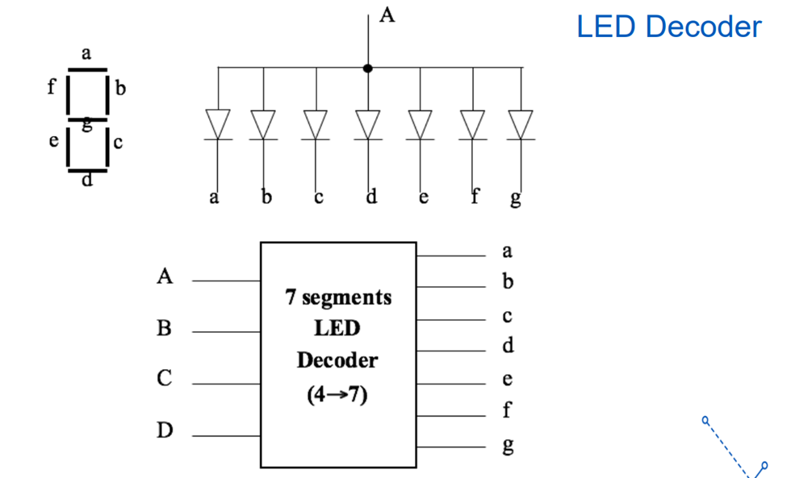
Input: 4-bit Binary Coded Decimal (BCD) - values 0000 to 1001 (0 to 9).
Output: 7 control signals for segments ‘a’ to ‘g’
Each binary input combination activates a specific pattern of segments to show a digit.
Quốc Hưng

Slide 19
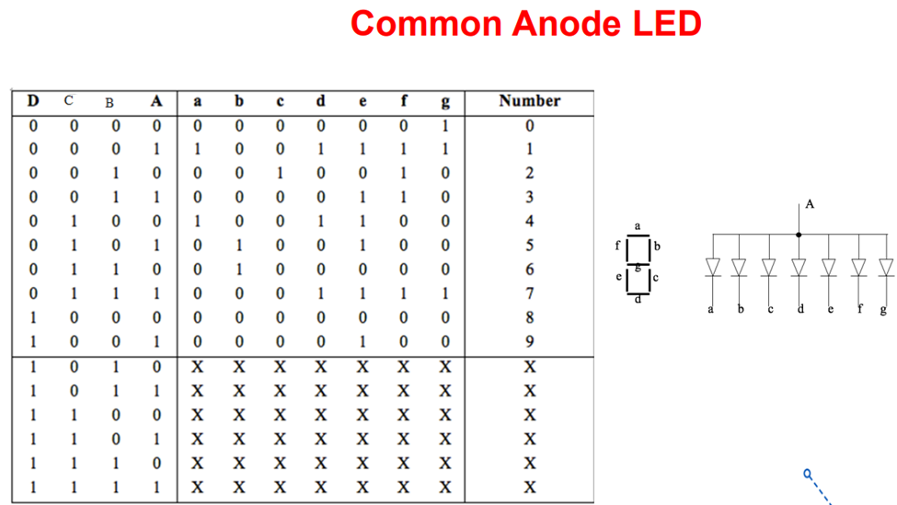
Quốc Hưng

Slide 20
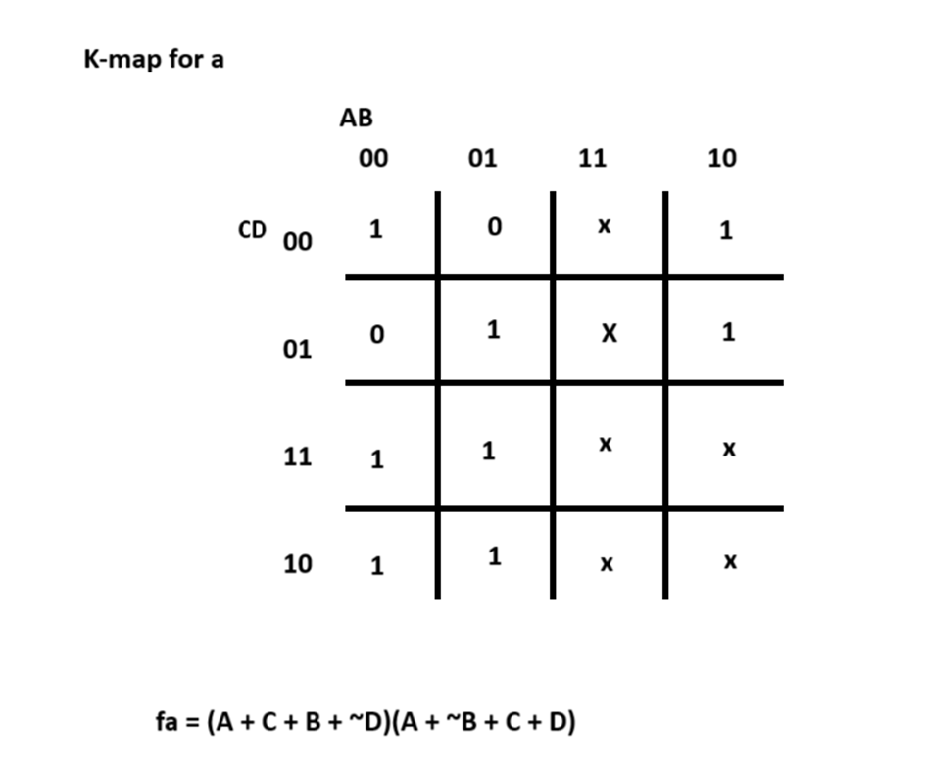
Quốc Hưng

Slide 21
05
COMPARATOR
Hồng Sơn

Slide 22
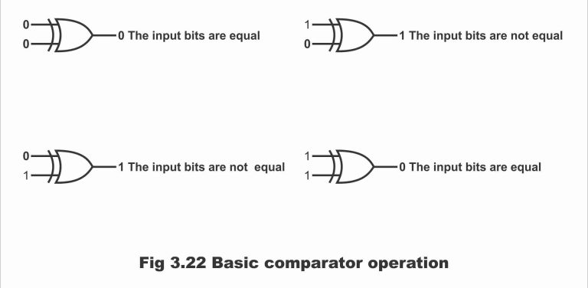
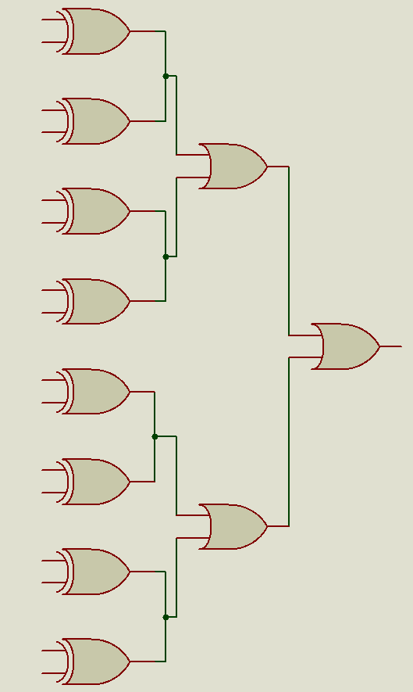
Compares the input number (from display memory) with the stored password (from password memory).
If they match exactly, output signal will unlock the system.
Each bit pair (A & a, B & b, …) goes into an NOR gate
NOR outputs = 0 if both bits are equal
All NOR outputs go to an OR gate
→ If all NORs = 0, then output = 0
Hồng Sơn

Slide 23
06
SIMULATION &
APPLICATIONS
Hồng Sơn

Slide 24
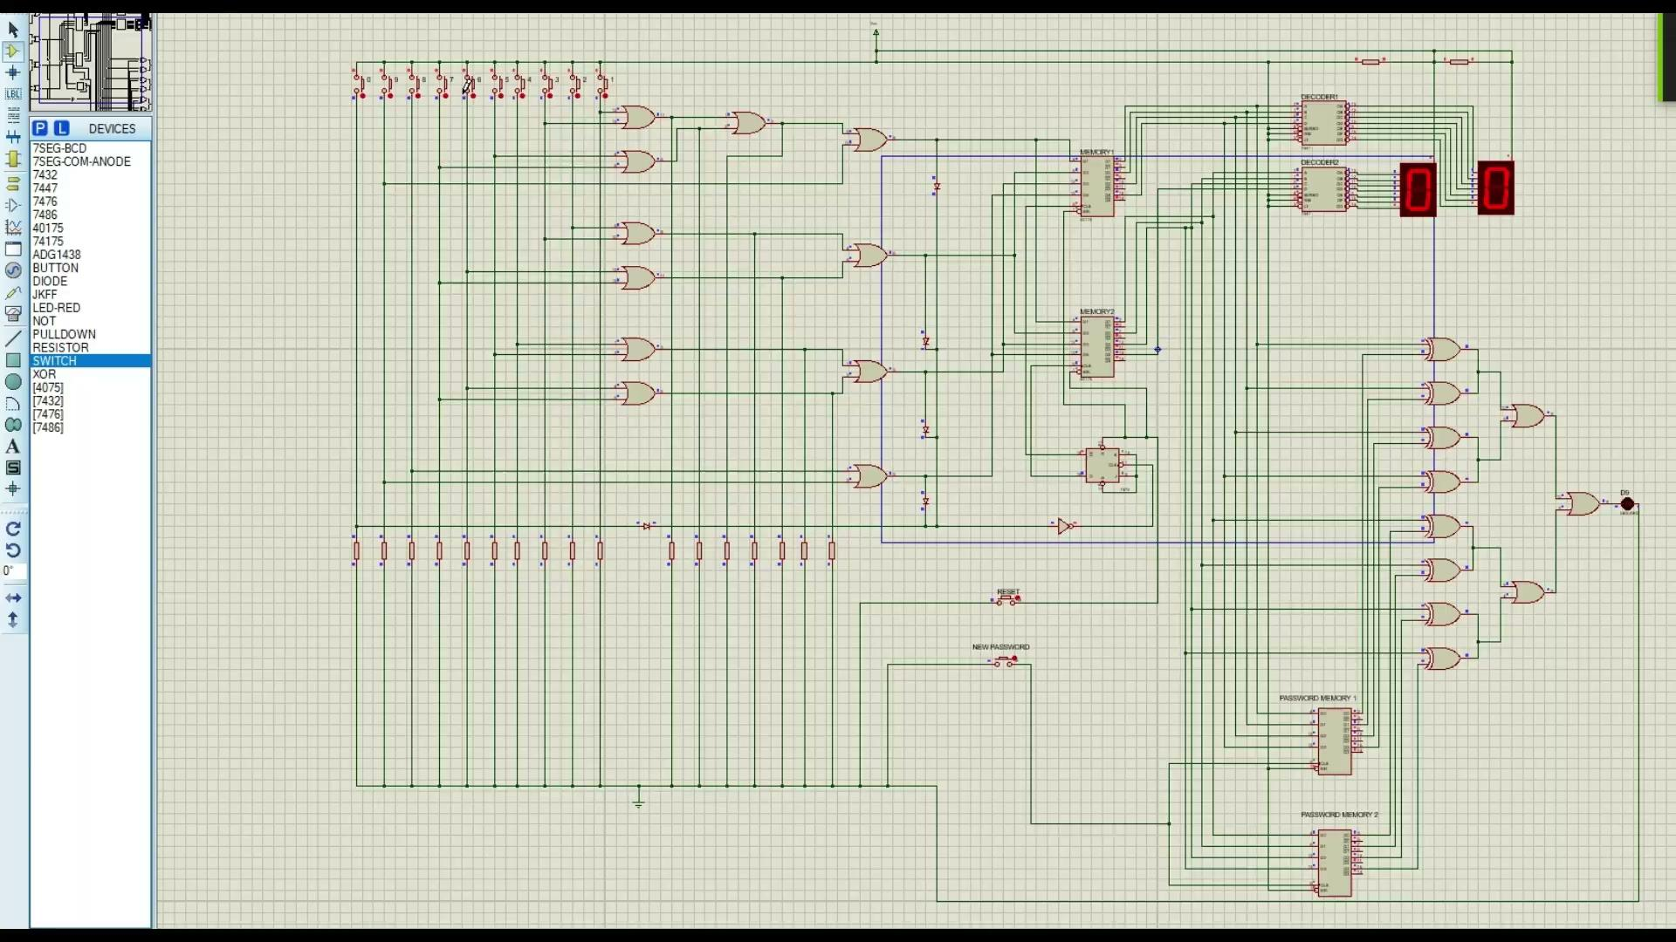
SIMULATION

Slide 25
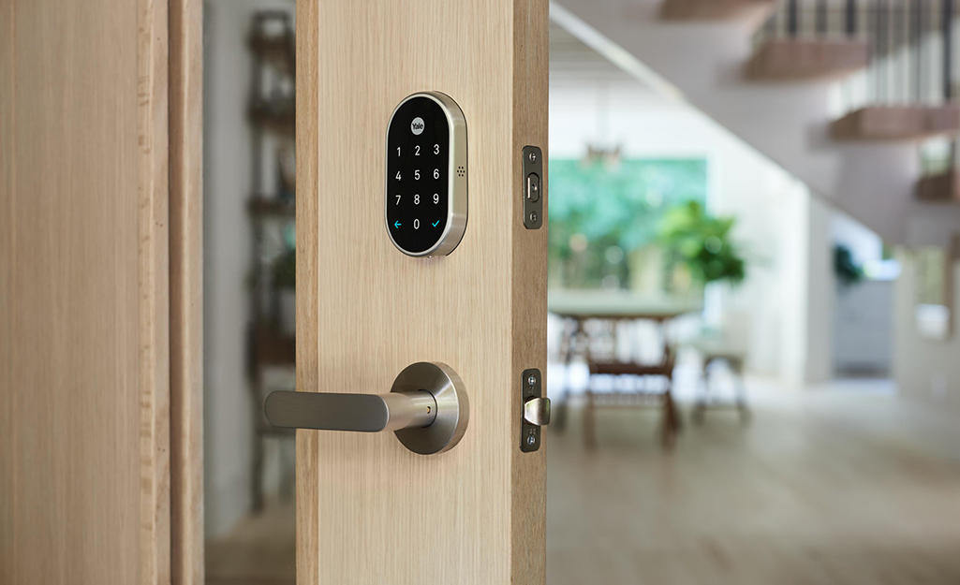
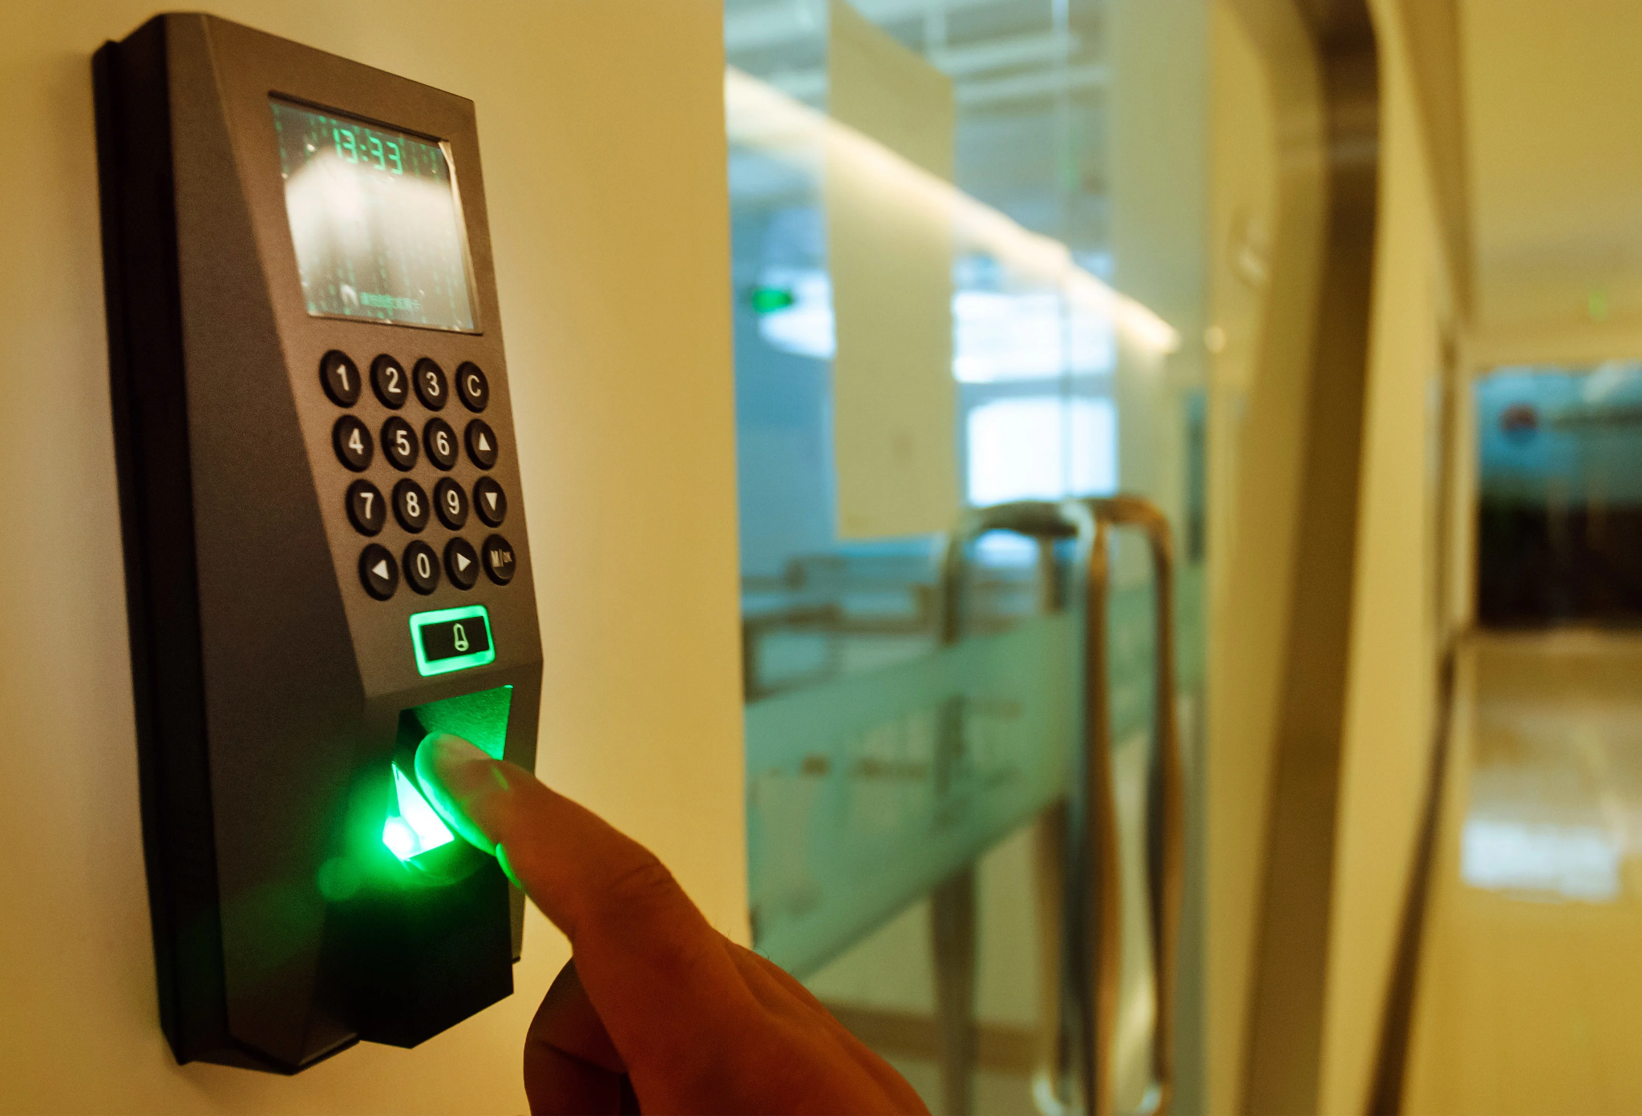
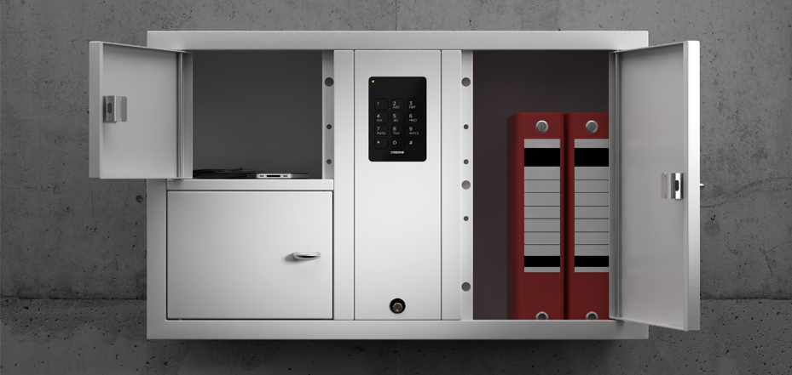
APPLICATIONS
home security lock
Office access systems
Locker systems
Hồng Sơn

Slide 26

THANK YOU !

