Slide 1

DevSecOps

Slide 2
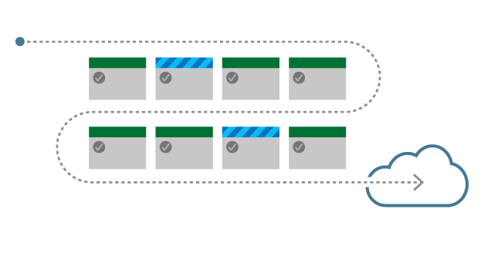
Agenda
DevSecOps
  What is DevOps?
  The Transition to DevOps
  Why DevOps?
  DevSecOps
About CI/CD
  What’s CI/CD
  CI/CD in DevOps
  Why’s CI/CD
Modern continuous delivery
  Trunk base development
  Feature flags
  Microservices
  Serverless
  Docker and Kubernetes
  Security testing
  Other techniques and tools
Demo & Practice
  Azure Pipeline
  Azure Pipeline & Google Cloud Platform
Data-driven Design

Slide 3
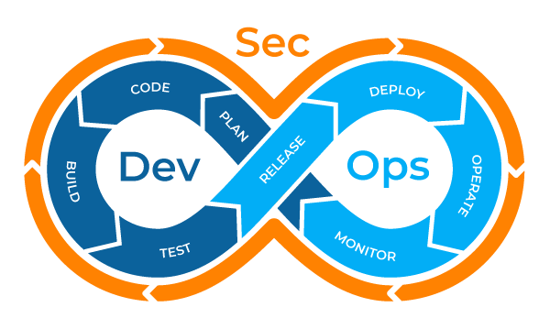
DevSecOps
“If you fear to release your system at any time, you are not DevOps yet”
Gene Kim, co-founder of DevOps
Notes:
DevOps is the change in IT culture. It focuses on rapid IT service delivery through the adoption of agile and lean practices in the context of a system-oriented approach according to Gartner. An amalgamation of two words, ‘development’ and ‘operations’ it aims at combining software development and software operations. It breaks the barrier between development and operation teams. The collaborative work between them leads to the benefit of combined skill.

Slide 4
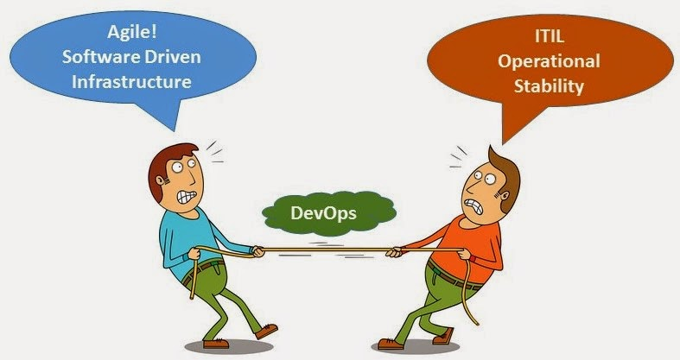
What is DevOps

Slide 5
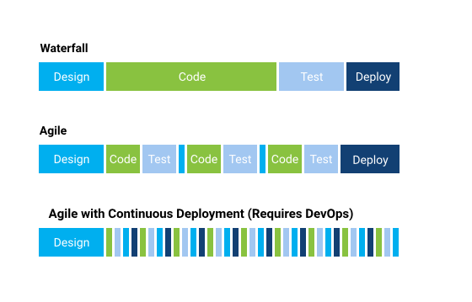
The Transition to DevOps

Slide 6
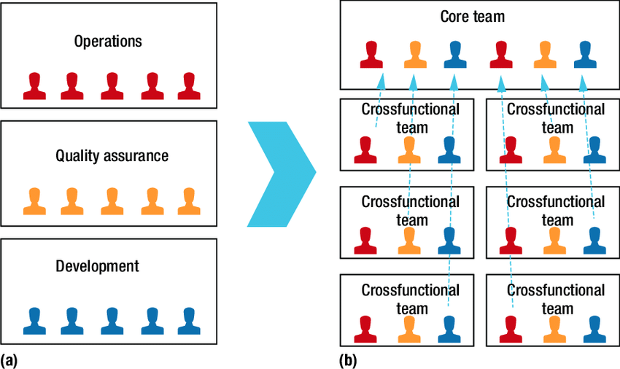
DevOps Team Formation
Notes:
DevOps team formation. (a) Traditional horizontal teams. (b) Vertical teams in DevOps. In DevOps, each team is responsible for a service and contains people with different skills, such as development and operations skills. The team members cooperate from the project's start to create more value for the particular service's end users

Slide 7
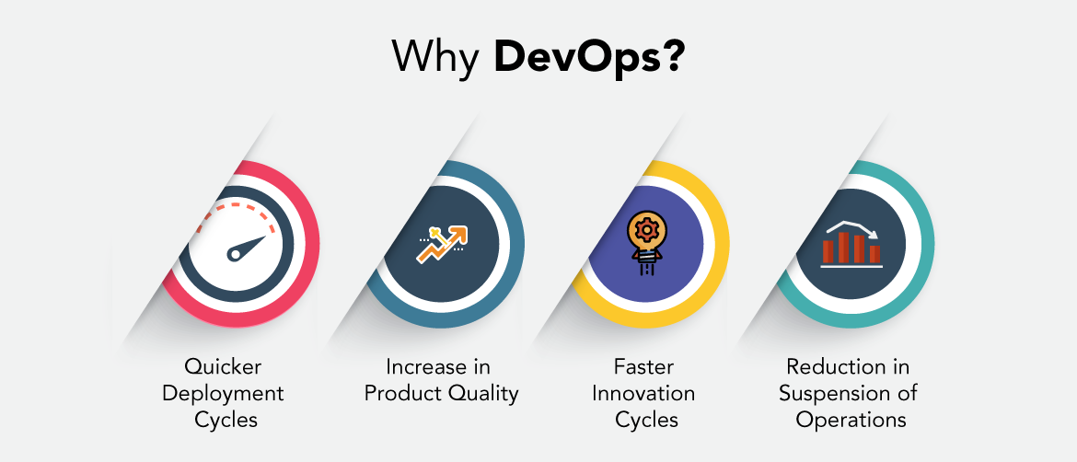
Why DevOps?

Slide 8
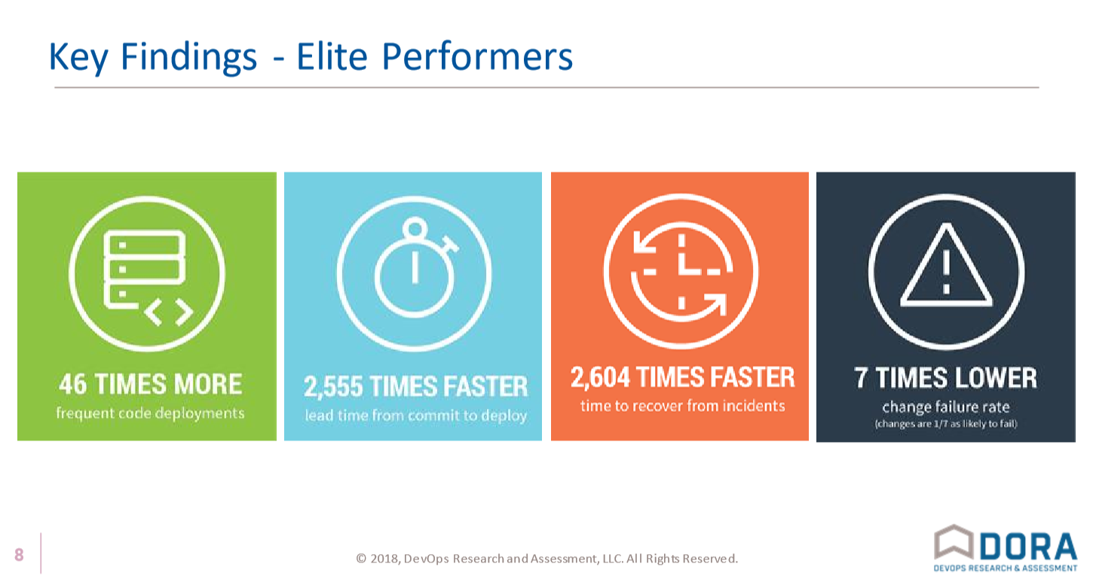

Slide 9
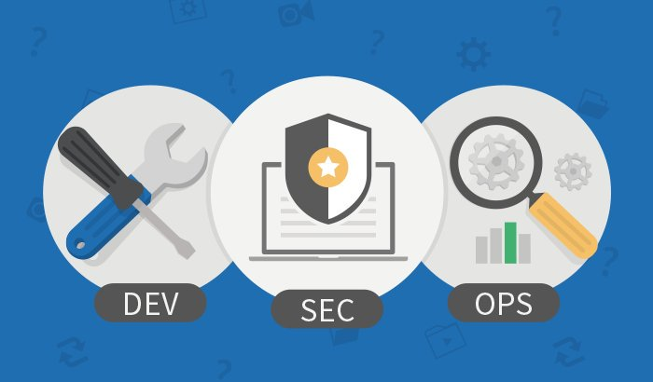
DevSecOps?
Security is not just a STEP in a pipeline!
Involves everything we do, from the CEO to the developers

Slide 10
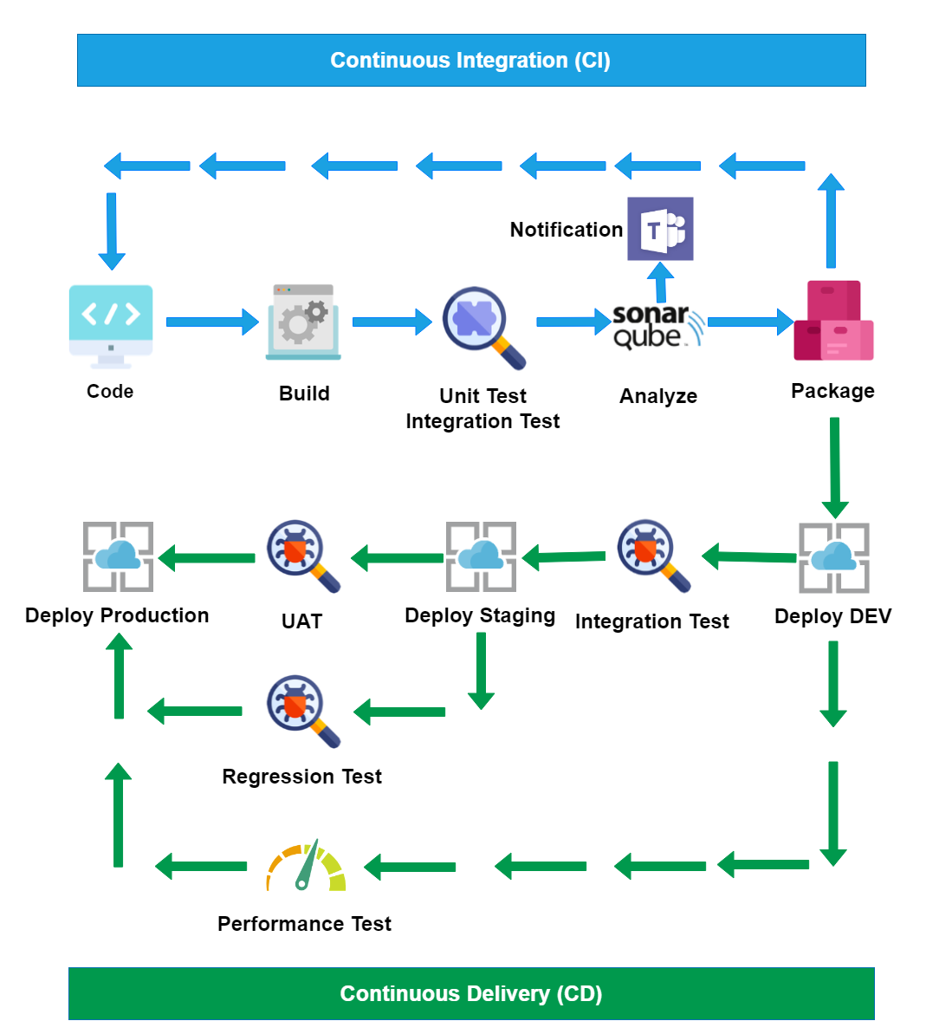
About CI/CD

Slide 11
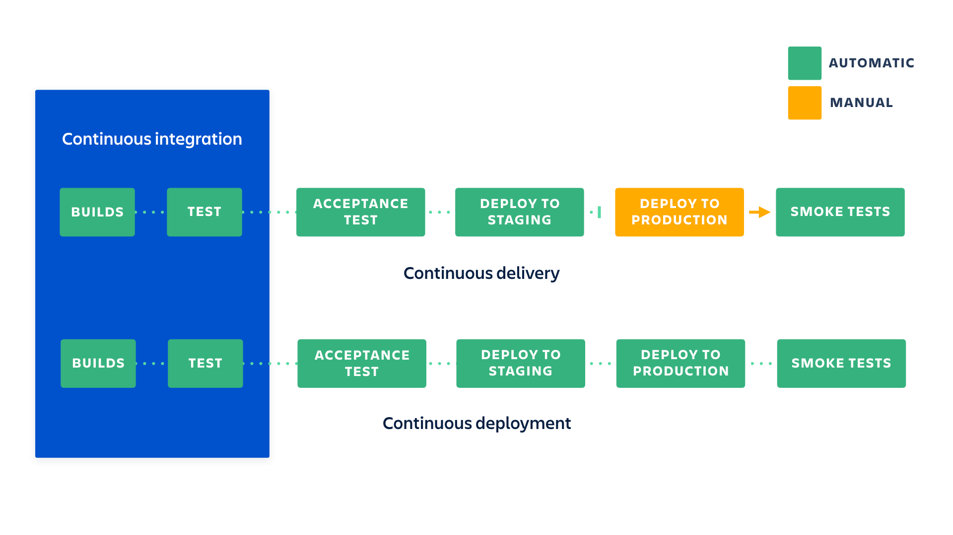
What’s CI/CD

Slide 12

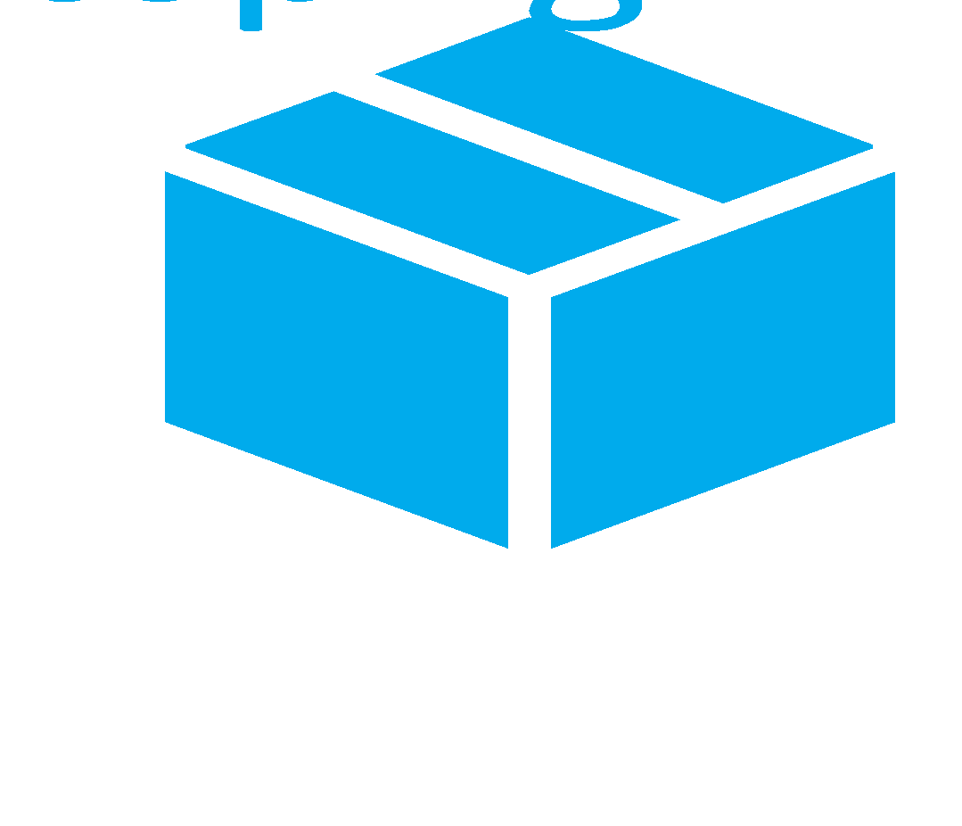




Continuous Delivery
CI/CD In DevOps
SOURCE CONTROL
BUILD
TEST
PACKAGE
DEVELOPMENT
TFVC
STAGING
DEV
OPS
MONITOR
PRODUCTION

Slide 13

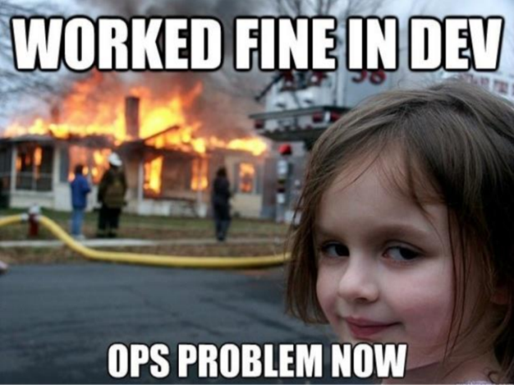

Benefits we got
Benefits for Development
Reduce manual work, develop faster
Detect and fix issues early
Ready to deploy at any time, any where
Increase transparency and visibility
Make testing efficient
Benefits for Business
Better product quality
Speed up time-to-market
Faster response to the market

Slide 14
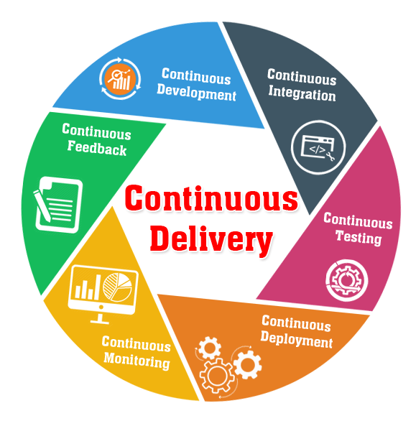
Modern continuous delivery
“It’s Not Continuous Delivery If You Can’t Deploy Right Now”
Ken Mugrage

Slide 15
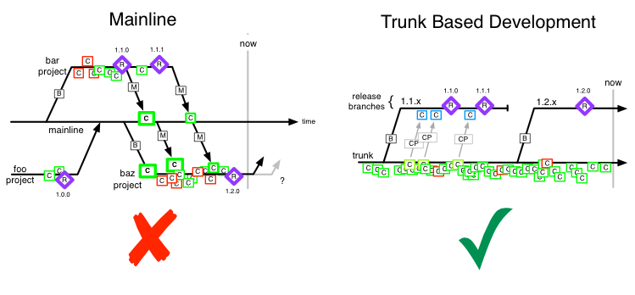
Trunk Based Development
Pain_of_merge =
fun (size_of_merge, duration_since_last_merge)
“Branches create distance between developers and
we do not want that”
Frank Compagner, Guerrilla Games
Notes:
Commit in trunk at least once a day
Trunk is always in releasable state
Hide unfinished code with feature flag
Refactor with branch by abstraction
Do not break the trunk. Commits are reviewed and must pass automated tests.
Advances:
Lean
Can release at any time
No merge hell
where each developer divides their own work into small batches and merges that work into trunk at least once (and potentially several times) a day.
In trunk-based development, developers push code directly into trunk. Changes made in the release branches—snapshots of the code when it's ready to be released—are usually merged back to trunk (depicted by the downward arrows) as soon as possible.
there are cases where bug fixes must be cherry picked and merged into releases
reduces the complexity of merging events and keeps code current by having fewer development lines and by doing small and frequent merges.

Slide 16
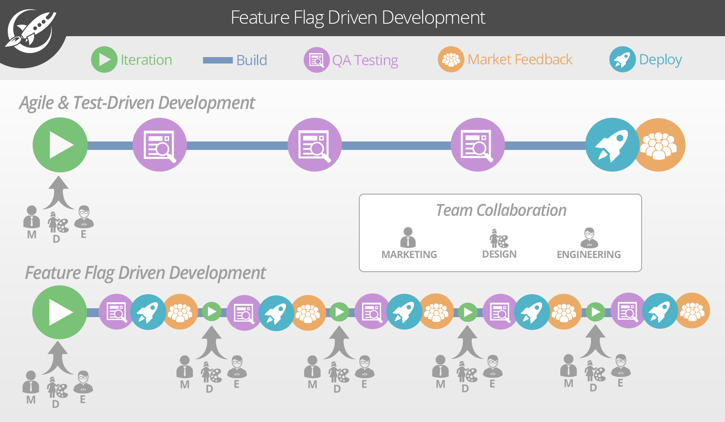
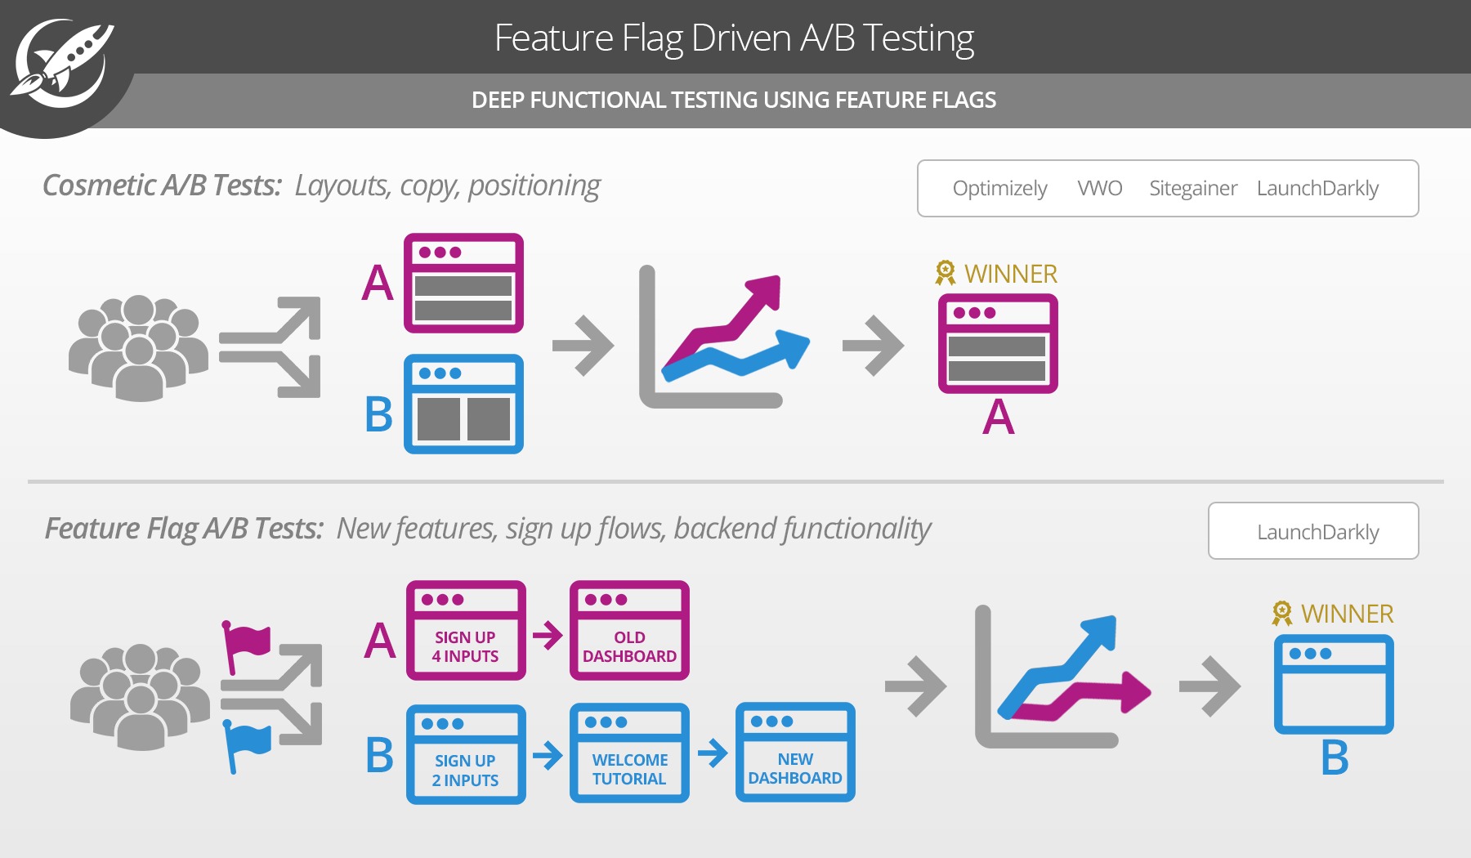
Feature-flag-driven development
Allows you to quickly release iterations of your features to market, receive feedback, improve, and redeploy
Based on real market feedback and make the necessary improvements to drive the product forward.
Control deep functional features and then target user segments
Analyze these feature tests using your Optimizely or New Relic goals.
Notes:
Because feature flags are implemented at the code level, you can control deep functional features and then target user segments. For example, let’s say I want to test a new sign-up flow and welcome tutorial (see above). I can flag the new functional components so that only certain users will receive the new flow.
With a suite like LaunchDarkly, you can then analyze these feature tests using your Optimizely or New Relic goals. This will allow you to see, for example, which sign up flow is generating better conversions or which check out flow is generating more revenue.

Slide 17
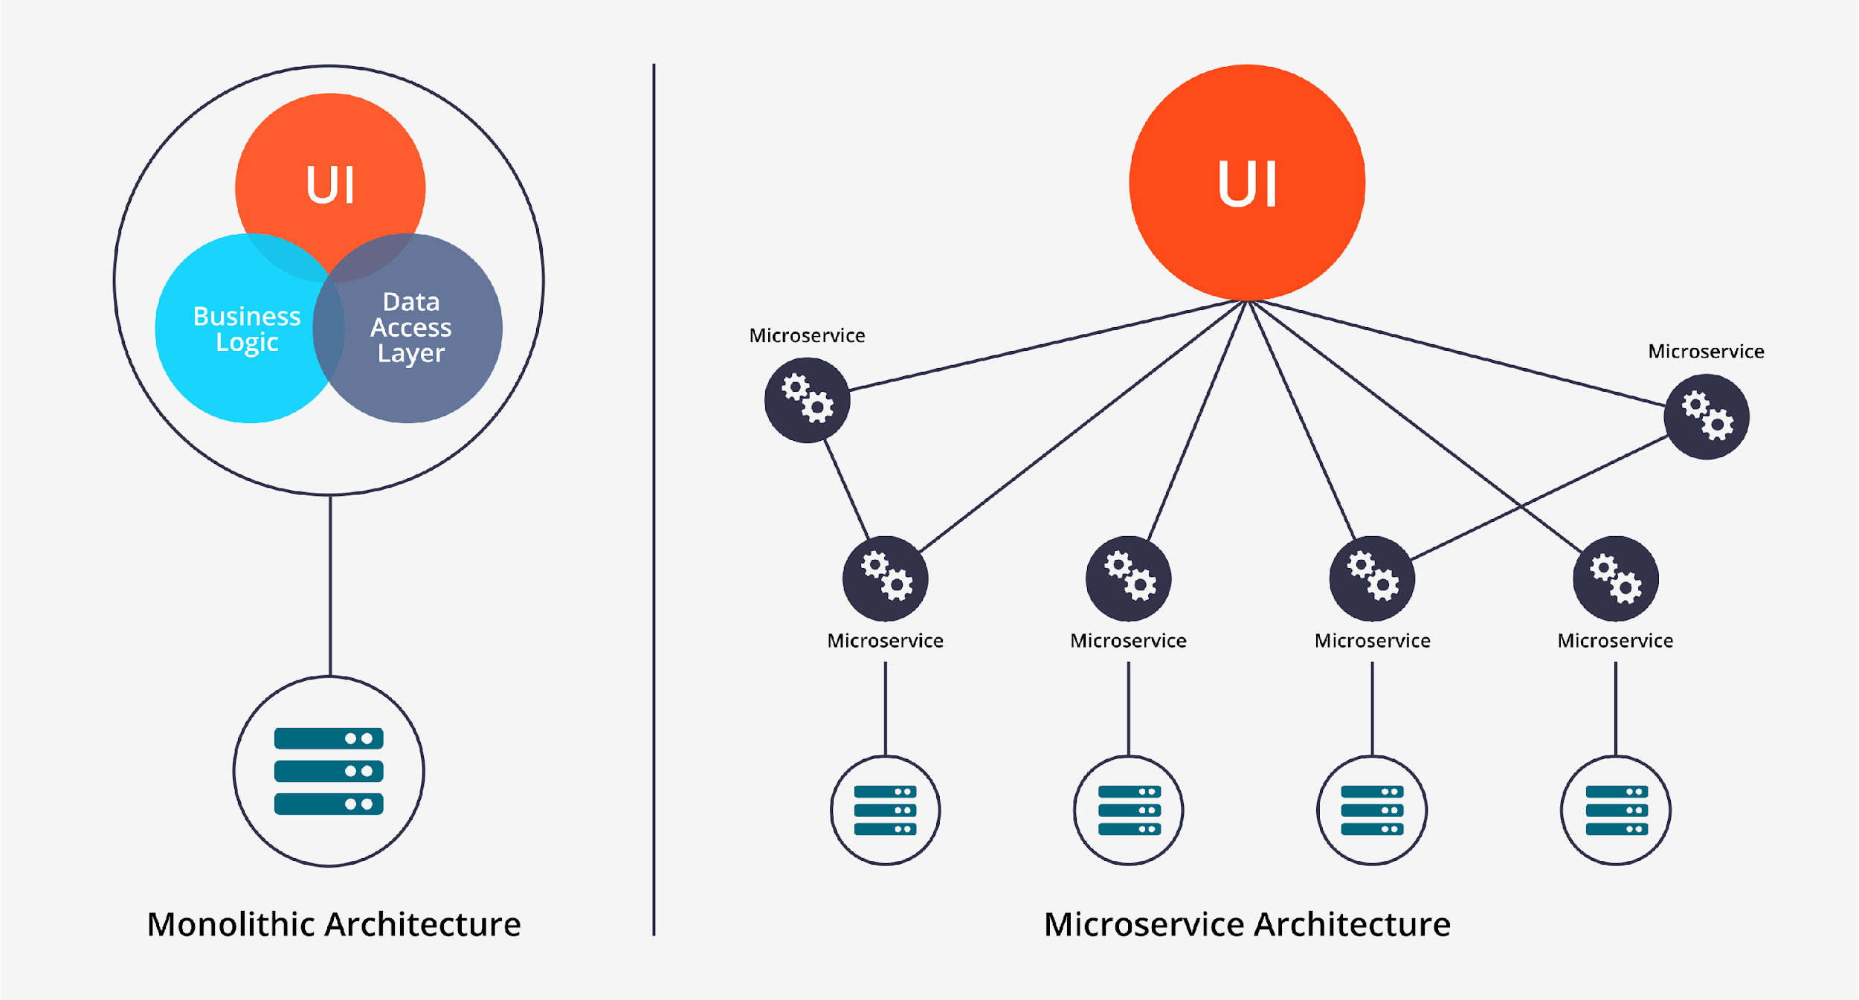
Microservices
Independent deployments.
Independent development
Small, focused teams.
Fault isolation.
Can make use of the latest technologies.
Mixed technology stacks
Pair well with containers
Granular scaling
Notes:
Microservices: Small autonomous services that work together, modelled around a business domain
Traditional architect:
- Entire system deployed at once
- Release were large
- Browser tests are flaky
- Rollbacks were hard

Slide 18
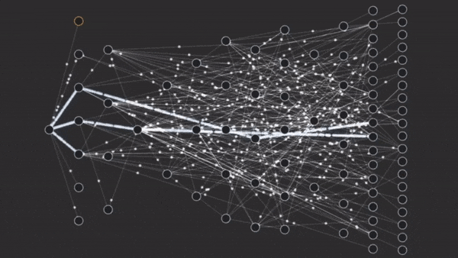
Mastering Chaos - A Netflix Guide to Microservices

Slide 19
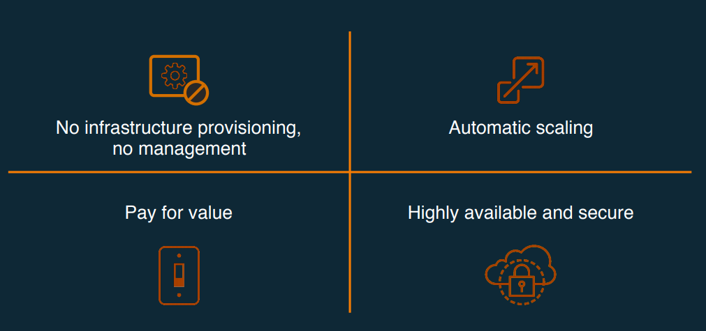
Serverless
Notes:
No management of server hosts or server processes.
Self auto-scale and auto-provision based on load.
Costs based on precise usage
Performance capabilities defined in terms other than host size/count
Implicit high availability and secure
Cons of a serverless architecture
Vendor lock-in
Vendor lock-in describes a situation when you give a vendor full control of your operations. As a result, changes to business logic are limited and migration from one vendor to another might be challenging.
Not for long-term tasks
A serverless model isn’t suitable for long-term operations. Serverless apps are good for short real-time processes, but if a task takes more than five minutes, a serverless app will need additional FaaS functionality.

Slide 20
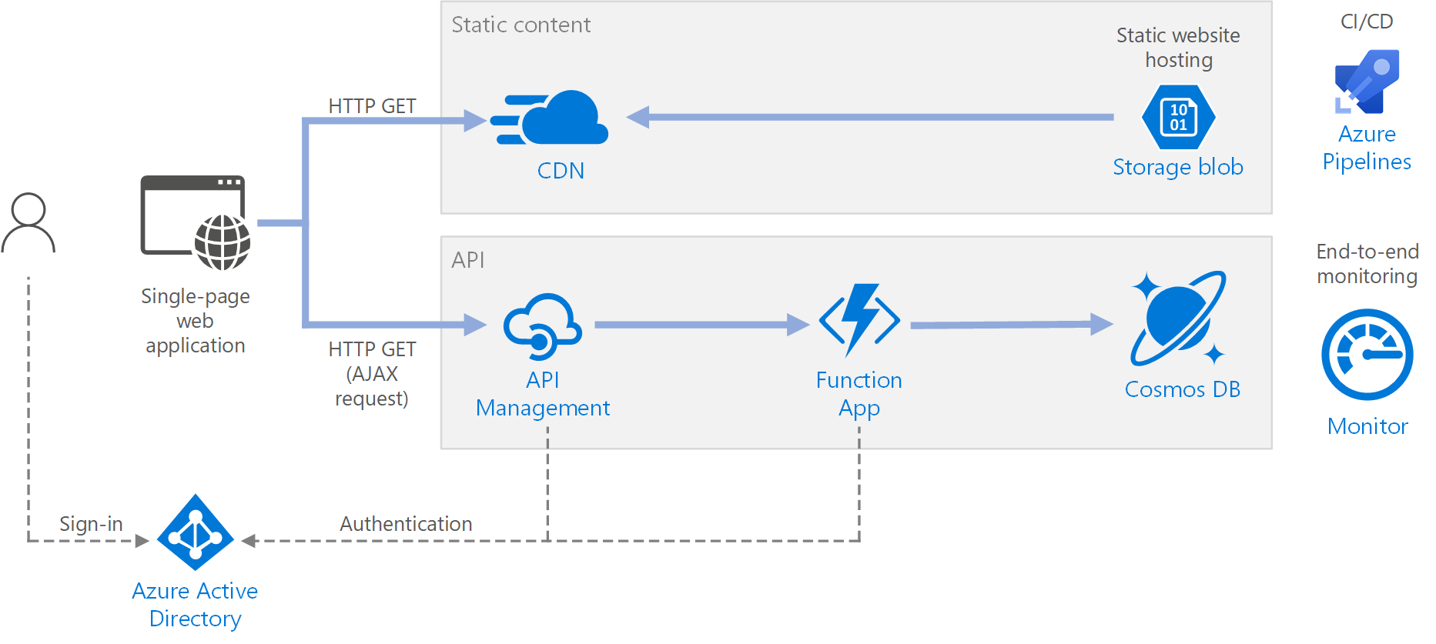
Serverless web application on Azure
Functions as a service (FaaS). In this model, a "function" is a piece of code that is deployed to the cloud and runs inside a hosting environment that completely abstracts the servers that run the code.

Slide 21
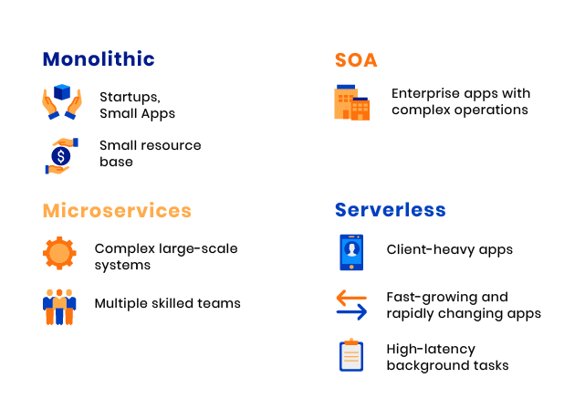

Slide 22
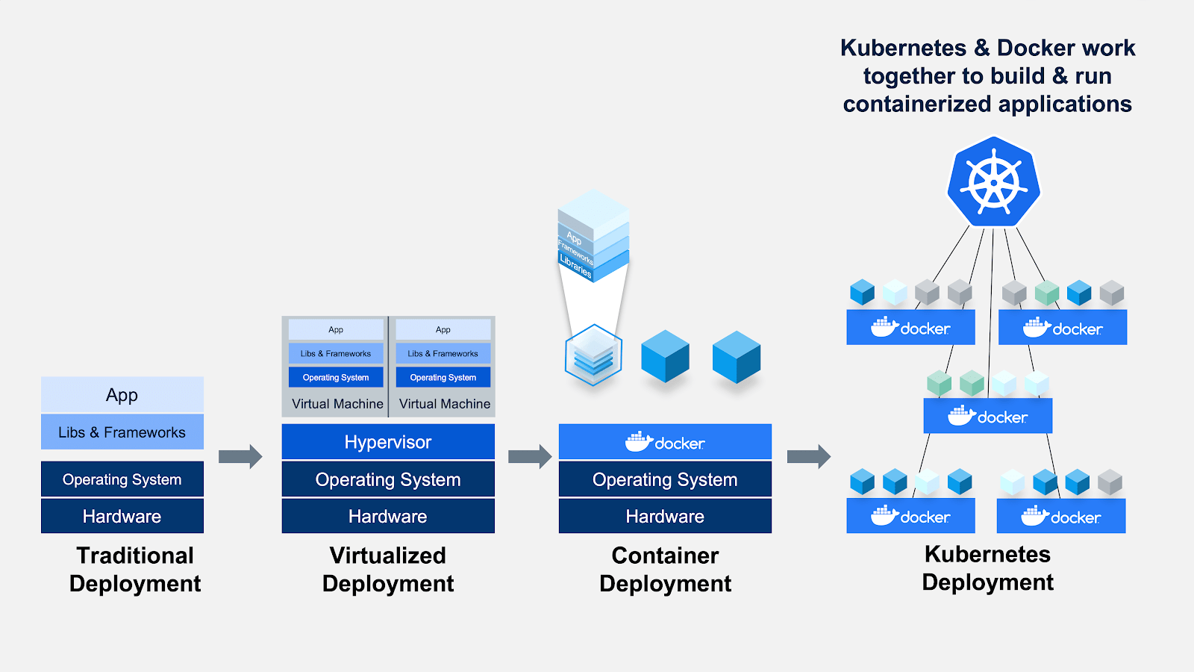
Docker and Kubernetes
Notes:
Docker:
Containers are a way to package software in a format that can run isolated on a shared operating system
Makes for efficient, lightweight, self-contained system and guarantees that software will always run the same, regardless of where it’s deployed
Kubernetes:
Inspired and informed by Google's experiences and internal systems
Is an open-source system for automating deployment, scaling, and management of containerized applications
Manage applications, not machines
Kubernetes is a great platform for complex applications comprised of multiple microservices.
Supports multiple cloud and bare-metal environments

Slide 23
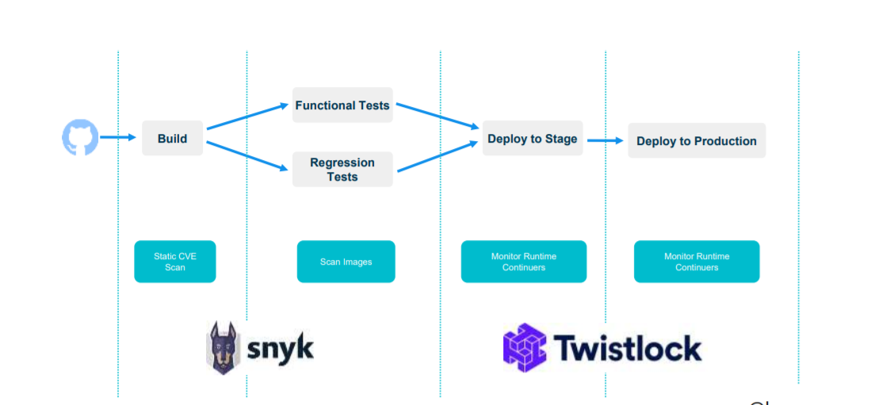
Security Testing
Static Application Security Testing (SAST)
Dynamic Application Security Testing (DAST)

Slide 24
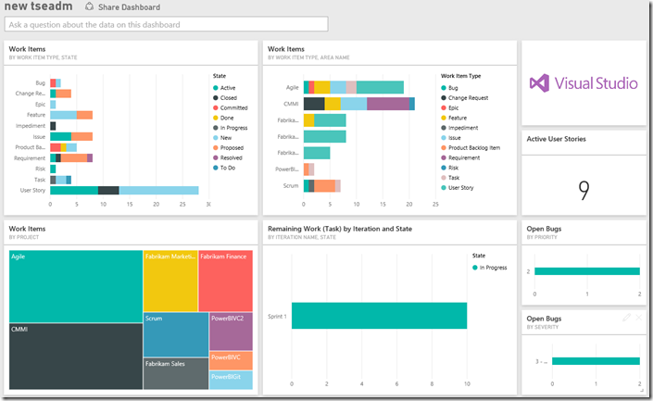
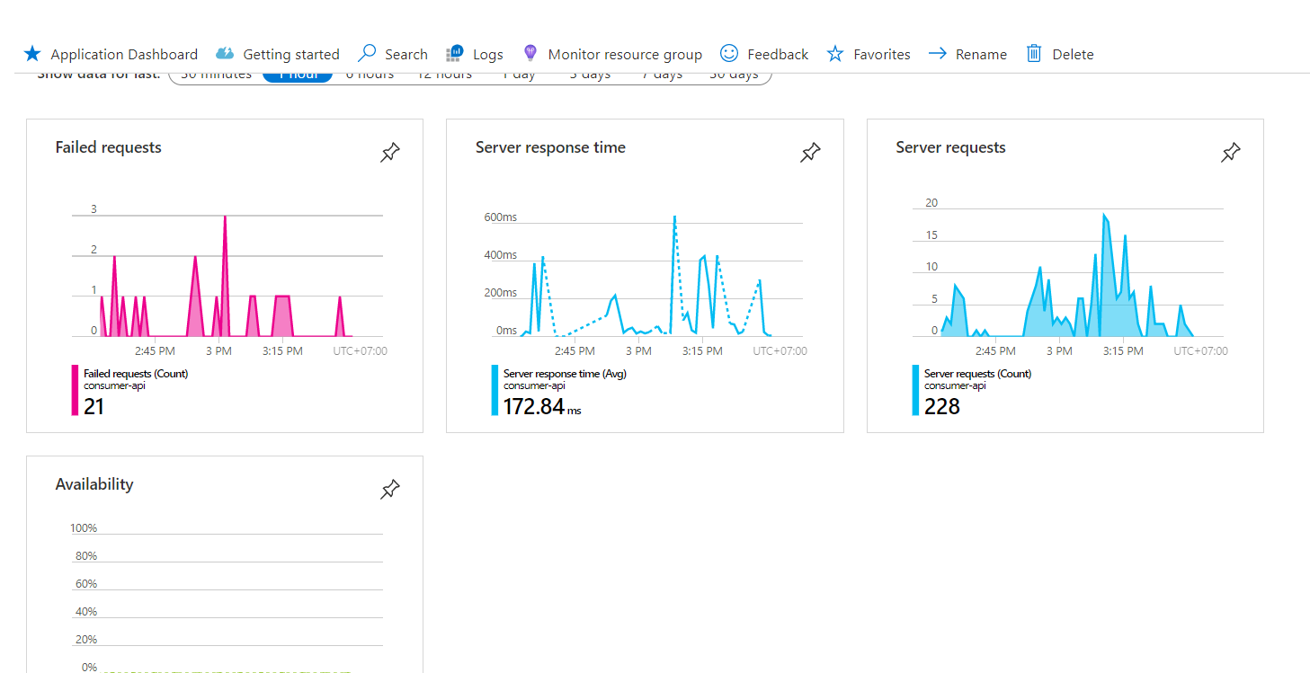
Monitor and react, learn and proact
PowerBI
  Centralize and visualize important indicators for any aspect of our organization
Application insights, AppCenter, etc.
  Help detect issues in Production environment to roll back in case necessary
  Alarms, dashboard, etc.

Slide 25
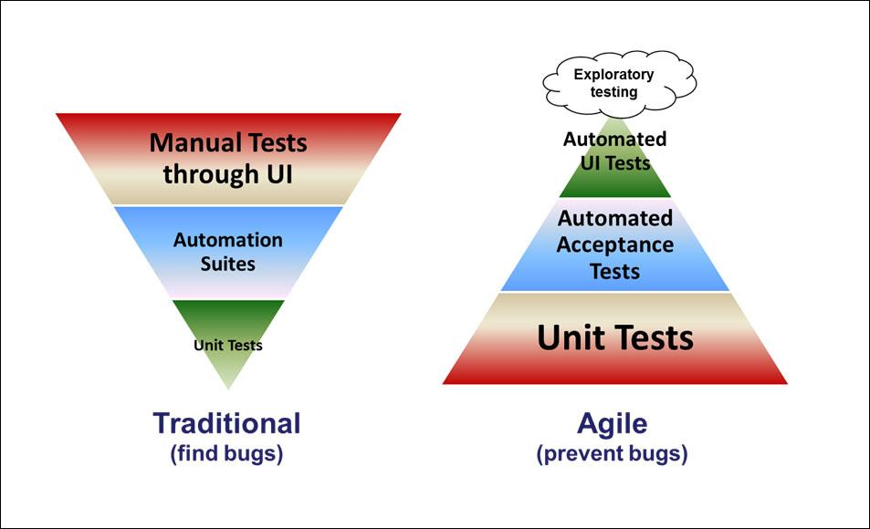
Agile Testing Pyramid
In the Agile world, an emphasis is laid on making this layer of the pyramid stronger and more robust and it is emphasized that most of the testing is achieved at this layer.​
Tools used in this layer of a pyramid are all the unit test tools.​
Tools used in the middle layer of the pyramid are – Fitnesse, Cucumber, and Robot Framework.​
Tools used in the top layer are – Selenium, QTP, and RFT.​

Slide 26
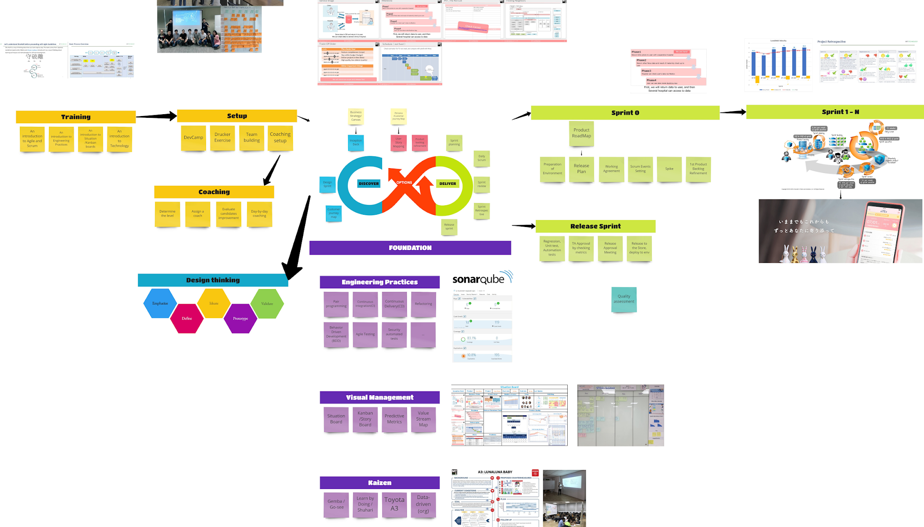
Flow of development
Ongoing
Feature teams

Slide 27
Other techniques and tools
Branch by abstraction
Monolith decomposition patterns
Deployment strategies: rolling update, blue green, canary
Infrastructure as code
Mutation testing

Slide 28
Practice & Demo

Slide 29

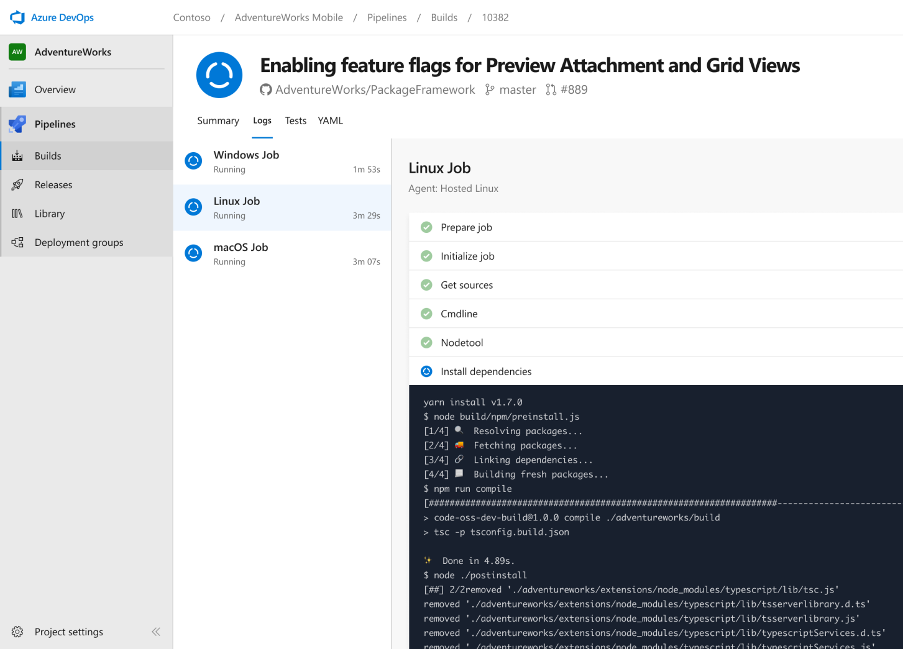


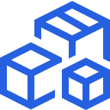

Azure Pipelines
Cloud-hosted pipelines for Linux, Windows and macOS, with unlimited minutes for open source
Any language, any platform, any cloud
Build, test, and deploy Node.js, Python, Java, PHP, Ruby, C/C++, .NET, Android, and iOS apps. Run in parallel on Linux, macOS, and Windows. Deploy to Azure, AWS, GCP or on-premises
Extensible
Explore and implement a wide range of community-built build, test, and deployment tasks, along with hundreds of extensions from Slack to SonarCloud. Support for YAML, reporting and more
Containers and Kubernetes
Easily build and push images to container registries like Docker Hub and Azure Container Registry. Deploy containers to individual hosts or Kubernetes.
Best-in-class for open source
Ensure fast continuous integration/continuous delivery (CI/CD) pipelines for every open source project. Get unlimited build minutes for all open source projects with up to 10 free parallel jobs across Linux, macOS and Windows

Slide 30
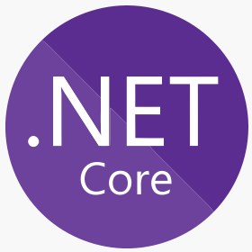






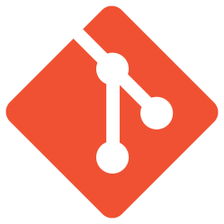


Tool - Technology
.NET Core
Azure Repos
Azure Pipelines
Sonar Cloud
Azure App Service
Visual Studio
Visual Studio Code
Source Tree
GIT
YAML Ain't Markup Language

Slide 31
Tool – Technology (cont.)
Azure DevOps account (MUST) (https://azure.microsoft.com/en-in/services/devops/)
Git (SHOULD) (https://git-scm.com/downloads)
SonarCloud account (SHOULD) (https://sonarcloud.io/)
.Net core (2.1+) (SHOULD) (https://dotnet.microsoft.com/download/dotnet-core/2.1)
Sourcetree git tool (SHOULD) (https://www.sourcetreeapp.com/)
Visual Studio 2019/2018 Community / Visual Studio Code (SHOULD) (https://visualstudio.microsoft.com/downloads/)

Slide 32
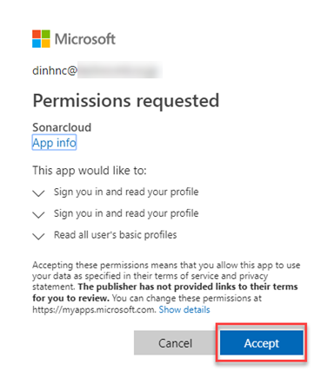
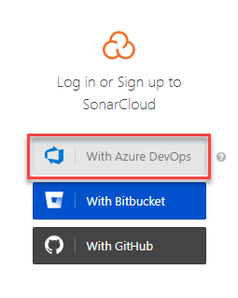
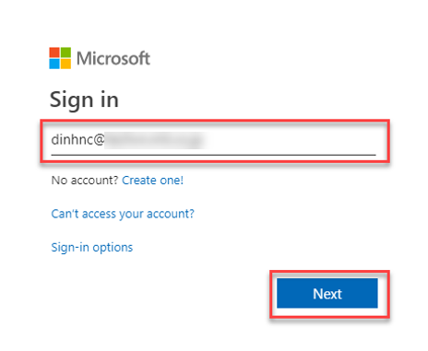
Create SonarCloud account
Access https://sonarcloud.io/sessions/new
Login with Microsoft account

Slide 33
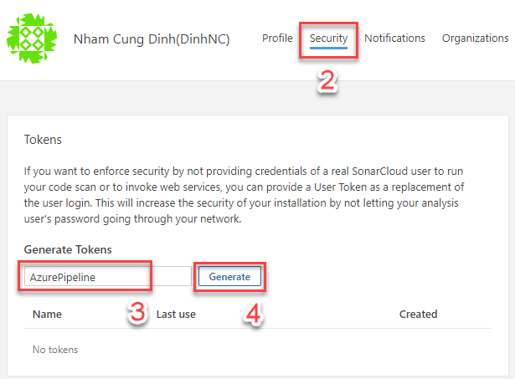
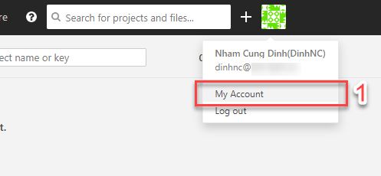
Generate SonarCloud user token
Go to My Account then Security to generate user token

Slide 34
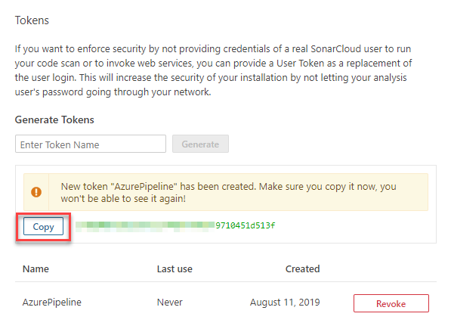
Generate SonarCloud user token
Copy this token and store it some where
Azure Pipeline will use this token to connect to SonarCloud later

Slide 35
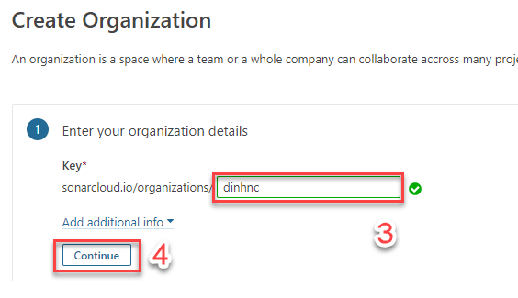
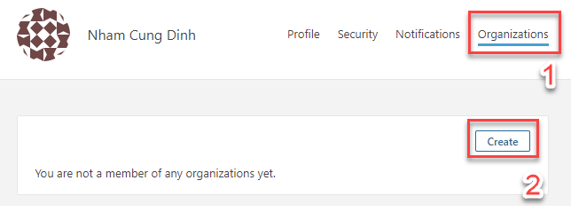
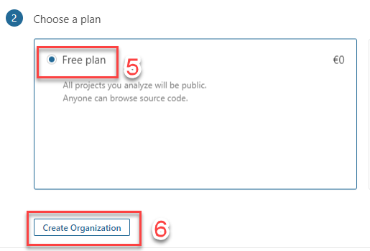
Create SonarCloud Organizations
Remember your organization’s name
Azure Pipeline will use this to connect to SonarCloud later

Slide 36
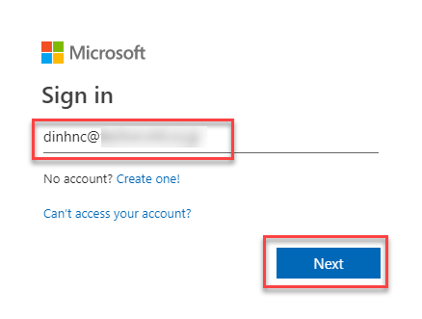
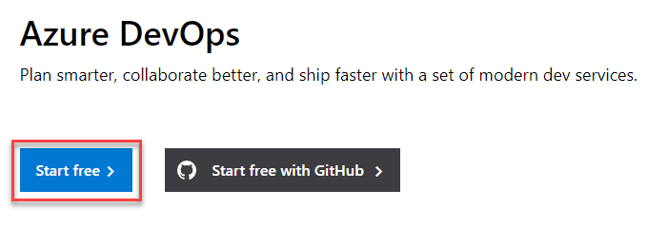
Create Azure DevOps account
Access https://dev.azure.com
Sign in with Microsoft account

Slide 37
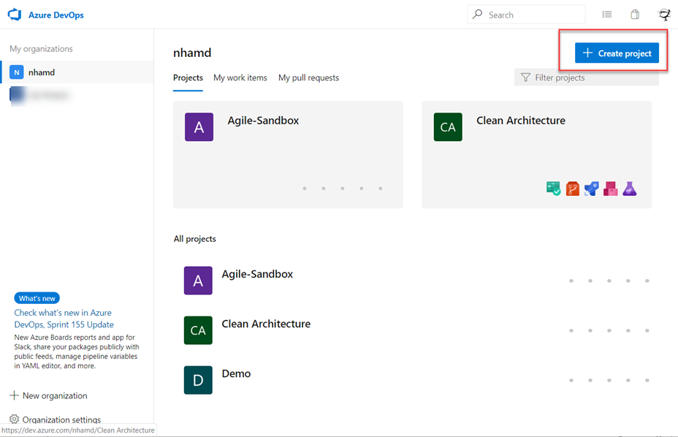
Create project
2
1

Slide 38
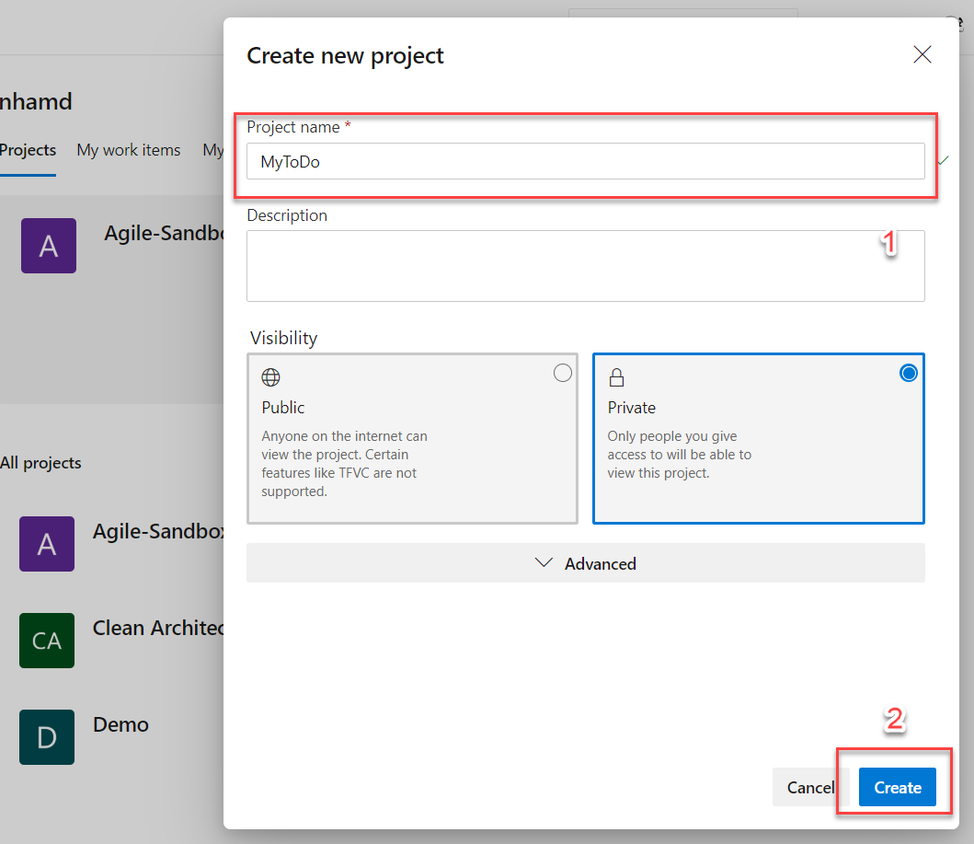
Create project

Slide 39
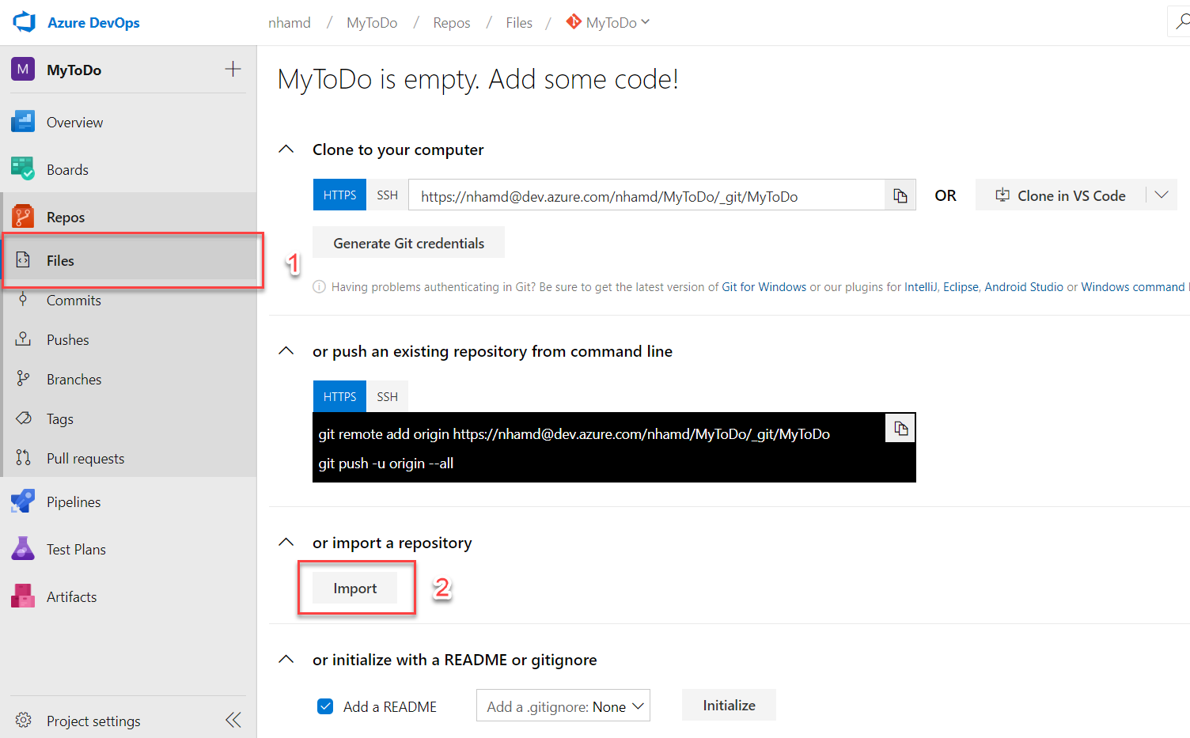
Import sample repository

Slide 40
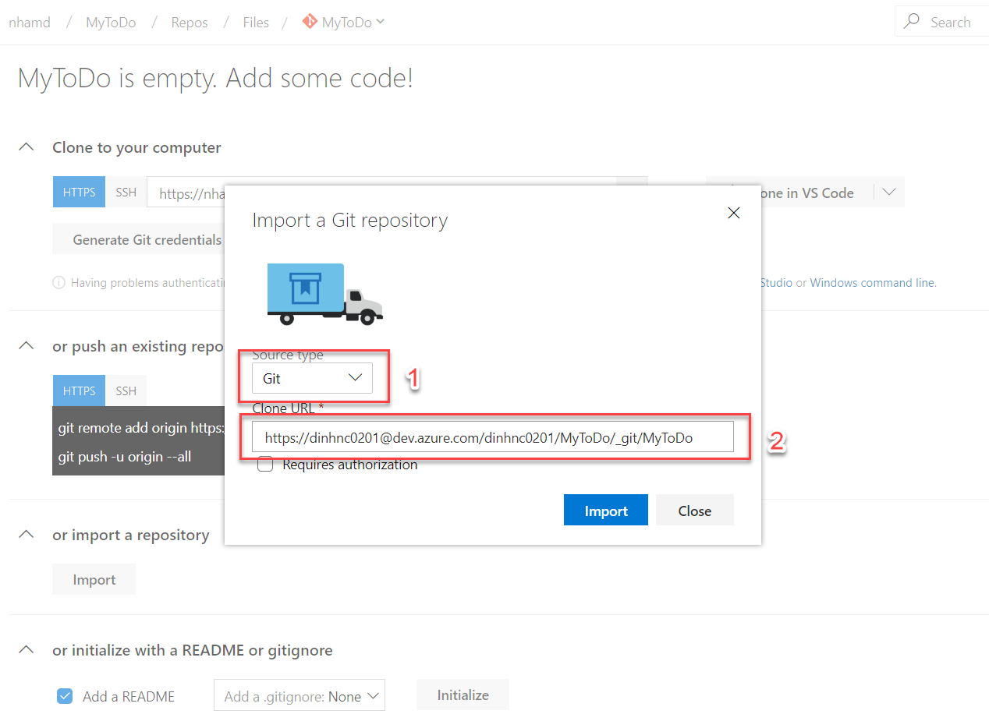
Import sample repository
Clone URL: https://dinhnc0201@dev.azure.com/dinhnc0201/MyToDo/_git/MyToDo

Slide 41
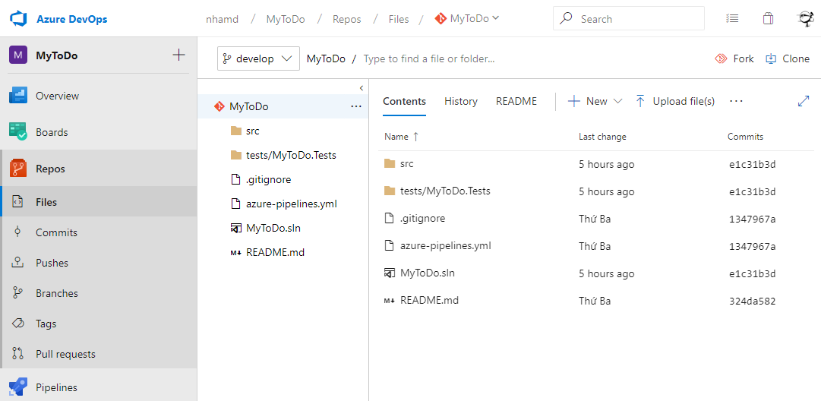
Import sample repository

Slide 42
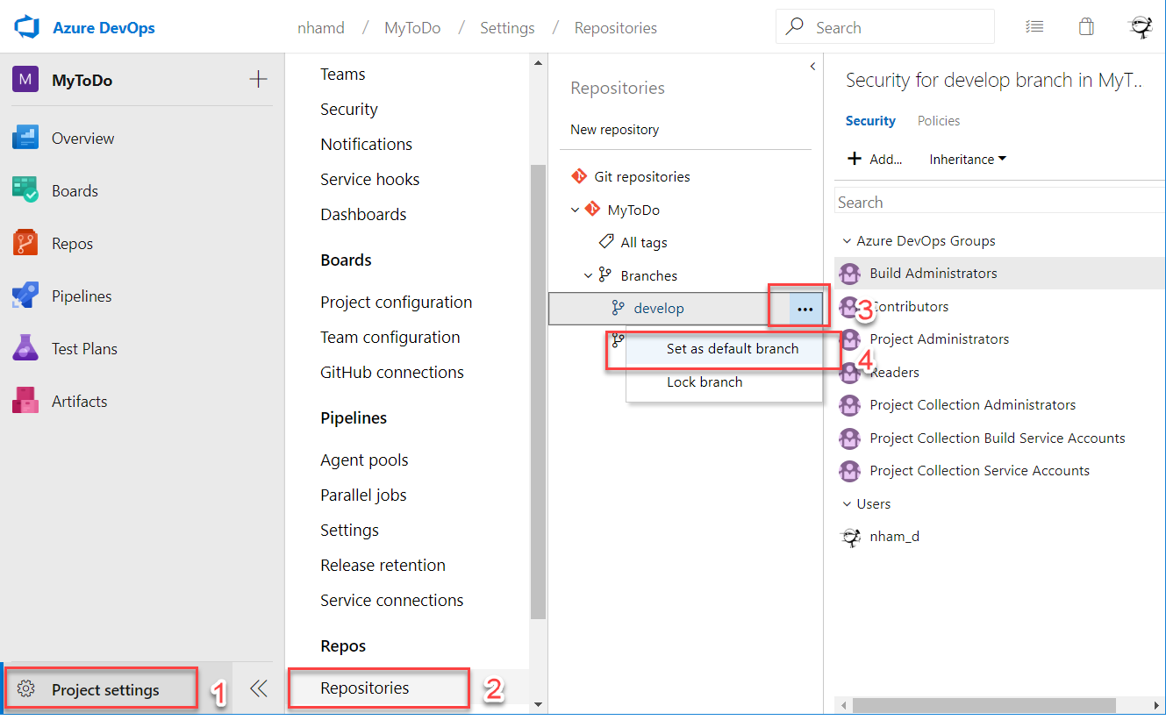
Change default branch

Slide 43
Build Pipeline Configuration

Slide 44
Automate build and artifact creation
Code
Artifact
Build

Slide 45
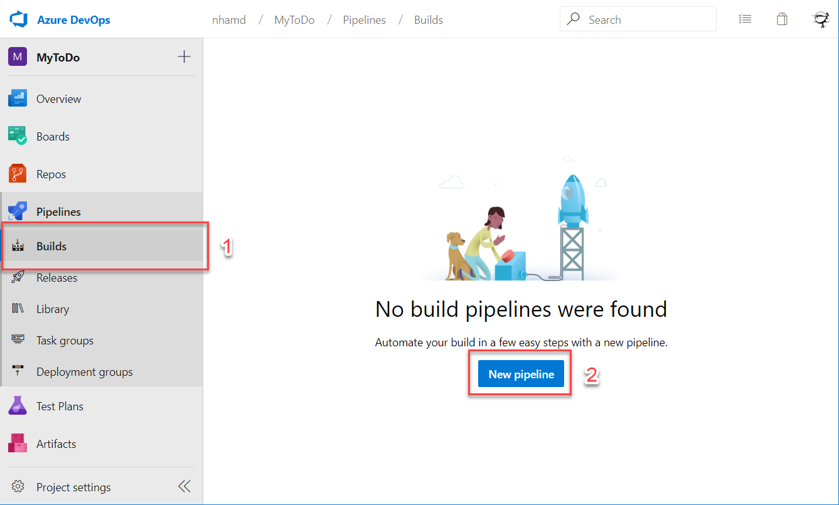
Create New Pipeline

Slide 46
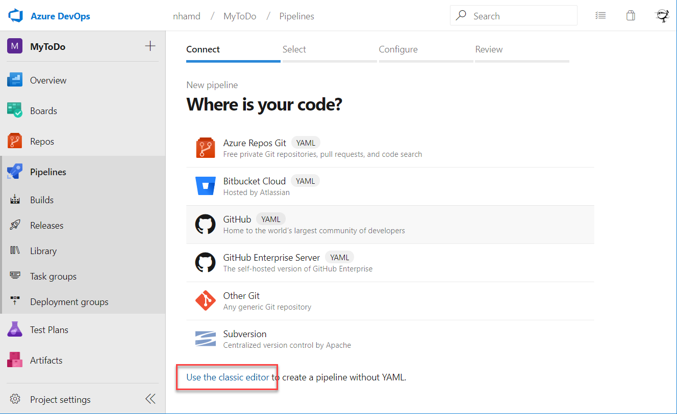
Create New Pipeline

Slide 47

Select your repository

Slide 48

Select a template

Slide 49

Configure property

Slide 50

.Net Core restore task

Slide 51

.Net Core restore task

Slide 52

Clone task

Slide 53

.Net Core build task
Arguments: --configuration $(BuildConfiguration)

Slide 54

.Net Core publish task
Arguments: --configuration $(BuildConfiguration) --output $(Build.ArtifactStagingDirectory)

Slide 55

Publish build artifacts

Slide 56

Publish build artifacts

Slide 57

Configure Variables

Slide 58

Configure Trigger

Slide 59

Configure Build Number Format
$(SourceBranchName)-$(Date:yyyyMMdd)$(Rev:.r)

Slide 60

Save & Queue

Slide 61

Execute the pipeline

Slide 62

Check The Logs

Slide 63

Check The Summary

Slide 64

Check The Artifacts

Slide 65

Check The Artifacts

Slide 66
Automate build, UT execution and artifact creation
Code
Artifact
Build
Test

Slide 67

Add Coverlet Tool

Slide 68

Add Coverlet Tool
dotnet add tests/MyToDo.Tests package coverlet.msbuild

Slide 69

.Net Core Test Task
Path to project(s): **/*[Tt]ests/*.csproj
Arguments: /p:CollectCoverage=true /p:CoverletOutputFormat=cobertura --configuration $(BuildConfiguration)

Slide 70

Publish Code Coverage Results

Slide 71

Publish Code Coverage Results
5
tests/MyToDo.tests/coverage.cobertura.xml

Slide 72

Execute the pipeline and check the result

Slide 73

Tests Result

Slide 74

Code Coverage Result

Slide 75
Automate build, UT execution, code analyze and artifact creation
Code
Artifact
Build
Analyze
Test

Slide 76

Add SonarCloud Plugin To AzureDevops
Access: https://marketplace.visualstudio.com/azuredevops

Slide 77

Add SonarQube Plugin To AzureDevops
Get and install the extension into your Azure DevOps organization

Slide 78

Output Open Cover Format

Slide 79

Add SonarQube Tasks

Slide 80

SonarQube – Prepare Analysis Configuration
Additional Properties:
sonar.organization=workshop
sonar.cs.opencover.reportsPaths=$(Build.SourcesDirectory)/tests/MyToDo.Tests/coverage.opencover.xml

Slide 81


SonarQube – Add SonarCloud Connection
Token: 8a335aa96ba934941bad101a1e72a77e227b12e3

Slide 82

SonarQube – Prepare Analysis Configuration
Because of sonarqube license, the Pipeline will analyze on default branch only (develop)
and(succeeded(), eq(variables['Build.SourceBranch'], 'refs/heads/develop'))

Slide 83

SonarQube – Run Code Analysis

Slide 84

SonarQube – Publish Quality Gate Result

Slide 85

Execute the pipeline and check the result

Slide 86

Execute the pipeline and check the result
Access:
https://sonarcloud.io/organizations/workshop/projects
And find your project

Slide 87
Configure Branch Protection

Slide 88

Update Branch Policies

Slide 89

Require A Minimum Number Of Reviews
In this workshop we will not set Require A Minimum Number Of Reviews

Slide 90

Check For Linked Work Items
In this workshop we will not set Check For Linked Work Items

Slide 91

Check For Comment Resolution

Slide 92

Limit Merge Types

Slide 93


Build Validation

Slide 94


Automatically Include Code Reviewers

Slide 95

Save Policies

Slide 96
Modify the code to make the pipeline fail
Clone repository to your local
Create and checkout new branch: `feature/update-done-status`

Slide 97

Modify the code to make the pipeline fail
Add new test case: ToDo Item mark complete should set Is Done To True

Slide 98

Modify the code to make the pipeline fail
Implement feature:
We should set IsDone = true but we will set it to false to make the pipeline fail

Slide 99

Create a Pull request
Push the code to remote
Go to Pull Requests then make a new Pull request

Slide 100

Check the CI result

Slide 101


Check the test result

Slide 102

Modify the code to make the pipeline pass
Update feature: Set IsDone = true to make the pipeline pass
Push the code to remote

Slide 103

Check the policies and complete PR

Slide 104

Complete the pull request

Slide 105

Check the CI will automatic trigger on develop after merge

Slide 106
Creation of Release Pipeline

Slide 107
Automatically deployed to DEV environment
Artifacts
Deploy DEV
Releases should be automatic to the development environment on a successful update to the "develop" branch

Slide 108

Create the Base Pipeline

Slide 109

Create the Base Pipeline

Slide 110

Create & Configure Stages for Deployment

Slide 111

Add An Artifact

Slide 112

Add An Artifact

Slide 113


Add cURL Upload Files

Slide 114

Add cURL Upload Files

Slide 115

Configure Variables
Deploy username: mti123456
Deploy password: mti123456
Deploy URL: https://trainee1.scm.azurewebsites.net/ZipDeploy

Slide 116

Continuous Deployment Trigger

Slide 117


Save the pipeline

Slide 118



Execute manual

Slide 119

Execute the pipeline and check the result

Slide 120

Check Development Environment
Access: https://trainee1.azurewebsites.net/swagger

Slide 121
Configuration of Pre-Deployment Conditions To RC, STG environment
Artifacts
Deploy DEV
Deploy RC
Deploy STG
Deploy PROD
Releases should be trigger to the RC, staging environment on a successful update to the “release” branch
Configuration Pre-deployment approvals: Select the users who can approve or reject deployments to this stage

Slide 122


Clone Stage

Slide 123



Configuration of Pre-Deployment Conditions

Slide 124

Create Stage For Pre-Confirmation Environment
Clone Deploy RC stage and rename it to Deploy STG, Deploy PROD

Slide 125

Configuration Variables
Because of the limitation of App Service so in this work shop we will use the same deploy URL for all environment

Slide 126
Configuration For Testing Stage
Artifacts
Deploy DEV
IT
Deploy RC
UAT
Deploy STG
Performance Test
Deploy PROD
In this workshop testing stage will configure as a Manual Intervention

Slide 127



Create Integration Test Stage

Slide 128



Create Agentless Job

Slide 129

Add Manual Intervention Task

Slide 130

Add Manual Intervention Task

Slide 131


Change Pre-deployment conditions of Deploy RC

Slide 132




Create UAT Stage

Slide 133


Change Pre-deployment conditions of UAT

Slide 134


Change Pre-deployment conditions of Deploy STG

Slide 135




Create Performance Test Stage

Slide 136


Change Pre-deployment conditions of Performance Test

Slide 137


Change Pre-deployment conditions of Deploy PROD

Slide 138

Finish Release Pipeline

Slide 139

Create A Release

Slide 140

Create A Release

Slide 141

Create A Release

Slide 142

Check The CI Is Automatic Trigged

Slide 143

Check The CD Is Automatic Trigged After CI Is Finished

Slide 144


Approve Manual Intervention

Slide 145


Approve Deploy

Slide 146

Approve All Stages

Slide 147
Check The result
Access: https://trainee1.azurewebsites.net/swagger

Slide 148
Tips/Advance Configuration for CI/CD

Slide 149
Pipelines as Code with YAML
🡺
https://docs.microsoft.com/en-us/azure/devops/pipelines/yaml-schema?view=azure-devops&tabs=schema

Slide 150

Pipelines as Code with YAML
YAML Based
Build on existing VSTS Build & Release model, including extensions
Support templating via Mustache
Makes it easy to share examples, samples etc
Scales from very simple to very complex
Version control better

Slide 151

New Pipeline From YAML File

Slide 152


New Pipeline From YAML File

Slide 153

Checking New Pipeline

Slide 154
Azure Pipeline For Front-end

Slide 155

Sample ReactJS repository
https://dinhnc0201@dev.azure.com/dinhnc0201/MyToDo/_git/MyToDoApp

Slide 156

Checking The Pipeline using YAML

Slide 157

Checking The Pipeline using YAML

Slide 158


Create New Pipeline From YAML And Execute The Pipeline

Slide 159
SonarQube build breaker and quality protection
An extension that breaks your build whenever the quality gate in SonarQube failed
🡺
https://marketplace.visualstudio.com/items?itemName=SimondeLang.sonar-buildbreaker

Slide 160

Usage
It is recommended to place the task after the 'Publish Quality Gate' task from SonarSource, this is because the official task has better error handling and you probably want to browse to SonarQube if this task makes your build fail

Slide 161

Usage
The task requires one input, your SonarQube endpoint. This is required in order to authenticate to the SonarQube instance

Slide 162

Configuration For Quality Gate

Slide 163

The pipeline will fail whenever the quality gate in SonarQube failed

Slide 164
SonarQube pull request analysis (SonarQube developer edition)
An extension that breaks your build whenever the quality gate in SonarQube failed
🡺
https://docs.sonarqube.org/latest/analysis/scan/sonarscanner-for-azure-devops/

Slide 165
SonarQube pull request analysis and line comments (SonarQube developer edition)
SonarQube can analyze the code of the new features and annotate your pull requests in TFS with comments to highlight issues that were found.
Pull request analysis is supported for any type of Git repositories. To activate it:
  In the Branch policies page of your main development branches (e.g. "master"), add a build policy that runs your build definition
  Create an Azure DevOps token with "Code (read and write)" scope
  In SonarQube, in the Administration > General Settings > Pull Requests page, set this token in the VSTS/TFS section
Next time some code is pushed in the branch of a pull request, the build definition will execute a scan on the code and publish the results in SonarQube which will decorate the pull request in TFS.

Slide 166

SonarQube pull request analysis and line comments (SonarQube developer edition)

Slide 167
Azure Pipelines with Microsoft Teams
🡺
https://docs.microsoft.com/en-us/azure/devops/pipelines/integrations/microsoft-teams?view=azure-devops

Slide 168

Azure Pipelines with Microsoft Teams

Slide 169
Azure Pipelines automation test with BDD, Azure Test Plan, Test Suite
🡺
https://docs.microsoft.com/en-us/azure/devops/test/run-automated-tests-from-test-hub?view=azure-devops

Slide 170

Azure Test Plans

Slide 171

Azure Pipelines automation test with BDD, Azure Test Plan, Test Suite

Slide 172

SpecFlow Build pipeline
https://www.visualstudiogeeks.com/DevOps/SpecflowPlusSpecRunVstsPipelineForBddStyleAutomatedGherkinFunctionalTests

Slide 173

Azure Pipelines automation test with BDD, Azure Test Plan, Test Suite
Test evidence (screenshot, videos,…) from automation test can attach to test result

Slide 174

Azure DevOps with & GCP products

Slide 175

Data-driven Design
“Data has a better idea”
“Data beats emotions”
Sean Rad

Slide 176

What is Data-driven
Data-driven is about building tools, abilities, and, most crucially, a culture that acts on data
Notes:
data-driven means that our progress in design sprints and projects is compelled by data derived from end-users.

Slide 177
Why is Data-driven
Spot (and predict) new market trends first
Identify customer experience improvements
Make smarter decisions with data
Make faster decisions with data
Identify the right growth opportunities
“6% more profitable and 5% more productive”
Research from MIT Center of Digital Business

Slide 178
What Makes A Digital Company
Data-driven decision making
Relentless experimentation (e.g A/B testing)
Short feedback cycles
Decision making pushed down in organization
Strategic data collection
Unified data warehouse
Pervasive use of AI automation
Notes:
Not digital:
Using email
Have website
Use social media
Video conferencing
Chatbots

Slide 179


Slide 180

Use-case
Notes:
Data source: We will have many type azure, git, sonar, excel, forms,...
Extractor, transformer: can be any type of tool, language you like (the tool in the image I prefer but you can change if you want)
Using Azure Data Lake Storage for the destination data, it can be json, csv, table,....
End user services: reporting, dashboard,…

Slide 181

Thank you

