Slide 1
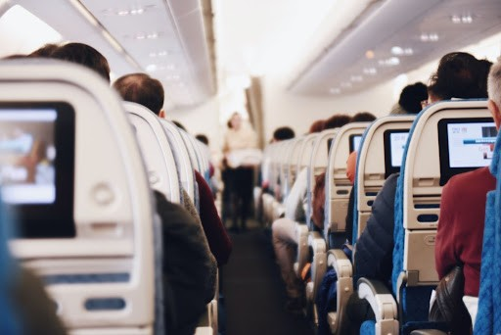
Airline Customer Satisfaction Analyis
Insights on Customer Experience in Airlines
DA241029 - Lê Anh Khoa

Slide 2

Enhancing Airline Customer Satisfaction
Exploring key factors in
customer experience and satisfaction
❇︎ Impotance of Customer Satisfaction
Understanding customer satisfaction is essential for airlines to enhance service quality and maintain loyalty.
❇︎ Identifing Satisfaction Factors
Identifying factors leading to Satisfaction and Dissatisfaction helps in making informed decisions to improve services.

Slide 3
Airline Customer Insights
Analysis of Customer Satisfaction Data
Source of Data
The data sourced is from a public dataset available on Kaggle. This ensures credibility and reliability in the analysis.
🔗 kaggle.com/datasets/raminhuseyn/airline-customer-satisfaction
1

Slide 4
Overview of Airline Data Insights
Analyzing customer satisfaction metrics
Data Overview
2
129,487 users
100% non-null
Total Responses
Complete Data
Flight Metrics
13 Diverse Insights
Flight Distance, Departure Delay in Minutes, Arrival Delay in Minutes ...
Seat comfort, Inflight entertainment, On-board service, Food and drink, Inflight wifi service ...

Slide 5

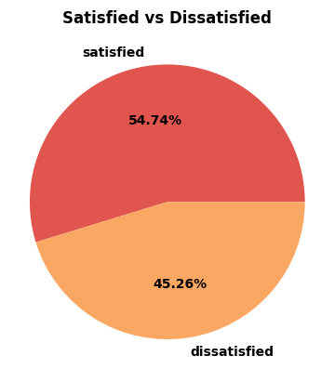
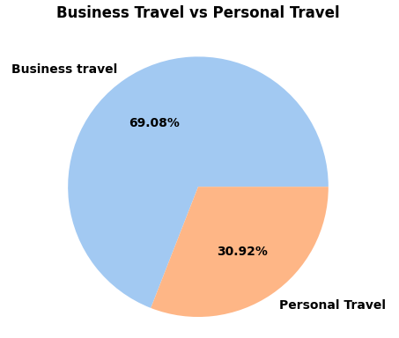
Overview of Airline Data Insights
Exploring trends among airline passengers
・ The number of Satisfied customers Exceeds the number of Dissatisfied customers, indicating a prevailing trend towards positive experiences with the flight service.
・Business travel accounts for the vast majority, at 69.08%. This significant share suggests that for the population or dataset this chart represents, travel is predominantly undertaken for professional purposes.

Slide 6

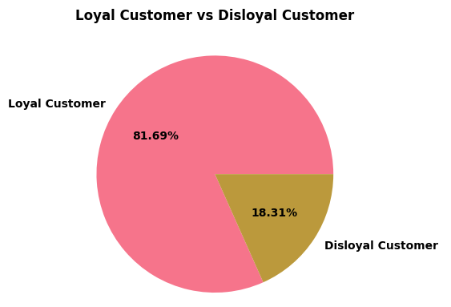
Overview of Airline Data Insights
Exploring trends among airline passengers
81,69% High Loyalty
A significant majority of customers show loyalty, comprising 81.69% of the total dataset.
18,31% Low Loyalty
Only 18.31% of customers are identified as disloyal, indicating a weak brand attachment.

Slide 7

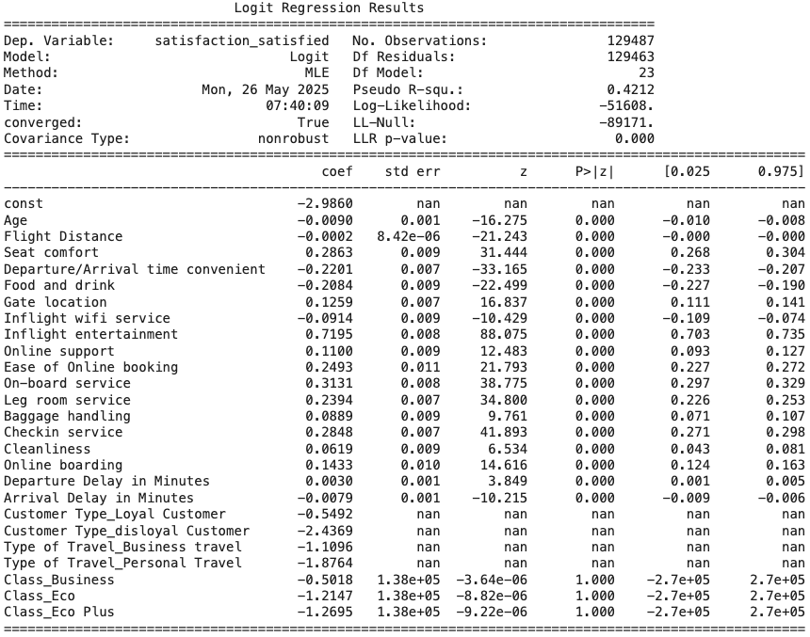
Key Factosrs Influencing Satisfaction
Exploring the elements that drive airline customer satisfaction
1
Inflight entertainment (0.7195) has the strongest positive association with customer satisfaction, enhancing overall experience.
On-board service (0.3131) significantly impacts satisfaction, with attentive staff being a key element.
2
3
Seat comfort (0.2863) also plays a crucial role in customer satisfaction, affecting passenger comfort levels during flights.

Slide 8
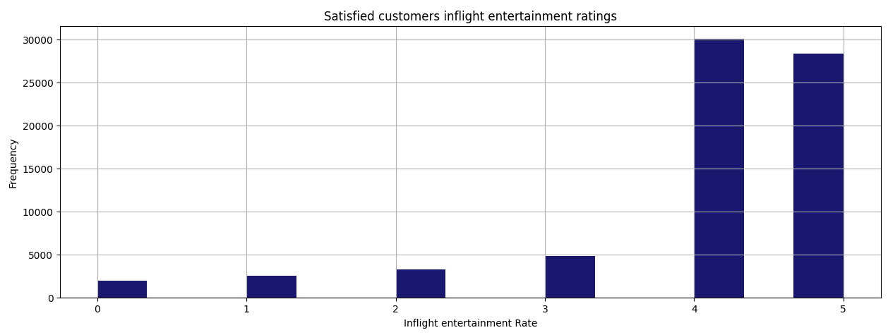
Key Factosrs Influencing Satisfaction
Exploring the elements that drive airline customer satisfaction
1
Inflight entertainment (0.7195) has the strongest positive association with customer satisfaction, enhancing overall experience.

Slide 9
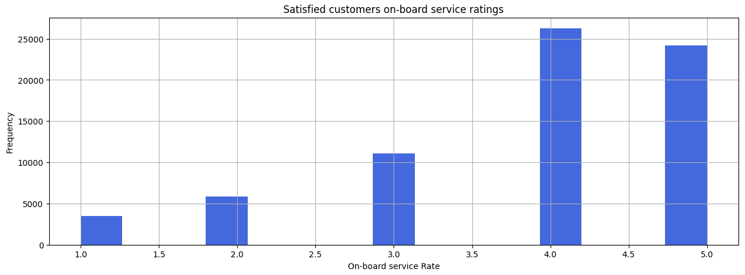
Key Factosrs Influencing Satisfaction
Exploring the elements that drive airline customer satisfaction
2
On-board service (0.3131) significantly impacts satisfaction, with attentive staff being a key element.

Slide 10
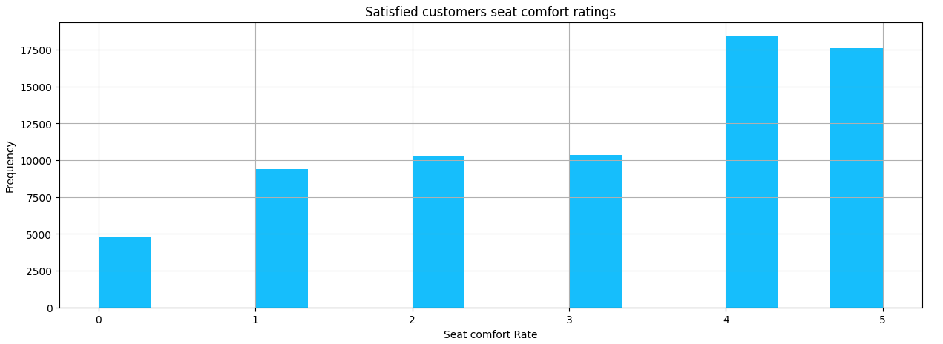
Key Factosrs Influencing Satisfaction
Exploring the elements that drive airline customer satisfaction
3
Seat comfort (0.2863) also plays a crucial role in customer satisfaction, affecting passenger comfort levels during flights.

Slide 11

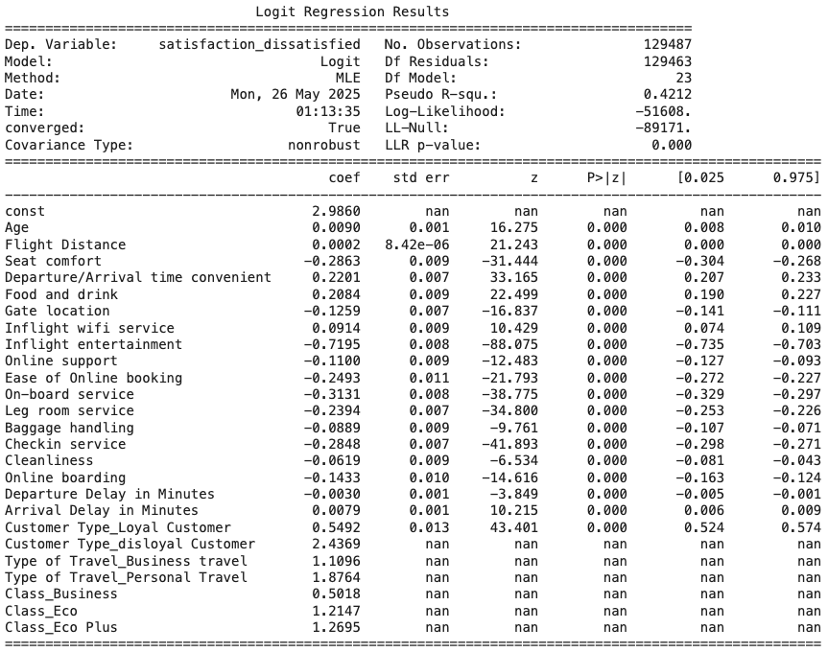
Key Factosrs of Airline Dissatisfaction
Understanding what impacts customer satisfaction in airlines
1
Departure/Arrival Timing convenience is the most impactful factor leading to dissatisfaction among airline customers.
Food and Drink Quality: Poor ratings for food and drink options substantially affect overall customer satisfaction levels during flights.
2
3
Inflight Wi-Fi Performance plays a significant role in contributing to negative experiences for passengers.

Slide 12
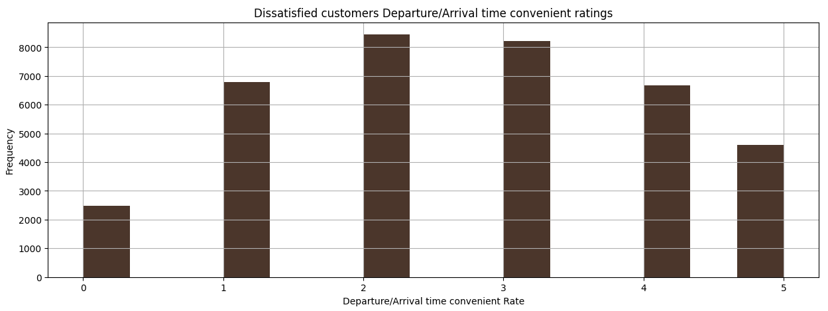
Key Factosrs of Airline Dissatisfaction
Understanding what impacts customer satisfaction in airlines
1
Departure/Arrival Timing convenience is the most impactful factor leading to dissatisfaction among airline customers.

Slide 13
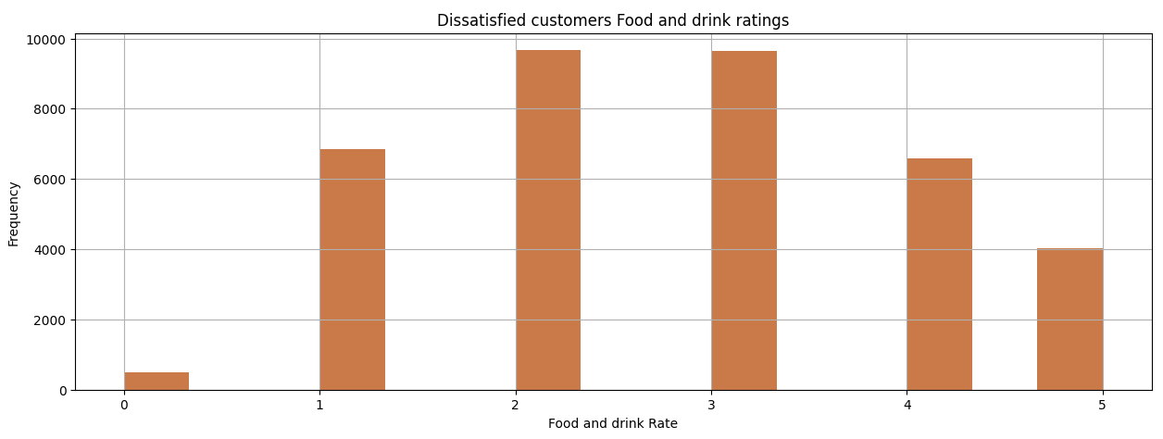
Key Factosrs of Airline Dissatisfaction
Understanding what impacts customer satisfaction in airlines
2
Food and Drink Quality: Poor ratings for food and drink options substantially affect overall customer satisfaction levels during flights.

Slide 14
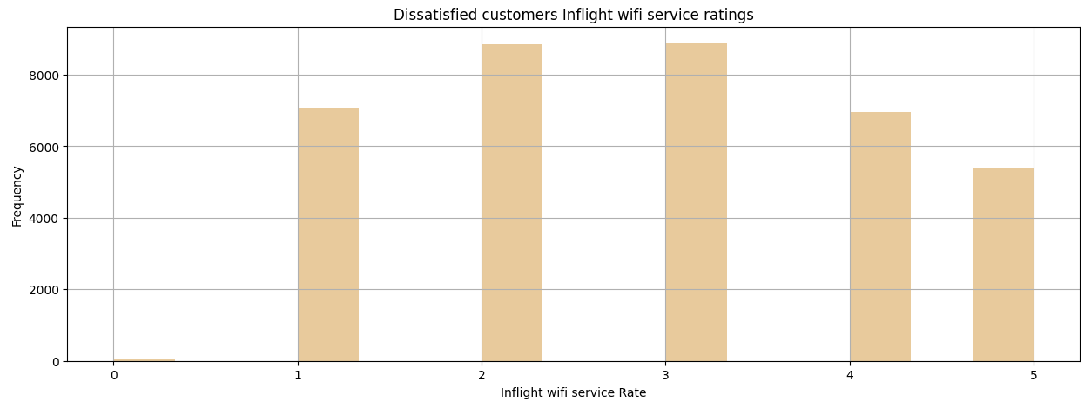
Key Factosrs of Airline Dissatisfaction
Understanding what impacts customer satisfaction in airlines
3
Inflight Wi-Fi Performance plays a significant role in contributing to negative experiences for passengers.

Slide 15

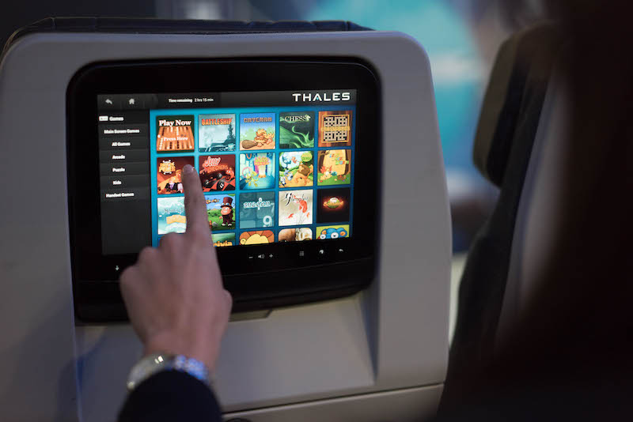
Enhancing Airline Customer Experience
Key Strategies to Boost Satisfaction
Airlines should prioritize improvements inflight entertainment,
on-board service, and seat comfort to enhance customer satisfaction and reduce dissatisfaction
◆ Inflight entertainment:
Movies and TV Shows: Provide library of the latest movies and TV programs, covering a wide range of genres (action, comedy, documentaries, children's shows, etc.).
Local Content: Offer content related to the destination or
local culture for passengers to learn more.
Good Quality Headphones: Offer headphones with
good sound quality or encourage passengers to use
their high-quality personal headphones via common connection ports.

Slide 16
Enhancing Airline Customer Experience
Key Strategies to Boost Satisfaction
Airlines should prioritize improvements inflight entertainment,
on-board service, and seat comfort to enhance customer satisfaction and reduce dissatisfaction
◆ On-board service:
Warm Welcome and Farewell: Ensure genuine greetings during boarding and appreciative farewells during disembarking. Using passenger names (where feasible and appropriate) can add a personal touch.
Streamlined Service Flows: Optimize processes for meal service, drink rounds, and duty-free sales to ensure efficiency without feeling rushed.

Slide 17
Enhancing Airline Customer Experience
Key Strategies to Boost Satisfaction
Airlines should prioritize improvements inflight entertainment,
on-board service, and seat comfort to enhance customer satisfaction and reduce dissatisfaction
◆ Seat comfort:
Personal Charging Ports: Provide USB charging ports or power outlets at each seat for passengers to charge their personal devices.
Improved Cushioning: Invest in higher-quality seat foam and padding that retains its shape and support over time, excessive firmness.

Slide 18



