Slide 1


JAVA BEST PRACTICES
Mar 23th, 2018

Slide 2
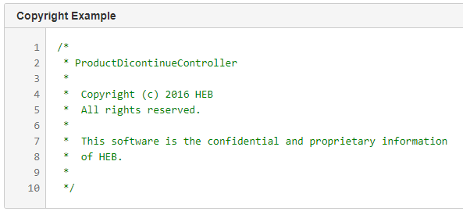
Java Code Practices
Copyright

Slide 3
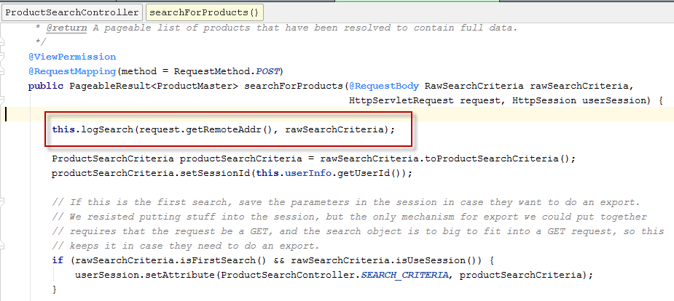
Java Code Practices
User log messages should constants enough information to trace what's going on

Slide 4
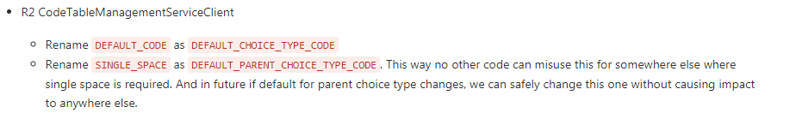

Java Code Practices
Use meaningful names for variables. Variable name must define the exact explanation of its content.

Slide 5
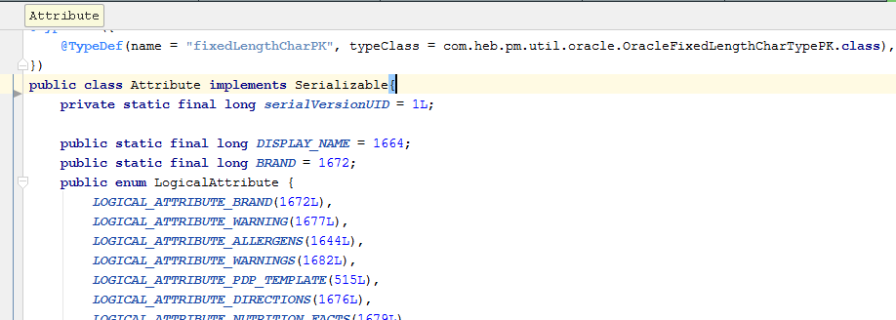
Java Code Practices
Put constants where they belong.

Slide 6
Java Code Practices
Do not use // for commenting class variables. Use /** .
No method name should go more than 50 chars. Long names will bring ugly and hard-to-read code, also may not run on some compilers because of character limit.

Slide 7
Java Code Practices
Use meaningful names for methods. The name must specify the exact action of the method and for most cases must start with a verb. (e.g. createPasswordHash)

Slide 8
Java Code Practices
When you merge, please do not change the author name and also ensure of proper @Since number. Do not overwrite these values.
Using “enum” for code tables

Slide 9
Java Code Practices
Follow Java naming conventions for method names (no underscores).
put in appropriate breaks and keeps lines of code (generally) to less than 120 characters

Slide 10
Java Code Practices
Do not name classes xxxVO
All entity classes need equals, hashCode, and toString
Sort constants should be inside the respective Entities

Slide 11
Java Code Practices
Include prefix "QUERY" for SQL constants
Instead of StringUtils.isNotEmpty on a trimmed string, use StringUtils.isNotBlank.
Remove unuse code

