Slide 1
Interactive Visualization of Student Stress Factors
Exploring Correlations Between Lifestyle and Stress Levels
Team 1:
Colin Nguyen, Francis Salonga, Peter Tawfik, Trung Le, and Trong Le.

Slide 2
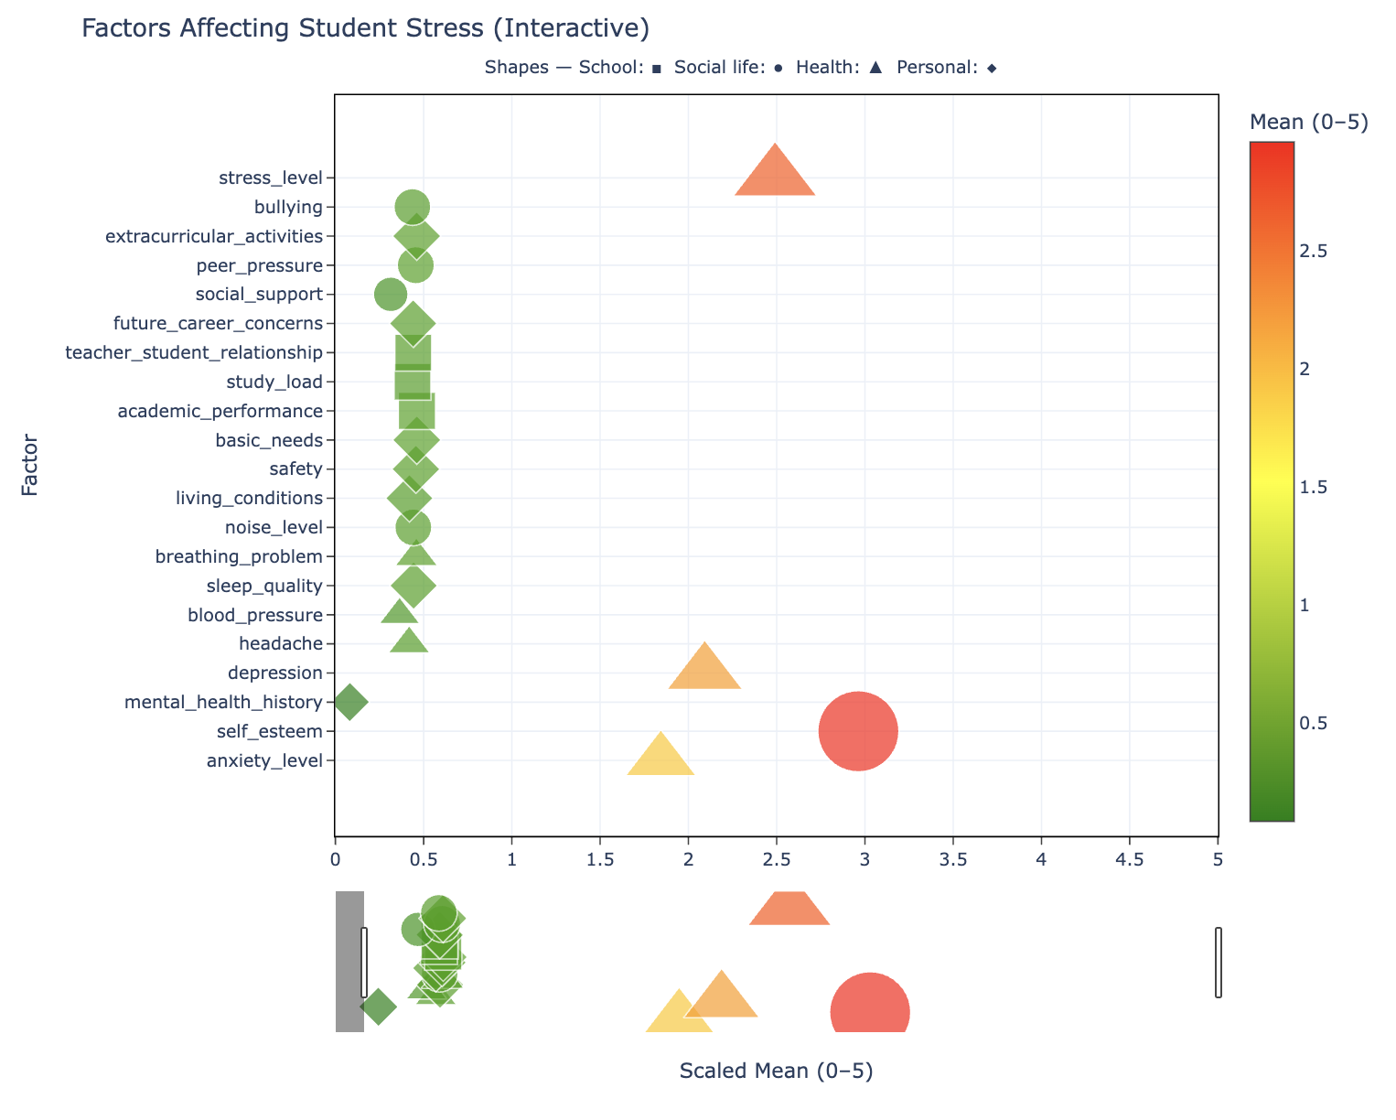

Slide 3
Objective
Goal: To visualize how various factors—such as depression, sleep quality, and self-esteem—affect student stress levels.
Key Questions:
- Which factors most strongly correlate with stress?
- How can visualization help reveal these relationships?

Slide 4
Design Considerations
Alternatives Explored:
- Static Chart (Matplotlib): Simple but lacks interactivity.
Interactive Dashboard (Plotly): Interactive but complex.
Chosen Design - Interactive Scatter Plot (Plotly):
- Combines clarity, color-coding, and interactivity for better user engagement.

Slide 5
Design Elements
Visual Encoding:
- X-axis: Scaled Mean (0–5)
- Y-axis: Factor Names
- Dot Color: Mean intensity (green → yellow → red)
- Dot Shape: Category (■ School, ● Social life, ▲ Health, ◆ Personal)
Interactive Features: Hover tooltips, range slider, colorbar legend.

Slide 6
Implementation Overview
Core Technologies Used: Python, Plotly Graph Objects, CSV, Math/Statistics.
1
Code Flow:
2
1. Load dataset → calculate raw and scaled means.
3
2. Compute Pearson correlation (r) for each factor vs stress level.
4
3. Categorize each factor → assign symbol.
5
4. Plot interactive scatter with custom hover data.
6

Slide 7
Pearson Correlation Insight
Formula: r = (nΣxy - ΣxΣy) / √[(nΣx² - (Σx)²)(nΣy² - (Σy)²)]
Interpretation Scale:
0.90–1.00 = Very strong | 0.70–0.90 = Strong | 0.50–0.70 = Moderate | <0.50 = Low/Negligible
Example Findings:
- Depression → r = 0.73 (Strong Positive)
- Self-esteem → r = -0.76 (Strong Negative)

Slide 8
Enhancements & Adjustments
Color Scale: Green → Yellow →Red Clear mean-level visualization.
Custom Hover Template: Added raw mean + correlation.
Range Slider: Allows zooming into factor ranges.
Improved Layout: Adjusted margins, added colorbar, expanded width.
Categorical Shapes: Visual distinction by domain.
Template: plotly_white for modern, clean aesthetic.

Slide 9
Technical Challenges
1. Challenges Faced:
Integrating correlation computation across multiple factors.
Handling missing/non-numeric data.
Merging code contributions from multiple team members.
Adjusting figure layout for colorbar and hover text.
Managing symbols, color, and interactivity simultaneously in Plotly.
2. Solutions:
Iterated through factors, skipped nulls, modularized code, fine-tuned layout.

Slide 10
Lessons Learned
• Importance of interactive design for data storytelling.
• Value of statistical measures (correlation) in insight generation.
• Need for collaboration and version control.
• Balancing aesthetic clarity with technical performance.

Slide 11
Conclusion
1. Key Takeaways:
Visualization highlights correlations between stress and key factors.
Interactivity enhances exploration and comprehension.
Strong relationships identified between mental health and stress levels.
2. Future Improvements:
Add filtering and dynamic factor selection.
Use machine learning for stress risk prediction.

Slide 12
Thank you for listening.

