Slide 1
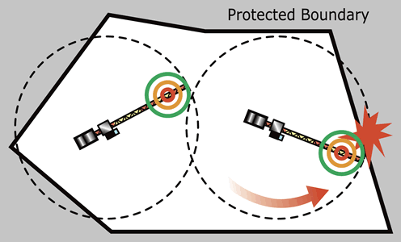
BOUNDARY TEST
Focus on the boundaries of the input space to identify test cases
What is the rationale for using this technology?

Slide 2
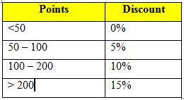
BOUNDARY TEST
How to apply
Test at the boundaries
Test boundary’s adjacent values
Test nominal value for each partition
Test for single fault assumption
Problems
Apply discount for customers base on the their point then calculate the order total
0
50
100
200

Slide 3
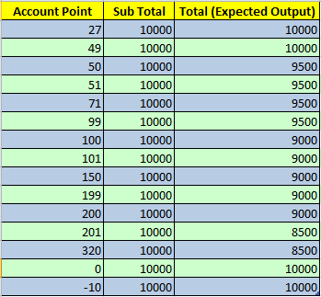
BOUNDARY TEST
Test cases
0
50
100
200

Slide 4
BOUNDARY TEST
Pros and cons
Relatively straightforward test-case generation
Pre-test
Suitable for input data that:
Independent
Physical measure
Bounds are not always obvious
Bounds are not always appropriate
Inadequate when there are dependencies between variables

