Slide 1
Sprint 01
Report sprint_01 and planning next sprint
Team Lion
Nguyen Dang Khoa - Leader
Ngo Quoc Thai
Pham Minh Huy
Ha Xuan Huy
Vo Thanh Minh Khoi
Huynh Nhut Anh

Slide 2
Week 1: Knowledge preparation & setup
Identify network’s components
Identify the basis node aliases in the network (Hospital, Ministry of Health, City, etc.)
Map node aliases to nodes (ie Hospital can be a Peer, City can be Organization, Country can also be Organization on worldwide deployment)
Express JS
Understand how to use Express JS to an acceptable extend
Able to run a simple CRUD server
Understand the concept of route, middleware, request and response.
Hyperledger Fabric network deployment
The network should be able to connect nodes and fulfill elementary tasks(extending - more peer, more organizations,etc) at least on the command prompt (using dummy, basic ledgers)

Slide 3
Previous sprint
Taskc | Assignee | Status
Research ExpressJS CRUD server | Minh Huy, Xuan Huy, Nhut Anh, Minh Khoi | Done
Research Hyperledger Fabric network | Whole team | Done
Vaccine blockchain network implementation | Whole team | Done
Code structure | Quoc Thai, Dang Khoa | Done

Slide 4
Current status
Task | Assignee | Status
ExpressJS server | Minh Huy, Xuan Huy, Quoc Thai | Working on, parts of them are done
Blockchain network devops | Dang Khoa | Almost done, no deployed chaincode yet
User authentication + register/login endpoint | Nhut Anh | Some problems, but on correct track
Research ExpressJS server | Minh Khoi | In good shape, able to build a simple CRUD, serving static file,...

Slide 5
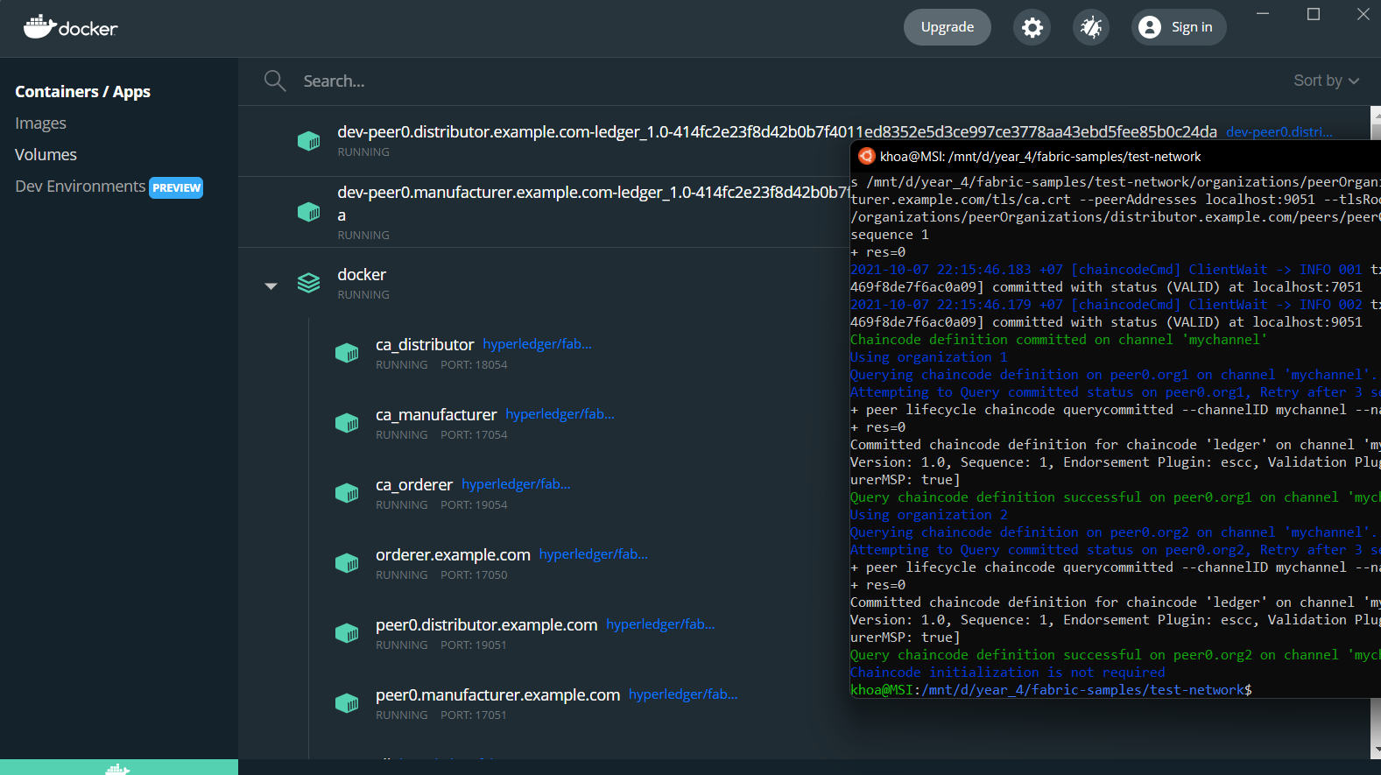

Slide 6
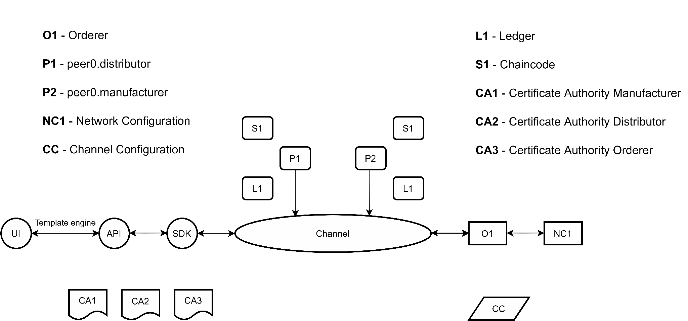
Architecture v1.0

Slide 7
Database schema: CouchDB
[
{
vaccineID: “astra5423asd”,
vaccineName: “astra”,
vaccineManufacturer: “org1”,
owner: “org1”,
deliverTo: “org1”
}
{
vaccineID: “moderna1341md”,
vaccineName: “moderna”,
vaccineManufacturer: “org1”,
owner: “org1”,
deliverTo: “org1”}
{...}
]
vaccineID - a unique ID of the vaccine
vaccineName - vaccine's name
vaccineManufacturer - vaccine's manufacturer
owner - owner of the vaccine, could be either manufacturer, distributor or citizens
deliverTo - current state of the owner ('org1', 'org2', 'user')

Slide 8
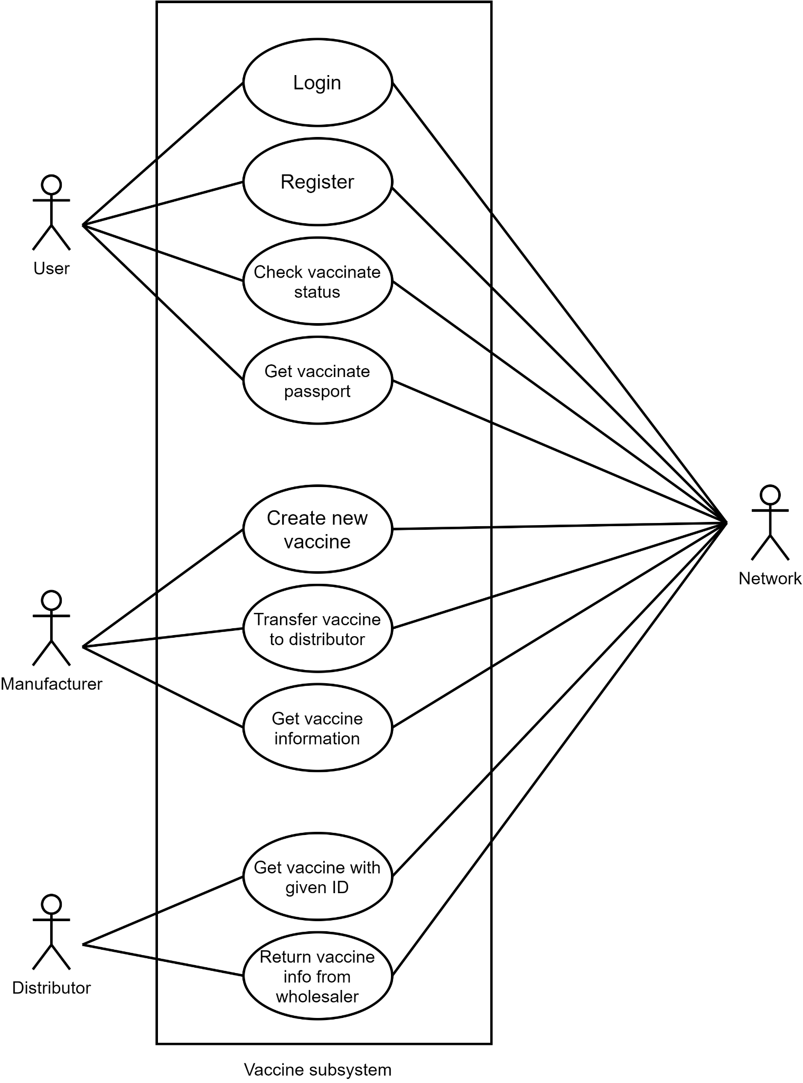

Slide 9
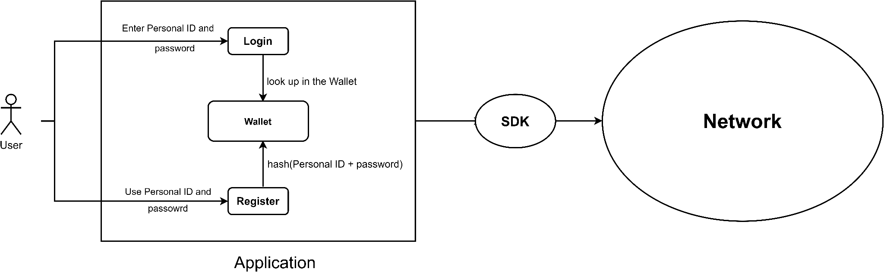
System flow

Slide 10
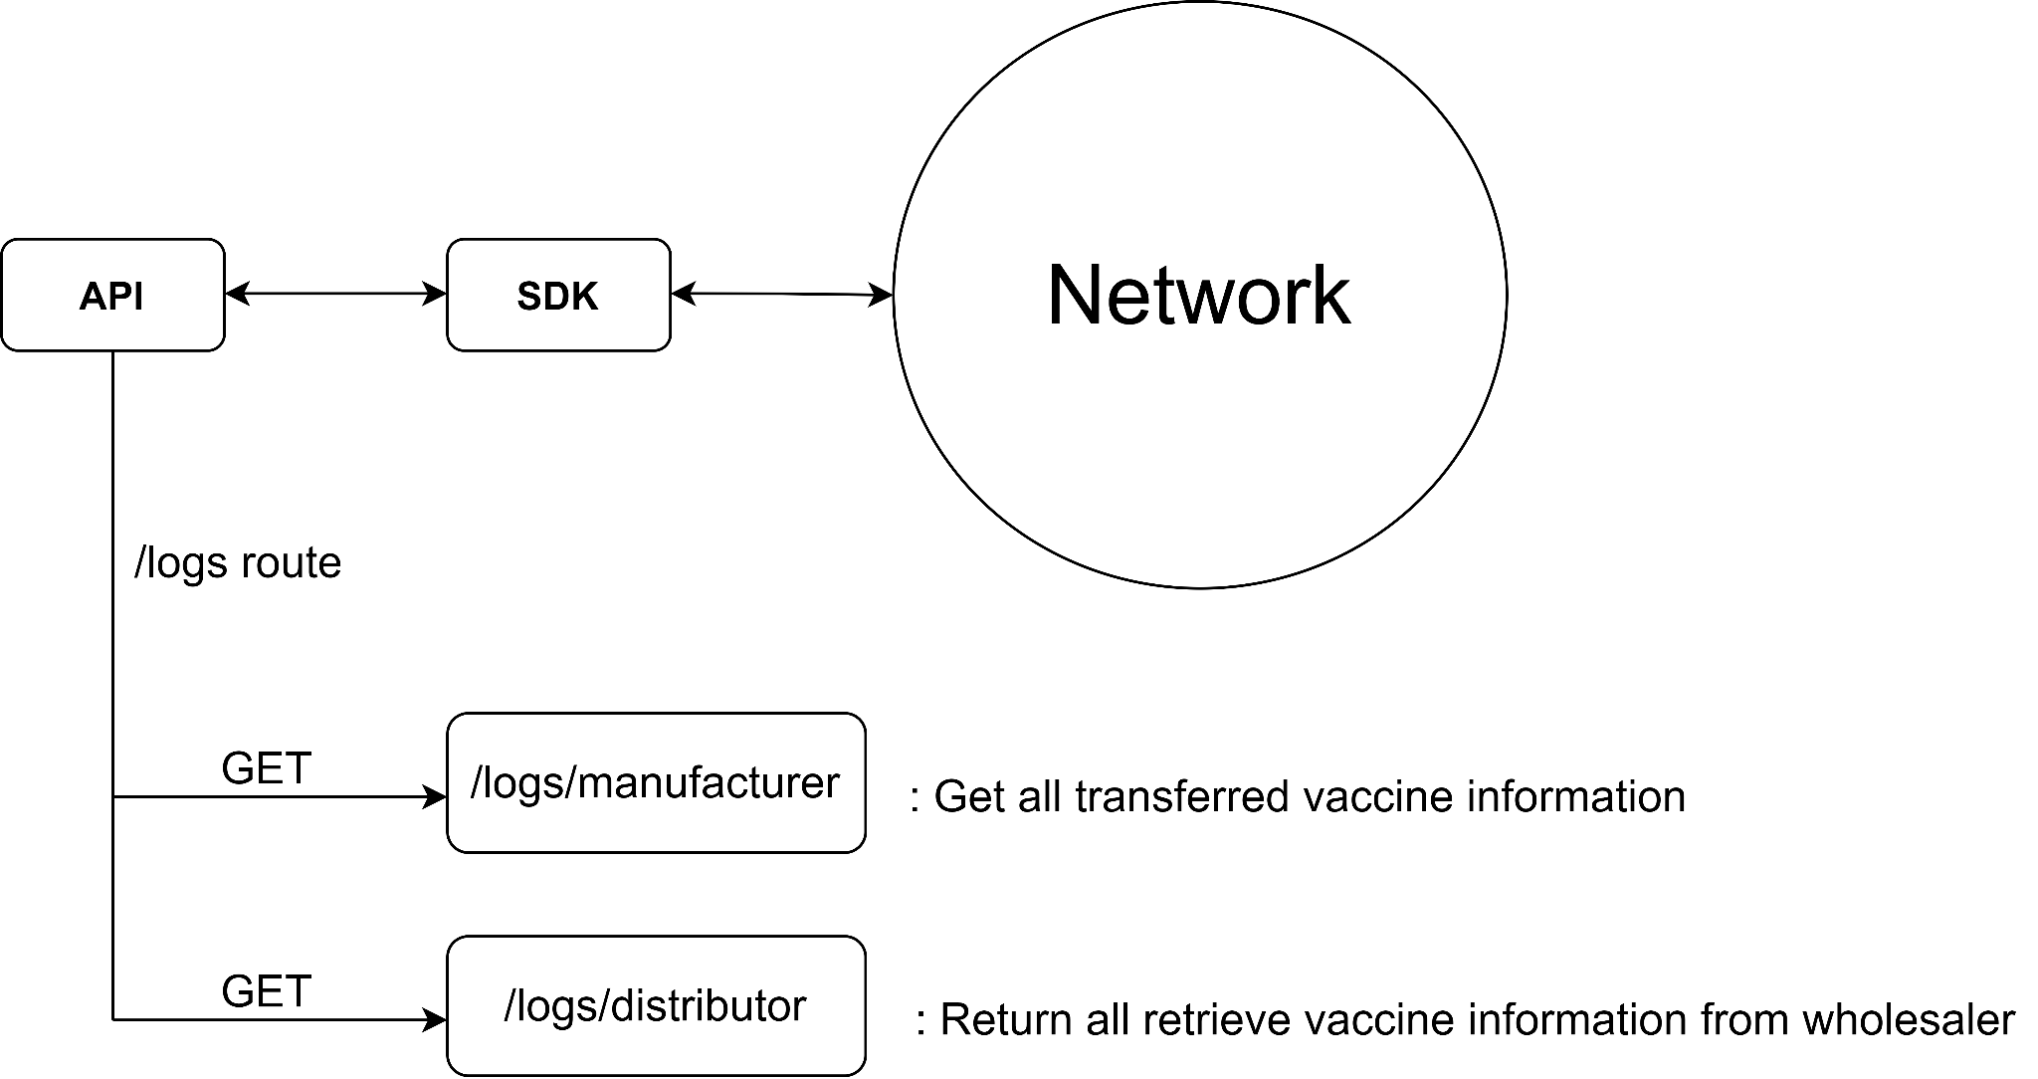
Logs route

Slide 11
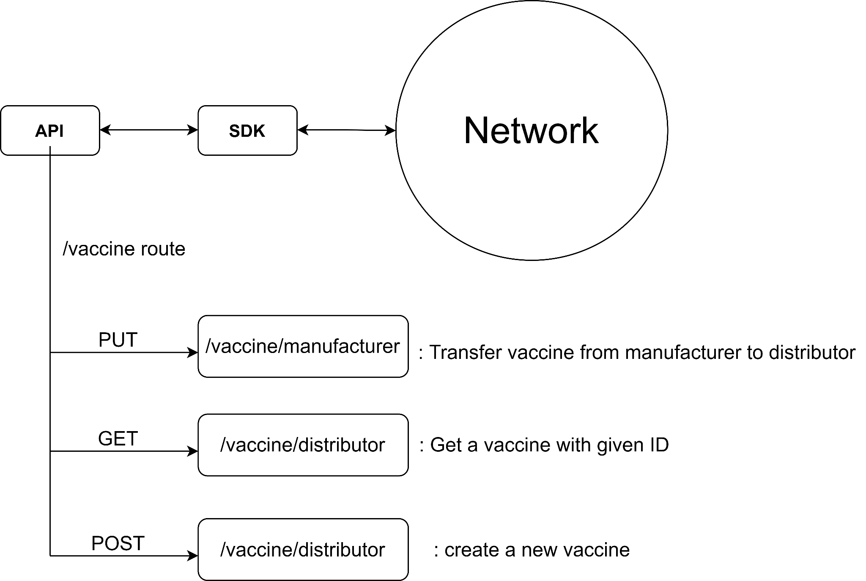
Vaccine route

Slide 12
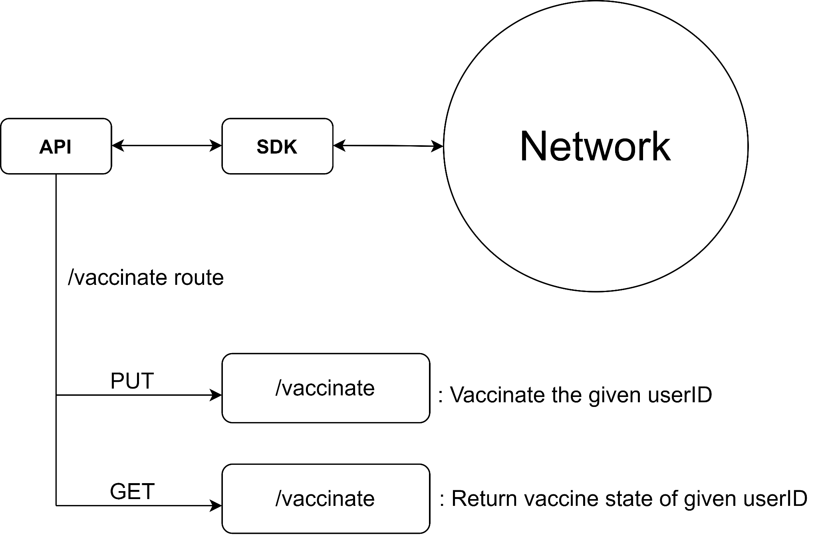
Vaccinate route

Slide 13
Next sprint plan
Task | Assignee | Description
Architecture blockchain v2.0 | Dang Khoa | Upgrade the current v1.0, adding more peers, orgs
Web-server simple interface | Minh Khoi | Apply a simple user interface by template engine
Chaincode update | Quoc Thai, Xuan Huy, Minh Huy | Overall review after testing, more chaincode functionality
APIs endpoint | Quoc Thai, Xuan Huy, Minh Huy, Minh Khoi | Testing done endpoint, adding more endpoint
User authentication feature | Nhut Anh | Need more discussion
Notes:
Chaincode update, overall review after testing to see if there are any function to be changed before adding more functionality to the chaincode

Slide 14
Conclusion
Pros:
Overall, all of the deadlines are met and features are acquired , Lion’s making a good progress.
Chaincode is done sooner than expected, moving to apply web-server interface layer over the blockchain network.
The approach to quickly build the product first, then moving on by adding or extending the current features.
Cons:
Trouble with time management in term of meetings, don’t have enough time to consider problems thoughtfully → try different approaches for meetings
Many problems has arised with Hyperledger Fabric network configuration → current Lion’s network is working, but no chaincode deployed yet

