Slide 1
Sprint 02
Report sprint_02 and planning next sprint
Team Lion
Nguyen Dang Khoa - Leader
Ngo Quoc Thai
Pham Minh Huy
Ha Xuan Huy
Vo Thanh Minh Khoi
Huynh Nhut Anh

Slide 2
Week 2: Building prototype
Final network architecture
Finalize the network architecture, should not be changed in the following week
Smart contract
Create basic queries such as get all, get specific, update, create
Web-server integration
Create CRUD for handle request from clients
User-interface for all of the roles
Ledger Deployment with Network
Network should be able to deploy with ledgers
Queries can be invoked successfully by peers
Notes:
Before moving on any technical details, let me briefly describe what we have done so far, as well as the architecture of the network and web-server, and finally the small demonstration with the first UI and authentication mechanism.
According to our workplan beforehand, this week is focusing on building prototype and adding more feature to the application

Slide 3
Previous sprint plan
Task | Assignee | Description
Architecture blockchain v2.0 | Dang Khoa, Minh Huy | Done, no error until now
Web-server simple interface | Minh Khoi, Dang Khoa | 20%, only web-server interface for manufacturer
Chaincode update | Quoc Thai, Xuan Huy, Minh Huy | Done, but buggy, should apply more testing
APIs endpoint | Quoc Thai, Xuan Huy, Minh Huy, Minh Khoi | Done
User authentication feature | Nhut Anh, Dang Khoa | All logics are done, but only apply for manufacturer

Slide 4
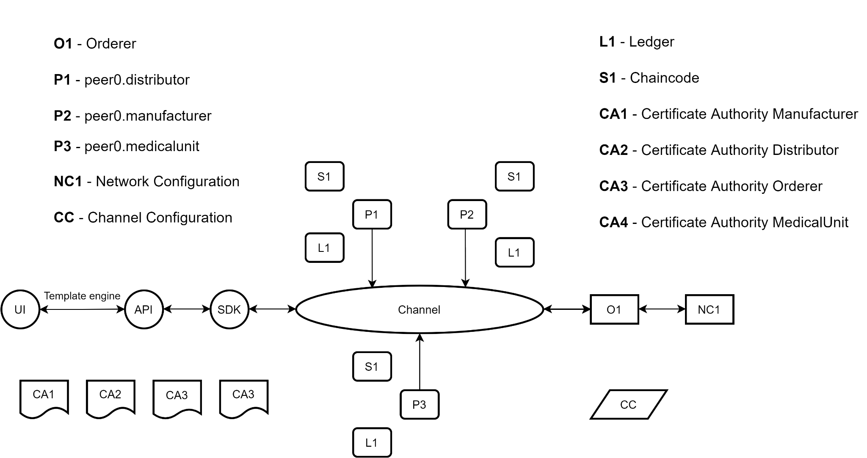
Architecture Network

Slide 5
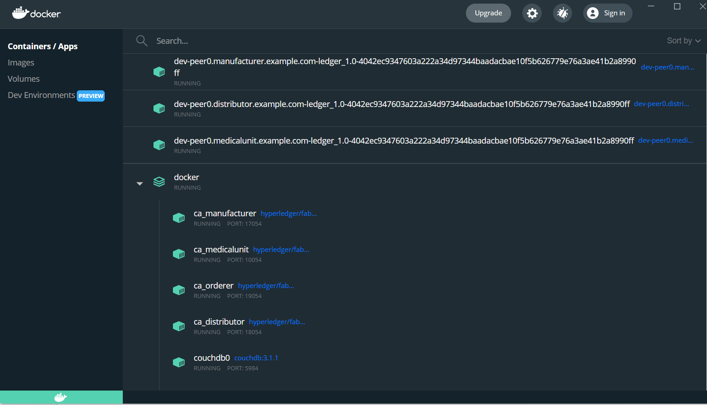

Slide 6
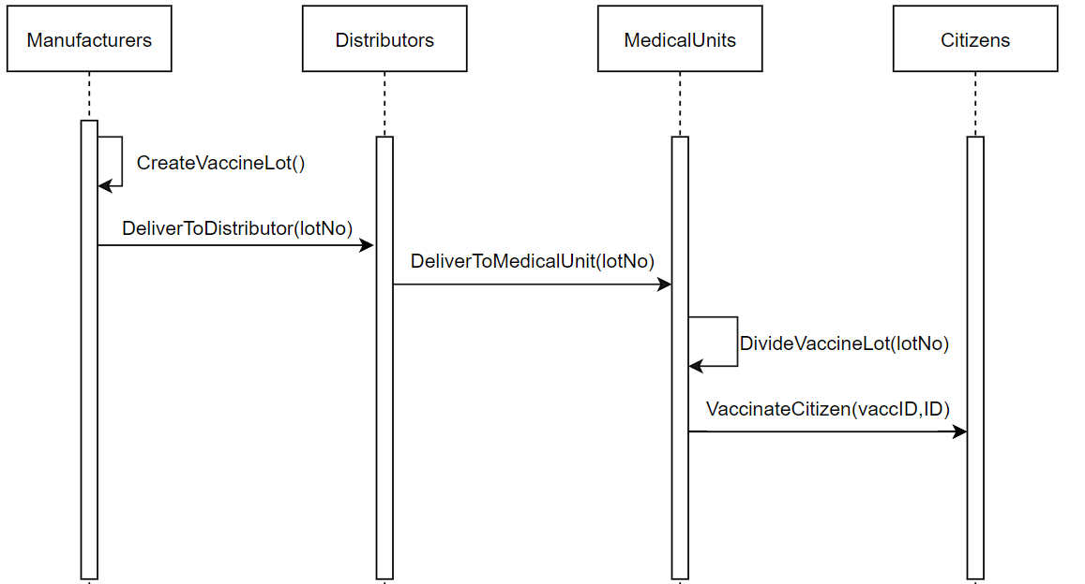
Flow of transactions

Slide 7
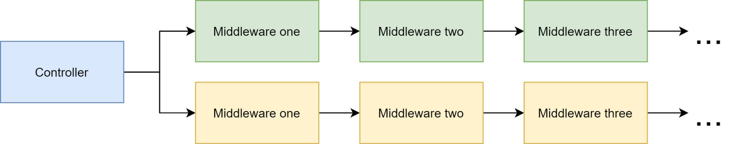
Server architecture
Each controller holds chain of middlewares
Separate business logic into piece of middlewares
→ Clean web-server architecture, interchangeable logic business

Slide 8
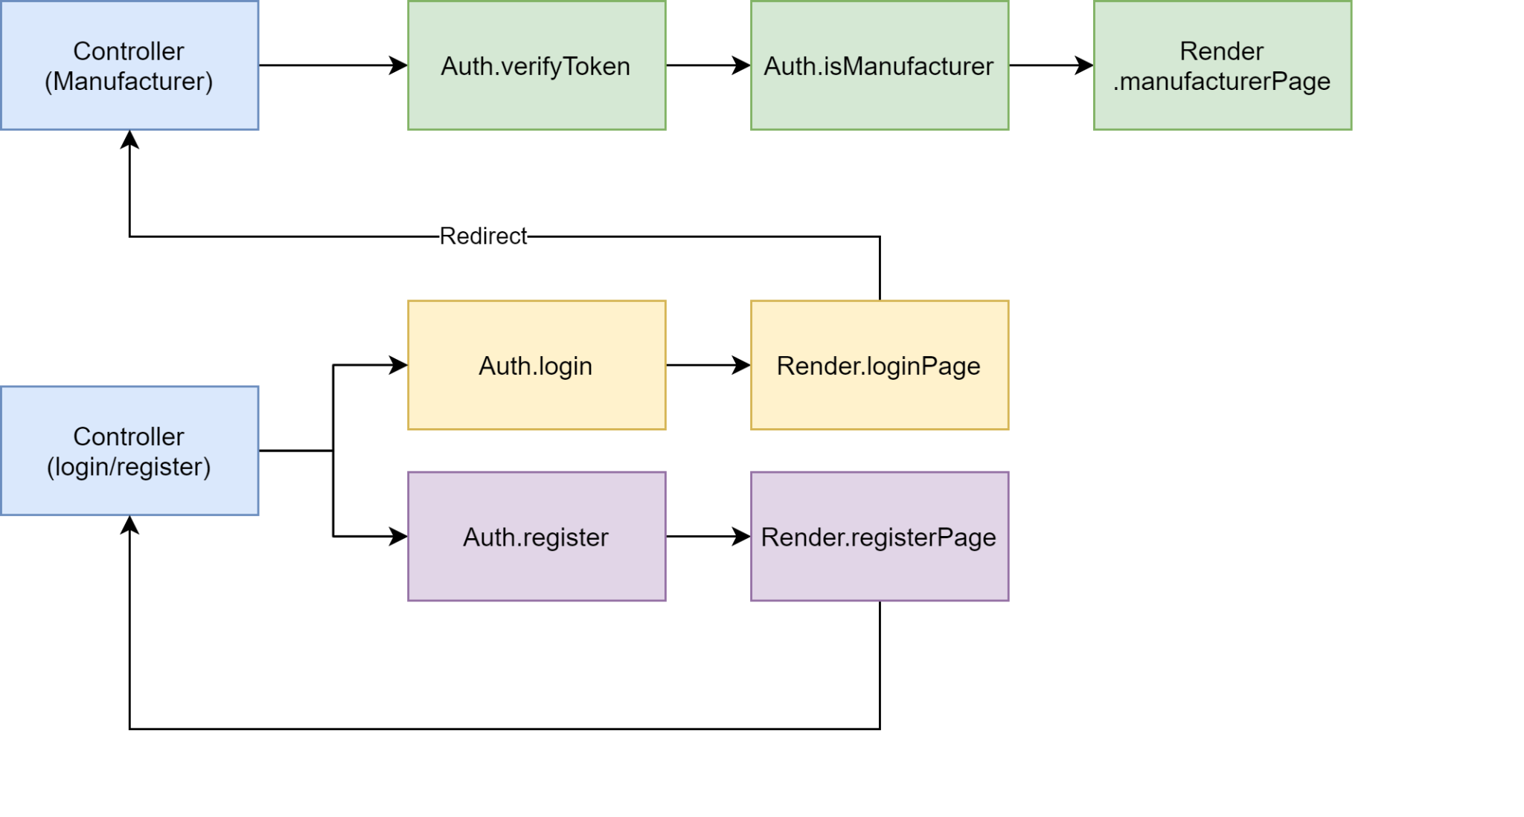
Authentication logic

Slide 9
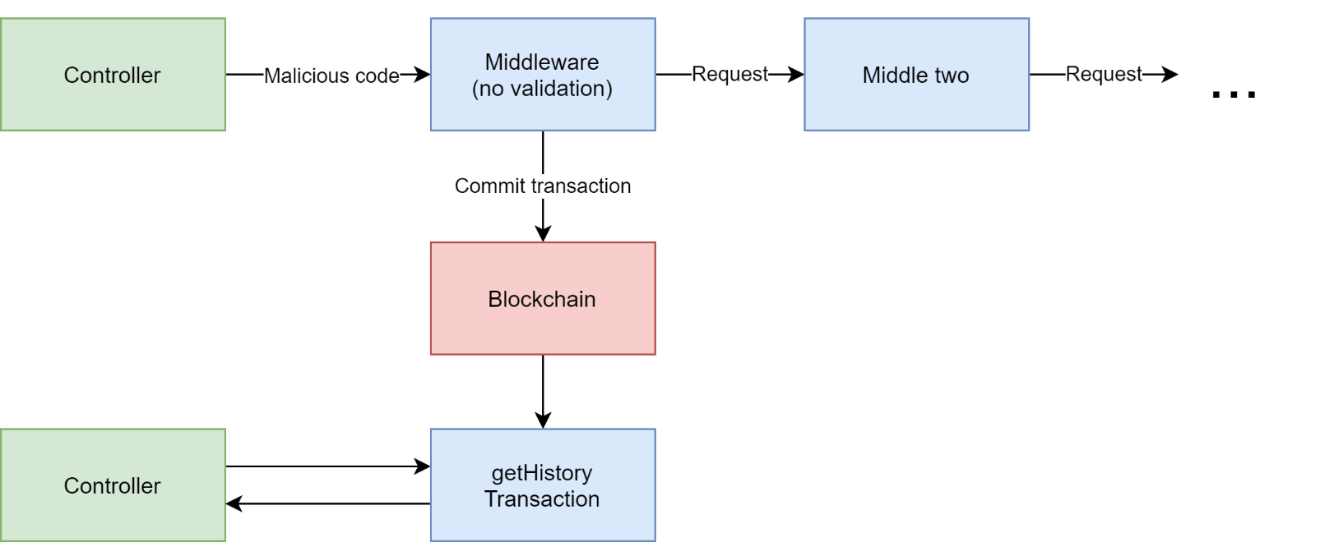
Vulnerability
Potentially harms to blockchain, since it’s immutable
It’s important to validate data type before commit to blockchain

Slide 10
New database schema
[
{
vaccineLot:'test01' ,
vaccineManufacturer: 'org1',
vaccineName: 'astra',
vaccineQuantity:'3',
dateOfManufacturer: '12/10/2021'
},
{
vaccineLot:'test02' ,
vaccineManufacturer: 'org2',
vaccineName: 'mordena',
vaccineQuantity:'5',
dateOfManufacturer: '13/10/2021'
},
{...}
]
For Manufacturer, Distributor, MedicalUnit
vaccineLot - a unique vaccine lot's number
vaccineManufacturer - vaccine's manufacturer
vaccineName - vaccine's name, stated by manufacturer
vaccineQuantity - number of vaccines available in a lot
dateOfManufacture - vaccine's date of manufacture
owner - owner of the vaccine, could either manufacturer, distributor, medical unit or citizens
For MedicalUnit
vaccineId - a unique vaccineID
vaccineManufacturer - vaccine's manufacturer
vaccineName - vaccine's name, stated by manufacturer
dateOfManufacture - vaccine's date of manufacture
owner - current owner of the vaccine, could either a medical unit or user's ID

Slide 11
Next sprint plan
Focus on testing, complete the current feature and adding more
Task | Assignee | Description
Testing chaincode | Quoc Thai, Xuan Huy, Nhut Anh | Testing and fix buggy code
Testing API endpoint | Minh Huy | Validation testing, and response checking
UI completion | Dang Khoa, Minh Khoi | Overall review after testing, more chaincode functionality
Network maintenance | Dang Khoa | Testing done endpoint, adding more endpoint

Slide 12
Conclusion
Pros:
All of the core features are implemented, Lion’s team is in good shape.
Chaincode and web-server have been done sooner than expected, working on first UI implementation
Changes plan to adapt to the requirements, showing the completion of one feature before moving on to the next ones.
Testing chaincode & API endpoint → find buggy code in early stage
Cons:
Blockchain network still unstable in the half of the second week → resolved successfully
Code quality and structure are low due to the lack of time → could be improved in the future

