Slide 1
Workplan
Blockchain web application
in Covid-19 vaccine management system
Team Lion
Nguyen Dang Khoa - Leader
Ngo Quoc Thai
Pham Minh Huy
Ha Xuan Huy
Vo Thanh Minh Khoi
Huynh Nhut Anh

Slide 2
Scenario
The need of vaccine passport to travel during Covid-19 pandemic
Vaccine passport that are issued can be forged
Transparency of vaccine information:
Amounts of vaccine doses and kinds are available for a specific local area
Information of used vaccine doses
Prevent fraud (people selling fake vaccine slot)
Vaccine dose management is crucial to coordinate between medical units and government in order for more accurate and effective countermeasure to epidemics
People cannot influence who is going to be vaccinated first just by themselves
Vaccinated information for each person must be kept confidential, cannot modify, update without proper permissions ...
Notes:
Due to covid-19 pandemic in Vietnam, the need of vaccine passport to travel within Ho Chi Minh city is crucial, however vaccine passport can be forged due to the transparency of vaccine information.
For example, citizens don’t know the amount of vaccine distribute for specific local area, information about used vaccine doses, and probably, some of the parties take advantage of this scenario to sell fake vaccine slot.
Government agencies and medical unit such as hospital, vaccinate location,... as well as the subscribers might have some trust issue. In my experience, i saw a lot of people take advantage of this scenario to vaccinate without actually register before or paying to become the

Slide 3
Introduction
Due to the immutable and decentralization nature of blockchain, we could use this technology to manage the vaccine supply chain, which decide the vaccine passport for citizens
Vaccine wholesale, vaccine transfers between vaccine provider and vaccine buyer (government, private medical unit,...)
Vaccine supply chain, management for vaccine quantity, exported lot number, doses taken by citizens by using blockchain.
Vaccine passport, citizen could be verified after taking an sufficient amount of vaccine dose. The vaccine should contain information about personal information, brand, amount of vaccine taken, date and vaccine original.
→ Lack of information about vaccine, and untrusted parties between government, medical unit, citizens could be resolved.

Slide 4
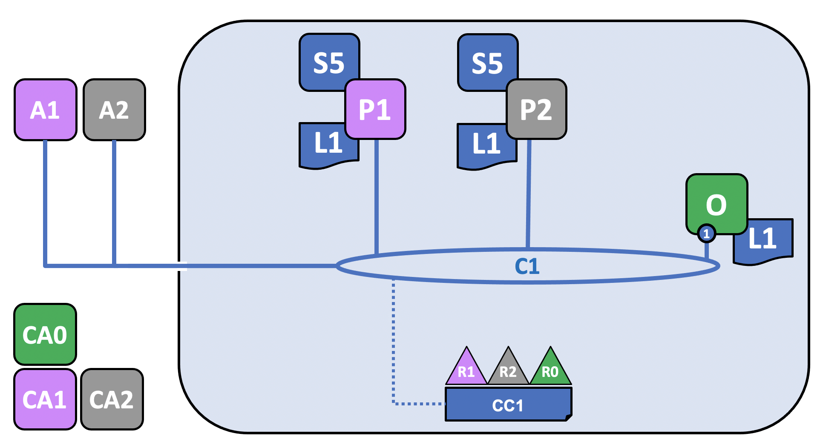
System Design
Users, who wants to take vaccine must register to the network.
Peers, acts like medical unit, vaccine providers or vaccine buyers.
Ledger holds vaccine information, quantity and vaccine registration, vaccine owner.
Application is a registration gateway, to communicate between subscribers and vaccine providers (date to take vaccine, how many doses have taken,…).
Vaccine acts as assets, which can be transferred from vaccine provider to legitimate users in the network.

Slide 5
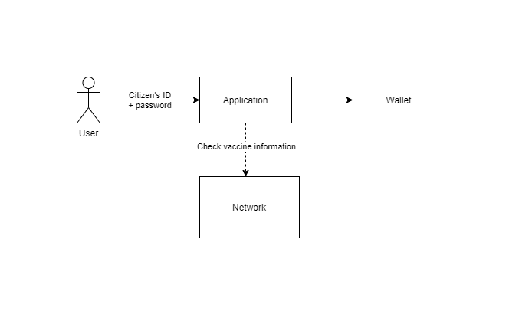
Simple workflow
Users, can register the the network, to get a unique UUID.
Application, acts as a information gateway, allowing users to check, obtains vaccine passport, but no update or create.
Wallet, holds all users’ identity
Network, where transaction committed, maintains information about vaccine assets.

Slide 6
Week 1: Knowledge preparation & setup
Identify network’s components
Identify the basis node aliases in the network (Hospital, Ministry of Health, City, etc.)
Map node aliases to nodes (ie Hospital can be a Peer, City can be Organization, Country can also be Organization on worldwide deployment)
Express JS
Understand how to use Express JS to an acceptable extend
Able to run a simple CRUD server
Understand the concept of route, middleware, request and response.
Hyperledger Fabric network deployment
The network should be able to connect nodes and fulfill elementary tasks(extending - more peer, more organizations,etc) at least on the command prompt (using dummy, basic ledgers)

Slide 7
Week 2: Building prototype
Forming basis of ledger
Create an objective-corresponding ledger format
Smart contract
Create basic queries such as get all, get specific, update, create
Web-server integration
Create CRUD for handle request from clients
Ledger Deployment with Network
Network should be able to deploy with ledgers
Queries can be invoked successfully by peers

Slide 8
Week 3: Testing & UI
Testing section
Extensive network testing
API endpoint testing
Possible future features, vulnerabilities of first prototype
Create User Interface (if possible)
Create interface for users as webpage?
Allow users to check which kind of vaccine, including information about lot number that they were injected (if any)
Prepare for final presentation and demo

Slide 9
Week 4 + 5: Finalization steps
Focus on:
Writing the documentation.
Finalize the system, structuring code.
Analyze advantages and disadvantages overall of the system.

Slide 10
Communication & documentation
Communication channels are Slack and Google Meet
Version control system for code sharing: Github
Project planning schedule and description: Github’s project service

Slide 11
Conclusion
Leverage the immutable and decentralized features of blockchain into building web application for protecting data authenticity of Covid-19 vaccination management system
Blockchain technology is covered under web application to provide a easy approach for developers and users to interact with

Slide 12
Week 1 backlog
Task | Estimated effort | Assignee
Research ExpressJS CRUD server | 5 hours | Minh Huy, Xuan Huy, Nhut Anh, Minh Khoi
Research Hyperledger Fabric network | 10 hours | Whole team
Vaccine blockchain network implementation | 10 hours | Whole team
Code structure | 10 hours | Quoc Thai, Dang Khoa

Slide 13
Research ExpressJS library
Description
Able to build a simple CRUD application.
Architecture of the whole application, folder structure.
Deadlines: Friday, 08/10/2021
Task type: long-term
Critical level: medium

Slide 14
Research Hyperledger Fabric
Description
Deep dive and understand network’s components, communication protocols.
Successfully setup and deploy simple blockchain network.
Deadlines: Friday, 08/10/2021
Task type: long-term
Critical level: medium

Slide 15
Vaccine network implementation
Description
Identify the components in blockchain, which one equivalent to real scenario.
General system workflow, how vaccine transfer, how users register to network.
Database schema design, efficiency stores vaccine information.
A simple implementation version of the network must be deployed during this sprint
Deadlines: Wednesday, 06/10/2021
Task type: long-term
Critical level: medium

Slide 16
Code structure
Description
Able to build a simple CRUD application.
Architecture of the whole application, folder structure.
Deadlines: Tuesday, 05/10/2021
Task type: short-term
Critical level: medium

