Slide 1

Predicting the direction of stock market prices using random forest
Authors Luckyson Khaidem , Snehanshu Saha , Sudeepa Roy Dey
Instructor : TS. Nguyễn Chí Thiện
Presenter : Võ Đăng Khoa -186005032
Nguyễn Vũ Khoa - 51503245

Slide 2
OVERVIEW
1. Yuqing Dai, Yuning Zhang (2013). Machine Learning in Stock Price Trend Forecasting. Stanford University.
=> Accuracy results ranging from 44.52% to 58.2% (next day)
2. Haoming Li, Zhijun Yang and Tianlun Li (2014). Algorithmic Trading Strategy Based On Massive Data Mining (Stanford University)
=> Success rate of 55.65%
3. Xinjie (2014). Stock Trend Prediction With Technical Indicators using SVM. Stanford University
=> The highest accuracy of 79.3%

Slide 3

Data Collection
Methodology and Analysis
Exponential Smoothing
Feature Extraction
Where d is the number of days after which the prediction is to be made
Ensemble Learning
Target = +1 => positive shift in the price after d days
Target = -1 => negative shift in the price after d days
Stock Market Prediction

Slide 4
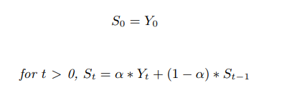
Exponential Smoothing
The exponentially smoothed statistic of a series Y can be recursively calculated as:
where α is the smoothing factor and 0 < α < 1

Slide 5
Feature Extraction
Relative Strength Index
Average Gain Over past 14 days
RS =
RSI > 70 : the stock is overbought
Average Loss Over past 14 days
100
RSI < 30: the stock is oversold
RSI = 100 −
1 + RS

Slide 6
Feature Extraction
2. Stochastic Oscillator
(C − L14)
%K = 100 ∗
Measures the level of the closing price relative to low-high range over a period of time
(H14 − L14)
Where :
C = Current Closing Price
L14 = Lowest Low over the past 14 days
H14 = Highest High over the past 14 days

Slide 7
Feature Extraction
3. Williams %R
(H14 − C)
Williams %R > -20 : sell signal
%R =
∗ −100
(H14 − L14)
Williams %R < -80 : buy signal
Where :
C = Current Closing Price
L14 = Lowest Low over the past 14 days
H14 = Highest High over the past 14 days

Slide 8
Feature Extraction
4. Moving Average Convergence Divergence (MACD)
MACD = EMA₁₂(C) − EMA₂₆(C)
MACD below SingalLine -> sell signal
SignalLine = EMA₉(MACD)
MACD above SingalLine -> buy signal
Where :
EMA stands for Exponential Moving Average
MACD = Moving Average Convergence Divergence
C = Closing Price series
EMA_{n} = n day Exponential Moving Average

Slide 9
Feature Extraction
5. Price Rate of Change
C(t) − C(t − n)
PROC(t) =
C(t − n)
Measures the most recent change in price with respect to the price in n days ago
Where
PROC(t) = Price Rate of Change at time t
C(t) = Closing price at time t

Slide 10
Feature Extraction
6. On Balance Volume
OBV (t − 1) + Vol(t) if C(t) > C(t − 1)
OBV (t) =
OBV (t − 1) − Vol(t) if C(t) < C(t − 1)
OBV (t − 1) if C(t) = C(t − 1)
Where
OBV(t) = On Balance Volume at time t
Vol(t) = Trading Volume at time t
C(t) = Closing price at time t

Slide 11
Key Definitions
Definition 1:We define a classification tree where each node is endowed with a binary decision if xi <= k or not ; where k is some threshold. The topmost node in the classification tree contains all the data points and the set of data is subdivided among the children of each node as defined by the classification. The process of subdivision continues until every node below has data belonging to one class only. Each node is characterized by the feature, xi and threshold k chosen in such a way that minimizes diversity among the children nodes. This is often referred as gini impurity.
Definition 2: X = (X1, ..., Xd) is an array of random variables defined on probability space called as random vectors. The joint distribution of X1, ..., Xd is a measure on µ on Rd, µ(A) = P(X ∈ A), A ∈ Rd where d = 1, ...., m. For example, Let x = (xi, ...., xd) be an array of data points. Each feature xi is defined as a random variable with some distribution. Then the random vector X has joint distribution identical to the data points, x.
Definition 3: Let us represent hk(x) = h(x|θk) implying decision tree k leading to a classifier hk(x). Thus, a random forest is a classifier based on a family of classifiers h(x|θ1), ...., h(x|θk), built on a classification tree with model parameters θk randomly chosen from model random vectorθ. Each classifier, hk(x) = h(x|θk) is a predictor of the number of training samples. y =+− 1 is the outcome associated with input data, x for the final classification function, f(x). Next, we describe the working of the Random Forest learner by exploiting the key concepts defined above.

Slide 12
RANDOM FOREST
-> Decision trees can be used for various machine learning applications
-> Trees that are grown really deep to learn highly irregular patterns tend to overfit the training sets
- > A slight noise in the data may cause the tree to grow in a completely different manner =>Decision trees have very low bias and high variance

Slide 13


RANDOM FOREST
Gini impurity = > measure the quality of split in each node
Shannon Entropy => measure the unpredictability in the information contained in a particular node of a tree

Slide 14
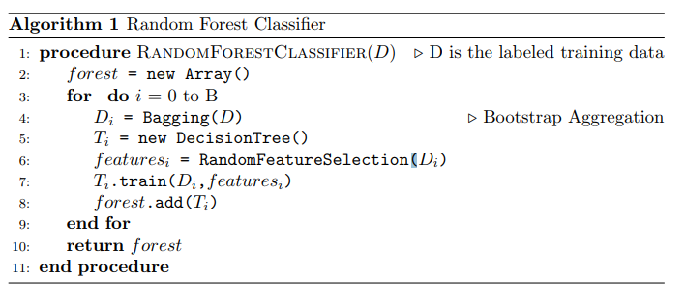
RANDOM FOREST PSEUDOCODE

Slide 15
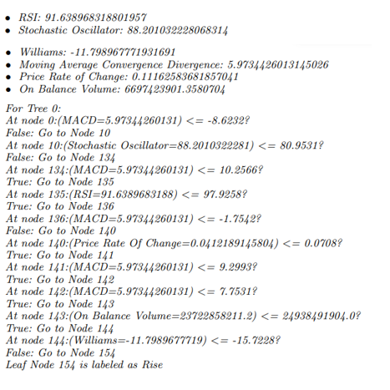
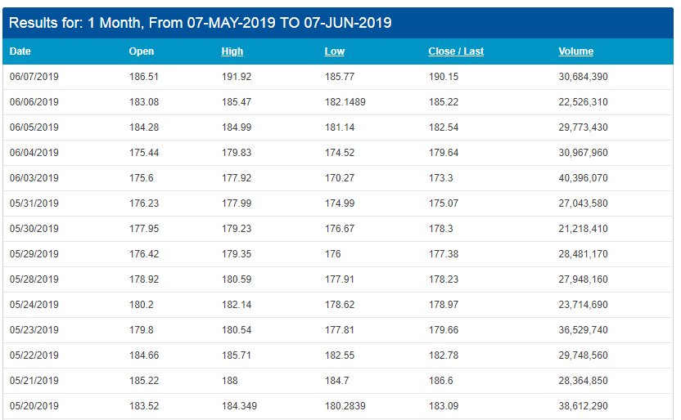
Tracing the RF algorithm

Slide 16
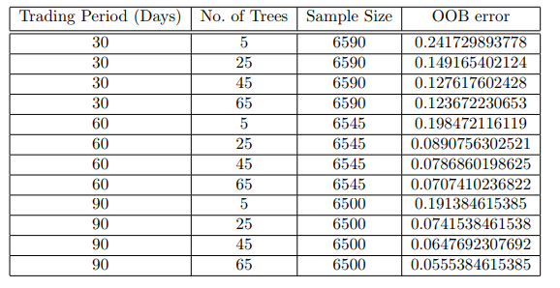
Tracing the RF algorithm

Slide 17

OOB error and Convergence of the Random Forest
The proof can be found in appendix I in Breiman (2001). To practically prove this theorem with respect to our dataset, the generalization error is estimated using out of bags estimates Bylander and Hanzlik (1999). The out of Bag (OOB) error measures the prediction error of Random forests algorithm and other machine learning algorithms which are based on Bootstrap aggregation. Note: The average margin of the ensemble of classifiers is the extent to which the average vote count for the correct class flag exceeds the count for the next best class flag.

Slide 18
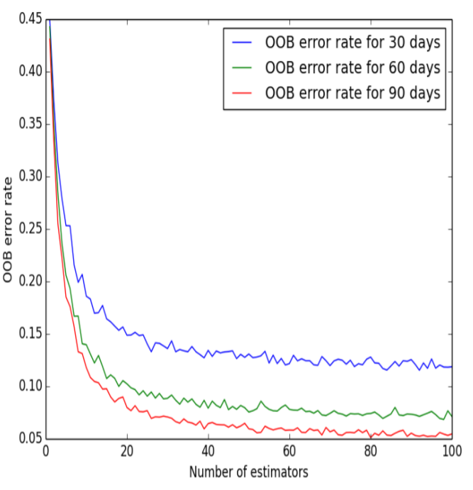
OOB error visualization
From the above plot, we can see that the OOB error rate decreases dramatically as more number of trees are added in the forest. However, a limiting value of the OOB error rate is reached eventually. The plot shows that the Random Forest converges as more number of trees are added in the forest. This result also explains why random forests do not overfit as more number of trees are added into the ensemble.

Slide 19
Results paper
tp
tp + tn
Accuracy =
Precision =
tp + tn + f p + fn
tp + f p
tp
tn
Recall =
Specificity =
tp + fn
tn + f p
Where :
tp = Number of true positive values
tn = Number of true negative values
fp = Number of false positive values
fn = Number of false negative values

Slide 20
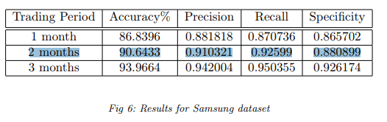
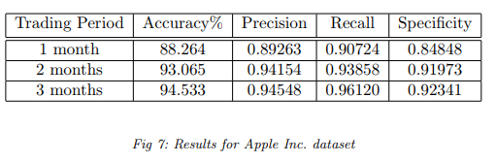
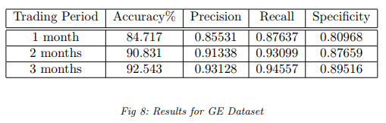
Results

Slide 21
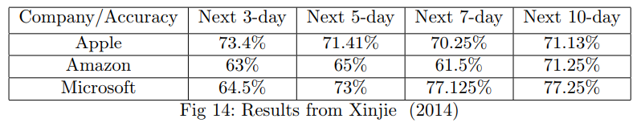
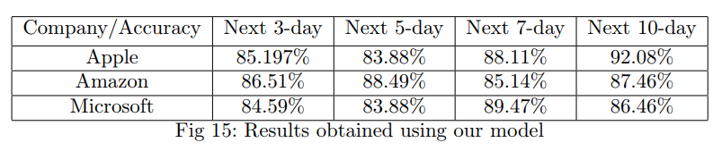
Results paper
Using the same dataset as in Dai and Zhang (2013)
-> the accuracy peaked at 96.92%

Slide 22
DEMO
A. DATA
Download data stock market Apple https://www.nasdaq.com/symbol/aapl/historical
From 11-JUNE-2018 TO 11-JUNE-2019
B. Environment setting and package required
Python version 3.5.1
Package required : pandas , numpy , sklearn , matplotlib

Slide 23
References
1. https://github.com/jmartinezheras/reproduce-stock-market-direction-random-forests
2. https://github.com/bukosabino/ta?fbclid=IwAR0fNa-pIaLcmaTQ8oCgKJkK3rJLpjej3xZkHzy-katKtu_-IlrHi8nrJx4
3. https://technical-analysis-library-in-python.readthedocs.io/en/latest/
https://www.quantopian.com/posts/technical-analysis-indicators-without-talib-code?fbclid=IwAR17dLC1DRFPFQNndMFQiDXO-ONXtpD7yJKyi-FRhVzComw-ROqs7kWEc6s

Slide 24
Thank you

