Slide 1



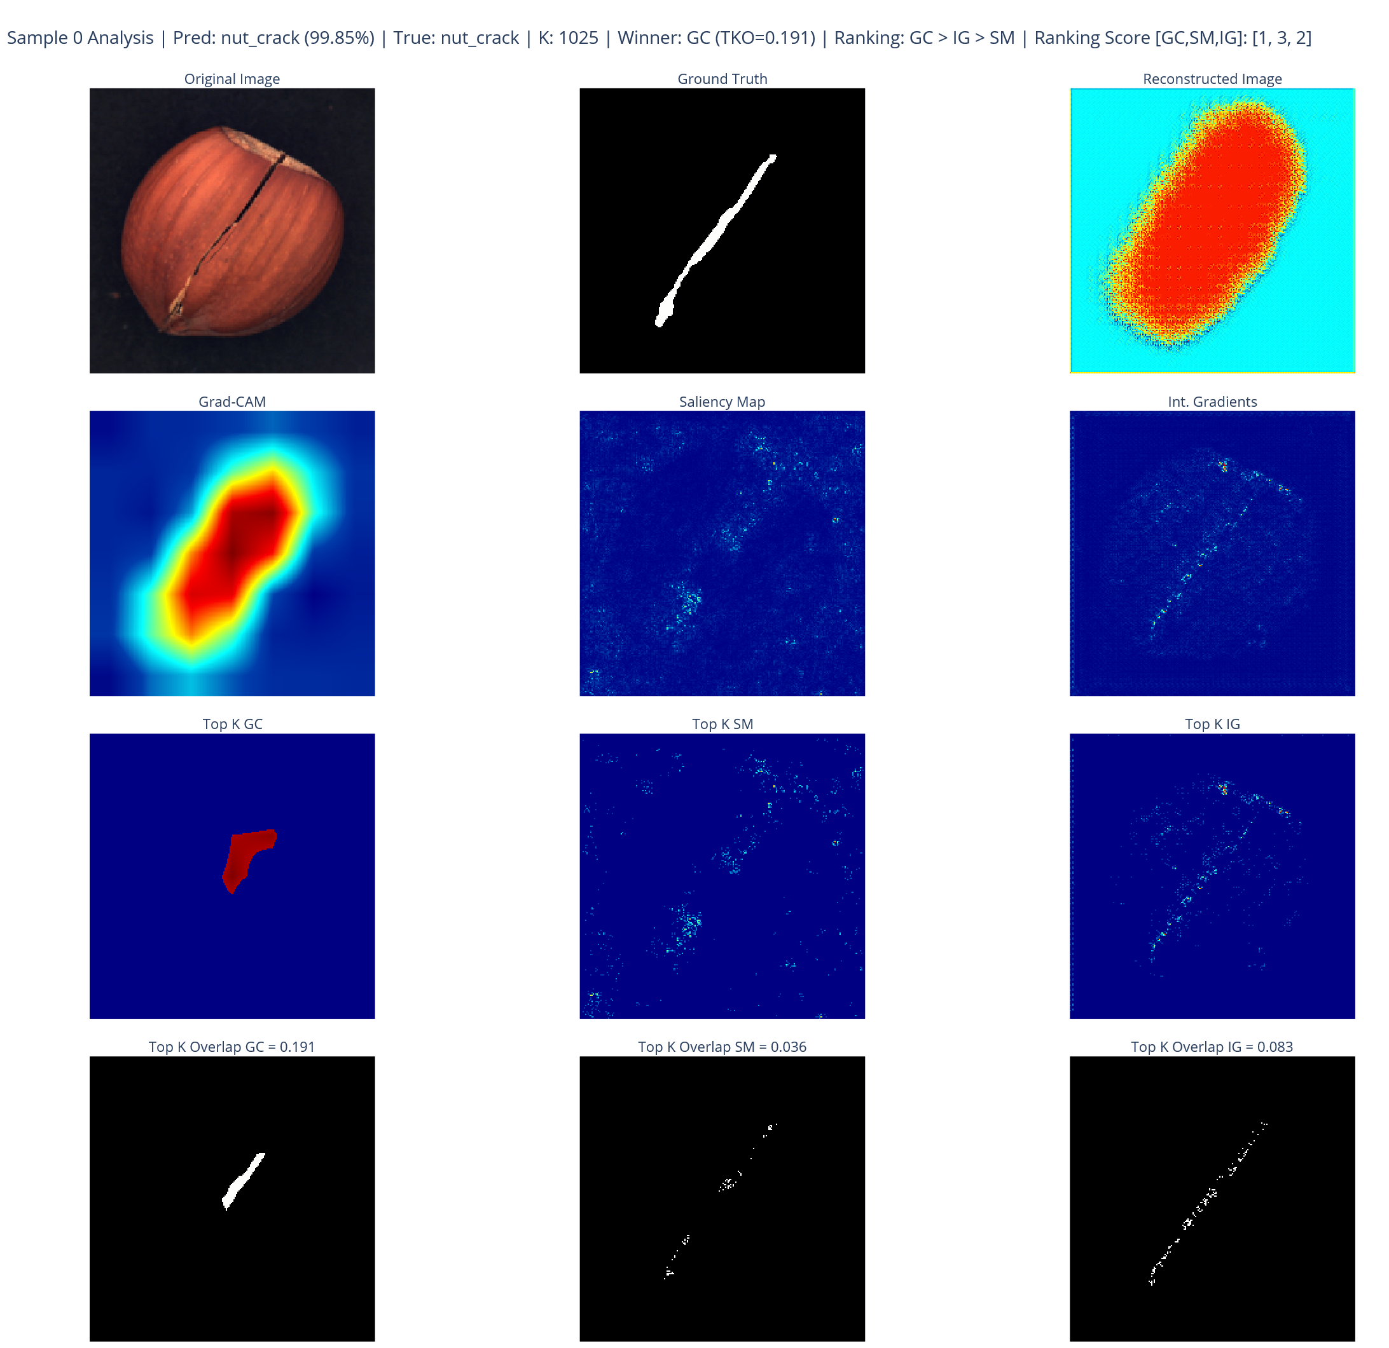
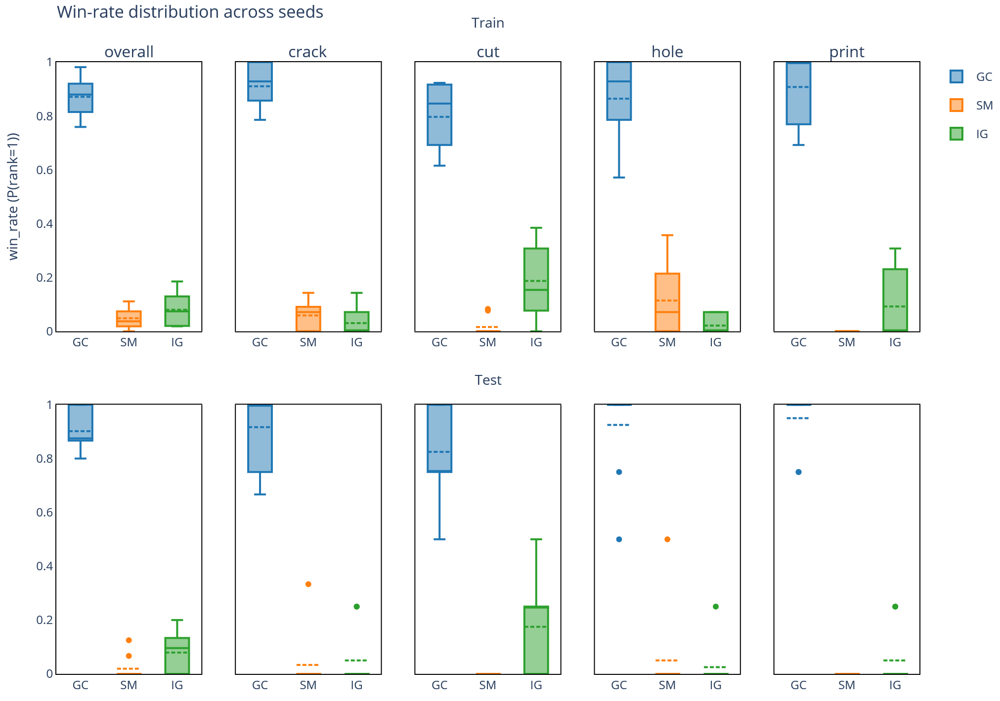
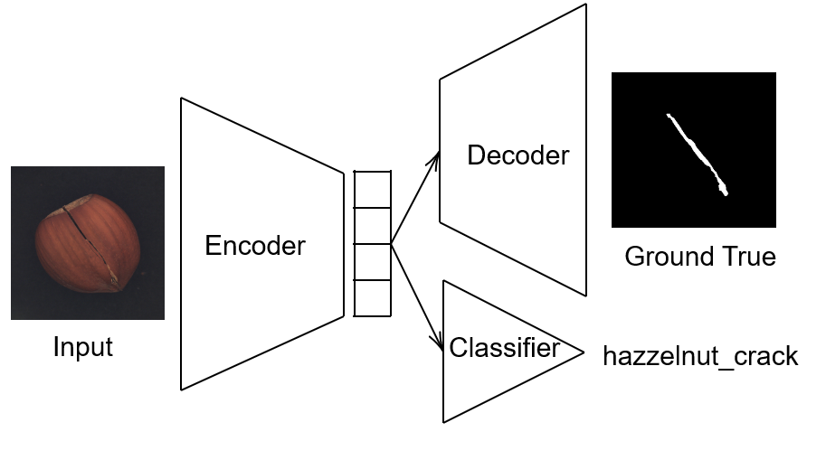
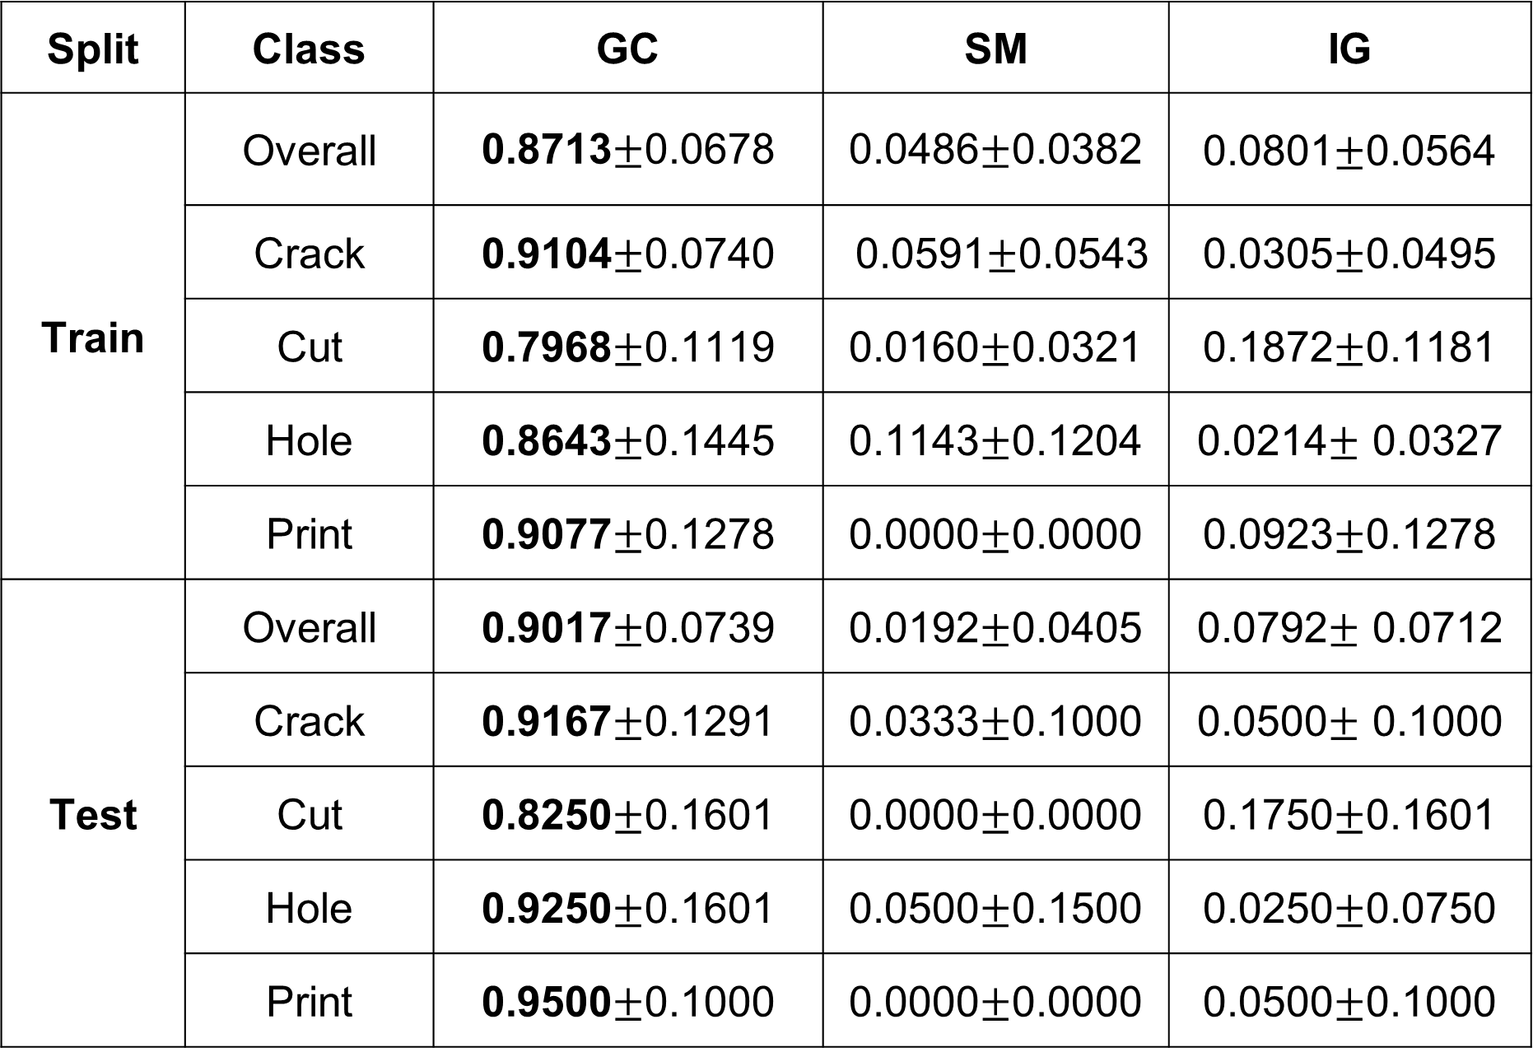
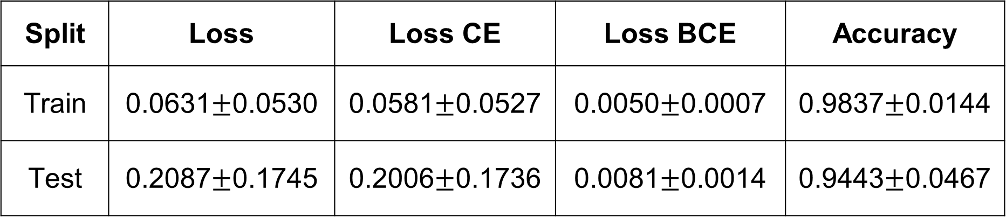

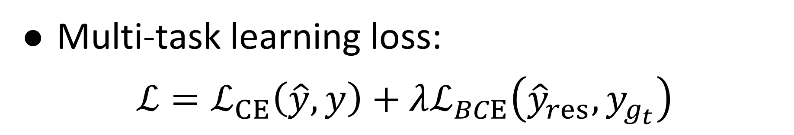
Ranking Explainable AI Methods Using Pixel-Level Evidence in Classification Tasks
Anh Khoa Pham – vibe_coding_scientist
Motivation
Top-K Overlap Evaluation
1
5
1
Introduce XAI methods for Deep Learning
Quantitatively compare Grad-CAM, Saliency Maps, and Integrated Gradients using a Top-K overlap metric
Identify the most suitable and faithful explanation method for image classification tasks with pixel-level ground truth
Set K as the number of positive pixels in the ground-truth mask
Select the Top-K highest-scoring pixels from each explanation map
Compute the overlap between selected pixels and the ground-truth region
Higher overlap indicates more faithful explanations
Motivation
Motivation 1 [Lastname et al. 2020]
Motivation 2
2
XAI Methods
2
Saliency Maps: ${SM}_{c}^{\left(i,j\right)}\left(x\right)=\max_{k∈\left\{1,…,C\right\}}\left|\frac{∂f_{c}\left(x\right)}{∂_{x_{j,j,k}}}\right|$
Integrated Gradients:
$$IG_{C}\left(x\right)=\left(x−x^{′}\right)⊙\int_{α}^{1}{\frac{∂f_{C}\left(x^{′}+α\left(x−x^{′}\right)\right)}{∂x}ⅆα}$$
Grad-CAM:
$$α_{k}^{C}=\frac{1}{z} \sum_{i}{\sum_{j}{\frac{∂f_{C}}{∂A_{ij}^{k}}}}$$
$$GC_{C}\left(x\right)=\operatorname{Re}{LU\left(\sum{α_{k}^{C}A^{k}}\right)}$$
Dataset
Win-Rate
Discussion
3
6
7
Subset of the MVTec AD dataset, focusing exclusively on hazelnut images
Each sample includes an input image, a pixel-level ground-truth annotation, and an image-level defect label
Five classes are considered: crack, cut, good, hole, and print
Primary task: image classification
Win-rate of each XAI method on the train and test splits, computed over the entire dataset and per class.
Conclusion:
GC consistently performs best across all classes and the full dataset.
GC produces smoother, less noisy explanations for CNN-based image classification by focusing on high-level semantic information.
Selecting the appropriate XAI method is task- and data-dependent.
2
Training Pipeline
4
Win-rate of XAI methods averaged 10 seeds
Split | Class | GC | SM | IG
Train | Overall | 0.8713$±$0.0678 | 0.0486$±$0.0382 | 0.0801$±$0.0564
 | Crack | 0.9104$±$0.0740 | 0.0591$±$0.0543 | 0.0305$±$0.0495
 | Cut | 0.7968$±$0.1119 | 0.0160$±$0.0321 | 0.1872$±$0.1181
 | Hole | 0.8643$±$0.1445 | 0.1143$±$0.1204 | 0.0214$±$ 0.0327
 | Print | 0.9077$±$0.1278 | 0.0000$±$0.0000 | 0.0923$±$0.1278
Test | Overall | 0.9017$±$0.0739 | 0.0192$±$0.0405 | 0.0792$±$ 0.0712
 | Crack | 0.9167$±$0.1291 | 0.0333$±$0.1000 | 0.0500$±$ 0.1000
 | Cut | 0.8250$±$0.1601 | 0.0000$±$0.0000 | 0.1750$±$0.1601
 | Hole | 0.9250$±$0.1601 | 0.0500$±$0.1500 | 0.0250$±$0.0750
 | Print | 0.9500$±$0.1000 | 0.0000$±$0.0000 | 0.0500$±$0.1000
Limitations
GC is limited to CNN-based image models.
Multi-task learning loss:
$$ℒ=ℒ_{CE}\left(\hat{y},y\right)+λℒ_{BCE}\left({\hat{y}}_{res},y_{g_{t}}\right)$$
Performance of the model averaged 10 seeds
Future Work
Apply GC to video-based tasks, such as object detection.
Split | Loss | Loss CE | Loss BCE | Accuracy
Train | 0.0631$±$0.0530 | 0.0581$±$0.0527 | 0.0050$±$0.0007 | 0.9837$±$0.0144
Test | 0.2087$±$0.1745 | 0.2006$±$0.1736 | 0.0081$±$0.0014 | 0.9443$±$0.0467

