Slide 1




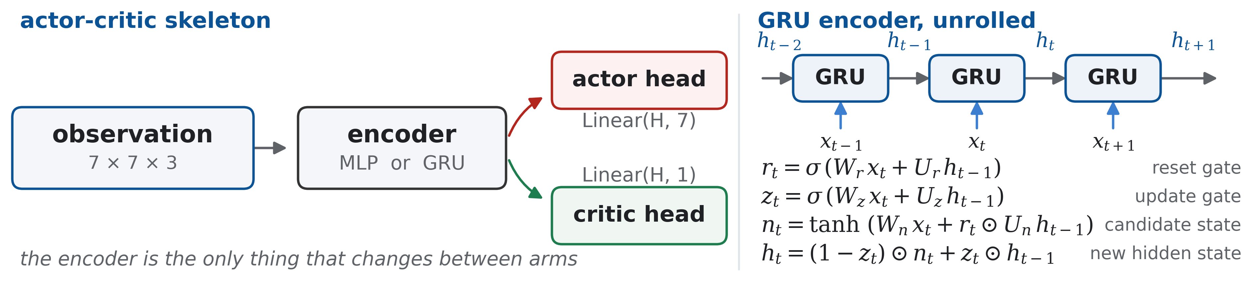
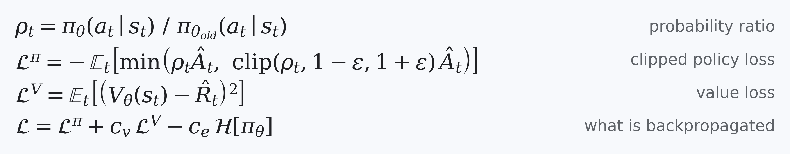
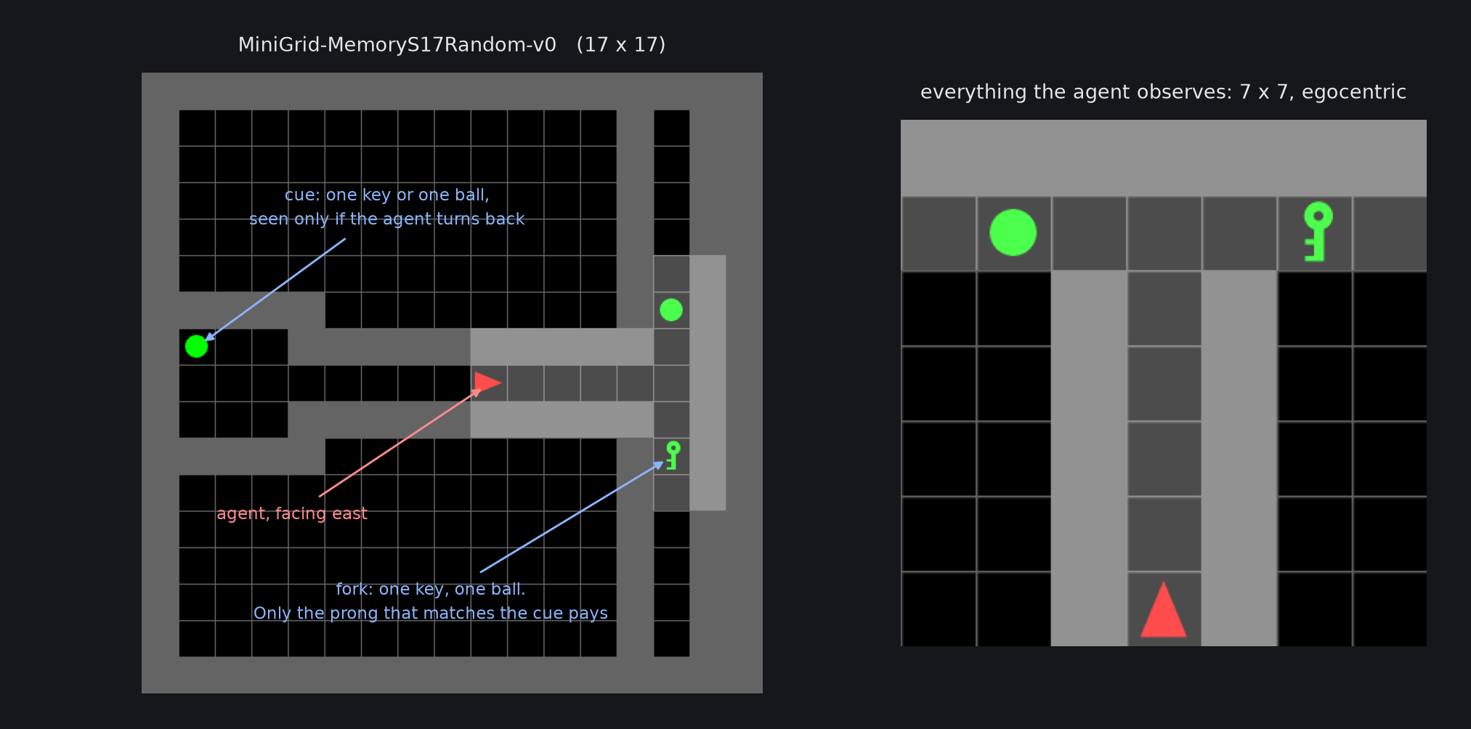
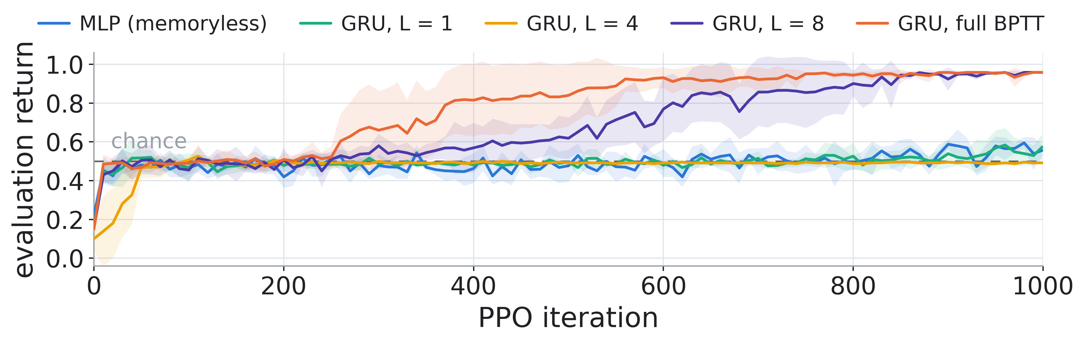
Memory Reach: GRU vs MLP under PPO on MiniGrid Memory
Anh Khoa Pham
Code, studies and
winning checkpoints
1
Motivation
3
Approach
• POMDP: only a 7 × 7 view is seen
• Memory must live in a state h
• Full BPTT costs memory ∝ length
• Truncation cuts gradients to L
Network
Core question: how far back must the gradient reach, and what does that reach cost?
PPO objective
250 runs · ≈ 250 GPU-hours · RTX 3060 12 GB · 16 CPUs
2
Problem Setting
The environment
• MiniGrid-MemoryS17Random-v0
• Cue (key or ball) in the west room
• Agent spawns facing away from it
• T-junction at the far east end
• Only the matching prong pays
• Reward 1 − 0.9 · steps / max_steps
Hyperparameter Optimization
• Surrogate model: Optuna TPE sampler, seeded at 42
• Budget: 50 trials per arm × 5 arms = 250 training runs
• Seeds per trial: 5, each 1000 iterations
• Objective: mean − std of return over the 5 seeds
The two encoders
4
Results
• MLP: linear layers with ReLU, memory less
• GRU: carries h, with memory
arm
return
success rate
steps
minibatch
time
MLP (memoryless)
0.556 ± 0.029
0.592 ± 0.027
24.3 ± 2.3
1024
1.3 h
GRU, L = 1
0.573 ± 0.064
0.588 ± 0.068
9.8 ± 4.1
4096
2.6 h
GRU, L = 4
0.492 ± 0.001
0.500 ± 0.000
7.0 ± 0.0
4096
1.6 h
GRU, L = 8
0.958 ± 0.004
1.000 ± 0.000
16.8 ± 1.4
4096
2.0 h
GRU, full BPTT
0.958 ± 0.002
1.000 ± 0.000
16.8 ± 0.9
512
1.3 h
Winning trial per study; mean ± std across the five seeds.
Left: the maze. Right: everything the agent sees.
5
Key Insights
1
Carrying h forward is not what matters.
Every GRU arm does it; only the reach of the gradient differs.
6
Limitations & Future Work
2
What matters is the cue→decision gap.
Not the episode length. ≤ 8 steps in 62 % of mazes, ≤ 4 in 0%.
• One task, one architecture, one algorithm
• GRU is slow: the recurrence runs step by step
• Next: LSTM for a bigger environment
• Next: transformer for a faster training time
3
The reach costs memory, not time.
Full BPTT is the fastest GRU arm (1.3 h); it pays in VRAM.
Recommendation. Full BPTT; L = 8 on a smaller GPU.
References. Hausknecht & Stone 2015 · Kapturowski et al. 2019 (R2D2) · Ni et al. 2022 · Schulman et al. 2017 (PPO) · Chevalier-Boisvert et al. 2023 (MiniGrid)

