Slide 1

JAVASCRIPT
truongconghieuptit@gmail.com

Slide 2
What is Javascript?
Javascript is a scripting or programming language, that is supported in almost all browsers such as Firefox, Chrome,…
It can be written right in a web page’s HTML and run automatically as the page loads.
Allows developer to implement complex features on web pages.

Slide 3
HTML
CSS
JavaScript

Slide 4
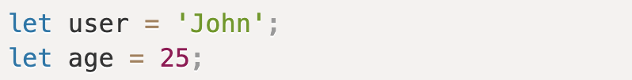
Variables
A variable is a “named storage” for data. To create a variable in Javascript, use the syntax:
<keyword (var/let/const)> <name> = <data>

Slide 5
Data types
Typed value not typed variable.
Primitive types: String, Number, Boolean (logical type)
Special types: Undefined, Null
Reference types : Array, Object, Function

Slide 6
Data types
Array
Syntax: <keyword> <name>= [element1, element2, element3]
Terms: element, index, length.
Read and change element of Array by arrayName[index]

Slide 7
Data types
Object
Syntax: <keyword> <name> = { key: value }
Read and change value of Object by objName[‘key’] or objName.key

Slide 8
Comparisons
=== : compare value and data type
== : compare value

Slide 9
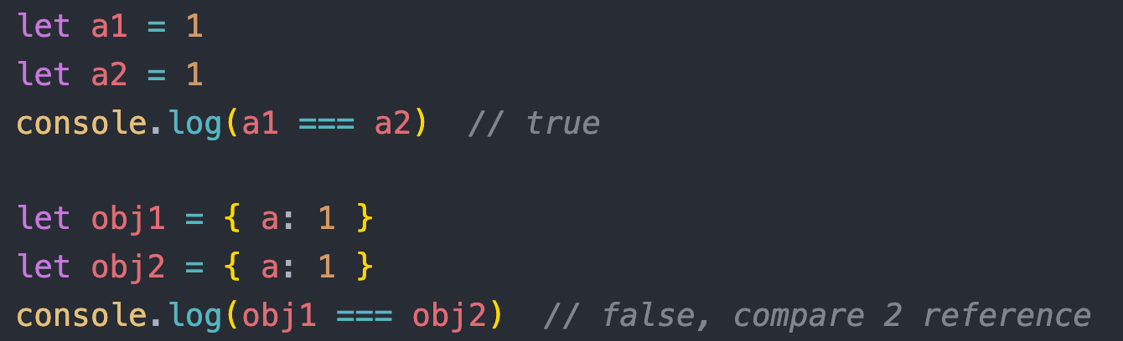
Example 1

Slide 10
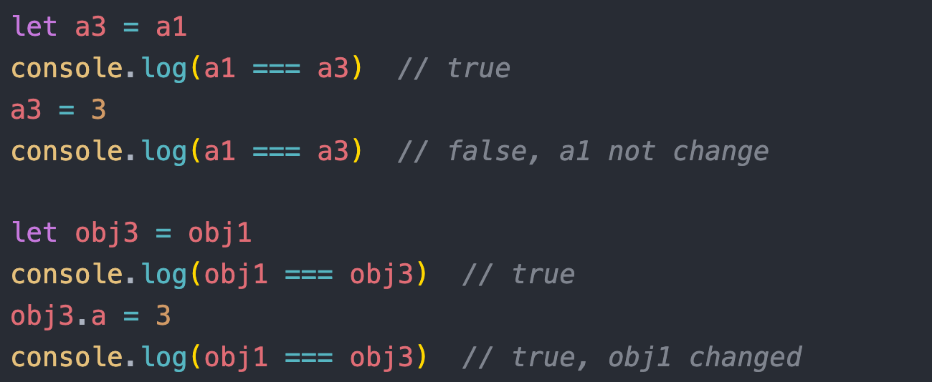
Example 2

Slide 11
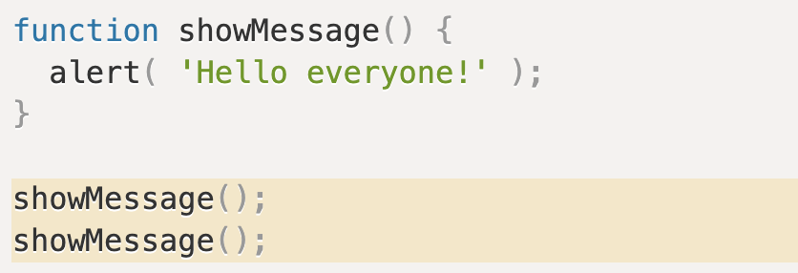

Function
Functions are the main “building blocks” of the program. They allow the code to be called many times without repetition.
$→$ need to perform a similar action in many places of the script.
Terms: parameter and argument.

Slide 12
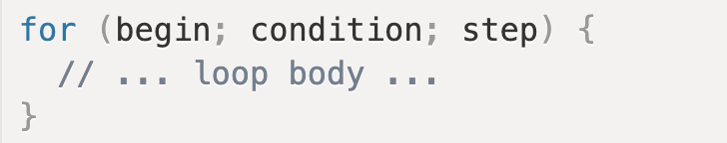
The For loop
For … of loop each element of array.
Ex: for (let number of numbers) {…}
For … in loop each key of object (key is string).
Ex: for (let key in object) {…}

Slide 13
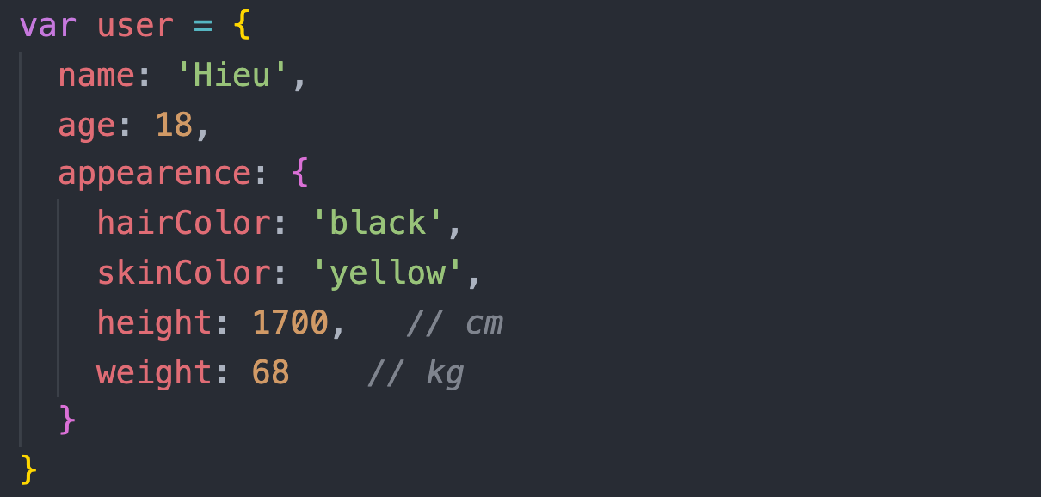
Example 3
Use for … in loop and recursive to get all keys of object

Slide 14
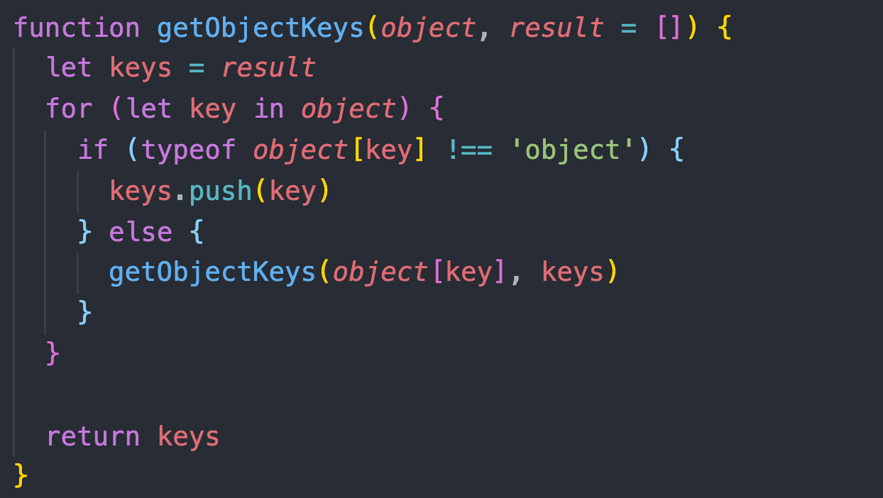
Example 3

Slide 15
Array methods
concat used to merge two or more arrays. This method does not change the existing arrays, but instead returns a new array.
push adds one or more elements to the end of an array and returns the new length of the array.
pop removes the last element from an array and returns that element. This method changes the length of the array.
shift similar to pop, but first elements intead of last elements
unshift similar to push, but first elements intead of last elements

Slide 16
Array methods
slice returns a shallow copy of a portion of an array into a new array object selected from begin to end (end not included). The original array will not be modified.
splice changes the contents of an array by removing or replacing existing elements and/or adding new elements in place.

Slide 17
Example 4
Write function have to remove “n” last elements of array.
Input: ([21, 4, 5, -1, 15, 4, 13], 3) // (array, n)
Output: [21, 4, 5, -1]

Slide 18
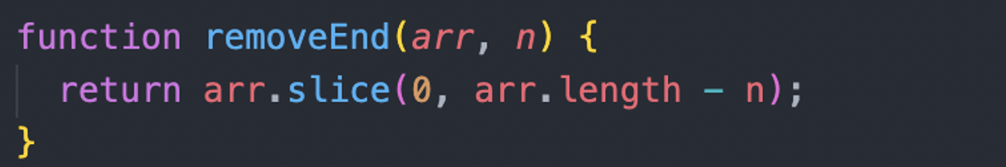
Example 4

Slide 19
Example 5
Write function to insert element at index of array.
Input: ([21, 4, 5, -1], 3, 99) // (array, index, element)
Output: [21, 4, 5, 99, -1]

Slide 20
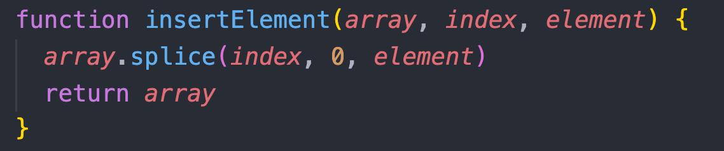
Example 5

Slide 21
Array methods
map creates a new array populated with the results of calling a provided function on every element in the calling array.
filter creates a new array with all elements that pass the test implemented by the provided function.
find returns the value of the first element in the provided array that satisfies the provided testing function.
reduce executes a reducer function (that you provide) on each element of the array, resulting in a single output value.

Slide 22
Example 6
Given a array of numbers, return a new array that only includes even numbers .
Input: ([2, 5, 1, 4, 9, 10]) // (array)
Output: [2, 4, 10]

Slide 23
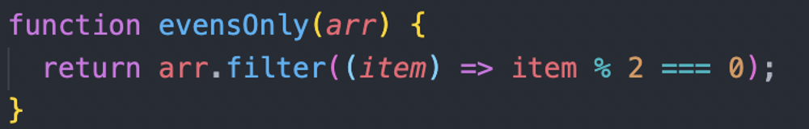
Example 6

Slide 24
Example 7
Write function to return frequency element object.
Input: ([‘a’, ‘b’, ‘c’, ‘a’, ‘c’, ‘z’]) // (array)
Output: {a: 2, b: 1, c: 2, z: 1}

Slide 25
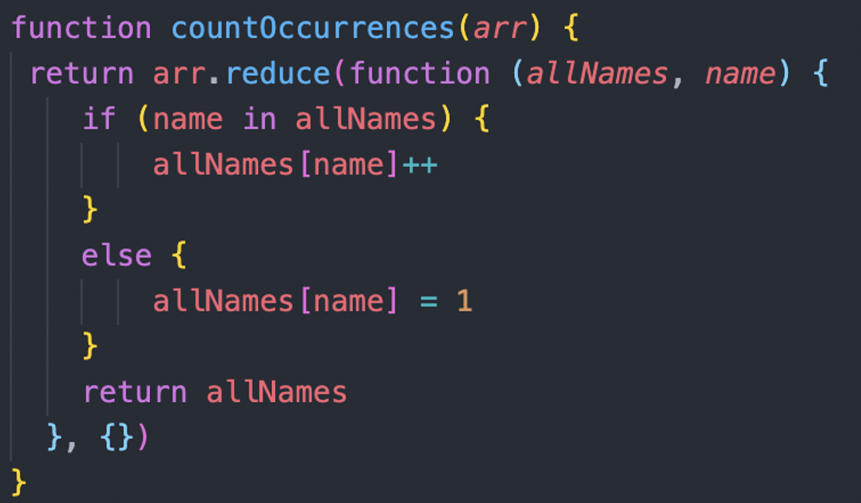
Example 7

Slide 26
Hoisting
Hoisting is JavaScript's default behavior of moving declarations to the top.

Slide 27
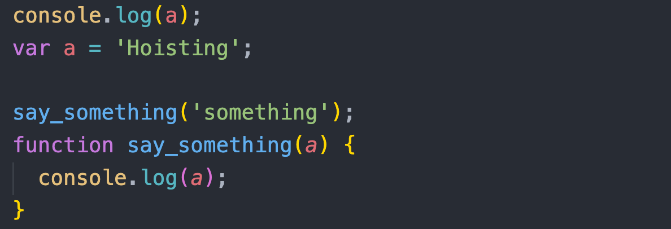
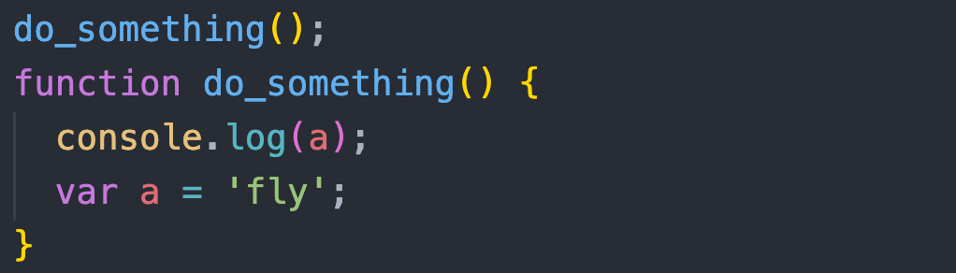
Example 8

Slide 28
Scope
Global scope
Function scope
Block scope

Slide 29
Function Scope
Variables in JavaScript are scoped within the function it’s declared in.
Variables not declared inside a function belong to the global scope (window on browsers or global in Node.js).
Nested scope has access to all of its outer scope’s variables.

Slide 30
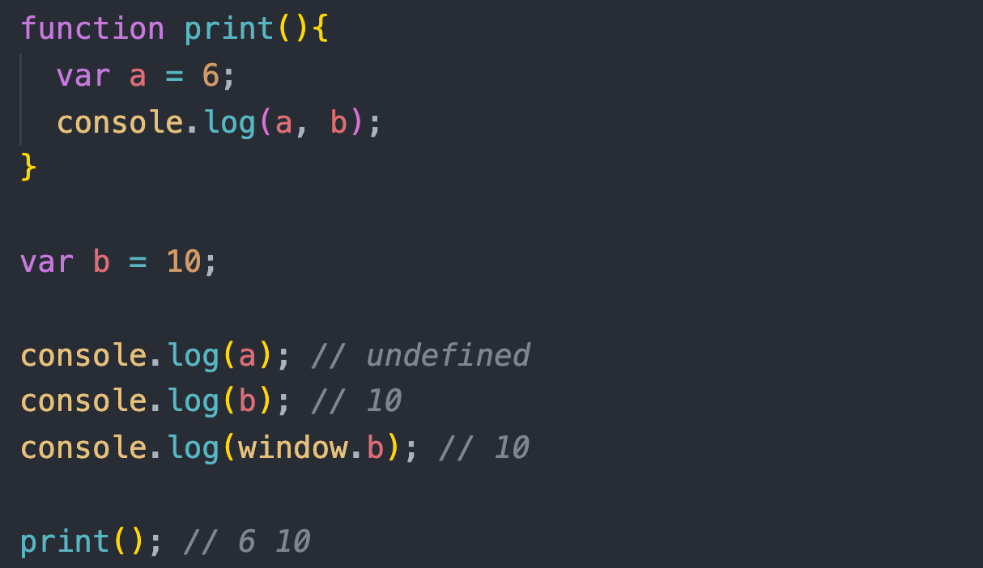
Example 9

Slide 31
Let, const and var
 | const | let | var
Re-declared with the same variable | can’t | can’t | can
Declared not assign value | can’t | can | can
Hoisting behavior | no | no | yes
scope | block scope | block scope | function scope

Slide 32
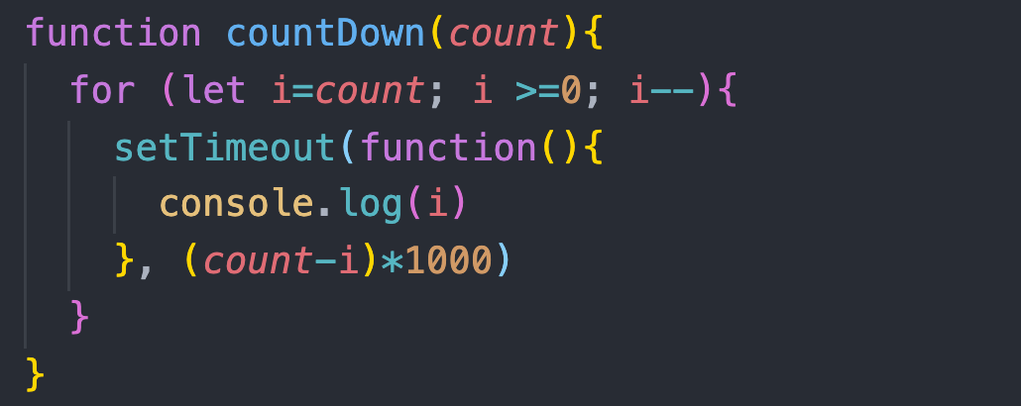
Example 10

Slide 33
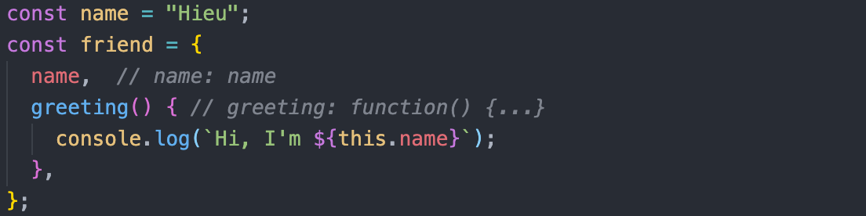
Enhanced object literals

Slide 34
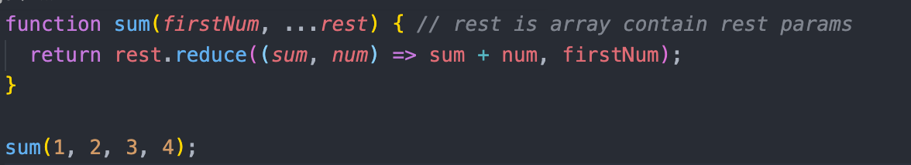
Rest

Slide 35
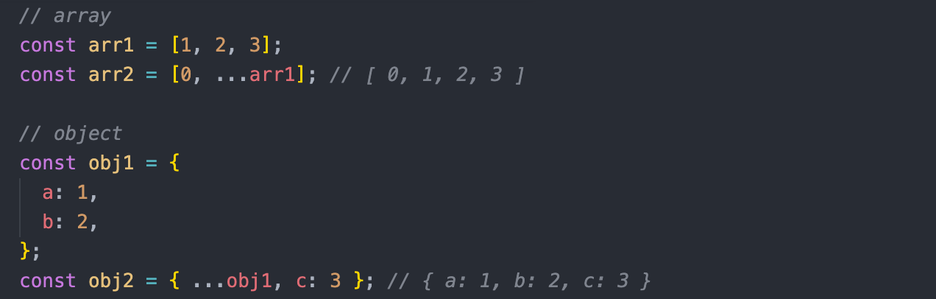
Spread

Slide 36
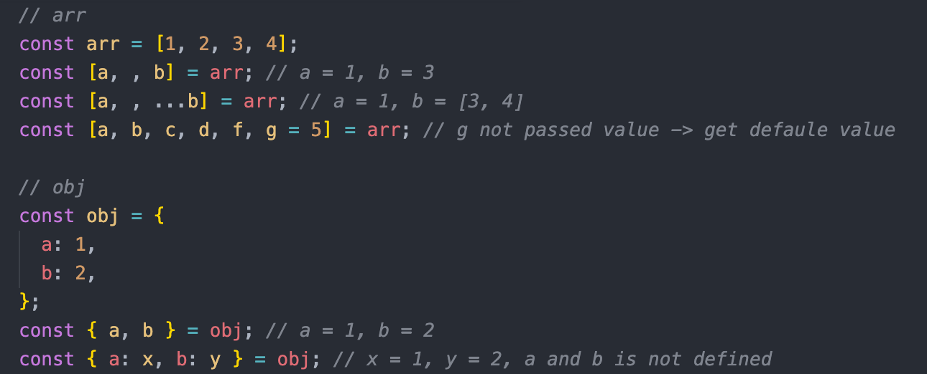
Destructuring

Slide 37
DOM
When a web page is loaded, the browser creates a Document Object Model of the page.
The HTML DOM model is constructed as a tree of Objects:

Slide 38
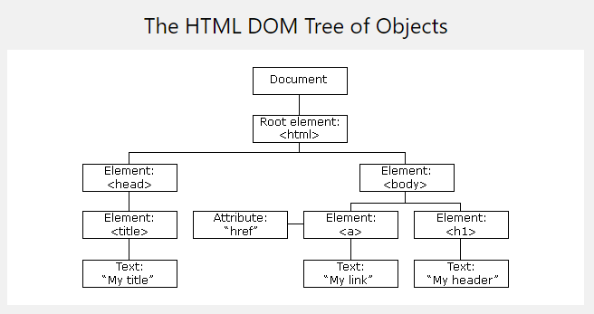
DOM

Slide 39
DOM Element
Finding HTML element by id:
document.getElementById(id)
Finding HTML elements by tag name
document.getElementsByTagName(name)
Finding HTML elements by class name
document.getElementsByClassName(name)
Finding HTML elements by CSS selectors
document.querySelectorAll(”selector")

Slide 40
DOM HTML
Changing HTML Content
document.getElementById(id).innerHTML = new HTML
Changing the Value of an Attribute
document.getElementById(id).attribute = new value

Slide 41
DOM EVENTS
Assign events using event attributes
<button id=“btn” onclick="displayName()">Show Name</button>
Assign events using the HTML DOM
document.getElementById(”btn").onclick = displayName
Assign events using the addEventListener
document.getElementById(”btn").addEventListener("click", displayName)

Slide 42
WINDOW OBJECT
The window object represents an open window in a browser
window.location returns the Location
window.history (back, forward, go) returns the History object
innerHeight/innerWidth returns the height/width of a window's content area
localStorage and sessionStorage allow to save key/value pairs in a web browser.

Slide 43
THANKS!
truongconghieuptit@gmail.com

