Slide 1

MONGODB
truongconghieuptit@gmail.com

Slide 2
Overview

Slide 3
MongoDB
MongoDB is a cross-platform, document oriented database that provides, high performance, high availability, and easy scalability. MongoDB works on concept of collection and document.

Slide 4
MongoDB
Database is a physical container for collections. Each database gets its own set of files on the file system. A single MongoDB server typically has multiple databases.
Collection is a group of MongoDB documents.
A document is a set of key-value pairs.
_id is a 12 bytes hexadecimal number which assures the uniqueness of every document.

Slide 5
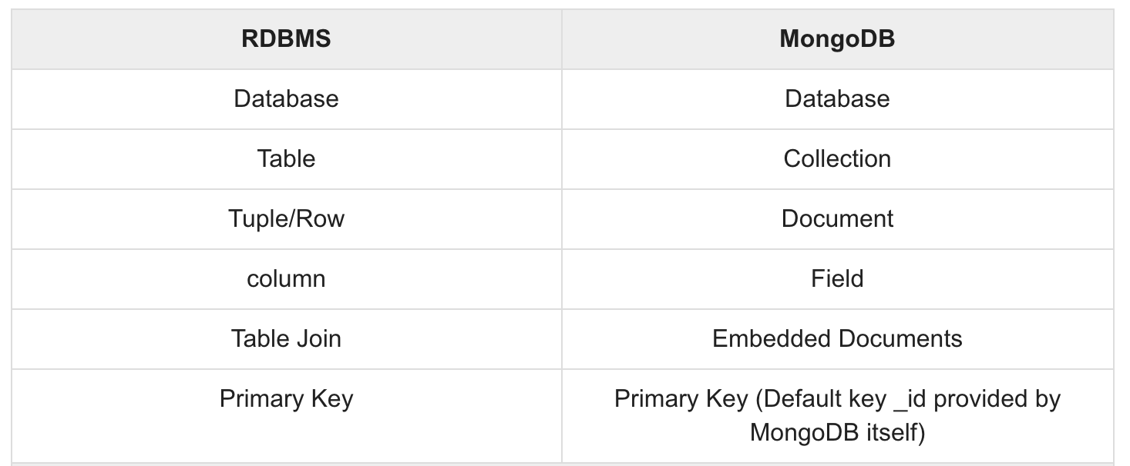
MongoDB

Slide 6
Environment

Slide 7
Installation
To install MongoDB, download the latest release of MongoDB from: https://www.mongodb.com/try/download/community
To use MongoDB run the following command: mongo

Slide 8
Data Modelling

Slide 9
Data Modelling
Documents in MongoDB has a flexible schema in the same collection. They do not need to have the same set of fields or structure. Common fields in a collection’s documents may hold different types of data.

Slide 10
Database

Slide 11
Database commands
use <DATABASE_NAME> - use a database with name.
db - check your currently selected database
show dbs - check your databases list
db.dropDatabase() - drop a existing database. If you have not selected any database, then it will delete default 'test' database.
db.COLLECTION.COMMAND (find, insert, update, delete, …)

Slide 12
Collection

Slide 13
Collection
db.createCollection(name, options) - create collection. MongoDB also creates collection automatically, when you insert some document.
show collections - check your databases list
db.COLLECTION_NAME.drop() - drop a collection from the database

Slide 14
Document

Slide 15
Insert Document
db.COLLECTION_NAME.insert(document) - insert data into MongoDB collection
db.COLLECTION_NAME.insertOne(document) - insert only one document
db.COLLECTION_NAME.insertMany([documents]) - insert multiple documents

Slide 16
Query Document
db.COLLECTION_NAME.find() - query data from MongoDB collection
db.COLLECTION_NAME.find().pretty() - query data and display the results in a formatted way
db.COLLECTION_NAME.findOne() - query data and returns only one document

Slide 17
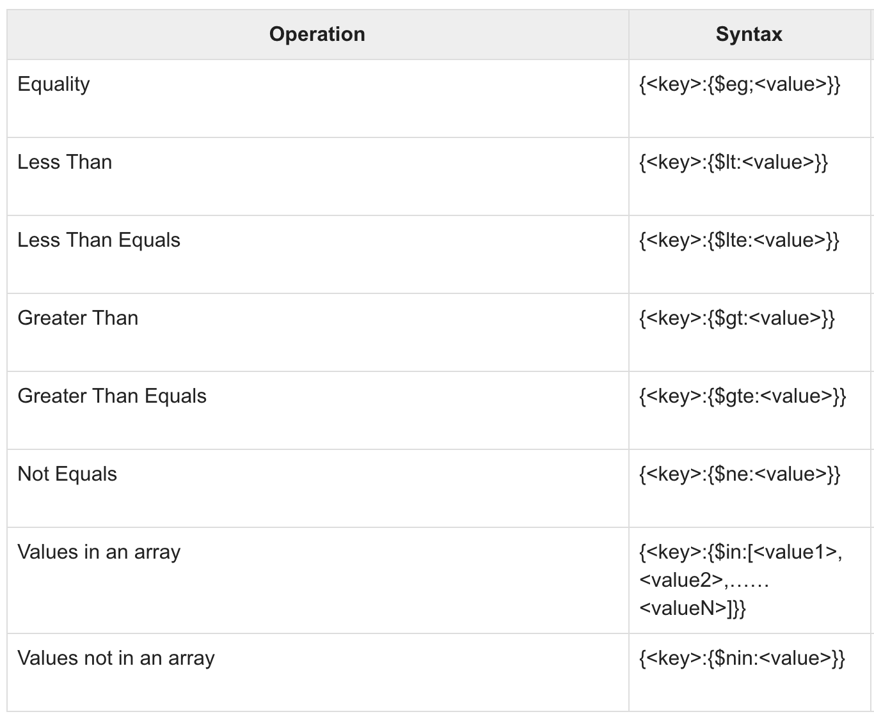
Operations

Slide 18
AND and OR
$and - query documents based on the AND condition.
$or - query documents based on the OR condition.
db.mycol.find({ $and: [ {<key1>:<val1>}, { <key2>:<val2>} ] })
db.mycol.find({ $or: [ {<key1>:<val1>}, { <key2>:<val2>} ] })

Slide 19
Update Document
db.COLLECTION_NAME.update(SELECTION_CRITERIA, UPDATED_DATA)
db.COLLECTION_NAME.updateOne(SELECTIOIN_CRITERIA, UPDATED_DATA)
db.COLLECTION_NAME.updateMany(<filter>, <update>)

Slide 20
Delete Document
db.COLLECTION_NAME.remove(DELLETION_CRITTERIA) - remove a document from the collection
db.COLLECTION_NAME.remove(DELETION_CRITERIA,1) - remove one.
db.COLLECTION_NAME.remove({}) – remove all.

Slide 21
THANKS!
truongconghieuptit@gmail.com

