Slide 1

MONGODB
RESTFUL APIS
truongconghieuptit@gmail.com

Slide 2
RESTFul APIs

Slide 3
Overview
An API is always needed to create mobile applications, single page applications, use AJAX calls and provide data to clients.
An popular architectural style of how to structure and name these APIs and the endpoints is called REST(Representational Transfer State

Slide 4
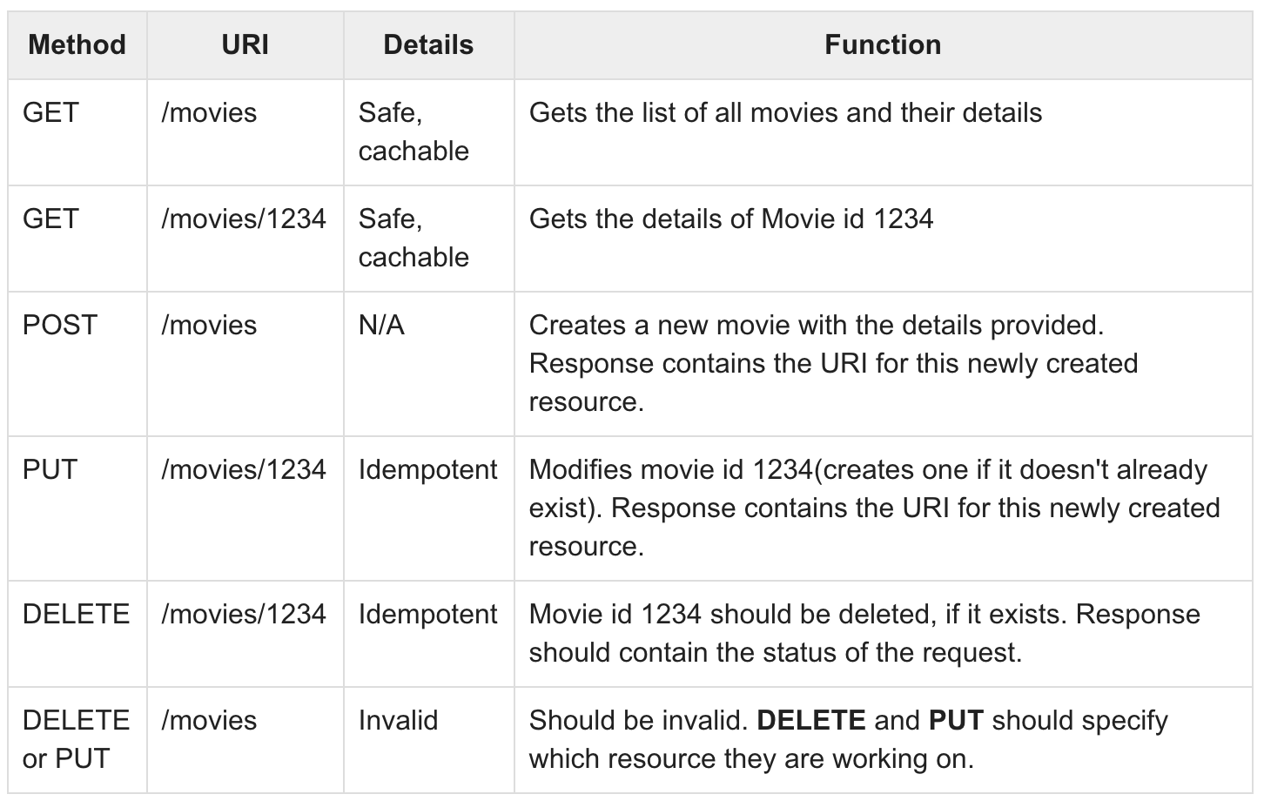

Slide 5
MongoDB

Slide 6
Setting up Mongoose
Install Mongoose: npm install --save mongoose
Create a database using the Mongo shell: use my_db
Require it in our index.js file and then connect to the mongodb service running on mongodb://localhost: 27017
Create new Model

Slide 7
Schema
Schema maps to a MongoDB collection and defines the shape of the documents within that collection.

Slide 8
SchemaTypes
String
Number
Date
Buffer
Boolean
Mixed
ObjectId
Array
Decimal128
Map

Slide 9
Models
Models are fancy constructors compiled from Schema definitions. An instance of a model is called a document.
Models are responsible for creating and reading documents from the underlying MongoDB database.

Slide 10
Saving Documents
newDocument.save()

Slide 11
Retrieving Documents
Model.find()
Model.findOne()
Model.findById()

Slide 12
Updating Documents
Model.updateMany()
Model.updateOne()
Model.findOneAndUpdate()
Model.findByIdAndUpdate()

Slide 13
Deleting Documents
Model.deleteMany()
Model.deleteOne()
Model.findOneAndDelete()
Model.findByIdAndDelete()

Slide 14
THANKS!
truongconghieuptit@gmail.com

