Slide 1

HTML
truongconghieuptit@gmail.com

Slide 2
What is HTML?
HTML stands for Hyper Text Markup Language
HTML describes the structure of a Web page
HTML is called a semantic language because its purpose is to describe what we mean.

Slide 3
HTML
CSS
JavaScript

Slide 4
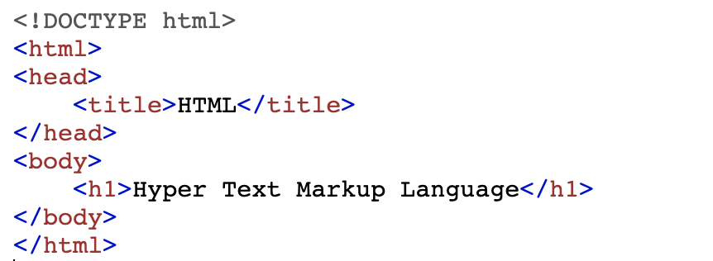
A Simple HTML Document

Slide 5
A Simple HTML Document
The <!DOCTYPE html> declaration defines that this document is an HTML5 document
The <html> element is the root element of an HTML page
The <head> element contains meta information about the HTML page
The <title> element specifies a title for the HTML page
The <body> element defines the document's body, and is a container for all the visible contents, such as headings, paragraphs, images, …
The <h1> element defines a large heading

Slide 6
HTML Elements
An HTML element is defined by a start tag, some content, and an end tag

Slide 7
HTML Attributes
All HTML elements can have attributes
Attributes provide additional information about elements
Attributes are always specified in the start tag
Attributes usually come in name/value pairs like: name="value"

Slide 8
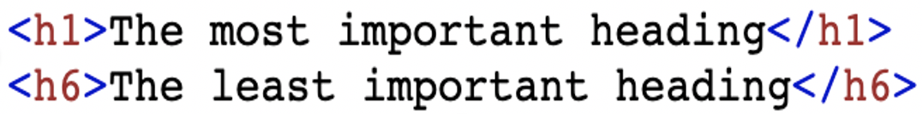
Common elements
Heading: titles or subtitles that you want to display on a webpage.
Paragraphs: defines a paragraph, starts on a new line and block of text.
Images: is used to embed an image in a web page.

Slide 9
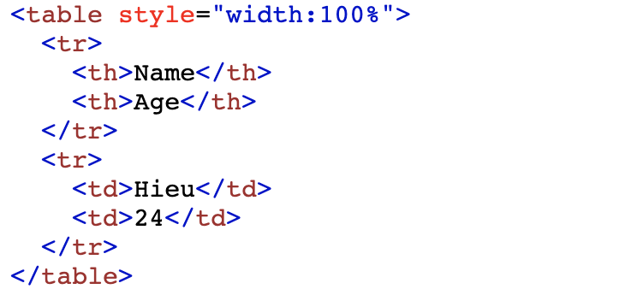
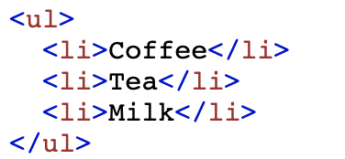
Common elements
Table: defines an table
List: of related items in lists, unordered list and ordered list
Link: defines a hyperlink

Slide 10
Common elements
<b> - Bold text
<i> - Italic text
<mark> - Marked text
<del> - Deleted text
<ins> - Inserted text

Slide 11
Common attributes
Styles: is used to add styles to an element, such as color, font, size, and more.
Classes: is used to specify a class for an HTML element
Id: is used to specify a unique id for an HTML element

Slide 12
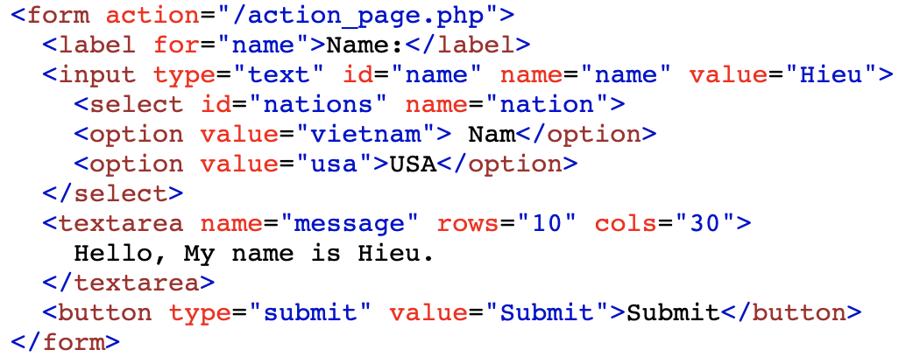
HTML Forms

Slide 13
HTML Comments
You can add comments to your HTML source by using the following syntax:

Slide 14
Block and Inline Elements
A block element always starts on a new line and takes up the full width available (<div>, <h1>, <p>, …)
An inline element does not start on a new line and it only takes up as much width as necessary

Slide 15
Semantic Elements
A semantic element clearly describes its meaning to both the browser and the developer.
non-semantic elements: <div> and <span> - Tells nothing about its content.
semantic elements: <form>, <table>, and <article> - Clearly defines its content.

Slide 16
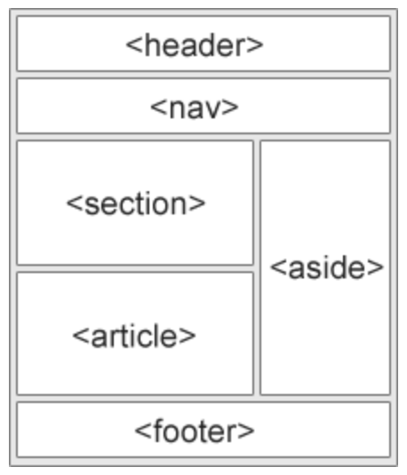
Semantic Elements

Slide 17
HTML Entities
HTML Entities are mostly used to display special characters that are not available on keyboard or reserved by HTML.
A detailed list of HTML entities is available at:
https://ascii.cl/htmlcodes.htm

Slide 18
Practice
Header
Nav
Content
List
Aside
Main
Table
Form
Footer

Slide 19
THANKS!
truongconghieuptit@gmail.com

