Slide 1

CSS
truongconghieuptit@gmail.com

Slide 2
What is CSS?
CSS stands for Cascading Style Sheets.
CSS describes how HTML elements are to be displayed on screen, paper, or in other media.
CSS saves a lot of work. It can control the layout of multiple web pages all at once.
External stylesheets are stored in CSS files.

Slide 3
HTML
CSS
JavaScript

Slide 4
Three Ways to Insert CSS
External CSS: must include a reference to the external style sheet file inside the <link> element, inside the head section.
Internal CSS: is defined inside the <style> element, inside the head section.
Inline CSS: add the style attribute to the relevant element.

Slide 5
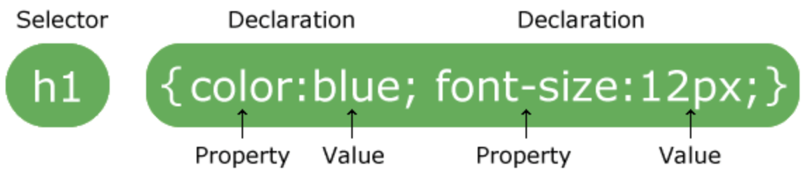
CSS Syntax
A CSS rule-set consists of a selector and a declaration block:

Slide 6
CSS Syntax
The selector points to the HTML element you want to style.
The declaration block contains one or more declarations separated by semicolons.
Each declaration includes a CSS property name and a value, separated by a colon.
Multiple CSS declarations are separated with semicolons, and declaration blocks are surrounded by curly braces.

Slide 7
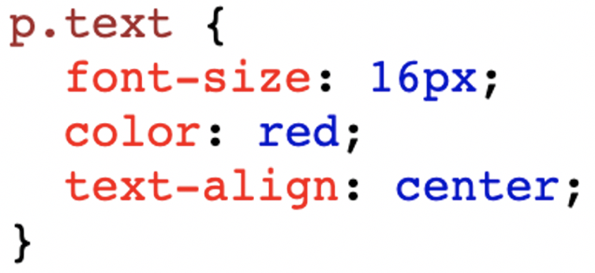
CSS Syntax

Slide 8
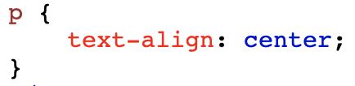
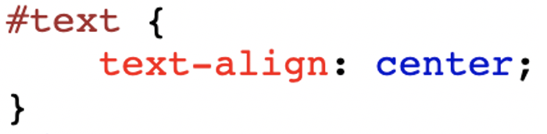
CSS Selectors
Element Selector: selects HTML elements based on the element name.
Id Selector: uses the id attribute of an HTML element to select a specific element.

Slide 9
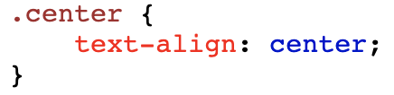
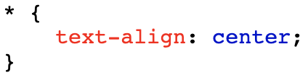
CSS Selectors
Class Selector: selects HTML elements with a specific class attribute.
Universal Selector: selects all HTML elements on the page.

Slide 10
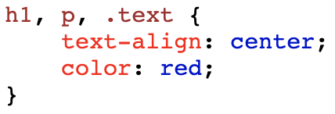
CSS Selectors
Grouping Selector: selects all the HTML elements with the same style definitions.

Slide 11
CSS Backgrounds
The CSS background properties are used to define the background effects for elements.
background-color
background-image
background-repeat
background-position

Slide 12
CSS Text
This text is styled with some of the text formatting properties
color
text-align
text-decoration
text-transform
text-indent
text-shadow

Slide 13
CSS Fonts
The CSS font properties define the font family, boldness, size, and the style of a text.
font-family
font-size
font-style
font-weight

Slide 14
CSS Links
Links can be styled in different ways.
a:link - a normal, unvisited link
a:visited - a link the user has visited
a:hover - a link when the user mouses over it
a:active - a link the moment it is clicked

Slide 15
CSS Display
The display property is the most important CSS property for controlling layout.
none: is commonly used to hide elements without deleting them.
block: starts on a new line and takes up the full width available.
inline: does not start on a new line and only takes up as much width as necessary, can’t set a width and height, top and bottom margins/paddings are respected.

Slide 16
CSS Display
inline-block: does not add a line-break after the element, so the element can sit next to other elements, allows to set a width and height on the element, the top and bottom margins/paddings are respected.

Slide 17
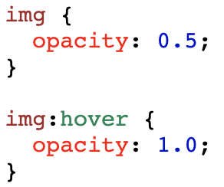
CSS Opacity / Transparency
The opacity property specifies the opacity/transparency of an element.
The opacity property can take a value from 0.0 - 1.0. The lower value, the more transparent.

Slide 18

CSS Box Model
All HTML elements can be considered as boxes border-style.

Slide 19
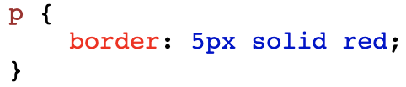
CSS Borders
The CSS background properties are used to define the background effects for elements.
border-style
border-width
border-color
Shorthand: width style color

Slide 20
CSS Margins
The CSS margin properties are used to create space around elements, outside of any defined borders.
margin-top
margin-right
margin-bottom
margin-left

Slide 21
CSS Margins
Shorthand:
top right bottom left
top right-left bottom
top-bottom right-left

Slide 22
CSS Padding
The CSS padding properties are used to generate space around an element's content, inside of any defined borders.
padding-top
padding-right
padding-bottom
padding-left

Slide 23
CSS Padding
Shorthand:
top right bottom left
top right-left bottom
top-bottom right-left

Slide 24
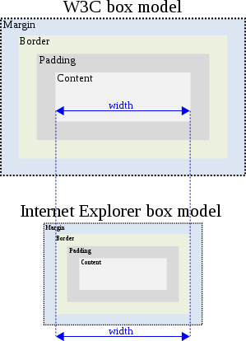
CSS Backgrounds
box-sizing: content-box;
box-sizing: border-box;

Slide 25
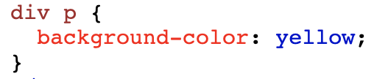
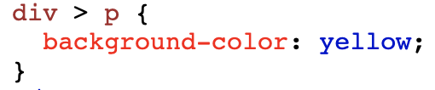
CSS Combinators
Descendant Selector: matches all elements that are descendants of a specified element.
Child Selector: selects all elements that are the children of a specified element..

Slide 26
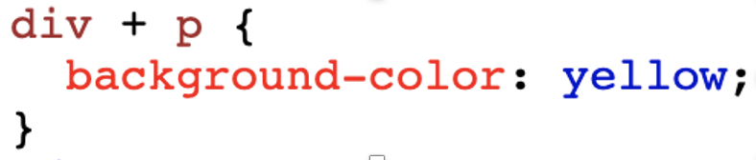
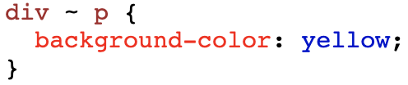
CSS Combinators
Adjacent Sibling Selector: selects all elements that are the adjacent siblings of a specified element.
General Sibling Selector: selects all elements that are siblings of a specified element.

Slide 27
CSS Pseudo-classes
A pseudo-class is used to define a special state of an element.
Selector | Example | Example description
:first-child | p:first-child | Selects every <p> elements that is the first child of its parent
:last-child | p:last-child | Selects every <p> elements that is the last child of its parent
:not(selector) | :not(p) | Selects every element that is not a <p> element
:active | a:active | Selects the active link
:visited | a:visited | Selects all visited links
:focus | input:focus | Selects the <input> element that has focus

Slide 28
CSS Pseudo-elements
A CSS pseudo-element is used to style specified parts of an element.
Selector | Example | Example description
::after | p::after | Insert something after the content of each <p> element
::before | p::before | Insert something before the content of each <p> element
::first-letter | p::first-letter | Selects the first letter of each <p> element
::first-line | p::first-line | Selects the first line of each <p> element
::selection | p::selection | Selects the portion of an element that is selected by a user

Slide 29
CSS Attribute Selectors
The [attribute] selector is used to select elements with a specified attribute.
The [attribute="value"] selector is used to select elements with a specified attribute and value. padding-bottom.
The [attribute~="value"] selector is used to select elements with an attribute value containing a specified word.
The [attribute^="value"] selector is used to select elements whose attribute value begins with a specified value.

Slide 30
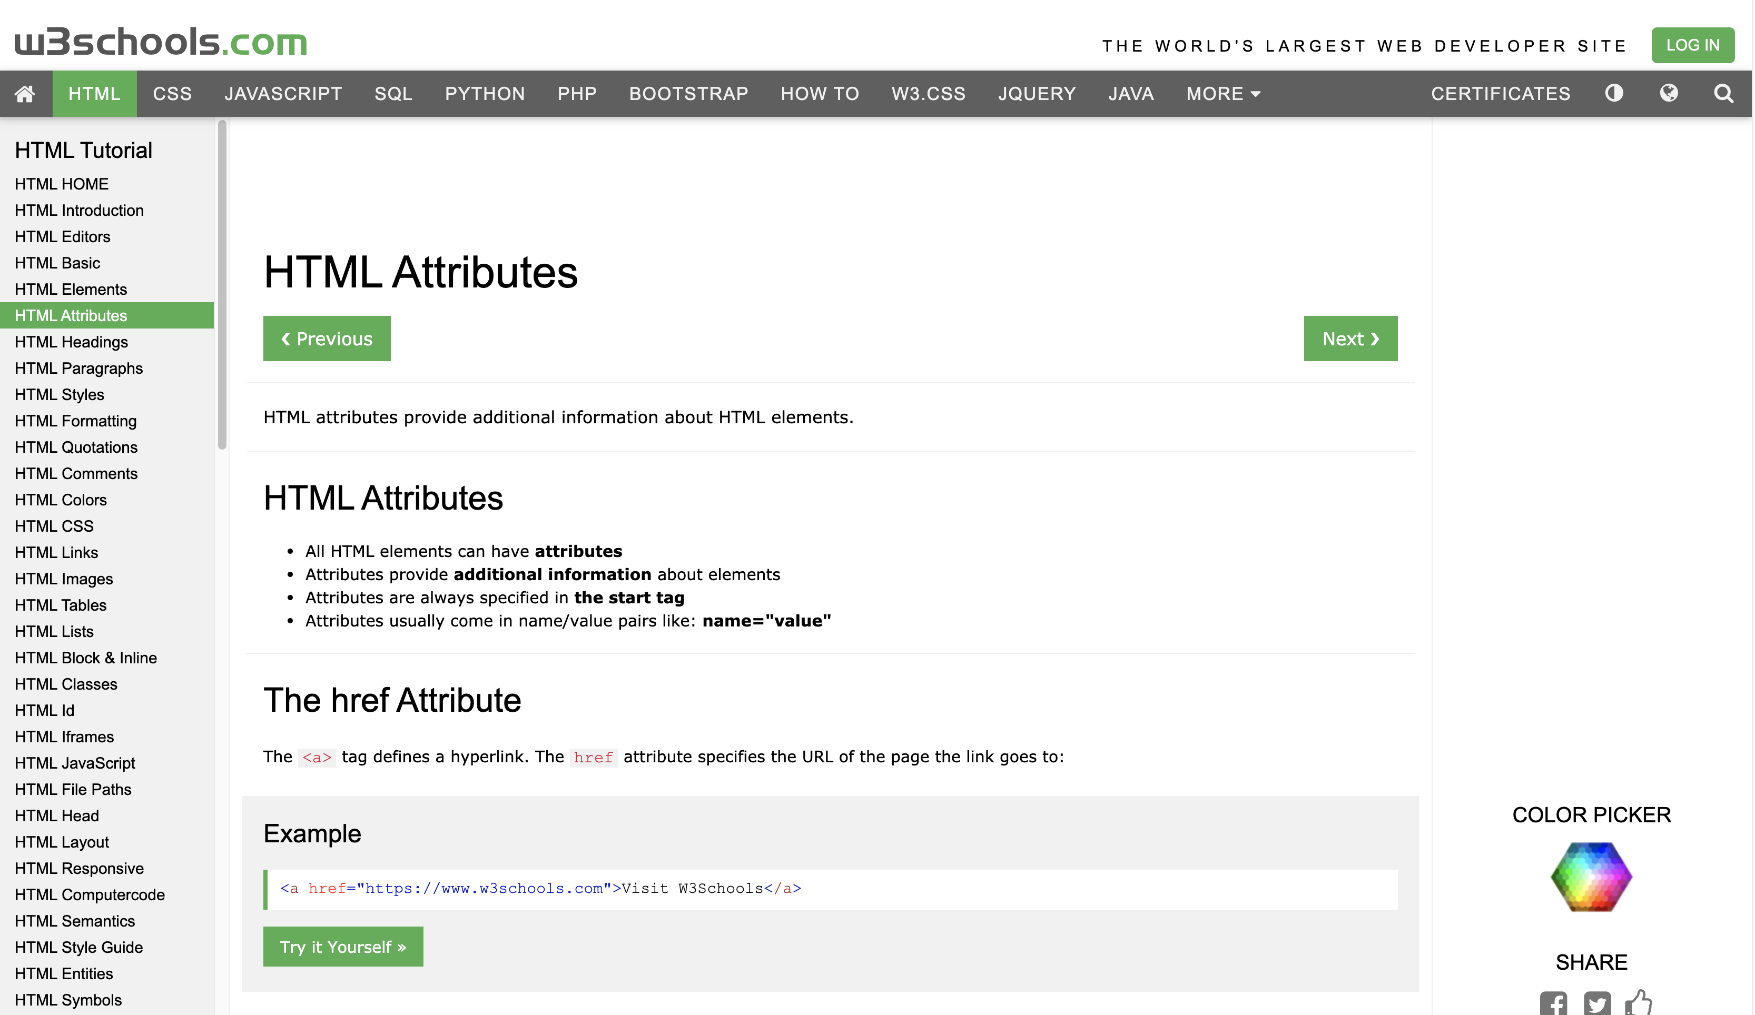
Practice

Slide 31
THANKS!
truongconghieuptit@gmail.com

