Slide 1

CSS
truongconghieuptit@gmail.com

Slide 2
CSS Position

Slide 3
CSS Position
The position property specifies the type of positioning method used for an element.
Elements are then positioned using the top, bottom, left, and right properties. However, these properties will not work unless the position property is set first.

Slide 4
CSS Position
position: static - Default value of all elements. Not affected by the top, bottom, left, right properties. The browser decides where to place the element.
position: relative - Top, right, bottom and left determine how the element is placed relative to its static position. Other content will not be adjusted to fit into any gap left by the element.

Slide 5
CSS Position
position: fixed - Top, right, bottom and left determine how the element is placed relative to the viewport, which means it always stays in the same place even if the page is scrolled.
position: absolute - Top, right, bottom and left determine how the element is placed relative to its first non-static parent.

Slide 6
CSS Float

Slide 7
CSS Float
The CSS float property specifies how an element should float.
float: left - The element floats to the left of its container.
float: right - The element floats to the right of its container
float: none - The element does not float (will be displayed just where it occurs in the text). This is default
float: inherit - The element inherits the float value of its parent

Slide 8
CSS Float - clear
The clear property specifies what elements can float beside the cleared element and on which side.
left - No floating elements allowed on the left side.
right- No floating elements allowed on the right side.
both - No floating elements allowed on either the left or the right side.
inherit - The element inherits the clear value of its parent.

Slide 9
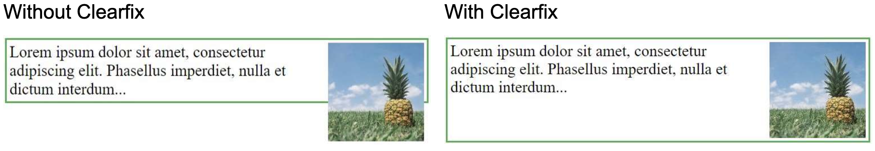
CSS Float - clearfix
If an element is taller than the element containing it, and it is floated, it will "overflow" outside of its container.

Slide 10
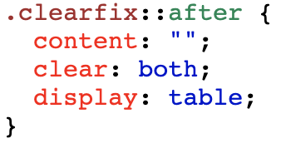
CSS Float - clearfix

Slide 11
CSS Flexbox

Slide 12
CSS Flexbox
The CSS Flexbox makes it easier to design flexible responsive layout structure without using float or positioning.
Reference:
https://css-tricks.com/snippets/css/a-guide-to-flexbox/

Slide 13
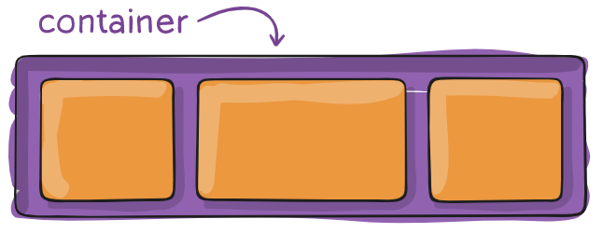
CSS Flex Container
The CSS Flexbox makes it easier to design flexible responsive layout structure without using float or positioning.

Slide 14
CSS Flex Container
display - This defines a flex container, enables a flex context for all its direct children.
flex-direction - Defines in which direction the container wants to stack the flex items.
flex-wrap - By default, flex items will all try to fit onto one line. So can change that and allow the items to wrap as needed with this property.

Slide 15
CSS Flex Container
flex-flow - A shorthand for the flex-direction and flex-wrap properties, which together define the flex container’s main and cross axes.
justify-content - This defines the alignment along the main axis.
align-items - This defines the default behavior for how flex items are laid out along the cross axis on the current line.

Slide 16
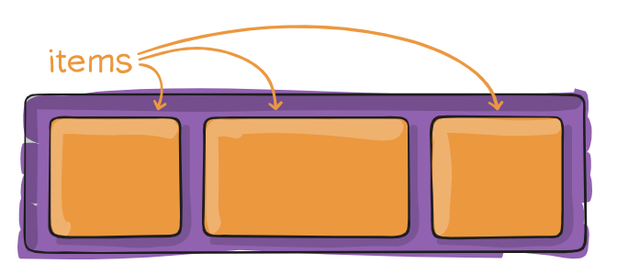
CSS Flex Items
The direct child elements of a flex container automatically becomes flexible (flex) items.

Slide 17
CSS Flex Items
order - Specifies the order of the flex items.
flex-grow - Specifies how much a flex item will grow relative to the rest of the flex items.

Slide 18
CSS Units

Slide 19
CSS Units
CSS has several different units for expressing a length.
Unit | Description
px | Pixels (px) are relative to the viewing device, points (1pt = 1/72 of 1in)
em | Relative to the font-size of the element (2em means 2 times the size of the current font)
rem | Relative to font-size of the root element

Slide 20
CSS Specificity

Slide 21
CSS Specificity
If there are two or more conflicting CSS rules that point to the same element, the browser follows some rules to determine which one is most specific and therefore wins out.
Think of specificity as a score/rank that determines which style declarations are ultimately applied to an element.
Reference:
https://cssspecificity.com/

Slide 22
CSS Specificity
!important - The !important value overrides even inline styles from the markup. The only way it can be overridden is with another !important rule declared later in the CSS and with equal or great specificity value otherwise.
Inline styles (1000) - An inline style is attached directly to the element to be styled. Example: <h1 style="color: #ffffff;">.
IDs (100) - An ID is a unique identifier for the page elements, such as #navbar.

Slide 23
CSS Specificity
Classes, attributes and pseudo-classes (10) - This category includes .classes, [attributes] and pseudo-classes such as :hover, :focus etc.
Elements and pseudo-elements (1) - This category includes element names and pseudo-elements, such as h1, div, :before and :after.
The universal selector (0) – This has low specificity

Slide 24
Example 2
#footer li
<li style=“color: red;”>
.nav_main a:hover
body.title .right-container h2
#categories-list .fixed li a:active

Slide 25
CSS Transform

Slide 26
CSS Transform
CSS transforms allow you to move, rotate, scale, and skew elements.
translate() - This moves an element from its current position (according to the parameters given for the X-axis and the Y-axis).
.rotate() – This rotates an element clockwise or counter-clockwise according to a given degree.

Slide 27
CSS Transform
scale() - This increases or decreases the size of an element (according to the parameters given for the width and height).
skew() - This skews an element along the X and Y-axis by the given angles.

Slide 28
CSS Transitions

Slide 29
CSS Transitions
CSS transitions allows you to change property values smoothly, over a given duration.
Property | Description
transition | A shorthand property for setting the four transition properties into a single property
transition-delay | Specifies a delay (in seconds) for the transition effect
transition-duration | Specifies how many seconds or milliseconds a transition effect takes to complete
transition-property | Specifies the name of the CSS property the transition effect is for
transition-timing-function | Specifies the speed curve of the transition effect

Slide 30
CSS Animations

Slide 31
CSS Animations
animation-name
animation-duration
animation-delay
animation-iteration-count
animation-direction
animation-timing-function
animation-fill-mode
animation

Slide 32
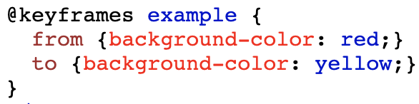
CSS Animations
@keyframes - When you specify CSS styles inside the @keyframes rule, the animation will gradually change from the current style to the new style at certain times.

Slide 33
THANKS!
truongconghieuptit@gmail.com

