Slide 1

NODEJS
truongconghieuptit@gmail.com

Slide 2
Web development

Slide 3
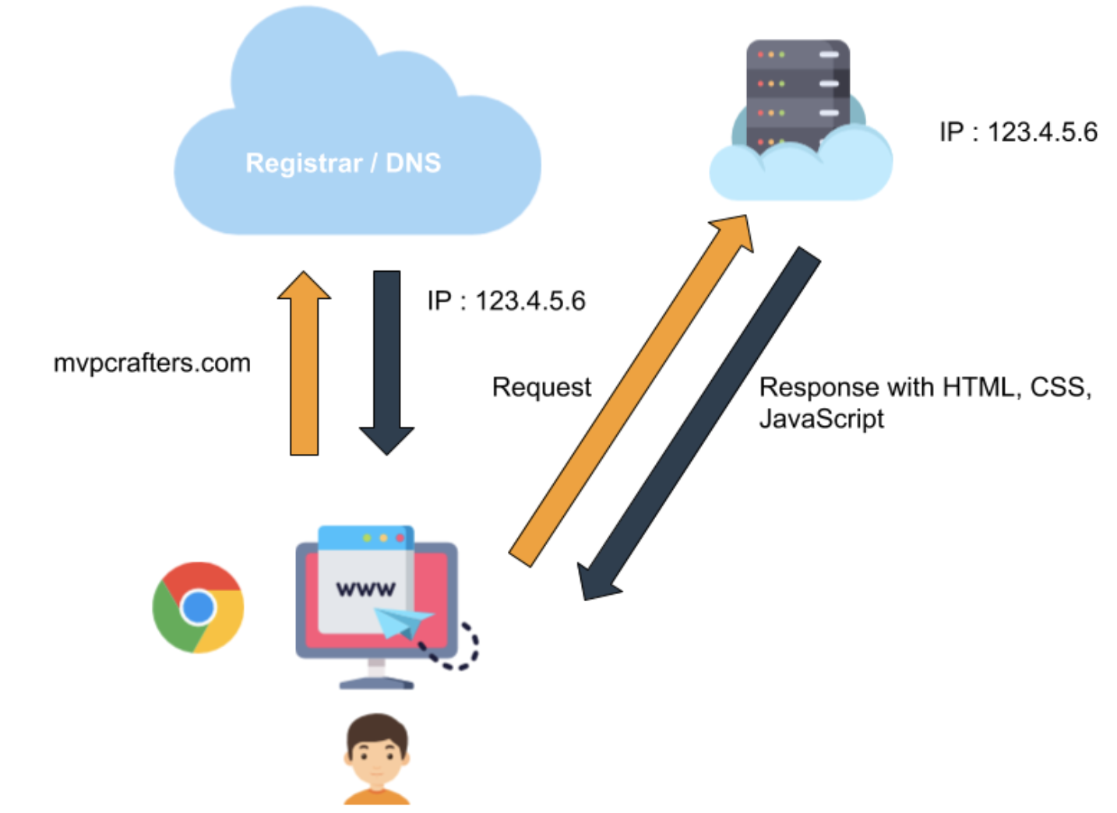
How the Web works

Slide 4
How the Web works
Term:
Browser (Chrome, Firefox, Opera, and Microsoft Edge, etc)
Internet
Web Server
DNS Server
Data

Slide 5
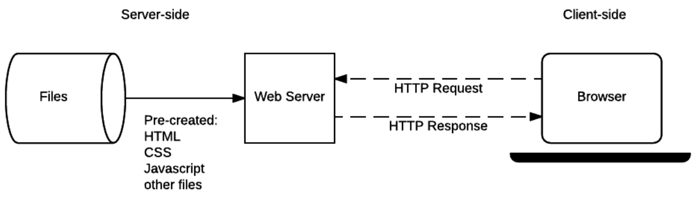
Client-side and Server-side

Slide 6
Front-end and Back-end
Front-end
Back-end

Slide 7
NodeJS

Slide 8
Introduction
Node.js is a very powerful JavaScript-based platform built on Google Chrome's JavaScript V8 Engine.
It is used to develop I/O intensive web applications like video streaming sites, single-page applications, and other web applications.
Node.js is open source, completely free, and used by thousands of developers around the world.

Slide 9
Features
Asynchronous and Event Driven − All APIs of Node.js library are asynchronous. It essentially means a Node.js based server never waits for an API to return data. The server moves to the next API after calling it and a notification mechanism of Events of Node.js helps the server to get a response from the previous API call.
Very Fast - Based on Google Chrome's V8 JavaScript Engine.
Single Threaded but Highly Scalable

Slide 10
Environment Setup
Text Editor (Visuo Studio)
The Node.js (https://nodejs.org/en/)
Verify installation:
Checking version: node –v and npm -v
Executing a File

Slide 11
First Application
A Node.js application consists of the following three important components:
Import required modules − We use the require directive to load Node.js modules.
Create server − A server which will listen to client's requests similar to Apache HTTP Server.
Read request and return response − The server created in an earlier step will read the HTTP request made by the client which can be a browser or a console and return the response.

Slide 12
Node Package Manager (NPM)
Node Package Manager provides two main functionalities:
Online repositories for node packages/modules.
Command line utility to install Node.js packages, do version management and dependency management of Node.js packages.

Slide 13
Example 1
Create server with hostname and port.

Slide 14
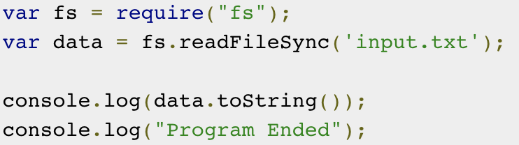
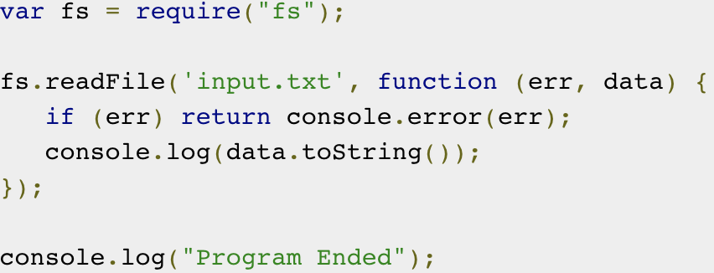
Blocking and Non-Blocking
Blocking
Non-Blocking

Slide 15
Global Objects
__filename - Represents the filename of the code being executed.
__dirname - Represents the name of the directory that the currently executing script resides in.
setTimeout, clearTimeout, setInterval, Console

Slide 16
Example 2
Create server that have some features:
Read file .txt sync
Read file .txt async
Read file .html async

Slide 17
Module
A module is just a file. One script is one module. As simple as that.
Modules can load each other and use special directives export and import to interchange functionality, call functions of one module from another one:
export keyword labels variables and functions that should be accessible from outside the current module.
import allows the import of functionality from other modules.

Slide 18
Example 3
Continue to implement previous project, use import and export to split down main file.

Slide 19
THANKS!
truongconghieuptit@gmail.com

