Slide 1

EXPESSJS
truongconghieuptit@gmail.com

Slide 2
Overview

Slide 3
ExpressJS
A minimal and flexible Node.js web application framework
Providing a simple API to build websites, web apps and back ends.

Slide 4
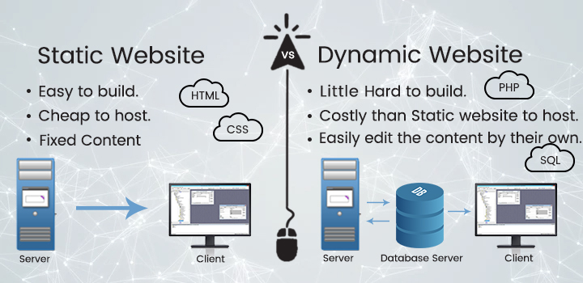
Static web server and Dynamic web server

Slide 5
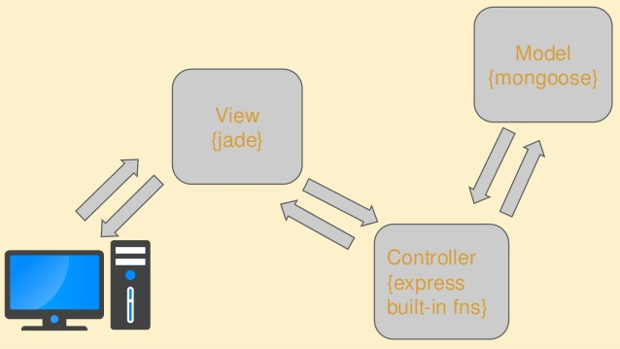
MVC Pattern

Slide 6
Environment

Slide 7
Environment
Text Editor (Visuo Studio)
Nodejs
Npm (Node Package Manager)
Postman

Slide 8
Config
Create a new folder
Whenever we create a project using npm, we need to provide a package.json file
Install Express and add it to our package.json file
Install nodemon tool

Slide 9
ExpressJS

Slide 10
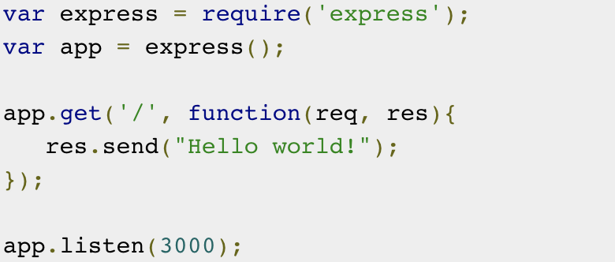
Hello word

Slide 11
Hello word
Imports Express, create an application and assign it to var app.
app.get(route, callback)
res.send()
app.listen(port, [callback]])

Slide 12
HTTP Methods
Method | Description
GET | The GET method requests a representation of the specified resource. Requests using GET should only retrieve data and should have no other effect.
POST | The POST method requests that the server accept the data enclosed in the request as a new object/entity of the resource identified by the URI.
PUT | The PUT method requests that the server accept the data enclosed in the request as a modification to existing object identified by the URI. If it does not exist then the PUT method should create one.
DELETE | The DELETE method requests that the server delete the specified resource.

Slide 13
HTTP Status Code
Status Code | Description
1xx | An informational response indicates that the request was received and understood.
2xx | This class of status codes indicates the action requested by the client was received, understood, and accepted. // thành công
3xx | This class of status code indicates the client must take additional action to complete the request.
4xx | This class of status code is intended for situations in which the error seems to have been caused by the client. // lỗi bên client
5xx | Response status codes beginning with the digit "5" indicate cases in which the server is aware that it has encountered an error or is otherwise incapable of performing the request. // lỗi bên sv( mạng, code)

Slide 14
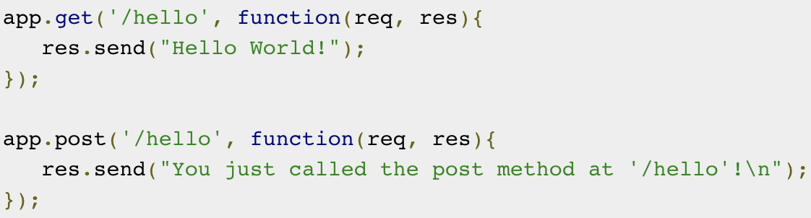
Route
Web frameworks provide resources such as HTML pages, scripts, images, etc. at different routes.

Slide 15
Route
The following function is used to define routes in an Express application: app.method(path, handler)
This method can be applied to any one of the HTTP verbs (get, post, put, delete).
Path is the route at which the request will run.
Handler is a callback function that executes when a matching request type is found on the relevant route.

Slide 16
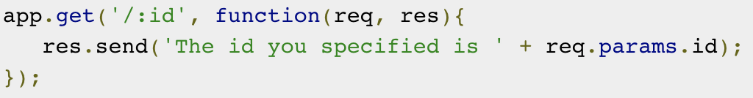
Dynamic Route
Using dynamic routes allows us to pass parameters and process based on them.

Slide 17
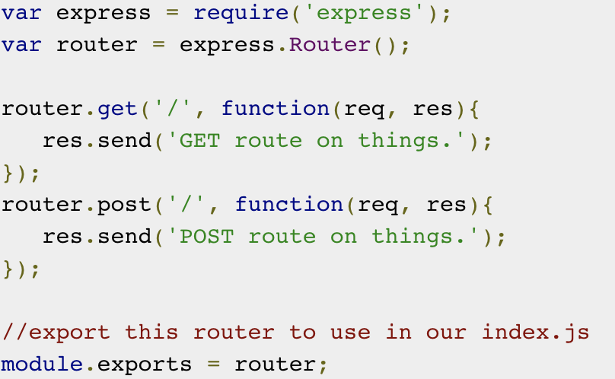
Router
Defining routes in main file is very tedious to maintain.
Separate the routes from main file by Express.Router.

Slide 18
Middleware
Middleware functions are functions that have access to the request object (req), the response object (res), and the next middleware function in the application’s request-response cycle.
These functions are used to modify req and res objects for tasks like parsing request bodies, adding response headers, etc.

Slide 19
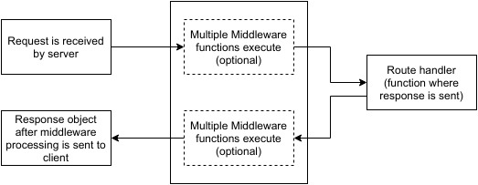
Middleware

Slide 20
Third Party Middleware
body-parser: This is used to parse the body of requests which have payloads attached to them.
cookie-parser: It parses Cookie header and populate req.cookies with an object keyed by cookie names

Slide 21
Templating
Pug is a templating engine for Express.
Pug is a very powerful templating engine which has a variety of features including filters, includes, inheritance, etc.
https://pugjs.org/api/express.html
https://pughtml.com/

Slide 22
Practice

Slide 23
Practice
Create application with bellowing features:
Signup
Signin
Renders user’s posts.
Renders user’s particular post.
Edit post
Remove post

Slide 24
THANKS!
truongconghieuptit@gmail.com

