Slide 1

JQUERY
truongconghieuptit@gmail.com

Slide 2
Overview

Slide 3
jQuery
jQuery is a lightweight, "write less, do more", JavaScript library.
The purpose of jQuery is to make it much easier to use JavaScript on your website.
jQuery takes a lot of common tasks that require many lines of JavaScript code to accomplish, and wraps them into methods that you can call with a single line of code.

Slide 4
jQuery
The jQuery library contains the following features:
HTML/DOM manipulation
CSS manipulation
HTML event methods
Effects and animations
AJAX
Utilities

Slide 5
How to Call a jQuery Library
There are several ways to start using jQuery on your web site.
Download the jQuery library from jQuery.com
Include jQuery from a CDN, like Google

Slide 6
jQuery HTML

Slide 7
Syntax
$(selector).action()
$ sign to define/access jQuery
(selector) to "query (or find)" HTML elements
action() to be performed on the element(s)

Slide 8
Events
All the different visitors' actions that a web page can respond to are called events.
An event represents the precise moment when something happens.

Slide 9
Events
Commonly jQuery Event
$(document).ready()
click()
dblclick()
mouseenter()
mouseleave()
hover()
focus()

Slide 10
Get
text() - Returns the text content of selected elements
html() - Returns the content of selected elements (including HTML markup)
val() - Returns the value of form fields
attr(‘attribute’) - Returns attribute values.

Slide 11
Set
text(‘value’) - Sets the text content of selected elements
html(‘value’) - Sets the content of selected elements (including HTML markup)
val(‘value’) - Sets the value of form fields
attr(‘attribute’, ‘value’) - Sets attribute values.

Slide 12
Add
append() - Inserts content at the end of the selected elements
prepend() - Inserts content at the beginning of the selected elements
after() - Inserts content after the selected elements
before() - Inserts content before the selected elements

Slide 13
Remove
remove() - Removes the selected element (and its child elements)
empty() - Removes the child elements from the selected element

Slide 14
Class
addClass() - Adds one or more classes to the selected elements
removeClass() - Removes one or more classes from the selected elements

Slide 15
CSS
The css() method sets or returns one or more style properties for the selected elements.

Slide 16
Dimension
width()
height()
innerWidth()
innerHeight()
outerWidth()
outerHeight()

Slide 17
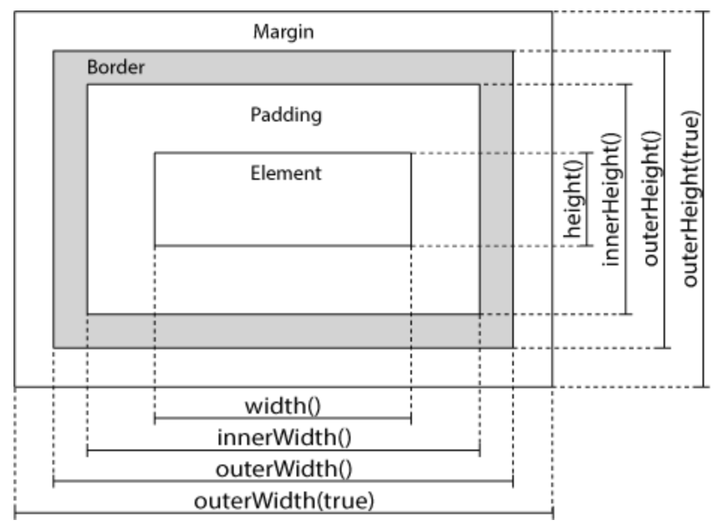
Dimension

Slide 18
jQuery Traversing

Slide 19
Ancestors
parent()
parents()
parentsUntil()

Slide 20
Descendants
children()
find()

Slide 21
Siblings
siblings()
next()
nextAll()
nextUntil()
prev()
prevAll()
prevUntil()

Slide 22
jQuery AJAX

Slide 23
AJAX
AJAX = Asynchronous JavaScript and XML.
AJAX is the art of exchanging data with a server, and updating parts of a web page - without reloading the whole page.

Slide 24
Load
The jQuery load() method is a simple, but powerful AJAX method.
The load() method loads data from a server and puts the returned data into the selected element.
Method: $(selector).load(URL,data,callback)

Slide 25
Load
URL − The URL of the server-side resource to which the request is sent.
data − This optional parameter represents an object whose properties are serialized into properly encoded parameters to be passed to the request. If specified, the request is made using the POST method. If omitted, the GET method is used.
callback − A callback function invoked after the response data has been loaded into the elements of the matched set. The first parameter passed to this function is the response text received from the server and second parameter is the status code.

Slide 26
Get
The $.get() method requests data from the server with an HTTP GET request.
Method: $.get(URL, callback)

Slide 27
Post
The $.post() method requests data from the server using an HTTP POST request.
Method: $.post(URL, data, callback)

Slide 28
THANKS!
truongconghieuptit@gmail.com

